Slide 1
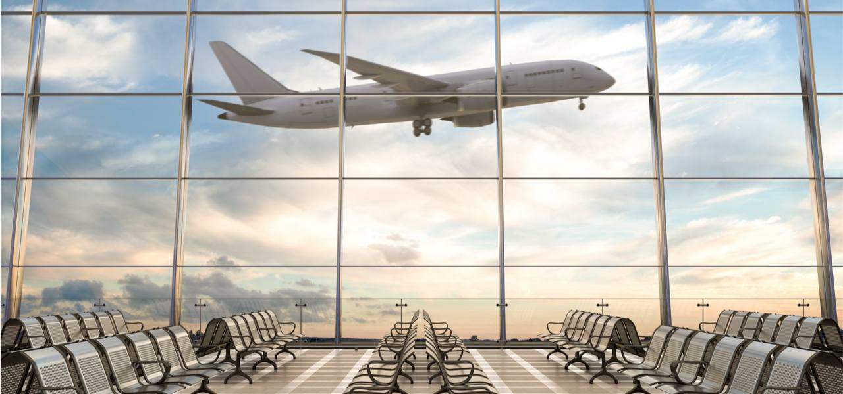
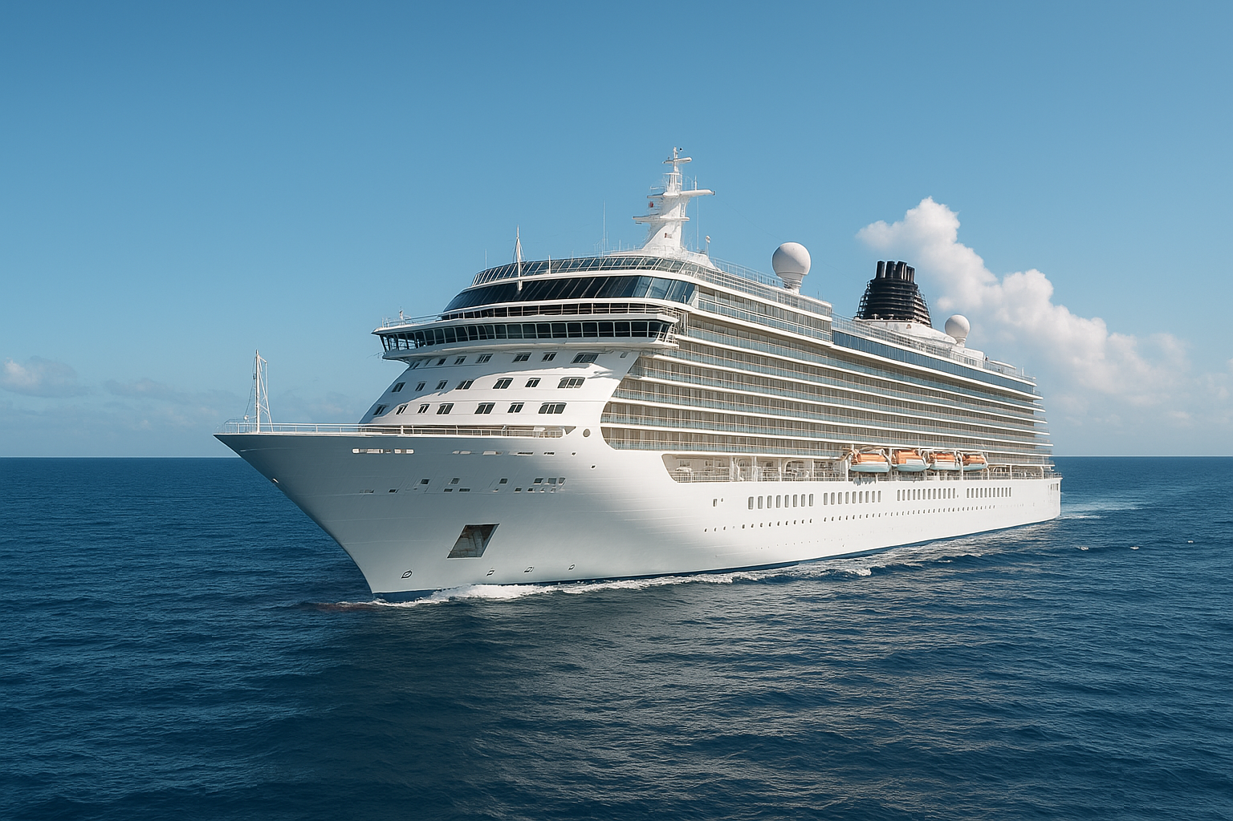

ALL PORTS TOURS CRUISE LINE
(APT)
Briefing
TEAM 5

Slide 2


Template
Template

Slide 3



Template
Security Posture
Vulnerable Hosts
Vulnerabilities Found

Slide 4





Template
SEVERITY
EASY TO EXPLOIT?
REMEDIATION
POTENTIAL EXPOSURE
BUSINESS IMPACT

Slide 5



Business Impact
Loss of Customer Trust
Financial Consequences
Operational Disruption

Slide 6
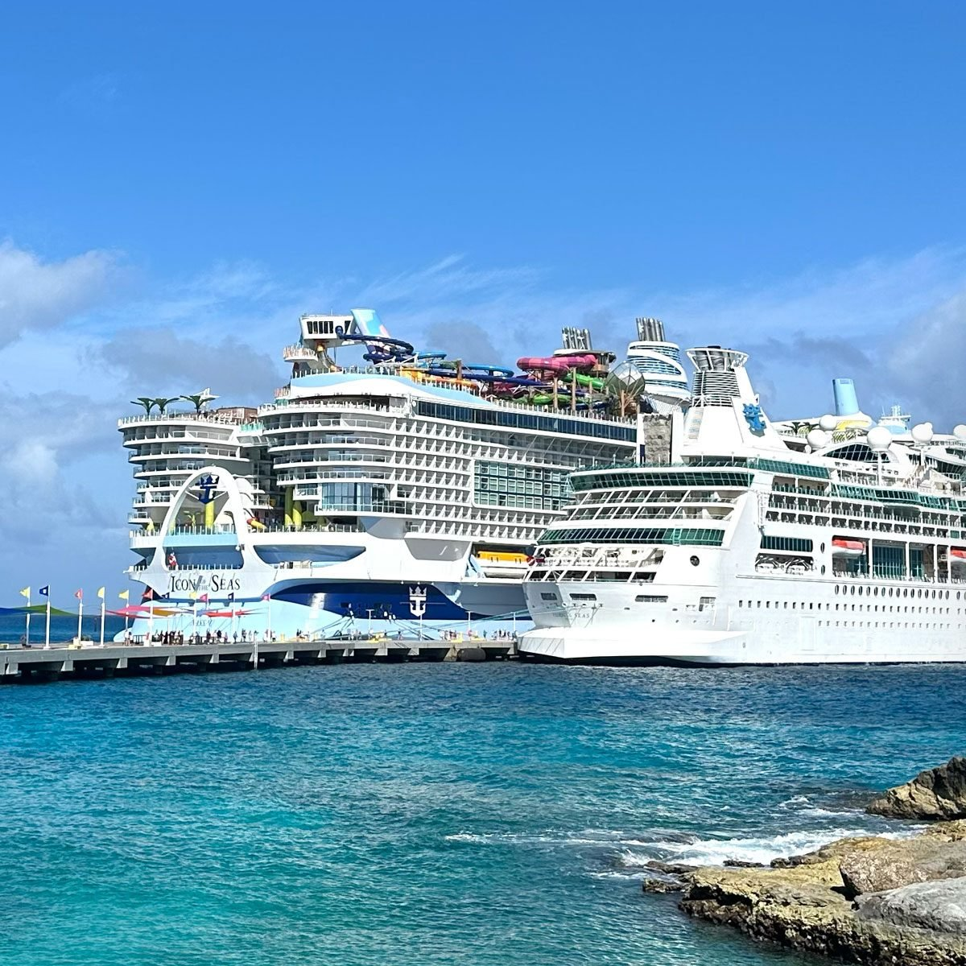
ඞ
Any Questions?
Thank You!

