Slide 1

EloMatch
Final Project by Peter J Salter and Rodrigo Zapata

Slide 2
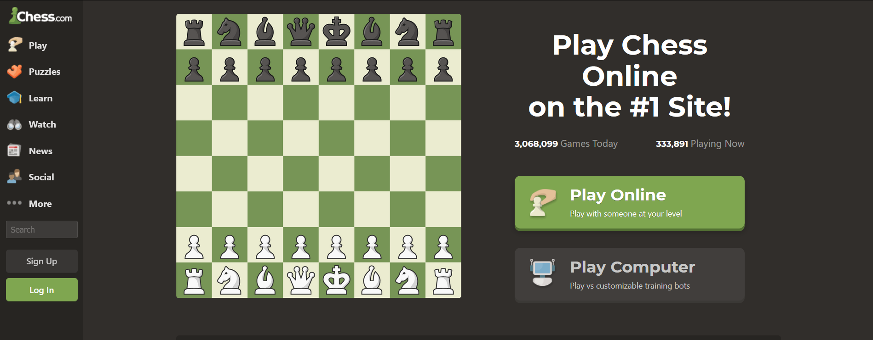
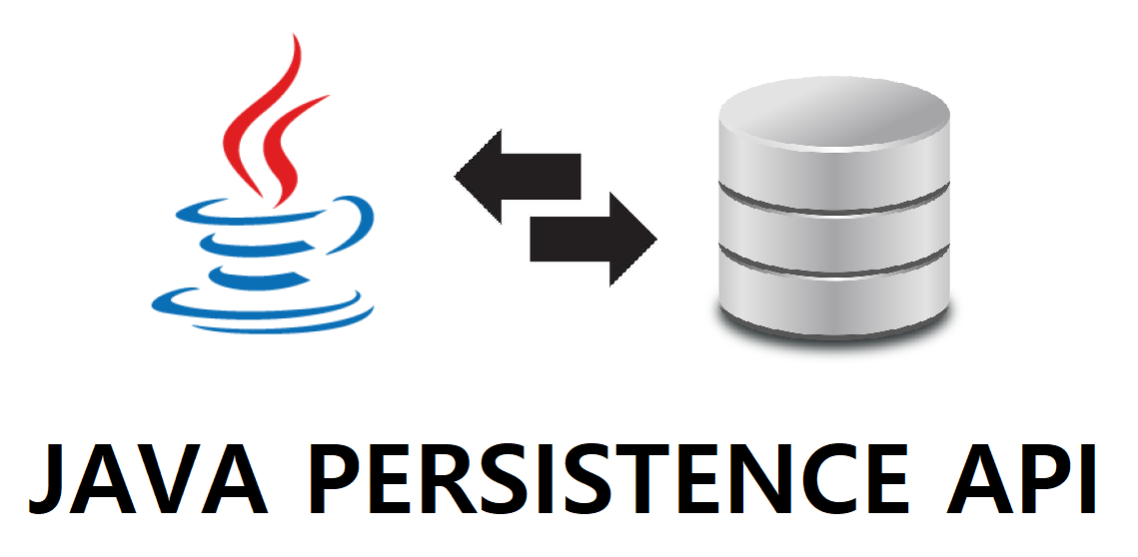
The IDEA
Chess online is a hugely popular hobby with more users playing each day, chess is more accessible than ever and chess websites, or any gaming related company, are always looking for ways to improve matchmaking.
We will be creating a matchmaking system for chess that’s easy to translate onto other games, using Java and JPA.

Slide 3



Technology
Front end: HTML, CSS, bootstrap templates.
Backend: Java, JPA, Spring, lombok
Database: MySQL, Workbench
Version Control: Git

Slide 4
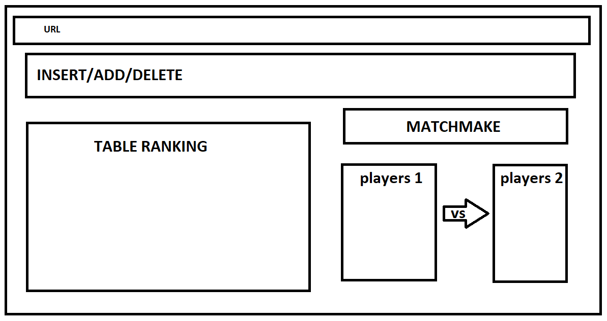
Wireframe

Slide 5
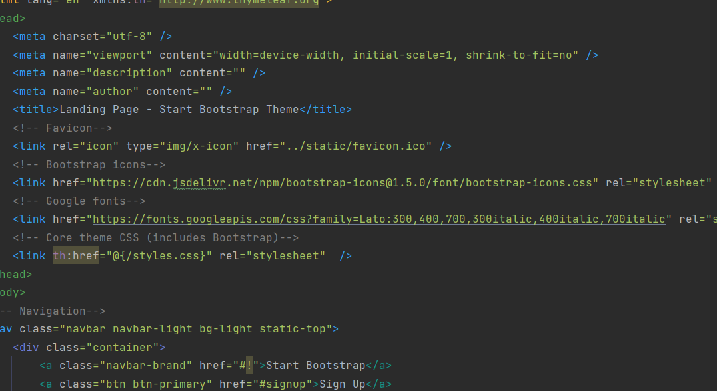
Bootstrap
Using bootstrap we can have the table set up inmediatly styled with little to no effort
Adding or taking away unneeded elements is quick and easy as bootstrap is extremely modular

Slide 6
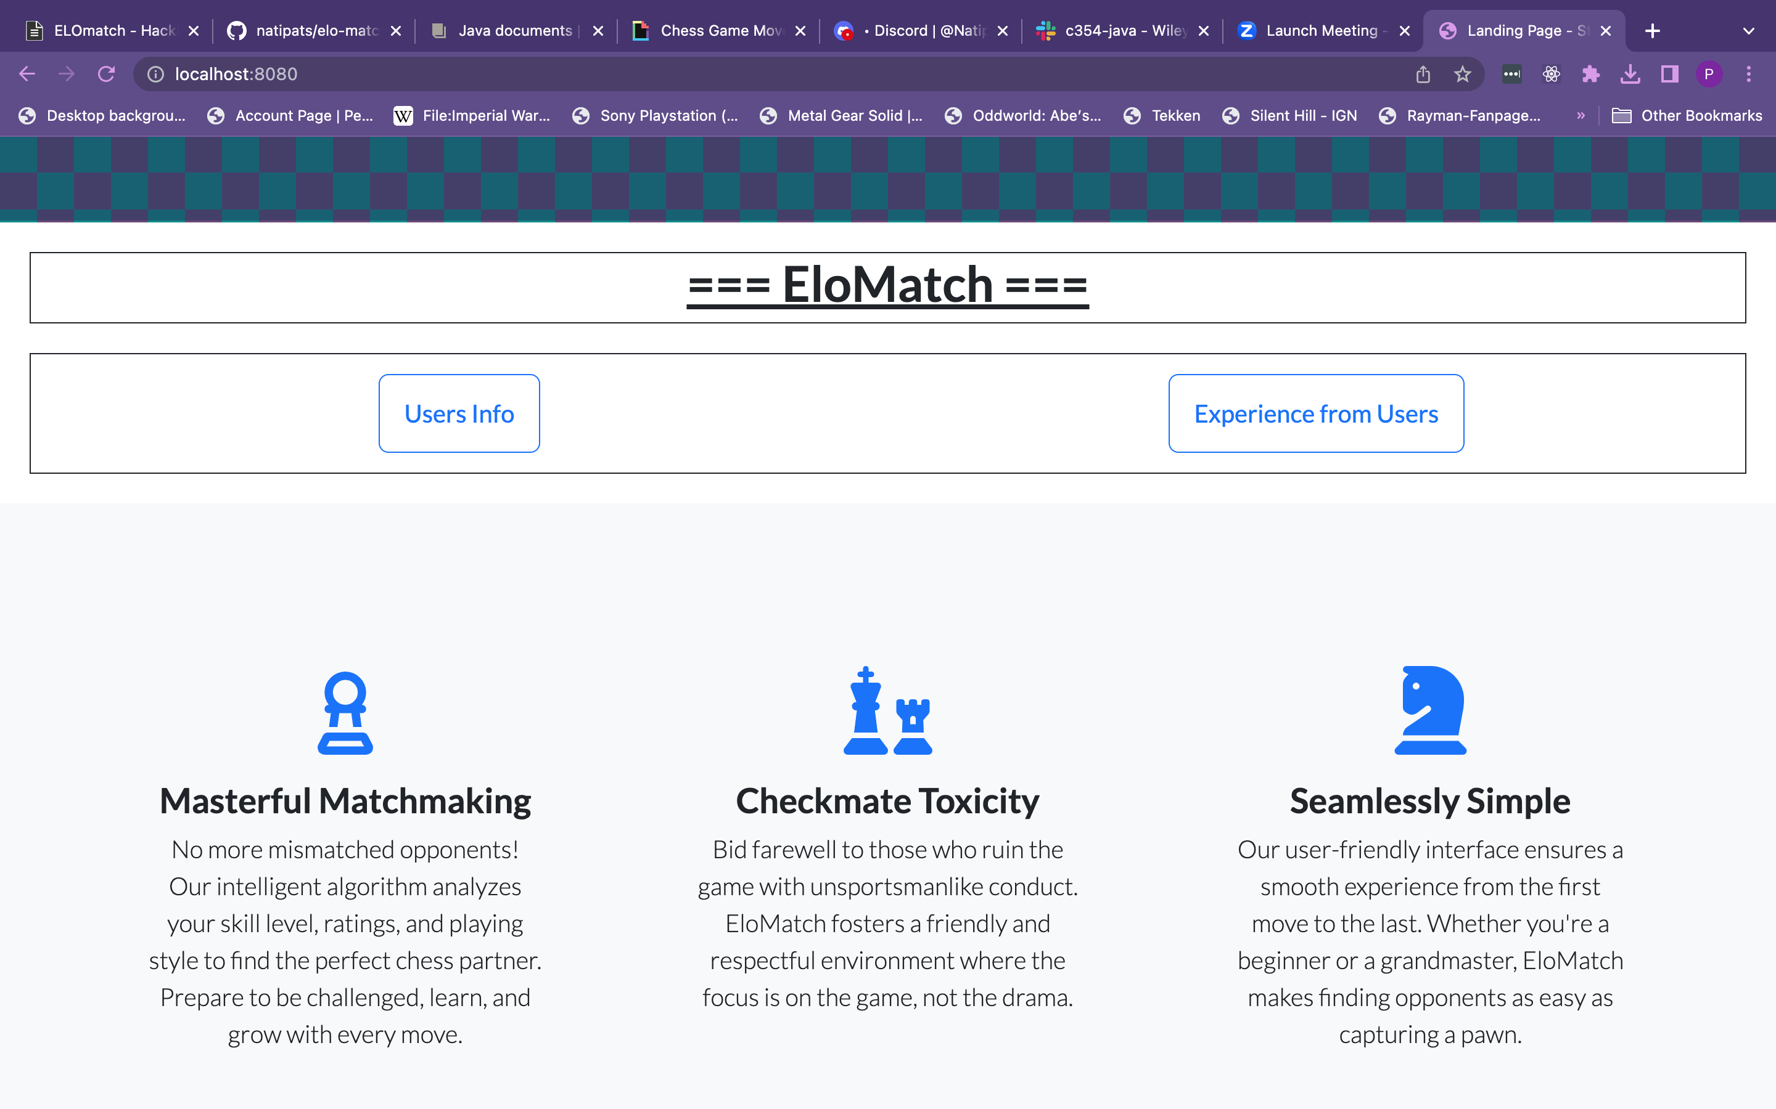

Slide 7
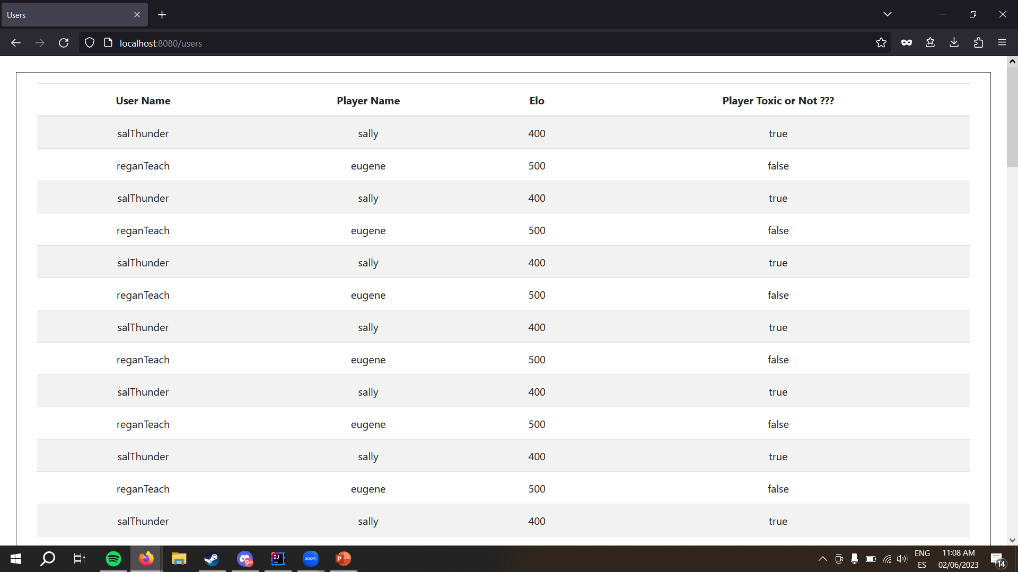

Slide 8
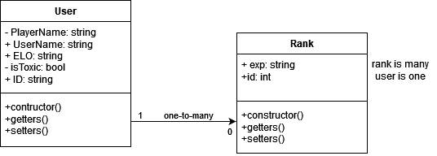
UML diagram
2 model classes
User Stores user information such as player name and their elo.
Rank Stores which users correspond in what rank.

Slide 9
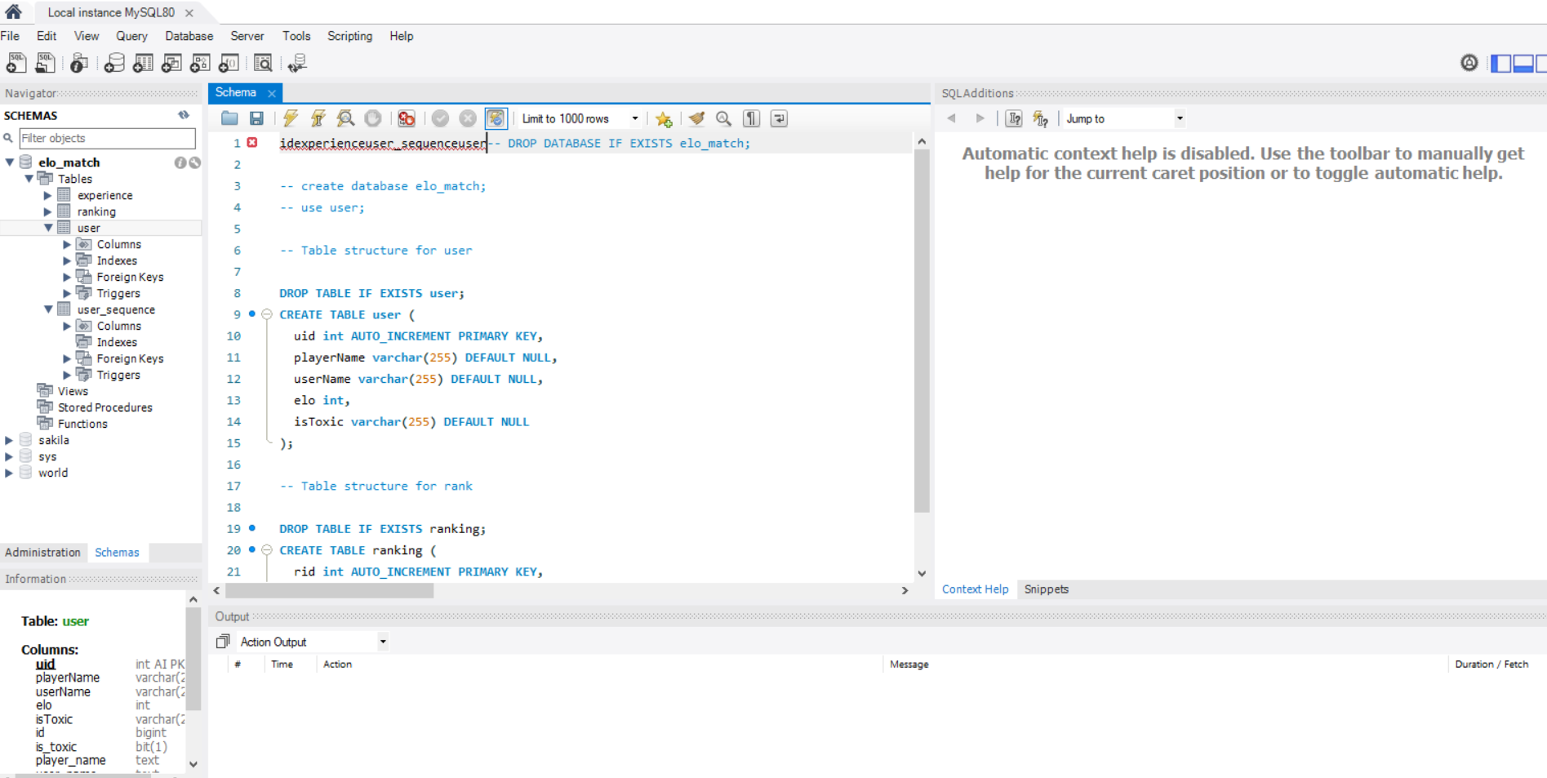
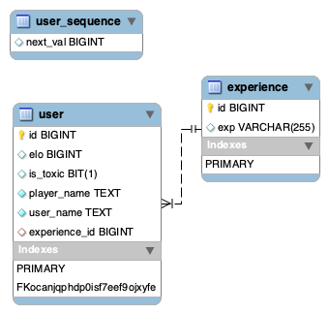
Database ERD
The database will have to store user data, elo. Data will be retrieved and displayed using JPA
Data can be added and viewed through the website, on top of serving as the matchmaker
Annotations have been used to create columns behind the scenes and for joining both tables

Slide 10
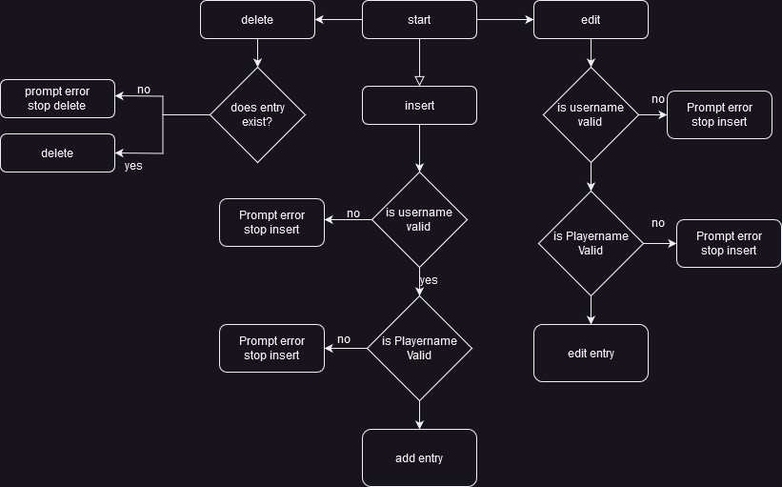
Insert edit delete

Slide 11
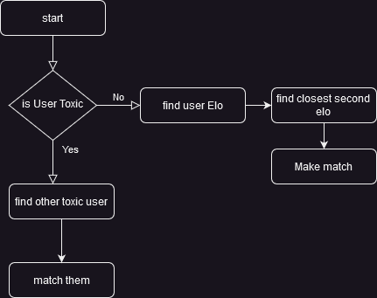
Matchmaker

Slide 12
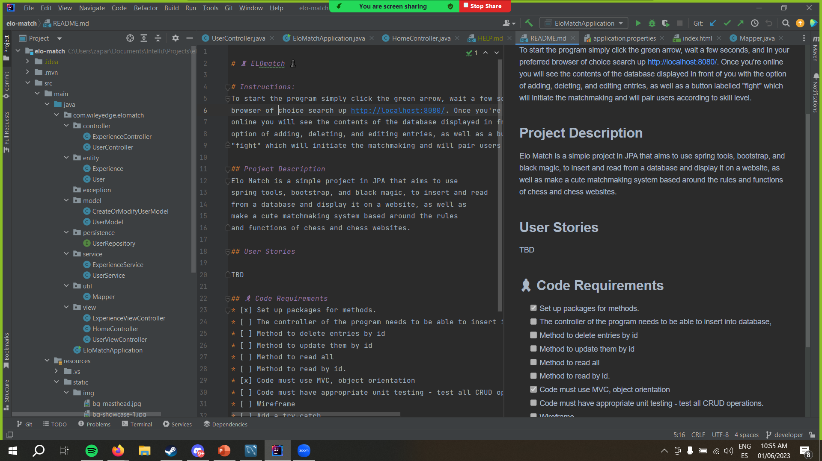
Structure and Testing
Code follows MVC structure
Implemented a database insertion and matchmaking system
Unit testing will be conducted to validate data entering database

Slide 13
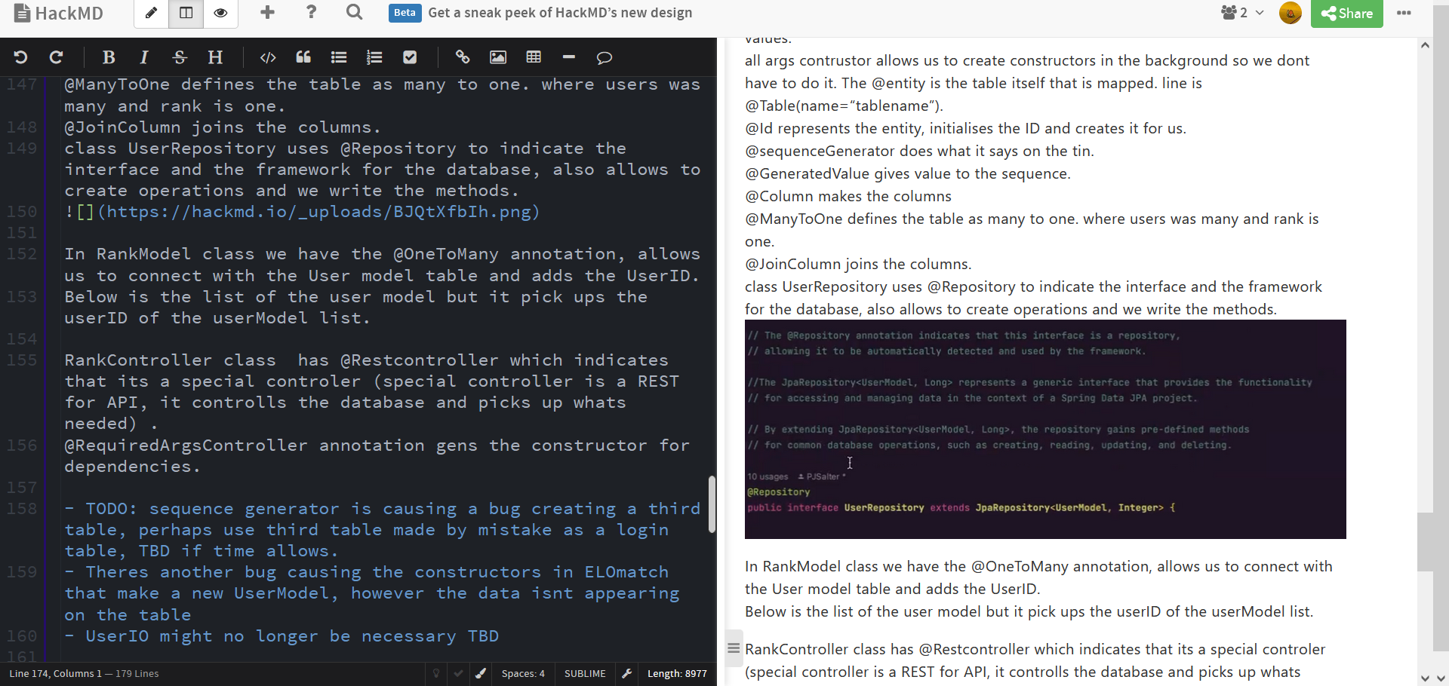
Documentation
Everything was documented on Hack.MD
With the help of git we documented every new feature, we even have a diary documenting changes we did every day

Slide 14
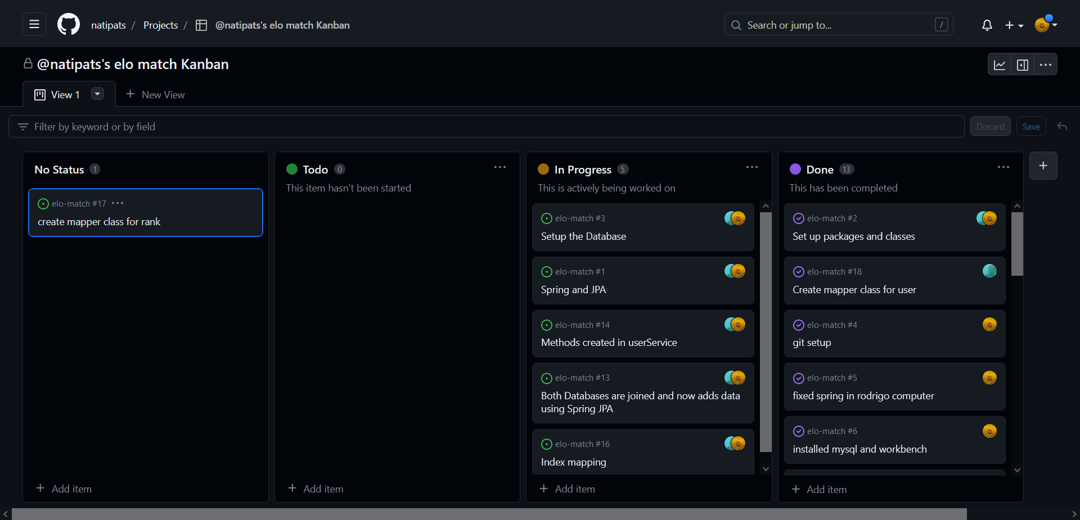
Tickets
Using githubs kanban boards, we can write down issues and organise the pace of work better.
When a new problem is encountered we will write it on the kanban board and when the fix is comitted the issue is marked as solved which lets us track progress

Slide 15
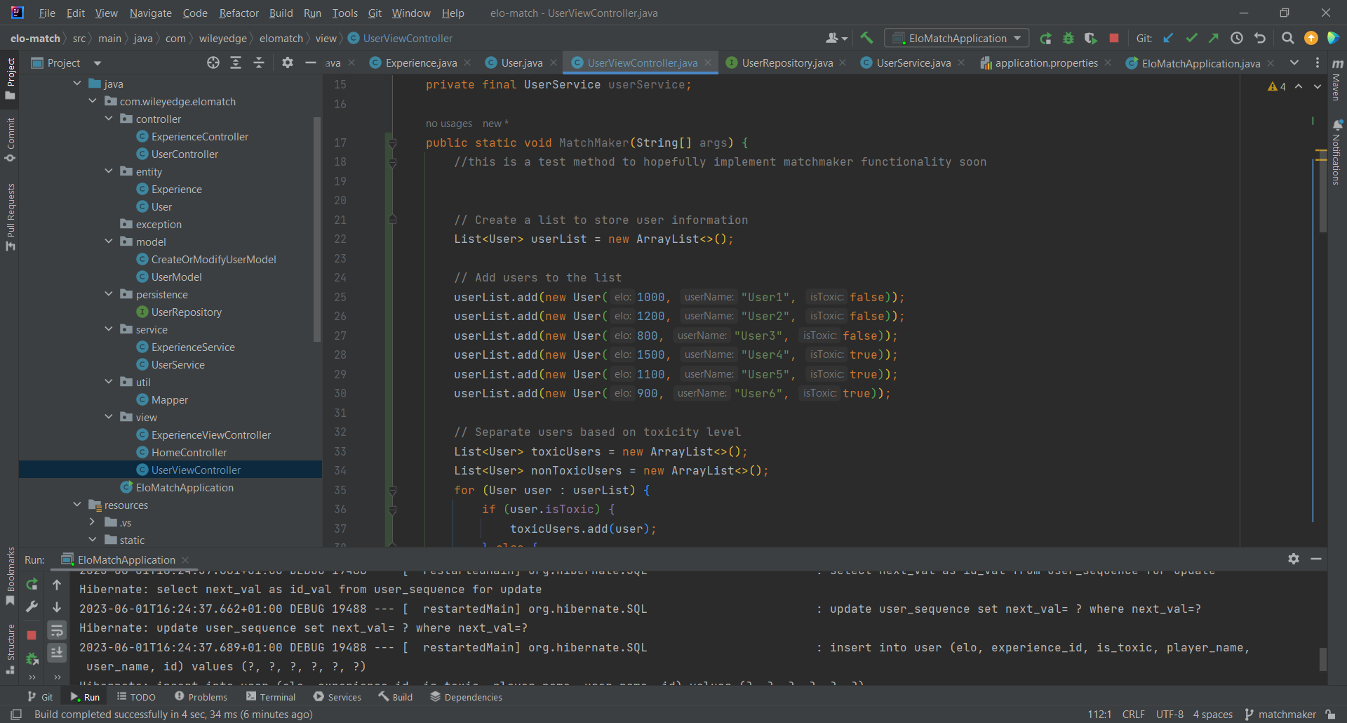
Matchmaker
Grabs the users compares them and matches them according to whats closest
It avoids matching toxic with nontoxic players, this is analogous to real competitive E-sports that isolate toxic players.

Slide 16
Issues we encountered
We encountered an issue with data duplication, we had to remove and delete content of data created after running because it would duplicate the same 10 users everytime we ran the project causing us to have thousands of uses
Encountered an issue with data rendering onto the frontend which we got help with
There is currently 6 red warnings in the bootstrap template, theyre inconsequential and do nothing but its intensely annoying to look at

Slide 17
What remains
Delete/edit, however we have display and insert so it shouldn’t take long
Matchmaker works but isnt connected to the database directly
Login system/Admin page is in the stretch goals however its not in the scope for this project
Data in the EXP table is missing we couldn’t add It in fear of it breaking for today

Slide 18
What we learned
JPA and spring
Bootstrap templates
Thymeleaf
The power of friendship (asking for help from your smart friend)
Special thanks to Csaba, hes pretty cool

