Slide 1

Front-End Development
Week 5
DOM

Slide 2
DOM- Meeting of HTML,CSS, and JavaScript-
Introduction to Document Object Model(DOM) & DOM tree
Programming the DOM
Finding and getting references to elements in the page
Creating, adding, and removing elements from the DOM tree
Inspecting and modifying elements and their content
Run code in response to events triggered by the user, browser, or other parts of our code

Slide 3
Introduction
Web pages rely on HTML for their initial structure and content. We write web pages using HTML, and then use web browsers to parse and render that HTML into a living (i.e., modifiable at runtime) tree structure. Consider the following HTML web page:

Slide 4
The DOM Tree is a living version of our HTML.
<!DOCTYPE html>
<html>
<head>
<title>This is a Document!</title>
<meta charset="utf-8">
</head>
<body>
<h1>Welcome!</h1>
<p>This is a paragraph with a <a href="index.html">link</a> in it.</p>
<ul>
<li>first item</li>
<li>second item</li>
<li>third item</li>
</ul>
</body>
</html>

Slide 5
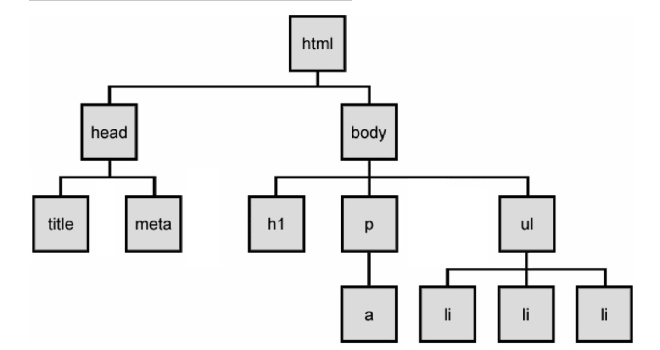
The browser will parse and render this into a tree of nodes, the DOM Tree:

Slide 6
The DOM Tree is made up of DOM Nodes, which represent all aspects of our document, from elements to attributes and comments. We’ll refer to nodes and elements interchangeably, because all elements are nodes in the tree. However, there are also other types of nodes, for example: text nodes (the text in a block element) and attribute nodes (key/value pairs). We don’t always show every node in our diagrams. Consider the <p> element from the example above:
<p>This is a paragraph with a <a href="index.html">link</a> in it.</p>

Slide 7
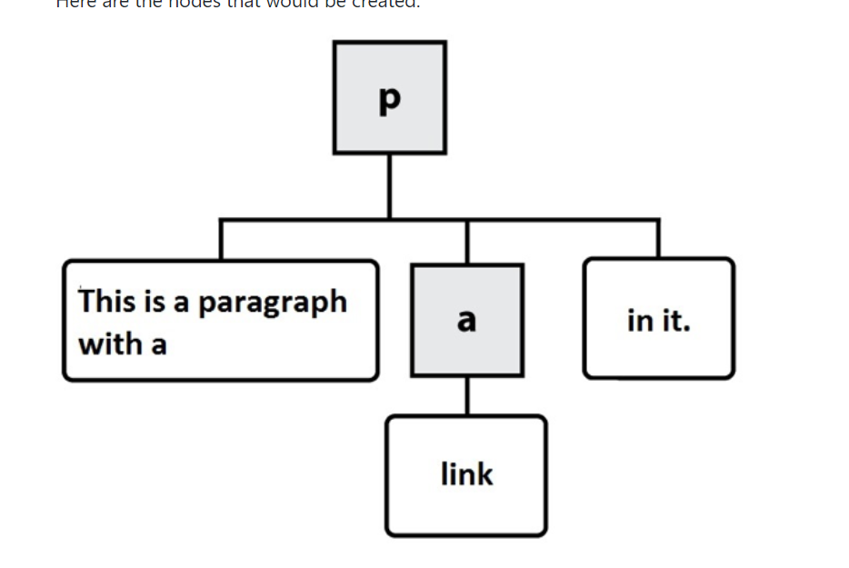
Here are the nodes that would be created: In this diagram, the gray, square boxes represent element nodes, while the white, rounded boxes are text nodes.

Slide 8
Programming the DOM
Web pages are dynamic: they can change in response to user actions, different data, JavaScript code, etc. Where HTML defines the initial structure and content of a page, the DOM is the current or actual content of the page as it exists right now in your browser. And this can mean something quite different from the initial HTML used to load the page.

Slide 9
Gmail.. Same or different for everyone?
Consider a web page like GMail (or another email web client). When you visit your Inbox, the messages you see are not the same as when your friend visits hers. The HTML for GMail is the same no matter who loads the page. But it quickly changes in response to the needs of the current user.

Slide 10
A valid question
So how does one modify a web page after it’s been rendered in the browser? The answer is DOM programming. We’ve been using this “DOM” acronym without defining it, and its high time we did.

Slide 11
Document Object Model (DOM)
The Document Object Model (DOM) is a programming interface (i.e., set of Objects, functions, properties) allowing scripts to interact with, and modify documents (HTML, XML). The DOM is an object-oriented representation of a web page. Client-side web programming is essentially using the DOM via JavaScript to make web pages do things or respond to actions (e.g., user actions).

Slide 12
How to..
As web programmers we use the DOM via JavaScript to accomplish a number of important tasks:
Finding and getting references to elements in the page
Creating, adding, and removing elements from the DOM tree
Inspecting and modifying elements and their content
Run code in response to events triggered by the user, browser, or other parts of our code

Slide 13
Finding elements in the DOM with JavaScript
Our entry point to the DOM from JavaScript is via the global variable window. Every web page runs in an environment created by the browser, and that environment includes a global variable named window, which is provided by the browser (i.e., we don’t create it).
There are hundreds of Objects, methods, and properties available to our JavaScript code via window. One example is window.document, which is how we access the DOM in our code:
// Access the document object for our web page, which is in the current window
var document = window.document;

Slide 14
Easy!
Our document’s tree of elements are now accessible to us, and we can access a number of well-known elements by name, for example:
// Get the value of the document's <title>
var title = document.title;
// Return a reference to the document's <body> element
var body = document.body;
// Return a list of all <a> elements in the document
var hyperlinks = document.links;
// Return a list of all the <img> elements in the document
var images = document.images;

Slide 15
Test this!
here are lots more. We can easily experiment with these in the dev tools web console, where we can access our window object. For example, here is the web page https://unsplash.com/search/photos/toronto with the web console open, and the result of window.document.images :

Slide 16
Common methods to find something!
document.getElementById(id)..
document.querySelector(selectors)..
document.querySelectorAll(selectors)..

Slide 17
Creating elements and Modifying the DOM with JavaScript
In addition to searching through the DOM using JavaScript, we can also make changes to it. The DOM provides a number of methods that allow use to create new content:
document.createElement(name) …
var paragraphElement=document.createElement(‘p’);
var imageElement=document.createElement(‘img’);
Document.createTextNode(text)
Var textNode = document.createTextNode(‘this is some text to show in elemnt’);

Slide 18
Created But not Added! :)
These methods create the new nodes, but do not place them into the page. To do that, we first need to find the correct position within the exsting DOM tree, and then add our new node. We have to be clear where we want the new element to get placed in the DOM.
For example, if we want to place a node at the end of the <body>, we could use .appendChild():

Slide 19
To add it …
var paragraphElement = document.createElement('p');
document.body.appendChild(paragraphElement);

Slide 20
To place it any where!
If we instead wanted to place it within an existing <div id="content">, we’d do this:
var paragraphElement = document.createElement('p');
var contentDiv = document.querySelector('#content');
contentDiv.appendChild(paragraphElement);
Some demo codes here!

Slide 21
Inspecting, Modifying a DOM element with JavaScript
Element Properties
element.id
element.innerHTML
element.parentNode
element.nextSibling
Element.className

Slide 22
Element methods
element.querySelector()..
Element.scrollIntoView()- scroslls the page until the element is in view
element.has Attribute(name)
element.getAttribute(name)-
element.setAttritbute(name,value)
Element.removeAttribute(name)
Some example codes here!

Slide 23
Events
The DOM relies heavily on a concept known as event-driven programming. In event-driven programs, a main loop (aka the event loop), processes events as they occur.
Examples of events include things like user actions (clicking a button, moving the mouse, pressing a key, changing tabs in the browser), or browser/code initiated actions (timers, messages from background processes, reports from sensors)

Slide 24
You can think …
You can think of events like light switches, and event handlers like light fixtures: flipping a light switch on or off triggers an action in the light fixture, or possibly in multiple light fixtures at once. The lights handle the event of the light switch being flipped.

Slide 25
Registering the events
We can register a DOM event handler for a given event in one of two ways:
element.onevent = function(e) {...};
element.addEventListener('event', function(e) {...}) and element.removEventListener('event', function(e) {...})

Slide 26
Common events
load - fired when a resource has finished loading (e.g., a window, img)
beforeunload - fired just before the window is about to be unloaded (closed)
focus - when the element receives focus (cursor input)
blur - when the element loses focus
click - when the user single clicks on an element
dblclick - when the user double clicks on an element
contextmenu - when the right mouse button is clicked
keypress - when a key is pressed on the keyboard
change - when the content of an element changes (e.g., an input element in a form)
mouseout - when the user moves the mouse outside the element
mouseover - when the user moves the mouse over top of the element
resize - when the element is resized

