Slide 1
Week 10
React JS!

Slide 2
Agenda!
Introduction to React!
What is React JS?
Why learn React JS?
Key Features of React
Component-Based Architecture
Virtual DOM
Declarative UI
JSX
Setting up a React application?
Understanding the folder structure of React App!

Slide 3
Introduction to React!
What is React JS?
A front-end JS library to create intuitive, responsive UIs.
HTML, CSS, JavaScript - front-end technologies! – Already discussed!

Slide 4
Why learn React JS?
When we have already learned HTML, CSS & JS, why should we learn it???
“UI becomes difficult to manage with Vanila JavaScript...”
Motivation#1: React will make UI so easy and intuitive with minimal effort!
Motivation#2: Google current jobs for React Developers!
Motivation#3: Huge community backing – why is it important?
Motivation#4: MEAN & MERN – MongoDB, Express JS , React/Angular JS, Node JS
Motivation#5: SPA (Single Page Applications) [Most important selling feature of react]

Slide 5
Key features of React!
Component-Based Architecture
Build encapsulated components that manage their own state
Let’s google some React based sites, and explore this point - Netflix, udemy
Virtual DOM
Optimized rendering process to enhance app performance
Declarative UI
Simplifies coding by focusing on “what” instead of “how” for UI rendering!
JSX (JavaScript eXpression)[Combination of HTML,CSS & JS]
HTML-like syntax within JavaScript!

Slide 6
Setting Up a React Project!
Traditional way:
npx create-react-app firstapp [for window users]
sudo npx create-react-app firstapp [for mac users]
New way:
npm create vite@latest firstapp
[Recommended now]

Slide 7
Understanding the folder structure!
src for components!
public for static files!
But it’s not the end!
package.json:
configuration file which holds all the important information about our project! What to install to make it run on the other side etc.
node_modules:
Collection of all the libraries/etc environment required to run the project

Slide 8
Very Important Information!
Never send “node_modules” while sending your project – even github ignores it anyhow ☺
Always send your “package.json” file, I will run “npm install” and will get the node_modules folder here! Please remember 😐

Slide 9
Let’s explore more about folder structure!
“index.html” - SPA (Remember?)
Contains a <div> with id root
“index.js” NOW “main.jsx” All important middle man!
That accesses that id root div from index.html and runs the App.js here
“App.js” or “App.jsx”
the component that index.js/main.jsx runs inside “index.html”
Confusing???

Slide 10
What is App.jsx after all!
It’s the main component of React Application!
All react components are like “functions”, with the difference being the components return “JSX”
Million-dollar question! What is JSX?

Slide 11
JSX
is a combination of HTML, CSS and JS.
{ } javascript expression box where we can write literally any javascript!
So as mentioned, every component returns "JSX" that is boiled down to HTML when it goes to index.html

Slide 12
Props (properties):
props to the components are LIKE parameters to the functions
We pass them while calling the component and receive them in called component....

Slide 13
Let’s make our coding a bit spicy!
Add the extension for “rafce” or “rfce” etc.
And now let’s make our own components and call and use them in our application!

Slide 14
Events
Events can be used in components.
We can send events as props too from one component to other.
We will discuss events in detail during the project – and will make some cool fun events.

Slide 15
State management in React!
In React, state refers to an object that holds data or information about a component, determining how it renders and behaves.
Each component can have its own state, which is stored internally and can be updated over time.
State is essential for making React applications interactive and dynamic, as it allows components to respond to user inputs, changes in data, or other events by re-rendering the UI with new data. (Remember our balls project in vanilla JavaScript?)

Slide 16
Key points about state in React!
Managed Locally: State is managed within a component and does not directly affect other components unless passed as props.
Reactivity: When state changes, React re-renders the component automatically to reflect the new data.[Re-rendering and http request]
Initialization and Update: State can be initialized when a component mounts and updated using functions like the useState Hook in functional components.

Slide 17
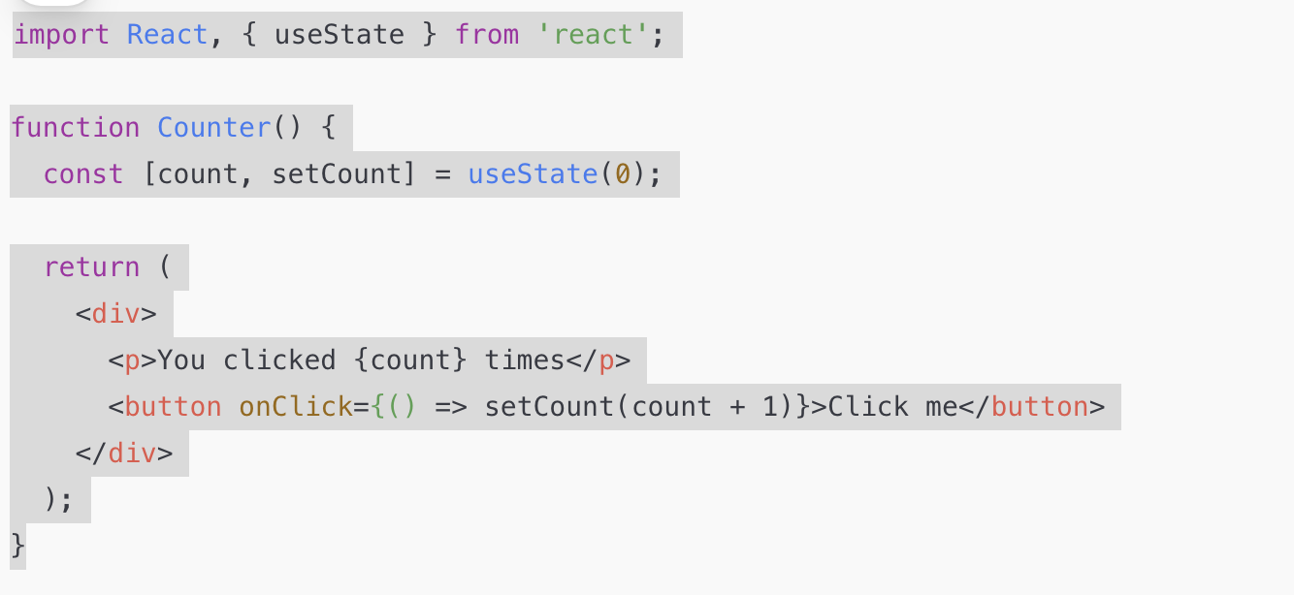
Example:

Slide 18
How state Differs from Props
State: Internal to the component and can be modified by the component itself.[Global variable]
Props: Passed down from parent components and cannot be modified by the child component.[Local variable]

Slide 19
Hooks
React Hooks are special functions that allow components to access features like state management and lifecycle events.
They let you use state and other React functionalities directly within functional components, enhancing functionality and enabling component-level logic to be shared and reused.
Hooks are a foundational aspect of React, bringing stateful behavior and lifecycle capabilities to functional components, which were previously limited to class components.

Slide 20
useState( ) Hook:
The useState Hook in React is a fundamental Hook that lets you add state to functional components.
It allows you to declare a state variable and a function to update that state, enabling your component to manage and respond to data changes.

Slide 21
Syntax:
const [state, setState] = useState(initialValue);
state: The current state value.
setState: A function that updates the state value and re-renders the component.
initialValue: The initial state value, which can be any type (number, string, array, object, etc.).

Slide 22
Same example:

Slide 23
Example explained..
We initialize count to 0 by passing 0 to useState.
The setCount function is used to update count whenever the button is clicked.
Each time setCount is called, React re-renders the component with the updated count value.

Slide 24
Key points here..
State Preservation: State persists across re-renders, so changes to count or user values are retained as the component re-renders.
Asynchronous Updates: Calling setState triggers a re-render asynchronously, so multiple state updates may be batched together.
The useState Hook is essential for making functional components stateful and interactive, making it easier to handle dynamic data and UI changes in React.

Slide 25
Some complex examples with arrays and object data with useState():
Let’s see how we update a collection!
First let’s do it with object
Then with the Array of numbers

Slide 26
Json Server for mock API:
Let’s install json server and set up for API calls!
get, post, put, delete calls to a live own server…
Step1: npm install json-server
Step2: in package.json, under “scripts” write following script:
”server”:Json-server –watch db.json –port 5000
Step3: Create db.json and then in db.json and add your data in json format there.
Step4: To run json server: npm run server
Step5:T To see the tasks http://localhost:5000/tasks [whatever the name of the list is]

Slide 27
useEffect() hook:
Like some side effects when a component gets loaded!

Slide 28
React Router DOM
React Router DOM is a library for implementing dynamic routing in a React application.
It allows navigation between views, URL parameter handling, and creating single-page applications (SPAs).

Slide 29
Key concepts:
Routes and Route Components:
Define different paths (URLs) and associate them with specific React components.
Render components conditionally based on the URL.
BrowserRouter:
Wraps your application and enables React Router features.
Uses the HTML5 history API for handling routing.
Link:
Used for navigation without reloading the page.
Replaces the traditional <a> tag for client-side routing.

Slide 30
Continued..
useNavigate:
A hook for programmatic navigation.
useParams:
Extracts route parameters from the URL.
useLocation:
Provides the current location object, including pathname and state.

Slide 31
Installation
npm install react-router-dom

Slide 32
Advantages
Seamless navigation between views without page reloads.
Easily manage application state through URLs.
Simplifies creating SPAs.
Supports dynamic and nested routing.
With React Router DOM, routing becomes intuitive and integrates well with React's component-based architecture.

Slide 33
Framer-motion
Framer Motion is a powerful React library for adding animations and transitions to your React components.
It provides a declarative way to define animations, making it easy to create smooth, high-performance animations without writing complex CSS or JavaScript logic.

Slide 34
Why framer-motion?
Ease of Use: Simplifies creating animations with declarative APIs.
Performance: Optimized for smooth animations with efficient rendering.
Flexibility: Supports keyframes, spring animations, gestures, and drag interactions.
Rich Features: Includes layout animations, shared element transitions, and more.

Slide 35
How to install?
npm install framer-motion
Let’s implement in our project

