Slide 1
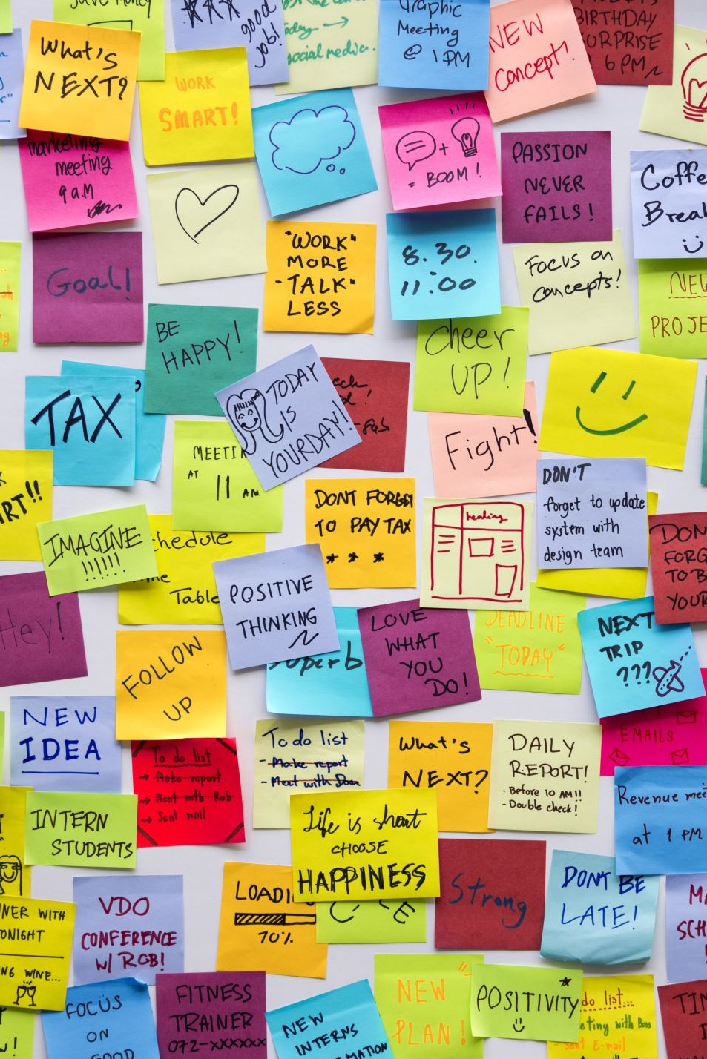
React Event Planner Assignment
Front-End Development & JavaScript
Build a real-world React app

Slide 2

Objective
Create an Event Planner app with add, delete, and toggle features

Slide 3

Core Concepts
useState
Props
map & filter
Spread operator
Controlled forms

Slide 4
Event Structure
id
title
date
location
attending (boolean)

Slide 5
Features Required
Display
Display events
Delete
Delete event
Toggle
Toggle attendance
Add
Add event via form

Slide 6
Controlled Form
Inputs must sync with state
Use onChange
Use value / checked

Slide 7
Toggle Logic
Double-click event
Flip attending true/false
Update UI dynamically

Slide 8
Add Event Logic
Create new object
Generate unique ID
Add to array using spread

Slide 9
Validation
Title is required
Show alert if empty
Prevent submission

Slide 10
UI Expectations
Clean layout
Highlighted attending events
Readable form inputs

Slide 11
Bonus Features
Count attending events
Filter events
Show/Hide form
Use localStorage

Slide 12
Submission
Submit project files
Include explanation of logic
Demonstrate working app

