Slide 1


Welcome To
General Science
QUIZ

Slide 2

Question by
Scientific, Geographical and
Astronomical Phenomena field

Slide 3
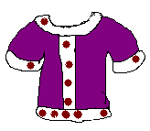


Q. 1. Woolen Clothes protect the body from cold because-
Cloth is a poor conductor of heat
Cloth is good conductor of heat
External heat rays enter into the body through woolen clothes
None of above
Ans. (a)

Slide 4

Q.2. The owl can see most clearly in total darkness because-
It has squint eyes
(b) It has large eyes with orbs directed forward, giving it binocular sight
(c) It has light bulbs in its eyes provided by nature
Ans. (b)

Slide 5


Q.3 Stainless steel contains-
(a) Chromium,Nickel,Iron and Carbon
(b) Nickel,Iron and Carbon
(c) Iron and Carbon only
(d) Chromium,Iron and Carbon
Ans. (d)

Slide 6

Q.4 The maximum limit of sound beyond which a person can become deaf is-
(a) 55 db
(b) 75 db
(c) 85 db
(d) 120 db
Ans. (d)
Too… Noisy

Slide 7

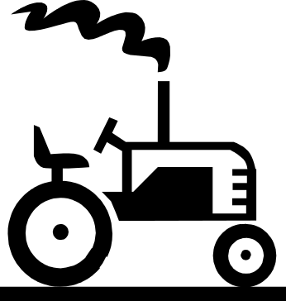
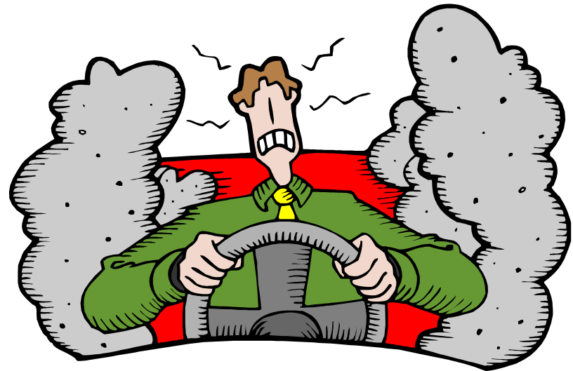
Q.5 Which gas often creates more air- pollution?
Nitrogen
Carbon dioxide
(c) Carbon monoxide
(d) Oxygen
Ans. (c)

Slide 8

Q.6 During cardiac failure, which of the following is advised as a first aid?
Mouth of Mouth resuscitation
(b) Giving external cardiac Massage
(c) Giving cool water to drink
(d) Giving complete body Massage
Ans. (a)

Slide 9
Q.7 … waves cannot be transmitted through vacuum-
(a) Light
(b) Heat
(c) Sound
(d) Electromagnetic
Ans. (c)

Slide 10
Q.8 The small bats can fly in dark because-
They can see the objects in darkness
(b) They have weak legs land are likely to be attacked by predators
(c) They generate flashes of light
(d) They generate ultrasonic sound waves
Ans. (d)

Slide 11

Q.9 The time period of a pendulum on moon-
Decreases
(b) Increases
(c) Remains the same
(d) Is zero
Ans. (b)

Slide 12
Q. 10 When water is filled in a bottle and is allowed to freeze, the bottle because –
Water expands on freezing
(b) Bottle contraits at fruzing point
(c) Temperature outside the bottle is ten than that iunde
(d) None of above
Ans. (a)

Slide 13
Q.11 Ice packed is saw dust does not melt quickly. Why?
Ans. Saw dust is a bad conductor of heat and protects the ice from the external heat and hence from melting away quickly.

Slide 14

Q. 12 A boatman pushes the bank with his pole. Why?
Ans. Action and reaction being equal and opposite,the bank will push the boat away from it.

Slide 15
Q. 13 A burning candle gets extinguished when covered with a tumbler. Why?
Ans. A burning candle gets extinguished when covered with a tumbler because the supply of oxygen is cut – off and the flame goes out.

Slide 16
Q.14 Why do you see rainbow after rain?
Ans. The water drops suspended in the atmosphere act as prism and disperse light into seven colours.

Slide 17
Q,15 A metal tea- pot has an ebony handle. Why?
Ans. Ebony being bad conductor of heat, the handle does not get hot.

Slide 18
Q. 16 Why is it easier to roll a barrel than to pull it along the road?
Ans. In winter the water vapour contained in the breath condenses into small droplets of water, which become visible. In summer it is not so.

Slide 19
Q. 17 Why is hot soup more tasty than the colder one ?
Ans. As temperature is increased, surface tension decreases and the liquid now occupies more area. Thus the hot soup occupies more area on the tongue and is, therefore, more tasty than the colder one.

Slide 20

Q. 18 Why do the stars twinkle?
Ans. The stars seem to twinkle due to two causes. First the light from the stars passes through several mediums; secondly .

Slide 21
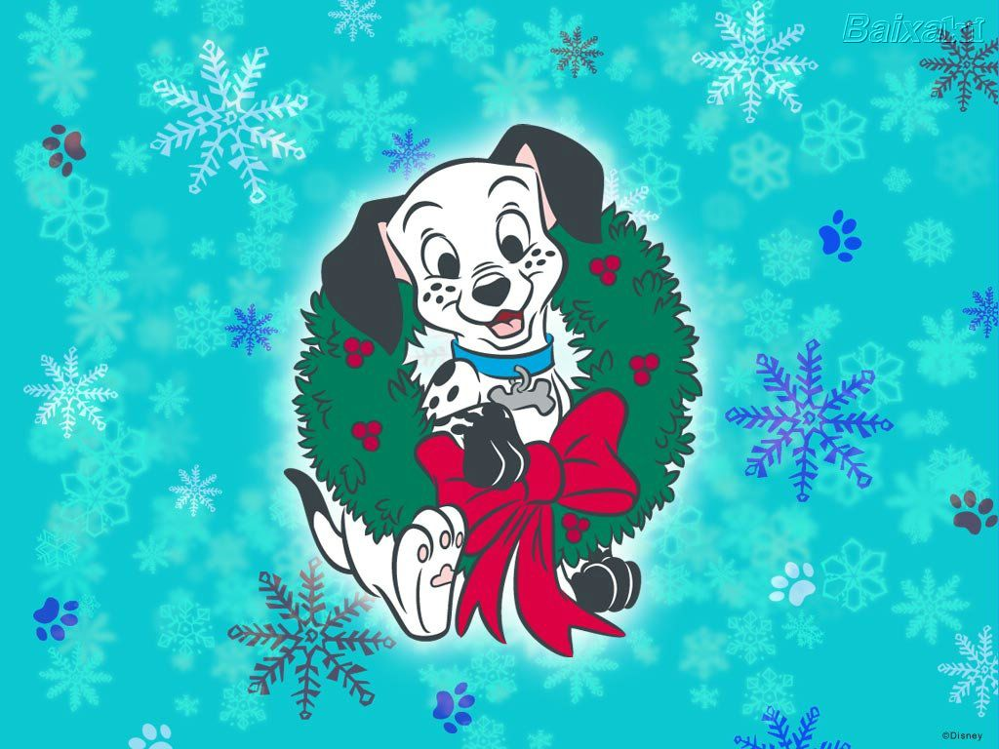
THANKS
MADE BY NIDHI
8th C

