Slide 1
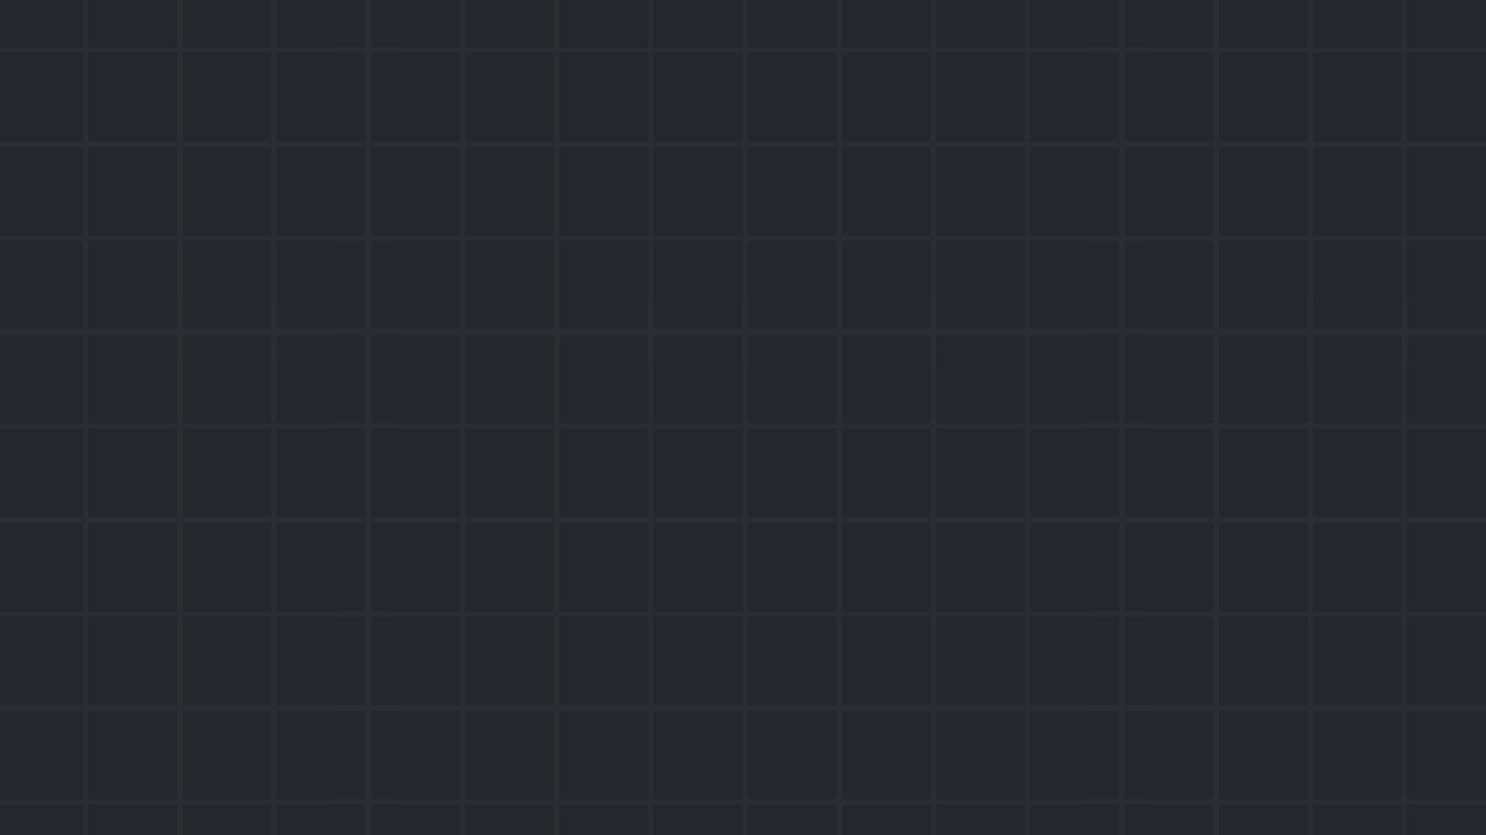

Forensics
Become a detective
Spring 24/25

Slide 2

Forensics - introduction
Forensics is the process of uncovering the digital traces left on a computer. It involves finding hidden information in various types of files, from simple logs to entire disk images.
In CTFs, forensics usually means:
You get a file (or a few).
Maybe a background story.
And you should:
Identify what file type(s) you are working with.
Find relevant tools.
Investigate deeply.
Extract the flag.
Flags can be hidden in the darkest and most obscure places!

Slide 3
Forensics challenges in CTFs
Most forensics challenges just hand you one or more files. Your job is to figure out what they are and what’s hidden inside.
Common challenges include:
System snapshots: Full memory dump or virtual machine states.
Packet captures (.pcap): Network traffic logs, used to trace communication or extract transferred data.
Disk images/file systems
Steganography: Innocent-looking media files hiding embedded data.
Application/event logs
Broken files: file types like PDF or PNG that follow a very specific format, which been tempered with and don’t open normally.

Slide 4
First Steps in Any Forensics Challenge
Whatever file you're given, start with basic inspection. These steps can reveal useful info — or even solve the challenge right away.
Common first-line tools:
file – Identify file type (not always reliable)
strings | grep – Extract readable text and filter for flags, URLs, etc.
exiftool – View or edit file metadata (often useful in images/docs)
binwalk, foremost – Extract embedded files or data chunks
These are part of almost every forensics checklist.

Slide 5
Diving into it
We’ll now go over some of the common forensics topics in more detail, and look at practical examples for each.
Keep in mind that forensics is a wide field with a lot of creativity and degrees of freedom involved in creating the challenges, and we won’t cover every branch in this session — just the ones most relevant to typical CTF challenges.

Slide 6
Disk/File system forensics
These challenges usually provide a disk image — a snapshot of a storage device’s (SSD, HDD, Flash drives, etc) contents and filesystem.
Common tasks include retrieving some meta data about the system or recovering deleted files.
There are several tools for analyzing disk images. One of the most commonly used is The SleuthKit, a collection of command-line utilities for filesystem forensics. The SleuthKit Wiki is a great resource for that.
Some common usage:
mmls – displays the different partition of the image.
fls – lists files/directories in the file system.
icat – print the contents of a file in the filesystem, based on it’s inode number.

Slide 7
Disk/File system forensics - example
https://www.root-me.org/fr/Challenges/Forensic/Fichier-supprime
Notes:
fls
icat

Slide 8
Network forensics
This one is usually pretty easy to identify. When the challenge is about network traffic analysis, we will usually be given a packet capture file, which is just a collection of packets sent over the network during a certain period of time.
easy challenges may ask us to retrieve some information about a connection. Harder challenges might be about malware analysis (for example – see shell commands an attacker who has a reverse shell sent).
The best and most common tool for analyzing packet captures is Wireshark. It has various wonderful features such as filtering for specific packets, identifying protocols in use, and analyze communication flows/streams in detail.

Slide 9
Network forensics - example
https://play.picoctf.org/practice/challenge/30
Notes:
Just open wireshark and follow tcp stream

Slide 10
Memory forensics
The RAM holds a snapshot of what the system was doing at a given moment — running processes, network connections, clipboard data, and more.
Memory dumps capture this snapshot and can contain some of the most valuable traces of user activity.
These dumps of data are often very large, but can be analyzed using a tool called Volatility. Volatility uses predefined OS memory layouts to extract useful information from the big blob of memory.
Some common commands:
imageinfo – display general information about snapshot
pslist – live processes list during the snapshot
netscan – live connections during the snapshot
Example: https://app.hackthebox.com/challenges/Reminiscent

Slide 11
Memory forensics - example
https://app.hackthebox.com/challenges/Reminiscent
Notes:
Find profiles (we’re given the output of imageinfo already, but good to know. Note that this uses volatility2): python2 ~/volatility/vol.py -f flounder-pc-memdump.elf imageinfo
Find running processes: python3 ~/volatility3/vol.py -f flounder-pc-memdump.elf windows.pslist
Find cmdline (that was used to run the process): python3 ~/volatility3/vol.py -f flounder-pc-memdump.elf windows.cmdline

Slide 12
Steganography
Steganography is the practice of concealing messages or information within other non-secret text or data.
These files can include basically any file type. Images, documents, video/audio files, etc.
Some useful tools (there are many, many more):
pngcheck to check for the integrity of a png file.
steghide – Embed or extract hidden data within image or audio files while preserving their apparent content.
zsteg – like steghide but mainly for images.
https://georgeom.net/StegOnline
https://www.aperisolve.com/ - Runs many different steganography tools

Slide 13
Steganography - example
https://ctflearn.com/challenge/894
Notes:
Find profiles (we’re given the output of imageinfo already, but good to know. Note that this uses volatility2): python2 ~/volatility/vol.py -f flounder-pc-memdump.elf imageinfo
Find running processes: python3 ~/volatility3/vol.py -f flounder-pc-memdump.elf windows.pslist
Find cmdline (that was used to run the process): python3 ~/volatility3/vol.py -f flounder-pc-memdump.elf windows.cmdline

Slide 14

Practice time

Slide 15
Class practice:
https://play.picoctf.org/classrooms/8492 - Our picoCTF classroom. Assignment “Week 6 – Advanced”.
https://ctflearn.com/challenge/1/browse - Challenges with rating > 4.5.
https://cyberdefenders.org/blueteam-ctf-challenges/ - “Endpoint forensics” for labs about Memory forensics like we learned.
Some resources:
https://cugu.github.io/awesome-forensics/ - basically all the info you’ll ever need about forensics.
https://github.com/uppusaikiran/awesome-ctf-cheatsheet
https://forensics.wiki/

