Slide 1
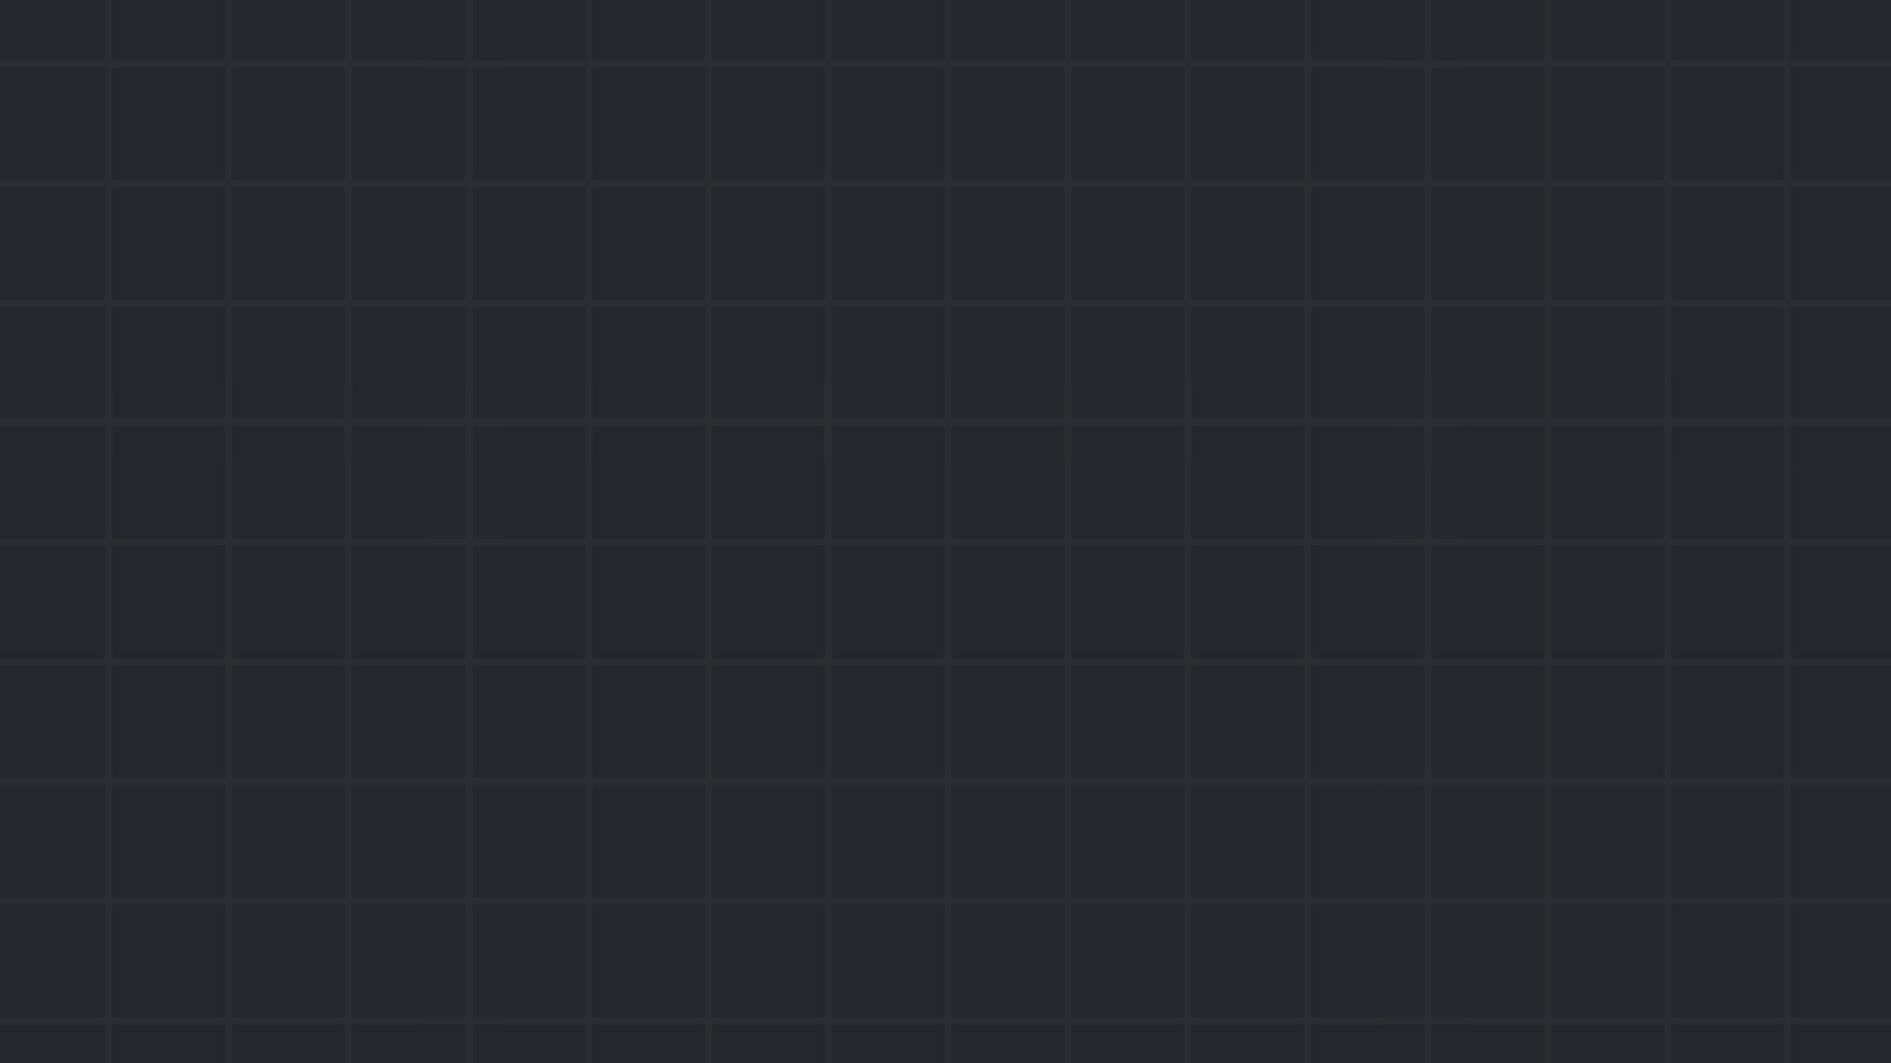

Binary Exploitation
Spring 24/25

Slide 2

Introduction
Binary exploitation (pwn) is about finding and abusing bugs in binary executables to gain control over the program.
In CTFs, a pwn challenge usually gives you:
A remote server running a vulnerable executable.
The compiled executable (and sometimes it’s source code).
Other files that are needed to replicate the environment (libc, dynamic loader, Dockerfile)
Your mission: Make it print the flag — or pop a shell and grab it yourself.

Slide 3
Tools of the trade
Must-have:
A Linux machine.
A disassembler and a decompiler (IDA, Ghidra).
GDB (with an extension like peda, gef or pwndbg).
pwntools (Python framework for scripting exploits).
Optional, but very helpful:
checksec –determine which mitigations are enabled (more on that later).
pwninit – auto-sets up challenge environments.
Docker – for easily replicating remote environment.

Slide 4
Stack basics & BOF
The most common types of exploits target the stack, because that’s where “function calls live”.
When a function is called, the return address (where to go back) is pushed onto the stack.
When the function ends, it’s popped and execution jumps there.
If we can overwrite that address — we control where the program goes next.
Lower addresses….
Junk, or remnants from calls to other functions
rsp
Local variables
Saved rbp (of previous frame)
rbp
Return address
Previous function stack frame
Higher addresses….

Slide 5
Buffer overflow
The classic stack exploit is a buffer overflow — writing more data than the buffer can hold.
On the stack, that’s extra dangerous: overflow past locals → overwrite return address → control execution.
A common and basic CTF example is a ret2win challenge: overflow the buffer, and jump straight to a hidden win() function (that prints the flag for you).
<example>

Slide 6
Shellcode
Most binaries won’t gift you a win() function — so you’ll have to run your own code.
That’s where shellcode comes in: a tiny piece of machine code that does something very specific (like spawn a shell), written directly into memory.
With a buffer overflow, instead of jumping to a win() function (which doesn’t exist anymore), you just jump to the your shellcode.
We usually our shellcode in the buffer we’re overflowing from.
<show what shellcode looks like>

Slide 7
No win(), no shellcode
If NX (No-eXecute) is enabled, shellcode won’t run — the stack, and other places where you can write your shellcode, cannot be executable.
So what do we do now?
We still have control over RIP, but seemingly no idea of where to return to.
Our only choice is to utilize existing parts of the program (which are in executable) in order achieve our own custom code execution.
Introducing: Return Oriented Programming (ROP)

Slide 8
Return Oriented Programming (ROP)
ROP chains together small code snippets (gadgets) already in the binary or libc to do whatever you want.
A classic move: call system("cat flag.txt") using a gadget chain.
To pull this off, we first need to understand how function arguments are passed.

Slide 9
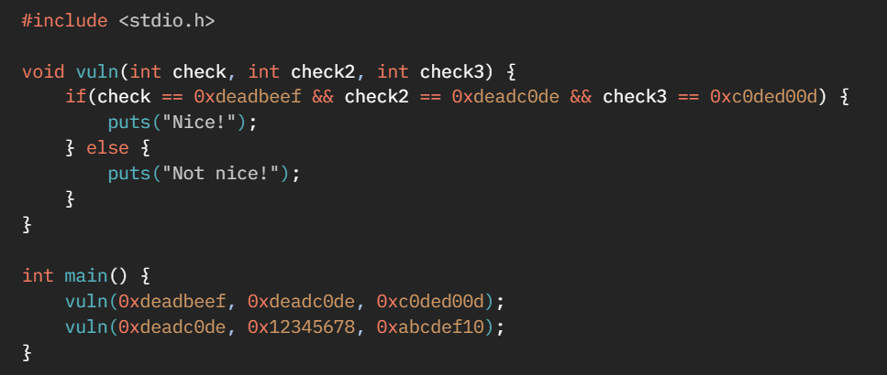
Calling conventions
Can you guess what the assembly of main will look like?

Slide 10
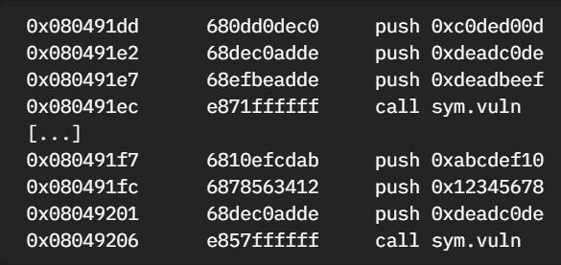
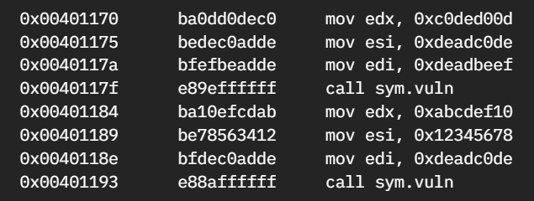
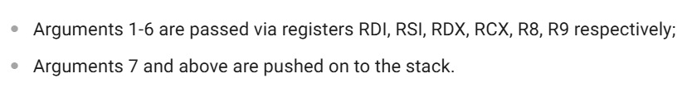
Calling conventions
Answer: it depends. That was a trick question.
x86:
x64:

Slide 11
ROP Gadgets
Gadgets are short instruction sequences ending in ret. For example:
0x1000 pop rdi
0x1001 ret
We use them to build chains that set up registers and control flow. If the stack looks like this when we get to pop rdi; ret:
[RSP] → 0x10
0x5655576724
Then 0x10 is popped into rdi, and execution continues at 0x5655576724.
We can use use this to jump to somewhere useful.

Slide 12
ROP Gadgets
When we overwrite the return address, we essentially are just overwriting the value that rsp points to when ret runs.
ret jumps to that value, then rsp moves to the next one word on the stack (rsp += 0x8). But wait — we control that too.
So we can chain gadget after gadget.
Note: This only works in x64, thanks to the fact that parameters are passed in registers.
Gadgets can be found using a program like ROPgadget or ropper.

Slide 13
ROP Gadgets
Once we control rsp, we control the flow — one ret at a time.
Each gadget or function return behaves like a mini trampoline:
Pop return address
Jump to it
Repeat
Functions are essentially just gadgets too — they start at a known address and return to the next one on the stack. This means we can "call" functions just by placing their address on the stack.
<example>

Slide 14
Mitigations
ROP is a well-known technique, so naturally, modern systems have developed defenses against it. We'll focus on the key mitigations used in Linux.
Stack canaries: Random bytes placed before the return address. If overwritten, the program detects tampering and aborts.
PIE (Position Independent Executable): The binary is loaded at a different address each time, making return addresses unpredictable.
ASLR (Address Space Layout Randomization): Shared libraries and other memory segments are mapped to random addresses on each run.
Still, all of these can often be bypassed with a single memory leak — for example, via a format string vulnerability (next lesson!).

Slide 15

Practice time

Slide 16
Class practice:
Challenges available at our site! Under https://natitati4.github.io/technion-ctf/advanced-workshops/pwn.
HW!
https://ropemporium.com/ - Practice different kinds of ROP, and even different archs.
pwnable.kr – Quite old, but teaches great concepts.
Other places to practice pwn:
https://app.hackthebox.com/ - pwn category, start with very easy – easy.
pwnable.xyz - modern CTF-style pwn challenges.
gracker.org - Binary challenges having a slow learning curve, and write-ups for each level.
https://www.root-me.org/fr/Challenges/App-Systeme - Challenges that introduce various useful techniques.
https://pwnable.co.il - Israeli site! (hard).
pwn.college

