Slide 1


TRANSLATE YOUR ANGULAR APPS
Using ngx-translate
11 de noviembre de 2017
By: Luis Fernando Sejas Soliz

Slide 2
About
Mobile developer apps.
Android
Xamarin.
Ionic.
javascript enthusiast.
Angular
Vue.js.
Restify.

Slide 3
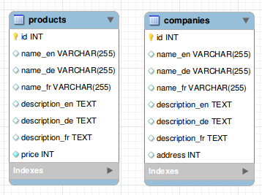
Some internationalization – i18n mechanisms
Storing the strings in a relational database.

Slide 4
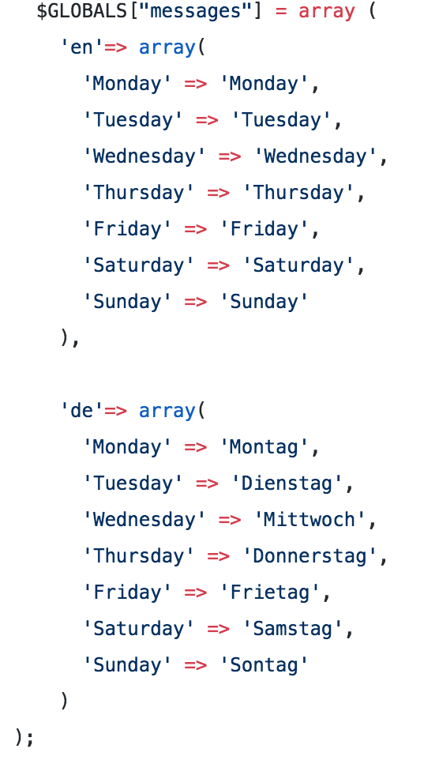
Some internationalization – i18n mechanisms
Storing the strings in message catalogues (string arrays).

Slide 5
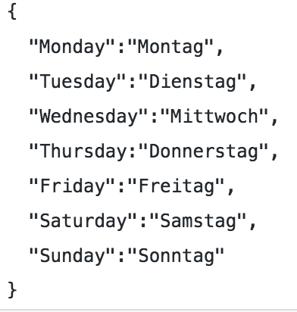
Some internationalization – i18n mechanisms
Storing the strings in JSON.

Slide 6
I18n ?
i18n = Internationalization: i, then 18 letters, then n
i+18+n

Slide 7
Translate your angular apps
New Project
Install ngx-translate and dependencies.
Pre requirements .
Create folder into assets with name i18n.
Add files translation files example en.json,br.js,de.js,etc
Using ngx-translate(module, component)
Demo

Slide 8
Translate your angular apps
ng new multilingual --prefix fss
npm install @ngx-translate/core --save
npm install @ngx-translate/http-loader
https://github.com/ngx-translate/core
Node > =6
Angular cli >=1.5

Slide 9
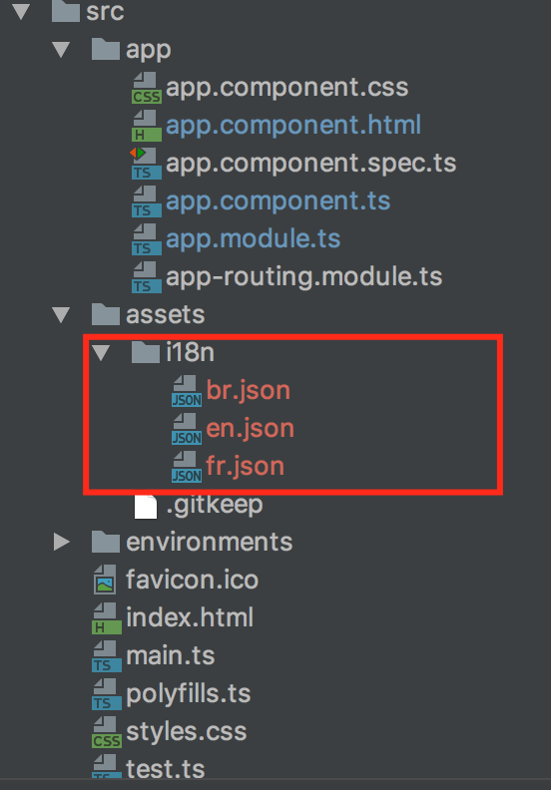
Pre requirements
Create folder i18n into assets
Put translation files

Slide 10
app.module

Slide 11
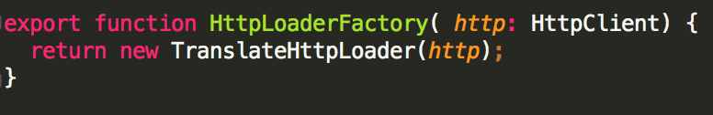
app.module

Slide 12
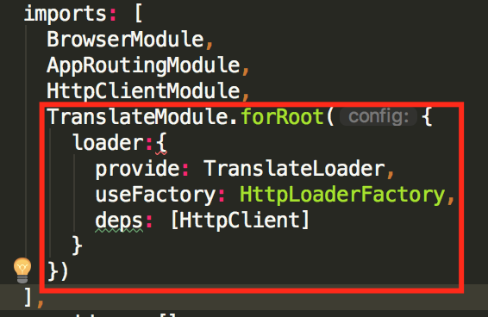
app.module

Slide 13
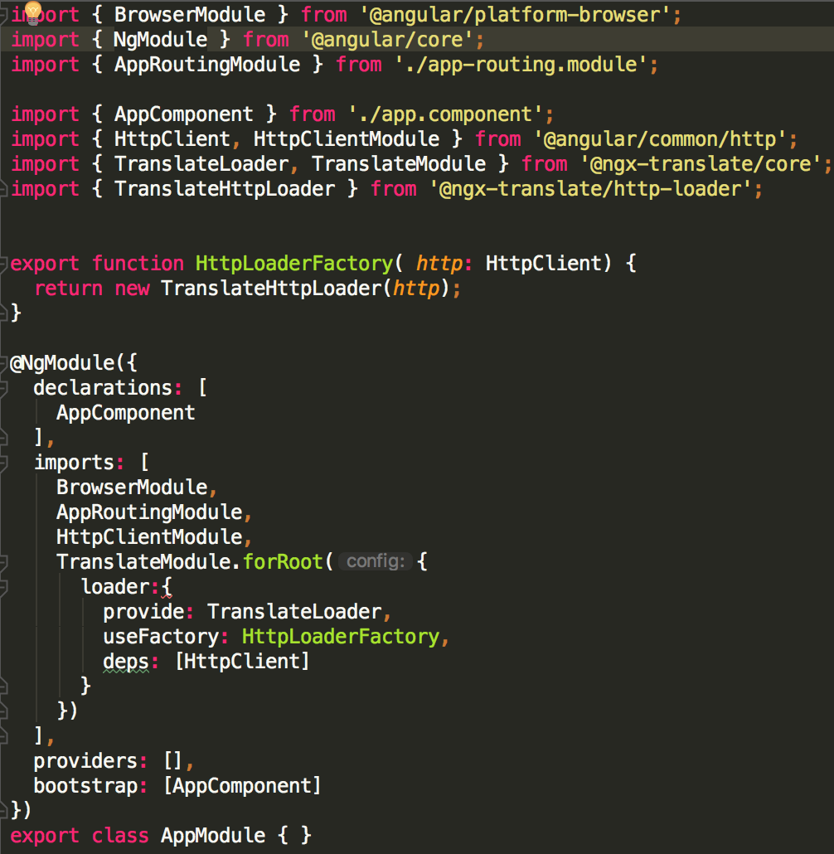
app.module

Slide 14
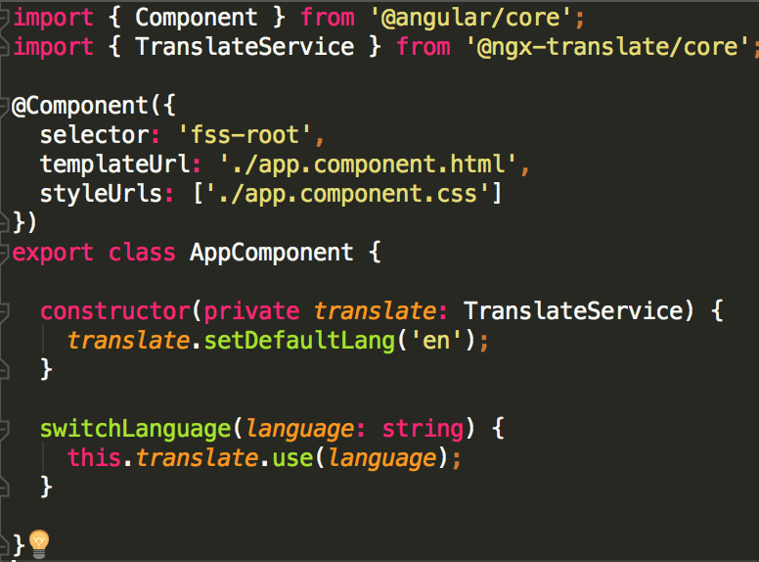
app.component

Slide 15
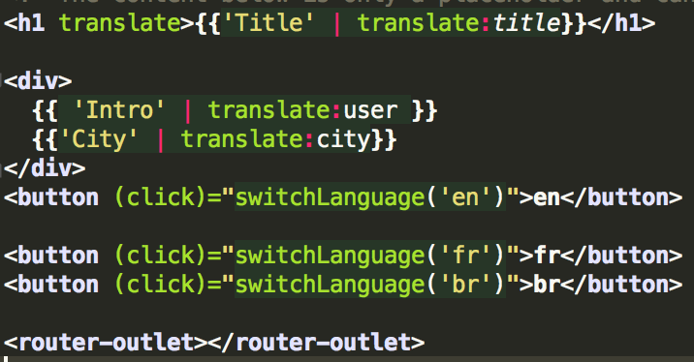
app.component.html

Slide 16
DEMO

