Slide 1
Gitting into it
Sometimes it is easier to peek under the hood

Slide 2
Topics
Concepts
Remotes
Commits
Hashes
Refs
Branches
Apply the concepts
Cherry picking
Rebasing
Tips and tricks

Slide 3
What is a remote?
A remote is a version of your repository hosted on the internet or your network
You can have as many or as few remotes as you like
The remote name is not special
”origin” is the default used when you clone a repo
To find out which remotes you have refs to:
git remote -v

Slide 4
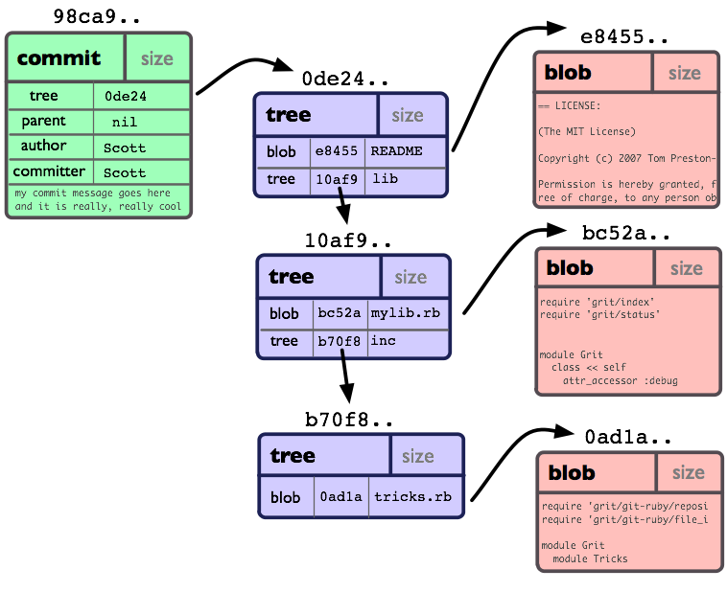
What is a commit?
A commit is a hash of a source tree
The tree is a graph whose nodes are other trees (folders) and blobs (files)
Image credit: https://journal.code4lib.org/articles/8482

Slide 5
What is a hash?
A hash is a mapping of any data to a fixed length string
Git uses the 40 character SHA-1 hash
File contents (blobs) + metadata are hashed
Directory listings (trees) + metadata are hashed
The entire source tree + metadata + previous commit hash is hashed using a merkle tree

Slide 6
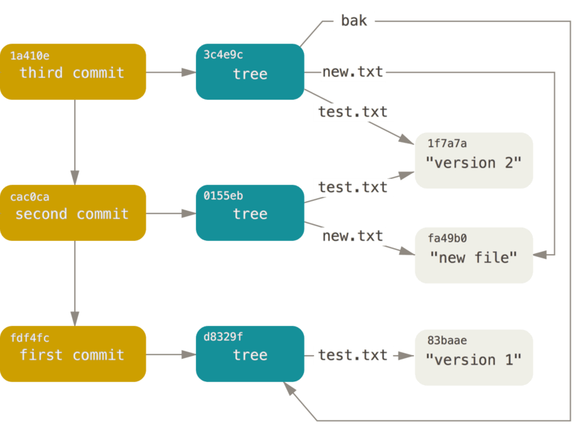
What the hell is a merkle tree?
A directed acylic graph (DAG) whose nodes are hashes of itself and children hashes
In git, the children are the previous commit, and the source tree and blobs
Image credit: https://git-scm.com/book/en/v2/Git-Internals-Git-Objects

Slide 7
Compare source trees
If your local commit hash is the same as a remote, then:
On branch master
Your branch is up to date with 'origin/master'.
If you have changed even one bit of one file then the commit hash is different
On branch master
Your branch is ahead of 'origin/master' by 1 commit.
(use "git push" to publish your local commits)

Slide 8
What is a ref?
A ref is anything that points to a commit
For example:
branches
tags
remote branches
Have a look at the .git/refs directory. You can reference anything in there by name
Refs are useful shortcuts to commits

Slide 9
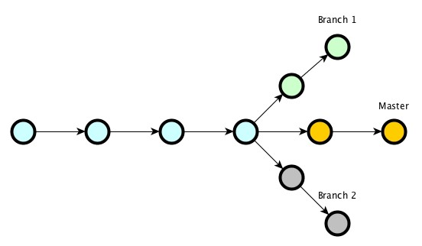
What is a branch?
A branch is simply a reference to a commit
When you create a new branch, all you are doing is creating a ref that points to the current commit in your local repo
Each time you add a new commit the ref is updated
Image credit: https://geeks.uniplaces.com/mastering-branches-in-git-f20cb2d0c51f

Slide 10
Cherry picking
“Copies” one or more commits from one branch to another
When would I use it?
Most common use case is maintaining two versions of a code/doc base
e.g. master contains all changes and release-x.y is the current release. You make some fixes in master, that also need to be in the release branch
git checkout release-x.y
git cherry-pick e5d05465 01537545
where e5d05465 & 01537545 are commits from the master branch

Slide 11
Rebasing to merge
Replays the commits from one branch onto the HEAD of another
When would I use it?
To merge the changes one one branch to another without creating an empty merge commit. Keeps history cleaner and neater.
git checkout my-branch
git rebase upstream/master
git push origin my-branch –force-with-lease **
** This rewrites the commit history of my-branch

Slide 12
Rebasing to squash
Squash a bunch of commits into one
When would I use it?
To create a pull request with a clean commit history
git rebase –i HEAD~5
Brings up an editor which allows you choose which commits to squash, and a new commit message
git push origin my-branch –force-with-lease

Slide 13
Git status
git status
When would I use it?
All the time! This command will tell you:
Which branch you are in
Whether you have any local unstaged changes
Whether you have staged changes
Whether your branch is up to date with its remote(s)

Slide 14
Git diff
git diff
When would I use it?
All the time! This command will tell you:
The differences between any unstaged changes and the local copy of your repo
git diff --cached
Shows differences between your staged changes and the HEAD of your branch

Slide 15
Git stash
Store changes for later without committing them
When would I use it?
When you are in the middle of making some changes and you need to checkout a different branch to do something else
git stash
Check out a different branch, do whatever …
Check out the original branch
git stash apply
You can stash multiple times. The stash is a stack

Slide 16
Checking out someone else’s branch
Add a remote
git remote add bob https://github.com/bob/repo
Fetch the remote
git fetch bob
Create a local reference to the remote branch
git checkout -b test bob/test

Slide 17
Pitfalls
Creating new branch from the wrong commit
Symptom
Strange commits in your PR
Remedy
git checkout master
git pull upstream master
git checkout -b my-new-branch
Creating a PR from your origin/master then trying to use your origin master again
Remedy
Use a different branch for PRs

Slide 18
Repo directory name
There is nothing special about the name of the directory into which you clone a repo
You can rename the cloned directory
git clone blahblah <new directory name>
Or you can move it
git clone blahblah
mv blah blah

