Slide 1
Java Logging
An introduction by Natalie Kershaw (Impinj)

Slide 2
Overview
Common properties of Java logging
Logging frameworks / APIs
Configuration
Output Handlers
Performance

Slide 3
Logging Levels
Logging hierarchy
e.g. ERROR > WARNING > INFO > DEBUG
When a level is set, then only levels greater than or equal to this are printed
e.g. set logging level to ERROR, then WARNING, INFO and DEBUG are not printed

Slide 4
Message Formatting
Using % property specifiers
%d{HH:mm:ss.SSS} [%thread] %-5level %logger{36} - %msg%n
You can also write your own layouts

Slide 5
Java Util Logging
Included with JDK
package java.util.logging
API
Logger
Logger.get
Logger.error() etc
Levels:
SEVERE (highest value)
WARNING
INFO
CONFIG
FINE
FINER
FINEST (lowest value)

Slide 6
Java Util Logging continued…
API provides a static factory method inside the Logger class
Pass in properties file -Djava.util.logging.config.file=<file>
Specify base level: .LEVEL= (defaults to INFO)
Configure individual handler levels: java.util.logging.ConsoleHandler.level = SEVERE
Messages are formatted using a formatter
Default is SimpleFormatter
You can write your own implementing java.util.logging.Formatter

Slide 7
log4j
External libraries:
compile group: 'org.apache.logging.log4j', name: 'log4j-api', version: '2.6.2'
compile group: 'org.apache.logging.log4j', name: 'log4j-core', version: '2.6.2’
API
Logger
LoggerManager
Logger.debug() etc
Levels
OFF
FATAL
ERROR
INFO
DEBUG
TRACE
ALL

Slide 8
Log4j continued
Logger Hierarchy
Loggers inherit their configuration from those with matching prefixes
e.g. com.foo.bar will inherit configuration from com.foo
Configuration can be overridden with a more specific logger name/prefix
e.g. com.foo.bar will override com.foo
Configurable and custom pattern outputs
File, console appenders
e.g. RollingFileAppender will roll file each day

Slide 9
slf4j
Simple Logging Façade for Java
As the title says, this is a simple façade for Java
A library can use the slf4j API, then an actually logging library can be chosen at deployment time e.g. java.util.logging, log4j, logback
This is useful for libraries, such as our java-client lib
Dependencies
slf4j-api-1.7.21.jar
To switch logging frameworks, just replace slf4j bindings on your class path
slf4j-simple-1.7.21.jar (this is the simplest implementation of the façade)
slf4j-log4j12-1.7.21.jar for log4j etc

Slide 10
slf4j/logback
API
Logger
LoggerFactory
Logger.info() etc
Levels
OFF
FATAL
ERROR,
WARN
INFO,
DEBUG
ALL
Logger hierarchy is also supported

Slide 11
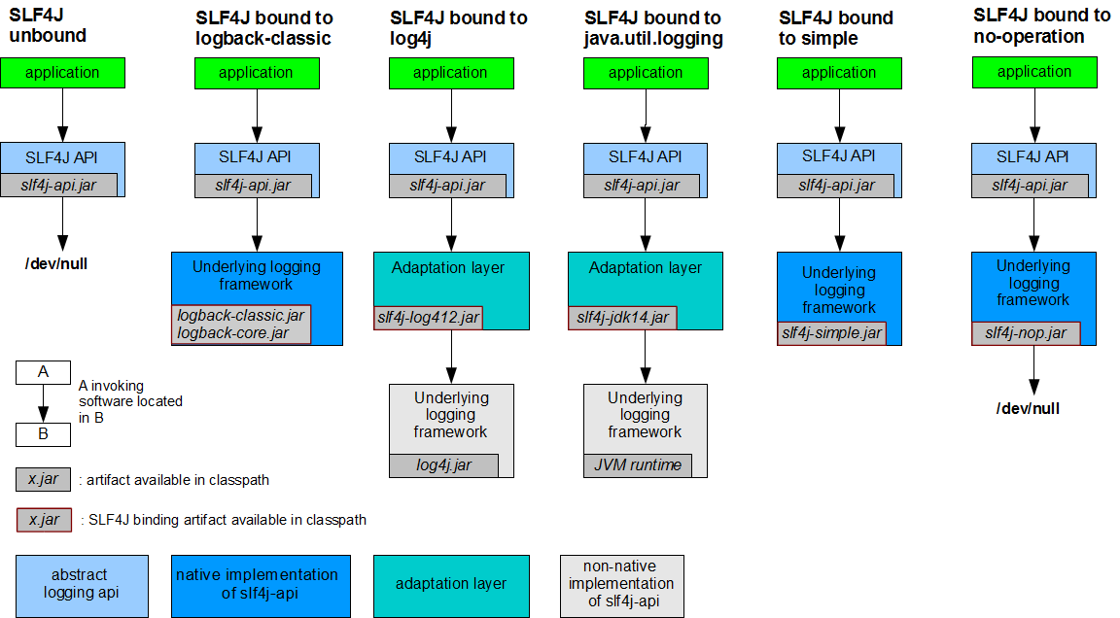
Slf4j continued (credit: http://www.slf4j.org/manual.html)

Slide 12
Performance
Only want logging messages to be constructed if that logging level is enabled
logger.debug("This " + this + " and " + that + "with " + compute());
Replace string concatenation with parameter markers
logger.debug("This {} and {} with {} ", this, that, compute());
Compute can be expensive:
if (logger.isDebugEnabled()) {
logger.debug("This {} and {} with {} ", this, that, compute());
}
Above is error prone – lots of extra code and have to make sure your levels match. Use lambdas! (I think this is only supported in log4j)
logger.debug("I am logging that {} happened.", () -> compute());

