Slide 1
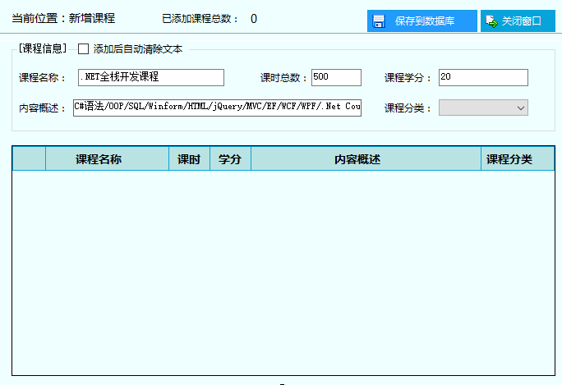
添加课程窗体：FrmAddCourse
ckbAutoClear
lblCount
btnSaveToDB
btnClose
groupBoxCourseInfo
txtCourseName
txtClassHour
txtCredit
cbbCategory
txtCourseContent
dgvCourseList

Slide 2
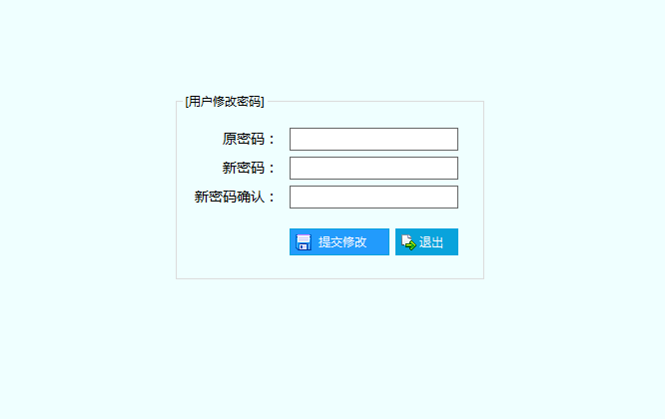
修改密码窗体：FrmModifyPwd
txtOldPwd
txtNewPwd
txtConfirmNewPwd
btnSaveToDB
btnClose

