Slide 1
Document Object Modeling (DOM)
Asst.Prof. Dr. Umaporn Supasitthimethee
ผศ.ดร.อุมาพร สุภสิทธิเมธี
https://developer.mozilla.org/en-US/docs/Web/API/Document_Object_Model/Introduction

Slide 2
Document Object Model (DOM)
Understanding the Document Object Model in JavaScript
Node Types
Traversing Nodes
Manipulating Nodes
Notes:
The DOM represents a document as a hierarchical tree of nodes, allowing developers to add, remove, and modify individual parts of the page.
Nodes Types: Document, Element, Text, Attribute,…
Node Relationships : Parent, Child, Sibling,…
Node Operations: Find, Add, Remove, Modify ,…

Slide 3
Introduction to Document Object Modeling (DOM)
The Document Object Model (DOM) represents the HTML page so that programs can change the document structure, style, and content.
The DOM represents a document as a hierarchical tree of nodes, allowing developers to select, add, remove, and modify individual parts of the page.
The DOM is now a truly cross-platform, language-independent way of representing and manipulating pages for markup.
The DOM is not a programming language, but without it, the JavaScript language wouldn't have any model or notion of web pages, HTML documents, XML documents, and their component parts.

Slide 4
<script> Tag Placement
<html>
<head>
<title>Example HTML Page</title>
<script src="script.js"></script>
</head>
<body>
<!-- content here -->
</body>
</html>
Including all JavaScript files in the <head> of a document means that all of the JavaScript code must be downloaded, parsed, and interpreted before the page begins rendering
Notes:
including all JavaScript files in the <head> of a document means that all of the JavaScript code must be downloaded, parsed, and interpreted before the page begins rendering (rendering begins when the browser receives the opening <body> tag).
In modern websites, scripts are often “heavier” than HTML: their download size is larger, and processing time is also longer.
When the browser loads HTML and comes across a <script>...</script> tag, it can’t continue building the DOM. It must execute the script right now. The same happens for external scripts <script src="..."></script>: the browser must wait for the script to download, execute the downloaded script, and only then can it process the rest of the page.
That leads to two important issues:
Scripts can’t see DOM elements below them, so they can’t add handlers etc.
If there’s a bulky script at the top of the page, it “blocks the page”. Users can’t see the page content till it downloads and runs:
Scripts: async, defer (javascript.info)

Slide 5
<script> Tag Placement
For pages that require a lot of JavaScript code, this can cause a noticeable delay in page rendering, during which time the browser will be completely blank.
For this reason, modern web applications typically include all JavaScript references in the <body> element, after the page content.
<html>
<head>
<title>Example HTML Page</title>
</head>
<body>
<!-- content here -->
<script src="script.js"></script>
</body>
</html>
Notes:
For pages that require a lot of JavaScript code, this can cause a noticeable delay in page rendering, during which time the browser will be completely blank. For this reason, modern web applications typically include all JavaScript references in the <body> element, after the page content, as shown in this example:

Slide 6
Document Object Modeling (DOM)
When an HTML document is loaded into a web browser, it becomes a document object, everything is a node
The document object is the root node of the HTML document and all other nodes: element nodes, text nodes, attribute nodes, and comment nodes
Each node type has different characteristics, data, and methods, and each may have relationships with other nodes.
These relationships create a hierarchy that allows markup to be represented as a tree, rooted at a particular node.
Notes:
The document object provides properties and methods to access all node objects, from within JavaScript.

Slide 7
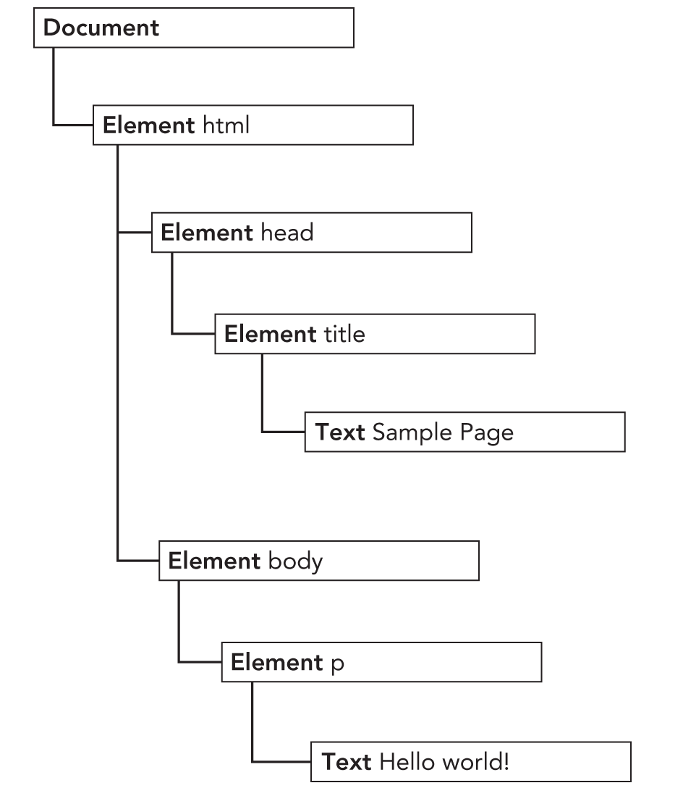
const rootNode = window.document
Dom and JavaScript
Root Node
<html>
<head>
<title>Sample Page</title>
</head>
<body>
<p>Hello World!</p>
</body>
</html>
Root/Document element
window
Document (root node)
html (root/document element)
head
body
In browsers, the document object is an instance of HTMLDocument (which inherits from Document) and represents the entire HTML page. The document object is a property of window and so is accessible globally. It is read-only.
Notes:
All nodes in a document have relationships to other nodes.
These relationships are described in terms of traditional family relationships as if the document tree were a family tree.
In HTML, the <body> element is considered a child of the <html> element; likewise the <html> element is considered the parent of the <body> element.
The <head> element is considered a sibling of the <body> element, because they both share the same immediate parent, the <html> element.

Slide 8
Nodes Types

Slide 9
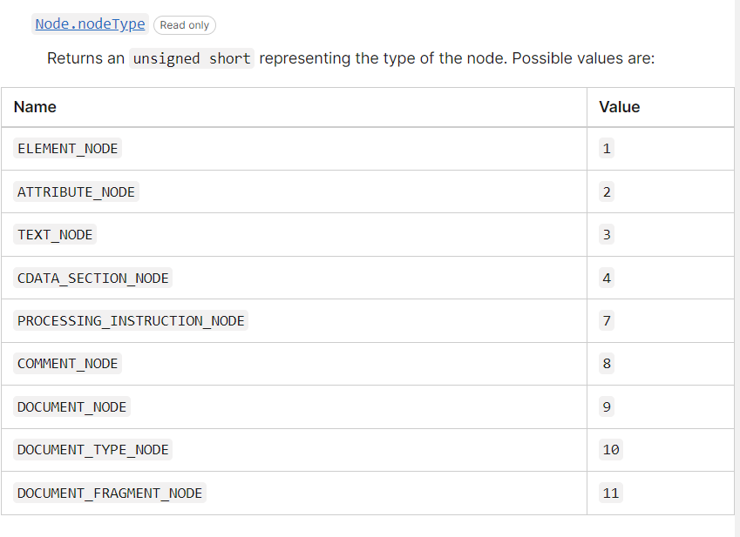
Node types are represented by one of the following 11 numeric constants
The Node interface is implemented in JavaScript as the Node type, which is accessible in all browsers
All node types inherit from Node in JavaScript, so all node types share the same basic properties and methods.
Every node has a node Type property that indicates the type of node that it is.
if (someNode.nodeType === Node.ELEMENT_NODE){
alert("Node is an element.");
}

Slide 10
The nodeName and nodeValue Properties
Two properties, nodeName and nodeValue, give specific information about the node.
The values of these properties are completely dependent on the node type.
It’s always best to test the node type before using one of these values, as the following code shows:
if (someNode.nodeType === 1){ //someNode.nodeType===Node.ELEMENT_NODE
value = someNode.nodeName // nodeName will be the element's tag name
// nodeValue is always null
}

Slide 11
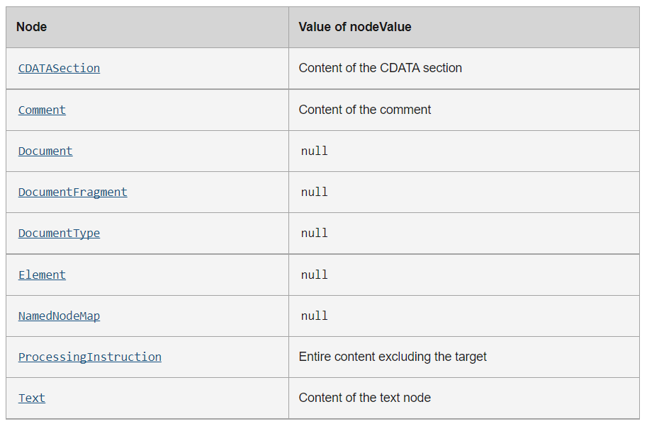
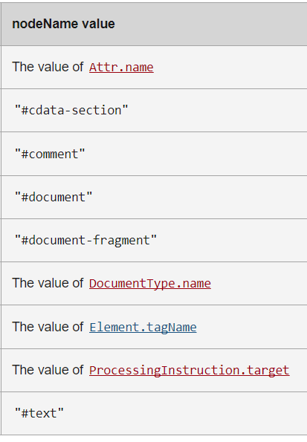

Slide 12
Document Children
This example shows that the values of documentElement, firstChild, and childNodes[0] are all the same—all three point to the <html> element.
As an instance of HTMLDocument, the document object also has a body property that points to the <body> element directly.
<html>
<body>
</body>
</html>
const html = document.documentElement // get reference to <html>
alert(html === document.childNodes[0]) // true
alert(html === document.firstChild) // true
const body = document.body // get reference to <body>

Slide 13
Creating Elements
New elements can be created by using the document.createElement() method.
This method accepts a single argument, which is the tag name of the element to create.
In HTML documents, the tag name is case-insensitive.
To create a <div> element, the following code can be used:
The element can be added to the document tree using appendChild(), insertBefore(), replaceChild(), removeChild().
The following code adds the newly created element to the document’s <body> element:
Once the element has been added to the document tree, the browser renders it immediately. Any changes to the element after this point are immediately reflected by the browser.
let div = document.createElement("div");
document.body.appendChild(div);

Slide 14
Attr Node
The Attr node inherits from Node but is not considered a part of the document tree.
Common Node attributes like parentNode, previousSibling, and nextSibling are null for an Attr node. You can, however, get the element to which the attribute belongs with the ownerElement property.
Notes:
In XPath terms, the element is the parent of each of its attribute nodes—however, an attribute node is not considered a child of its parent element.

Slide 15
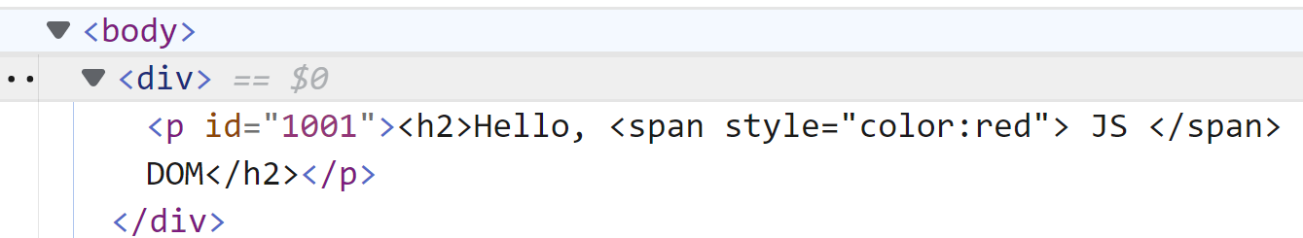
const pElement = document.createElement('p')
const idAttr = document.createAttribute('id')
idAttr.value = 1001
pElement.setAttributeNode(idAttr)
// pElement.setAttribute('id', 1001)
const pText = document.createTextNode('<h2>Hello, <span style="color:red"> JS </span> DOM</h2>’)
pElement.appendChild(pText)
const divElement = document.querySelector('div')
divElement.appendChild(pElement)
const rootDocument = divElement.ownerDocument
console.log(rootDocument.nodeName)//#document
console.log(rootDocument.nodeType)//9
console.log(rootDocument.nodeValue)//null
console.log(pElement.nodeName) //P
console.log(pElement.nodeType)//1
console.log(pElement.nodeValue)//null
console.log(idAttr.nodeName) //id
console.log(idAttr.nodeType) //2
console.log(idAttr.nodeValue) //1001
console.log(pText.nodeName) //#text
console.log(pText.nodeType) //3
console.log(pText.nodeValue) //'<h2>Hello, <span style="color:red"> JS </span> DOM</h2>'
console.log(pElement.parentElement) //div
console.log(idAttr.parentElement) //null
console.log(pText.parentElement)
//<p id="1001"...</p>

Slide 16
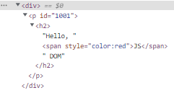


innerHTML, innerText, and textContent
const pElement = document.createElement('p')
pElement.innerHTML =
'<h2>Hello, <span style="color:red">JS</span> DOM</h2>'
const p = document.getElementsByTagName('p')
console.log(p[0].innerText)
console.log(p[0].textContent)
console.log(p[0].innerHTML)
textContent has better performance because its value is the raw content not parsed as HTML and also prevent Cross-Site Scripting (XSS) attacks. This includes <script> and <style> elements, whitespace, line breaks, and carriage returns.
Notes:
textContent gets the content of all elements, including <script> and <style> elements.
innerText only approximates the “rendered” text content of a node and is aware of styling and CSS. You should use innerText when you only need to see what’s in the element without the formatting. When using innerText it retrieves and sets the content of the tag as plain text. Whereas when you use innerHTML, it retrieves and sets the same content in HTML format. innerText is aware of the rendered appearance of text while textContent is not.
If we were to use innerHTML in the code above, it will return the string inside our as well as the HTML markup contained within our string, including any spacing or line breaks
If we use innerText, it will return only the string inside of our div, without any tags or extra elements or spacing
If we use textContent, it will return the content of all elements in the node, except for the tags . But it’s aware of formatting like spacing and line breaks and will return those.
https://uche-blog.hashnode.dev/innerhtml-vs-innertext-vs-textcontent

Slide 17
Traversing Nodes

Slide 18
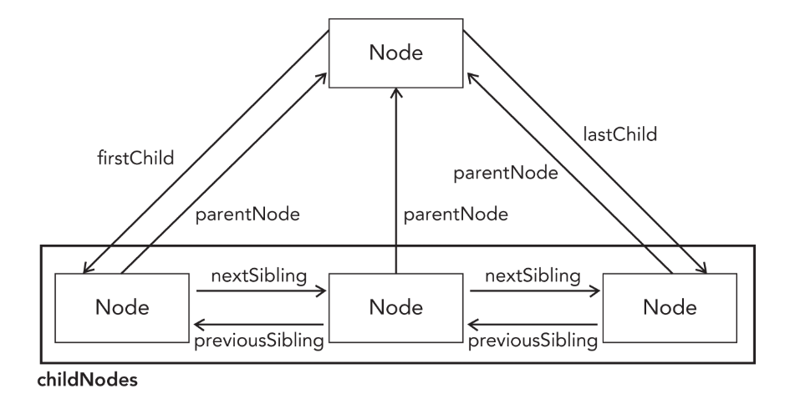
Node Relationships
The value of someNode.firstChild is always equal to someNode.childNodes[0],
and the value of someNode.lastChild is always equal to someNode.childNodes [someNode.childNodes.length-1].
With all of these relationships, the childNodes property is really more of a convenience than a necessity because it’s possible to reach any node in a document tree by simply using the relationship pointers.
Notes:
The firstChild and lastChild properties point to the first and last node in the childNodes list, respectively.
If there is only one child node, firstChild and lastChild point to the same node;
if there are no children, then firstChild and lastChild are both null.
All of these relationships help to navigate easily between nodes in a document structure.

Slide 19
Element Traversal
The Element Traversal API adds five new properties to DOM elements:
childElementCount—Returns the number of child elements (excludes text nodes and comments).
firstElementChild—Points to the first child that is an element. Element-only version of firstChild.
lastElementChild—Points to the last child that is an element. Element-only version of lastChild.
previousElementSibling—Points to the previous sibling that is an element. Element-only version of previousSibling.
nextElementSibling—Points to the next sibling that is an element. Element-only version of nextSibling.

Slide 20
const htmlElement = document.querySelector('html')
console.log(htmlElement.parentNode)//#document root node
console.log(htmlElement.parentElement)//null
Element Traversal Example
<!DOCTYPE html>
<html lang="en">
<head>
<title>Manipulating Elements</title>
</head>
<body>
<h3>SIT@KMUTT Restaurant</h3>
<div class="menu">
<ul id="appetizer">
<li class="vegan">Vegetable Rolls</li>
<li class="meat">Chicken Wings</li>
<li class="meat">Tuna Sandwich</li>
</ul>
<ul id="soup">
<li class="meat">Spicy Bacon-Corn Soup</li>
<li class="vegan">Vegetable Soup</li>
<li class="meat">Beef Soup</li>
<li class="vegan">Coconut Soup</li>
</ul>
</div>
<p>***Enjoy Your Meal, Thank you***</p>
</body>
</html>
const soupMenu = document.querySelector('#soup')
const firstChildNode = soupMenu.firstElementChild
const nextFirstChildNode = firstChildNode.nextElementSibling
const lastChildNode = soupMenu.lastElementChild
const previousLastChildNode = lastChildNode.previousElementSibling
console.log(firstChildNode)
//<li class="meat">Spicy Bacon-Corn Soup</li>
console.log(lastChildNode)
//<li class="vegan">Coconut Soup</li>
console.log(nextFirstChildNode)
//<li class="vegan">Vegetable Soup</li>
console.log(previousLastChildNode)
//<li class="meat">Beef Soup</li>
const meatMenus = document.querySelectorAll('.meat')
meatMenus.forEach((meatMenu) => console.log(meatMenu))
/*<li class="meat">Chicken Wings</li>
<li class="meat">Tuna Sandwich</li>
<li class="meat">Spicy Bacon-Corn Soup</li>
<li class="meat">Beef Soup</li>*/

Slide 21

Element Traversal Example
<!DOCTYPE html>
<html lang="en">
<head>
<title>Manipulating Elements</title>
</head>
<body>
<h3>SIT@KMUTT Restaurant</h3>
<div class="menu">
<ul id="appetizer">
<li class="vegan">Vegetable Rolls</li>
<li class="meat">Chicken Wings</li>
<li class="meat">Tuna Sandwich</li>
</ul>
<ul id="soup">
<li class="meat">Spicy Bacon-Corn Soup</li>
<li class="vegan">Vegetable Soup</li>
<li class="meat">Beef Soup</li>
<li class="vegan">Coconut Soup</li>
</ul>
</div>
<p>***Enjoy Your Meal, Thank you***</p>
</body>
</html>
let currentChildNode=soupMenu.firstElementChild
// <li class="meat">Spicy Bacon-Corn Soup</li>
while (currentChildNode !== null) {
if (currentChildNode.nodeType === 1) {
console.log(currentChildNode)
}
currentChildNode = currentChildNode.nextElementSibling
}
*The firstChild and lastChild return the first and last child of a node, which can be any node type including text node, comment node, and element node.
**The firstElementChild and lastElementChild return the first and last child Element node.

Slide 22
Selecting Nodes

Slide 23
Selecting Elements
The Document type provides methods to specific element or sets of elements to perform certain operations.
getElementById()// returns the element if found, or null if an element with that ID doesn’t exist.
HTMLCollection getElementByTagName() and getElementsByClassName()are live.
When an underlying document is changed, the HTMLCollection will be updated automatically.
getElementsByTagName()
//returns an HTMLCollection of elements with the given tag name.
getElementsByClassName()
//returns A live HTMLCollection an array-like object of all child elements which have all the given class name(s).
NodeList
getElementsByName()
// returns a NodeList, which returns all elements that have a given name attribute.
querySelectorAll()
//the CSS query and returns all matching nodes instead of just one. This method returns a static instance of NodeList.
querySelector()
//a CSS query and returns the first descendant element that matches the pattern or null if there is no matching element.
Notes:
Both have a length property defining the number of items in the list (collection).
Both provide an index (0, 1, 2, 3, 4, ...) to access each item like an array.
HTMLCollection items can be accessed by their name, id, or index number.
NodeList items can only be accessed by their index number.
Only the NodeList object can contain attribute nodes and text nodes.
A NodeList is almost the same as an HTMLCollection object.

Slide 24
HTMLCollection Vs. NodeList
An HTMLCollection is always a live collection of element nodes.
For example: If you add a <li> element to a list in the DOM, the list in the HTML Collection will also change.
A HTMLCollection items can be accessed by their name attribute, id attribute, or index number.
A NodeList is a list of all nodes including elements nodes, attribute nodes, and text nodes extracted from a document.
A NodeList is most often a static collection. For example: If you add a <li> element to a list in the DOM, the list in the NodeList will not change.
NodeList items can only be accessed by their index numbers.
Both an HTMLCollection object and a NodeList object is an array-like collections (lists) of nodes extracted from a document.

Slide 25
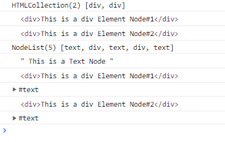
HTMLCollection and NodeList Examples
<!DOCTYPE html>
<html lang="en">
<head>
<title>Document</title>
</head>
<body>
<div id="app">
This is a Text Node
<div>This is a div Element Node#1</div>
<div>This is a div Element Node#2</div>
</div>
<script src="./main.js" />
</body>
</html>
//main.js
const myApp = document.getElementById('app')
const childrensHTML = myApp.children //return HTMLCollection
const childNodesList = myApp.childNodes //return NodeList
Array.from(childrensHTML).forEach((element) => console.log(element))
//HTMLCollection(2) [div, div], cannot use forEach directly and need to create array
childNodesList.forEach((element) => console.log(element))
//NodeList(5) [text, div, text, div, text] can use forEach

Slide 26
HTMLCollection (live) Vs. NodeList (static)
<div id="sections">
<div class="section">Section 1</div>
<div class="section">Section 2</div>
<div class="section">Section 3</div>
<div class="section">Section 4</div>
<!-- <div class="section">Section 5</div> -->
</div>
const sectionDiv = document.getElementById('sections')
const sectionsbySelectorAll = document.querySelectorAll('.section')
const sectionsByClassName = document.getElementsByClassName('section')
//create a new div section
const div = document.createElement('div')
div.classList = 'section'
div.innerHTML = 'section 5' sectionDiv.appendChild(div) console.log(sectionsByClassName.length) //5
console.log(sectionsbySelectorAll.length)//4

Slide 27
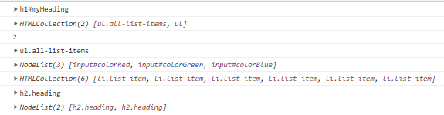
Selecting Elements
<html lang="en">
<head>
<title>Document Object Model Sample Page</title>
</head>
<body>
<h1 id="myHeading">Selecting Elements</h1>
<h2 class="heading">Document Object Model</h2>
<h2 class="heading">DOM</h2>
<ul class="all-list-items">
<li class=list-item>out of class</li>
<li class="list-item">[1] Single Element by ID:</li>
<li class="list-item">[2] Single Element by CSS selector:</li>
<li class="list-item">[3] Multiple Element by CSS selector:</li>
<li class="list-item">[4] Multiple Element by class (live):</li>
<li class="list-item">[5] Multiple Element by tag (live):</li>
</ul>
<ul>
<li>
<input type="radio" value="red" name="color" id="colorRed">
<label for="colorRed">Red</label>
</li>
<li>
<input type="radio" value="green" name="color" id="colorGreen">
<label for="colorGreen">Green</label>
</li>
<li>
<input type="radio" value="blue" name="color" id="colorBlue">
<label for="colorBlue">Blue</label>
</li>
</ul>
<script src="main.js"></script>
</body>
</html>
const domElementId = document.getElementById("myHeading")
const domByTagName = document.getElementsByTagName("ul")
const domByName =document.getElementsByName("color")
const domClassName = document.getElementsByClassName("list-item")
const domQuerySelector = document.querySelector(".heading")
const domQuerySelectorAll = document.querySelectorAll(".heading")
console.log(domElementId)//<h1 id="myHeading">Selecting Elements</h1>
console.log(domByTagName)//HTMLCollection(2) [ul.all-list-items,ul]
console.log(domByTagName.length) //2
console.log(domByTagName.item(0)) //<ul class="all-list-items">...</ul>
console.log(domByName)//NodeList(3) [input#colorRed, input#colorGreen, input#colorBlue]
console.log(domClassName)//HTMLCollection(6) [li.list-item, li.list-item,li.list-item, li.list-item, li.list-item, li.list-item]
console.log(domQuerySelector)//<h2 class="heading">Document Object Model</h2>
console.log(domQuerySelectorAll)//NodeList(2) [h2.heading, h2.heading]

Slide 28
Manipulating Nodes

Slide 29
Manipulating Nodes
appendChild() // adds a newly node to the end of the childNodes list
createElement() //create a new HTML element
insertBefore(newNode, referenceNode) //The node to insert becomes the previous sibling of the reference node
replaceChild(newChild, oldChild)//replaces a child node within the given (parent) node
removeChild(child)//removes a child node from the DOM and returns the removed node.

Slide 30
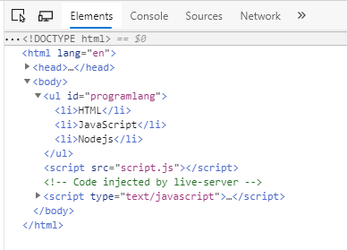

<html lang="en">
<head>
<title>Manipulating Elements</title>
</head>
<body>
<ul id="programlang"></ul>
</body>
</html>
const langs = ["HTML", "JavaScript", "Nodejs"]
const langElement = document.querySelector("#programlang")
for (const lang of langs) {
const li=document.createElement("li")
li.innerHTML=lang
langElement.appendChild(li)
}

Slide 31
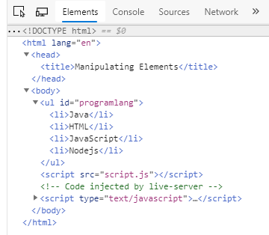
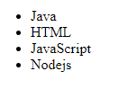
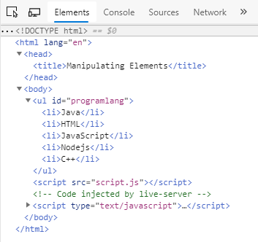
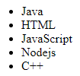
const firstLangElement=langElement.firstElementChild
const newLangNode=document.createElement("li")
newLangNode.innerHTML="Java"
langElement.insertBefore(newLangNode, firstLangElement)
const newLastLangNode=document.createElement("li")
newLastLangNode.innerHTML="C++"
langElement.insertBefore(newLastLangNode, null)

Slide 32
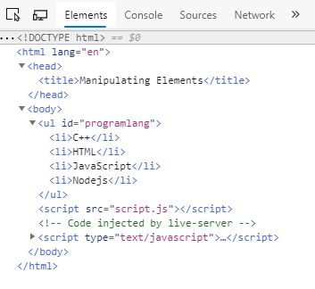

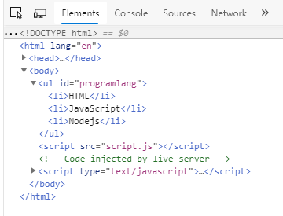
langElement.replaceChild(newLastLangNode, newLangNode)
langElement.removeChild(langElement.firstElementChild)

Slide 33
System Dialogs

Slide 34
System Dialogs
The browser is capable of invoking system dialogs to display to the user through the alert(), confirm(), and prompt() methods.
These dialogs are not related to the web page being displayed in the browser and do not contain HTML.
Their appearance is determined by operating system and/or browser settings rather than CSS.
Additionally, each of these dialogs is synchronous and modal, meaning code execution stops when a dialog is displayed, and resumes after it has been dismissed.

Slide 35
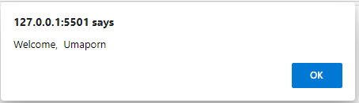
System Dialogs: alert()
The alert() method simply accepts a string to display to the user.
When alert() is called, a system message box displays the specified text to the user, followed by a single OK button.
Alert dialogs are typically used when users must be made aware of something that they have no control over, such as an error.

Slide 36
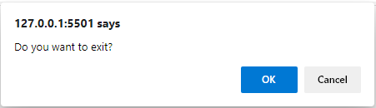
System Dialogs: confirm()
A confirm()method looks similar to an alert dialog in that it displays a message to the user.
The main difference between the two is the presence of a Cancel button along with the OK button, which allows the user to indicate if a given action should be taken.
The confirm() method returns true if the user clicked "OK", and false otherwise.

Slide 37
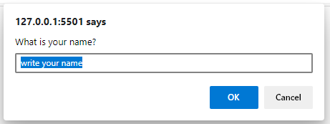
System Dialogs: prompt()
The final type of dialog is displayed by calling prompt(), which along with OK and Cancel buttons, this dialog has a text box where the user may enter some data.
The prompt() method accepts two arguments: the text to display to the user, and the default value for the text box (which can be an empty string).
If the OK button is clicked, prompt() returns the value in the text box; if Cancel is clicked or the dialog is otherwise closed without clicking OK, the function returns null.

Slide 38
TodoList Project Diagram
lib
ไฟล์ ./lib/todo.js เพื่อจัดการกับ property และฟังก์ชันของแต่ละ todo
ไฟล์ ./lib/todoManagement.js เพื่อจัดการโครงสร้างข้อมูลและฟังก์ชันของ todo ทั้งหมด
ไฟล์ ./UI/todoListUI.js เพื่อจัดการ dom ของเอกสาร HTML
ไฟล์ ./main.js สำหรับเรียกใช้ไฟล์ต่าง ๆ ที่เกี่ยวข้อง
todo.js
uses
todoManagement.js
uses
UI
todoList.js
uses
main.js

Slide 39
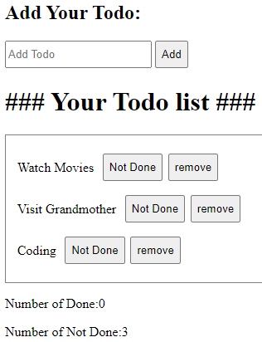
TodoList Project Requirement
ไฟล์ ./lib/todo.js เพื่อจัดการกับ property และฟังก์ชันของแต่ละ todo
1. ให้เพิ่ม property done (Boolean) และให้กำหนดค่าเริ่มต้น done เป็น false ที่ constructor
2. ให้เพิ่ม property done ในการคืนค่า object ที่ฟังก์ชัน getTodo
ไฟล์ ./lib/todoManagement.js เพื่อจัดการโครงสร้างข้อมูลและฟังก์ชันของ todo ทั้งหมด
1. ให้แก้ไขฟังก์ชัน addTodo(desc) ให้ return todo.id แทนการ return length ของ array
2. ให้เพิ่มฟังก์ชัน getNumberOfDone เพื่อ return จำนวนของ Todo ที่อยู่ในสถานะ Done
3. ให้เพิ่มฟังก์ชัน getNumberOfNotDone เพื่อ return จำนวนของ Todo ที่อยู่ในสถานะ Not Done
สร้างไฟล์ ./UI/todoListUI.js เพื่อจัดการ dom ของเอกสาร HTML
1.ให้เพิ่มฟังก์ชันที่ชื่อ showTodoItem(newId, newDescription) โดยทำการรับค่า todo id และ description เป็นพารามิเตอร์ เพื่อทำการแสดงรายการ todo ภายใต้ <div id="listTodo"></div> ของเอกสาร HTML โดยแต่ละรายการ todo ให้มีโครงสร้าง tags เรียงลำดับ ดังนี้ <div class="todoItem" id="newId">
<p>newDescription</p>
<button>Not done</button>
<button>remove</button>
</div>
2. ให้เพิ่มฟังก์ชัน showNumberOfDone(numberOfDone) เพื่อแสดงเลขจำนวนของ Todo ที่อยู่ในสถานะ Done ต่อท้ายข้อความ ภายใน <p id="done">Number of Done: </p>
3. ให้เพิ่มฟังก์ชัน showNumberOfNotDone(numberOfNotDone) เพื่อแสดงเลขจำนวนของ Todo ที่อยู่ในสถานะ Not Done ต่อท้ายข้อความ ภายใน <p id="notDone">Number of Not Done:</p>
สร้างไฟล์ ./main.js
1. ให้ทดสอบเรียกใช้ addTodo() และรับ id ที่ return จากฟังก์ชัน เพื่อส่งต่อให้ฟังก์ชัน showTodoItem() เพื่อทำการสร้าง tags แสดงผลใน HTML File
2. ให้ทดสอบเรียกใช้ getNumberOfDone() และ getNubmerOfNotDone() และรับค่าจำนวนของ Todo ที่อยู่ในสถานะ Done และ NotDone เพื่อส่งต่อฟังก์ชัน showNumberOfDone() และ showNumberOfNotDone() เพื่อแสดงผลใน HTML File

