Slide 1
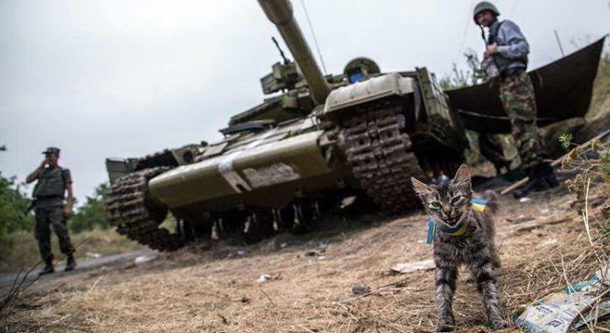
UKRAINE IED Activity update

Slide 2
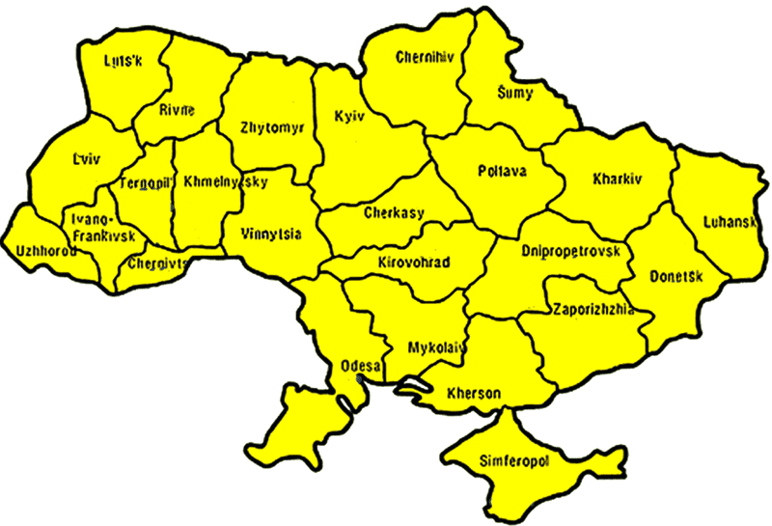
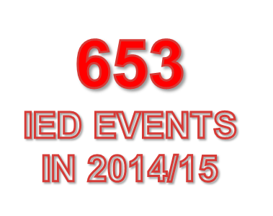
Identified & declared IED events
104
02
05
99
05
02
05
138
16
91
02
04
06
02
32
01
02
02
84
21
16
08
05
(Data taken from Open Sources
01 January 2014 to 09 December 2015)

Slide 3


METRICS
 | 2011 2013 | JAN- APR 14 | MAY 14 | JUN 14 | JUL 14 | AUG 14 | SEP 14 | OCT 14 | NOV 14 | DEC 14 | JAN 15 | FEB 15 | MAR 15 | APR 15 | MAY 15 | JUN 15 | JUL 15 | AUG 15 | SEP 15 | OCT 15 | NOV 15 | DEC 15 | TOTAL
Qty | 15 | 11 | 12 | 24 | 50 | 26 | 31 | 14 | 28 | 33 | 23 | 23 | 44 | 56 | 42 | 42 | 41 | 36 | 29 | 35 | 33 | 07 | 668
KIA | 5 | 1 | 0 | 3 | 8 | 3 | 0 | 2 | 2 | 3 | 1 | 6 | 8 | 0 | 15 | 2 | 1 | 2 | 2 | 2 | 3 | 0 | 68
WIA | 44 | 9 | 0 | 5 | 18 | 14 | 0 | 7 | 13 | 10 | 25 | 13 | 5 | 4 | 3 | 7 | 4 | 0 | 8 | 2 | 2 | 0 | 195
UNKNOWN
(2014/15 data were taken from 01 JAN 14 to 09 DEC 15)
FALSE/HOAX
PROJECTED
146
COMMAND IED
219
CACHE/FOUND
TIME
DELAY
FOUND
14
PROJECTED
245
10
VOIED
SUICIDE PERSON-BORNE
UNKNOWN
5
VBIED/PBIED
2
8
COMMAND IED
4
TIME DELAY
“Stolen EXPLOSIVES”
TARGETS | BUSSINES | RAILWAYS | ROADS | GOVERMENT | SECURITY | CIVILIANS | NO SPECIFIC
EVENTS | 61 | 93 | 29 | 148 | 63 | 60 | 213

