Slide 1
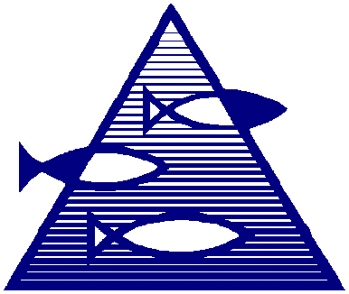
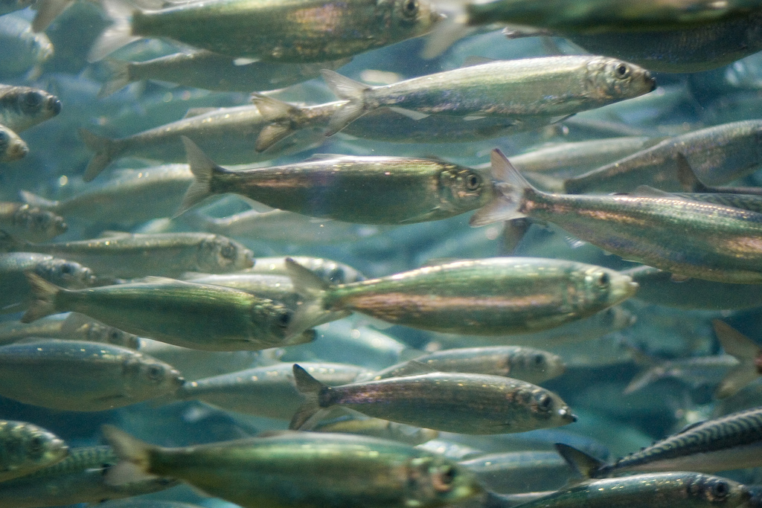
IBTSWG Meeting
Natoya Jourdain
Galway, March 19-23, 2018

Slide 2
Questions
Vessels are free to choose trawling positions in the statistical rectangle but check for “clear” tow. Is this still being done, if not when did each nation stopped, and what has each nation been doing?
Locations are randomly selected in advance from trawlable positions made from 2000-2017 (IBTS Q1 sampling procedure document has this information). When has this started, and have all nations been involved in this from its start, if no when has this been adopted by each nation?
Sampling of otoliths:
ICES suggested the sampling procedure in the following Table 7 (on the next slide) per ROUND FISH AREA
to 0.1cm below for shellfish,
to 0.5cm below for herring and sprat and
to 1cm below for all other species
Norway has been sampling 1 otolith per length class per TRAWL HAUL when Jennifer Devine took over IBTS Norway. What year was this (2013)? Have the other countries been sampling this way too, if so from when?
ICES suggested that from 2018 samples of otoliths per length class should be take from all TRAWL HAULS and not ROUND FISH AREAS, special instructions for Whiting and Norway pout (see Table 7, next slide) . Have all countries adopted the changes, if not what has been done by each nation?

Slide 3
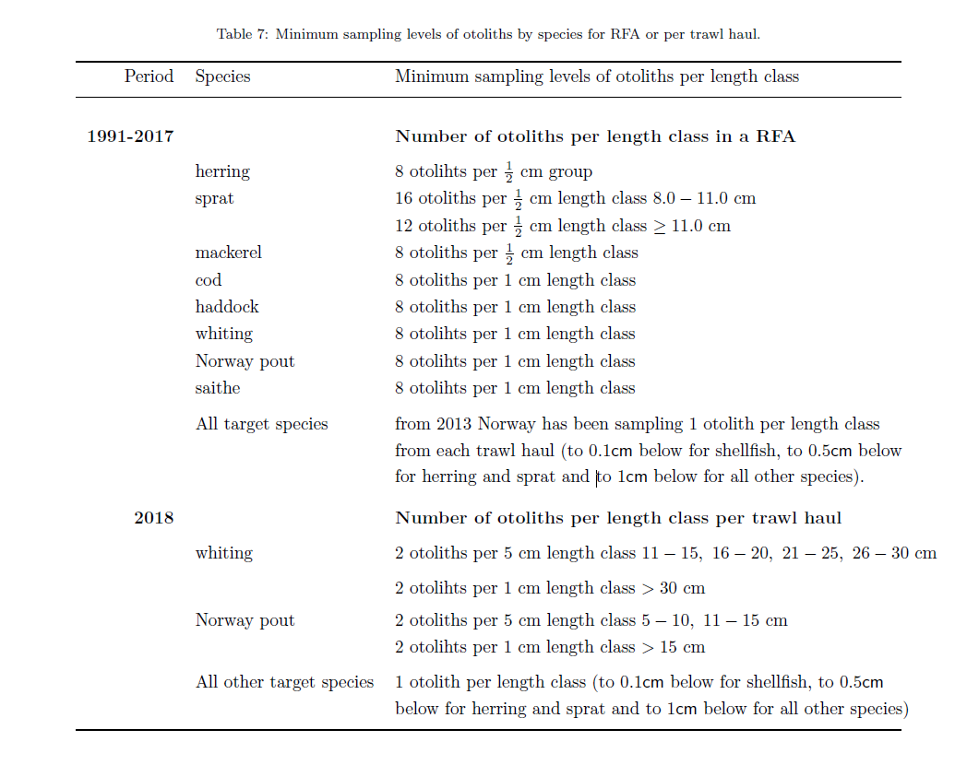
Questions

Slide 4
Questions
Are the primary sampling units SWEPT-AREA trawl hauls?
ICES suggested more than two trawl hauls be taken in the following areas in the Eastern English Channel, Southern North Sea and Central North Sea. Why is this the case, and is this sampling strategy still being adopted by the nations who typically fish in these areas?
at least 3 hauls per rectangle are taken in statistical rectangles 31F1, 31F2, 32F1, 33F4, 34F2, 34F3, 34F4, 35F3, 35F4;
while six or more hauls per rectangle are taken in statistical rectangles 30F1, 32F2, 32F3, 33F2, 33F3 (ICES 1999)
There are some guidelines in ICES documentation regarding door spread and headline height (See Figure 5 on next slide). Are all countries applying these guidelines, if not what guidelines are adopted by each nation?
ICES suggested that in some rectangles weights based on its surface area must be attached (see Table with weights) and CPUE estimates for herring, sprat and saithe must be adjusted by these weights. Why is this not applied to all fish species caught in these areas?

Slide 5
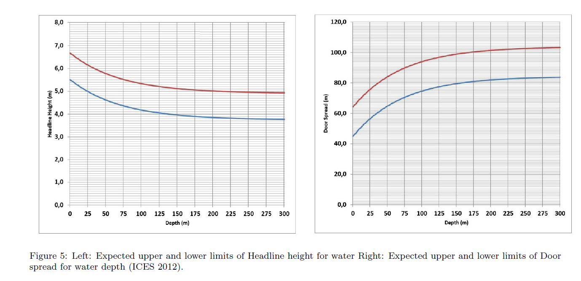
Questions

Slide 6
Questions

Slide 7
Questions
The standard gear is the GOV with either of two gears
Ground gear “A” for smooth bottom
Ground gear “B” for rough bottom
With an ``Exocet" kite and five floats attached to this kite
Does each nation uses a combination of these gears during surveys or a single gear (which)?

