Slide 1

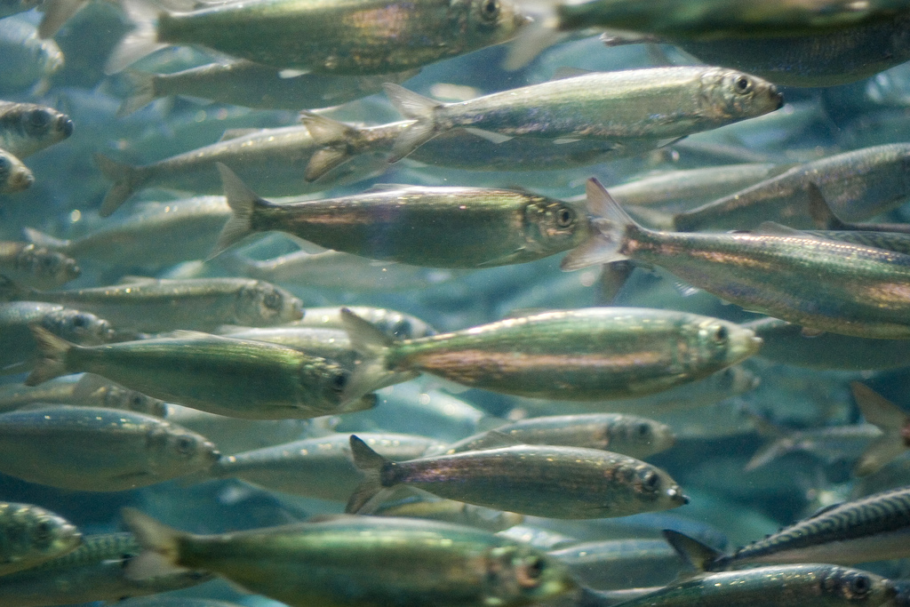
Uncertainty Estimation of the North Sea IBTS Abundance Indices
Natoya Jourdain - IMR, Norway
WGIBTS Oranmore Ireland, March 20, 2018
Collaboration with Norwegian Computing Centre (NR)
Olav Breivik, Edvin Fuglebakk, Jon Helge Vølstad, Sondre Aanes and David Hirst

Slide 2
Aims and Objectives
Main AIM of IBTS:
Provide information on seasonal distribution of stocks, and the environment
Use this information to monitor changes in fish stocks and abundance of all species
Provide point estimates of catch in numbers at age
Issues:
Points estimates are provided without estimates of uncertainty
Assumes age-length (ALK) compositions are the same over relatively large areas
Our Aim:
Provide uncertainty estimates of abundance indices
Develop an ALK that accounts for variation in age-length compositions
We propose a strong case for variation in ALK

Slide 3
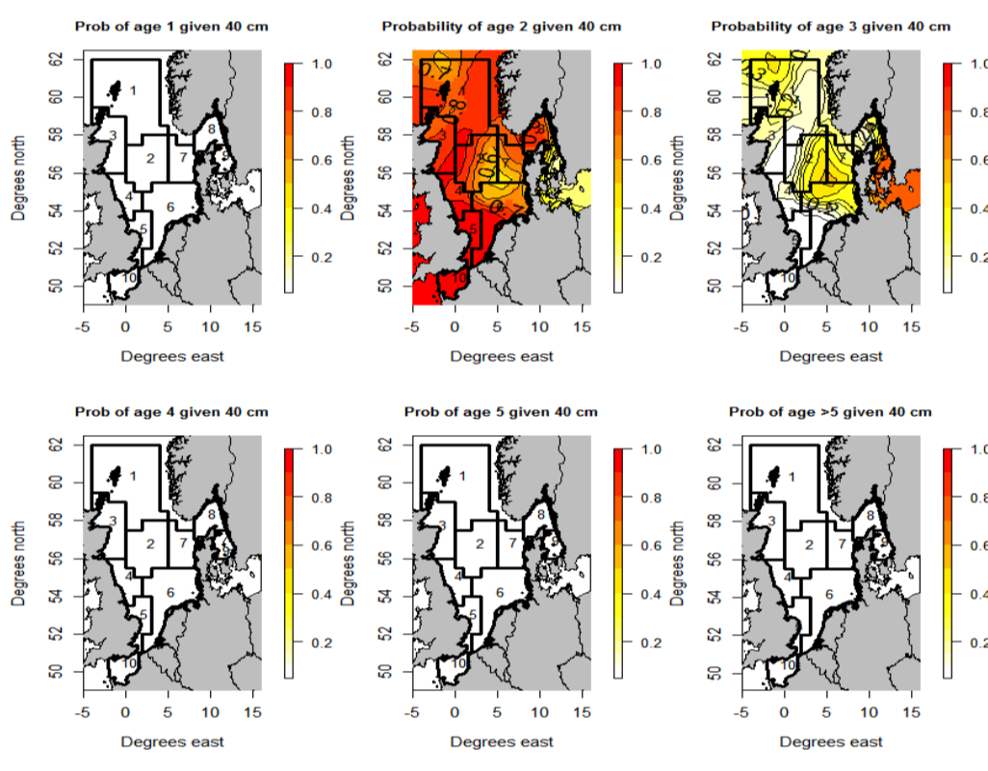
Aims and Objectives
Age distribution for age 2 cod of length 40cm clearly varies within Central North Sea and Northern North Sea

Slide 4
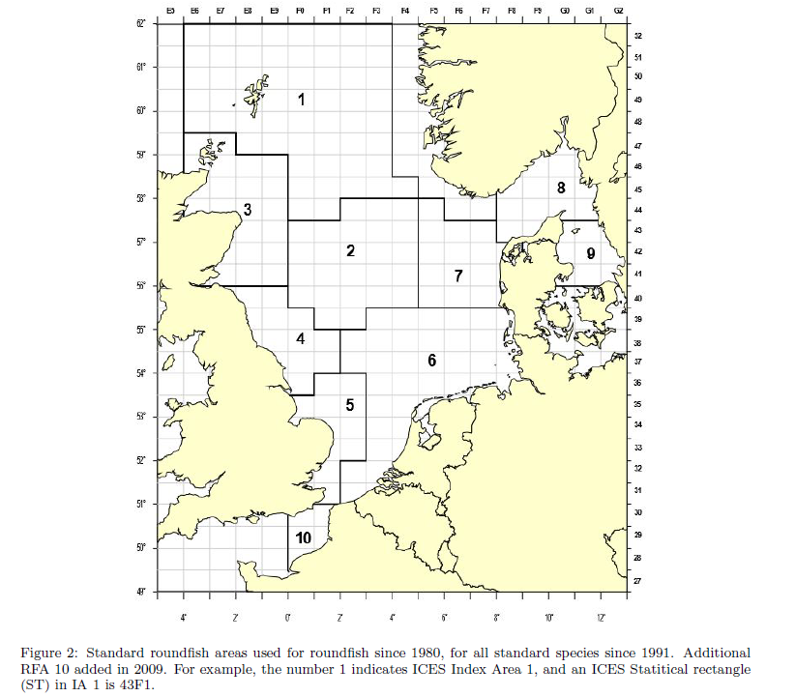
Sampling frame
Defined by ICES round fish areas (RFA) numbered 1 to 10
RFAs are substratified into small strata (statistical rectangles):
Research vessels were free to choose any position, clear of obstruction, in the rectangles (semi-random approach)
Presently sampling locations are “randomly” selected in advance from previously trawled positions from 2000-2017
Query regarding the sampling design for stations
What is the size in square kilometres of the RFAs?

Slide 5
Non Random Sampling
Plus side
it’s very cost- and time-effective.
It’s also easy to use
Can also be used when it’s impossible to conduct probability sampling
Down side
Cannot calculate the odds/probability of any member being selected for a sample
it’s impossible to know how well you are representing the population
Cannot calculate confidence intervals and identify bias
Parameter estimates must always be accompanied by their uncertainty

Slide 6
Non Random Sampling
Down side – case of IBTS
Fixed stations/Non random
Clustered stations to edge of rectangles (catches are most likely homogeneous)
Variation in data within rectangle would not be captured
Hauls close to each – at least 10 nautical miles a part may not be satisfied

Slide 7
Random Sampling
Plus side
Probability sampling
Every element in our population has a nonzero probability of being selected as part of the sample.
We have accurate knowledge of this probability
We would have accurate knowledge of this probability
Generalization /all of inferential statistics depends on probability models
Unbiased results about the population from studying the sample

Slide 8
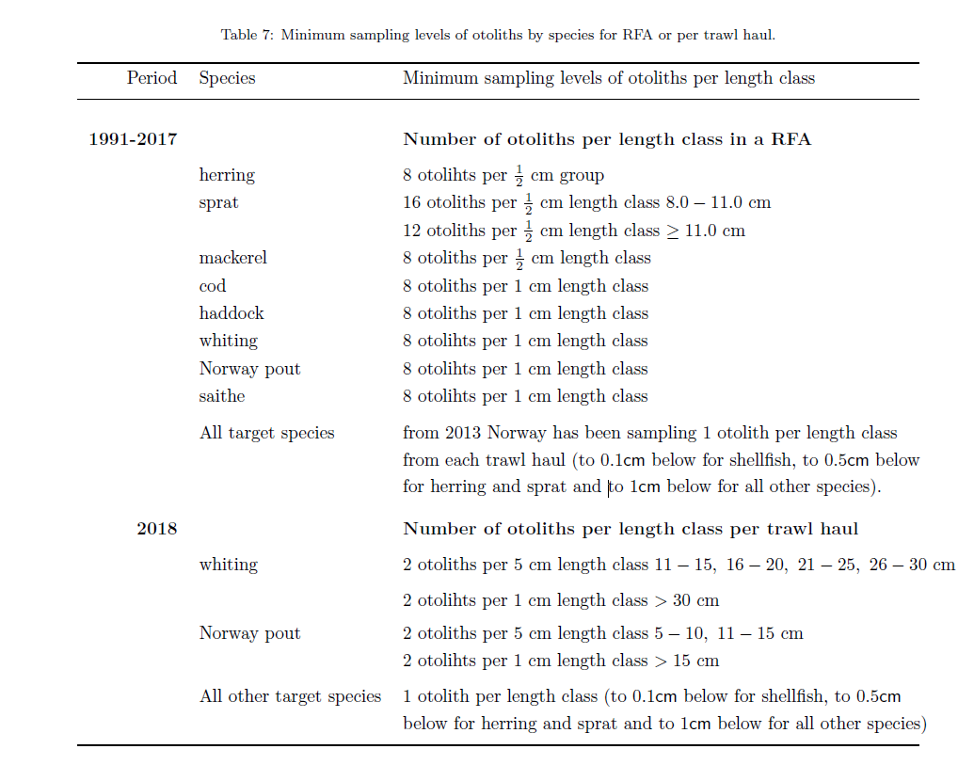
Sampling frame
Length data are collected for all fish species
to 0.1cm below for shellfish,
to 0.5cm below for herring and sprat and
to 1cm below for all other species
Otoliths were and are sampled according to the Table
Query about current otolith samples taken by each nation
By RFA? Issues such non-representative sampling
By Haul?
For consideration – 1 otolith per 5 cm?

Slide 9
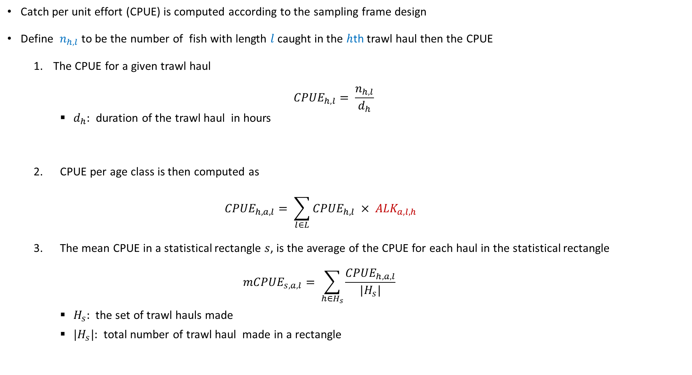
Methods
Catch per unit effort (CPUE) is computed according to the sampling frame design
Define $n_{h,l}$ to be the number of fish with length $l$ caught in the $h$th trawl haul then the CPUE
The CPUE for a given trawl haul
$${CPUE}_{h,l}= \frac{n_{h,l}}{d_{h}}$$
$d_{h}:$ duration of the trawl haul in hours
2. CPUE per age class is then computed as
$${CPUE}_{h,a, l}= \sum_{l∈L}{{CPUE}_{h,l}} × {ALK}_{a,l,h}$$
3. The mean CPUE in a statistical rectangle $s$, is the average of the CPUE for each haul in the statistical rectangle
$${mCPUE}_{s,a,l}= \sum_{h∈H_{s}}{\frac{{CPUE}_{h,a,l}}{|H_{s}|}}$$
$H_{s}:$ the set of trawl hauls made
${|H}_{s}|:$ total number of trawl haul made in a rectangle

Slide 10
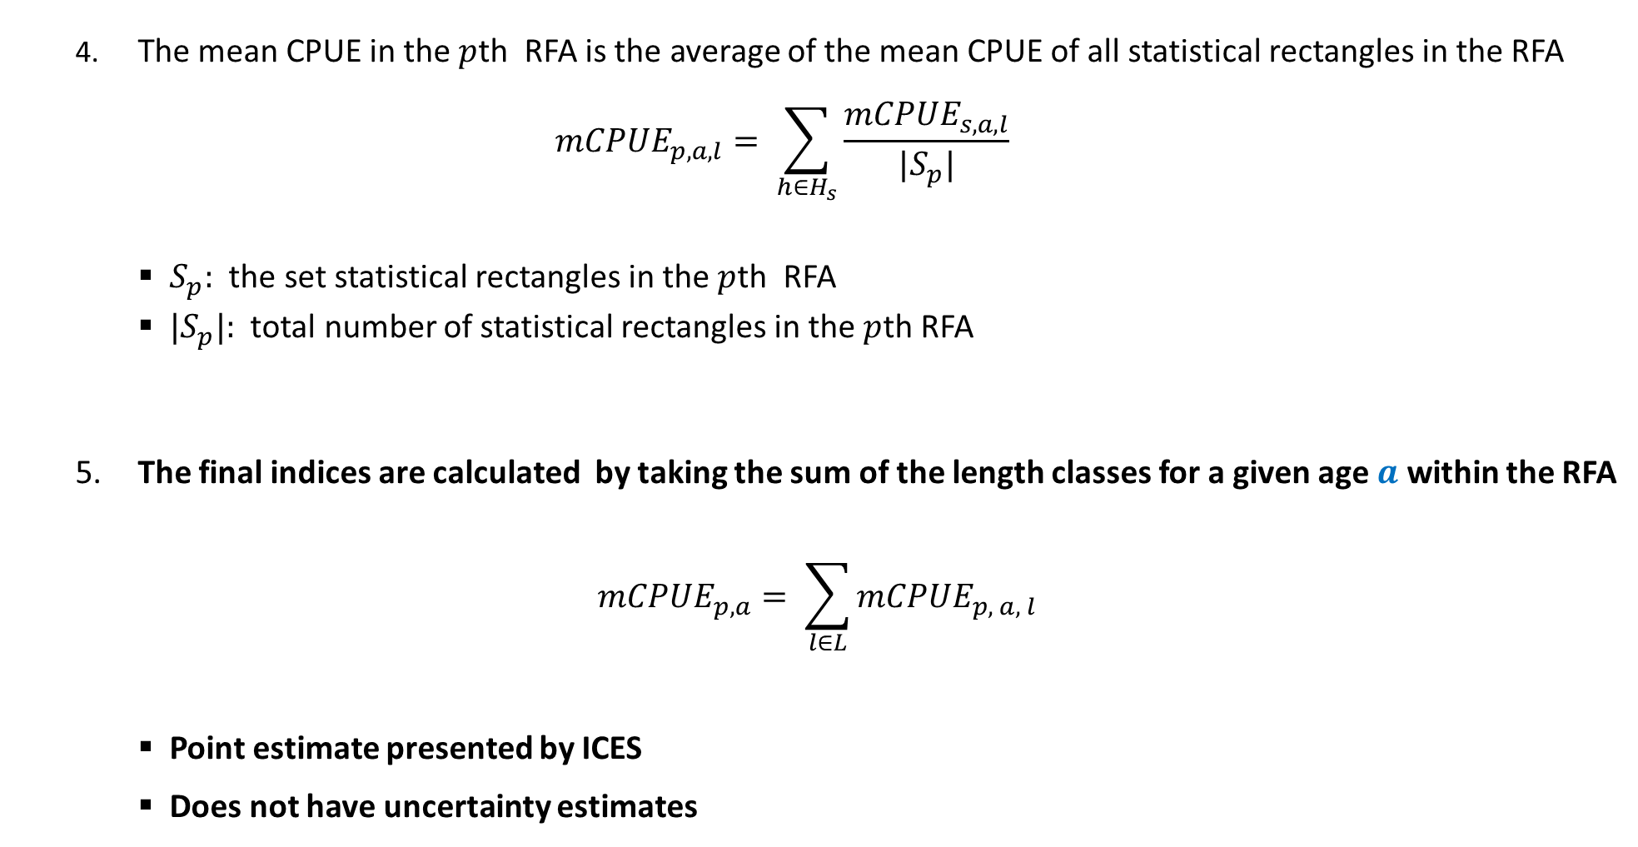
Methods
4. The mean CPUE in the $p$th RFA is the average of the mean CPUE of all statistical rectangles in the RFA
$${mCPUE}_{p,a, l}= \sum_{h∈H_{s}}{\frac{{mCPUE}_{s,a,l}}{|S_{p}|}}$$
$S_{p}:$ the set statistical rectangles in the $p$th RFA
${|S}_{p}|:$ total number of statistical rectangles in the $p$th RFA
5. The final indices are calculated by taking the sum of the length classes for a given age $a$ within the RFA
$$m{CPUE}_{p,a}= \sum_{l∈L}{{mCPUE}_{p, a, l}}$$
Point estimate presented by ICES
Does not have uncertainty estimates

Slide 11
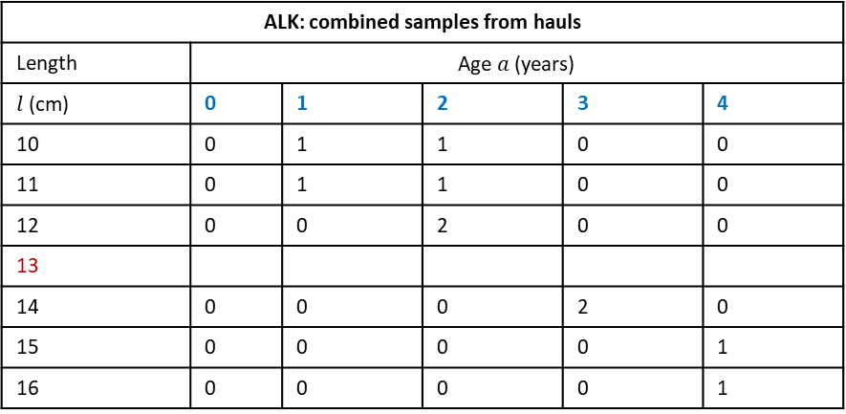
DATRAS ALK Estimator
This is an aggregation of individual samples from a haul combined over a RFA
Assumes age-length compositions are homogeneous within a RFA. This is not case as seen in age distribution Plot (2 – 40cm)
Violations of assumption will give bias results (Kimura, 1977)
+ =
Missing ALKs are imputed by extrapolation: taking averages and borrowing closest length group age-length composition
A single ALK for a RFA
Does not account for spatial variation in the data and as a consequence would result in
biased estimates, and
an underestimation of uncertainty
Haul ID: 11101
Length class (cm) | Age (years)
10 | 1
11 | 2
12 | 2
13
14 | 3
15 | 4
16
Haul ID: 56801
Length class (cm) | Age (years)
10 | 2
11 | 1
12 | 2
13
14 | 3
15
16 | 4
ALK: combined samples from hauls
Length | Age $a$ (years)
$l$(cm) | 0 | 1 | 2 | 3 | 4
10 | 0 | 1 | 1 | 0 | 0
11 | 0 | 1 | 1 | 0 | 0
12 | 0 | 0 | 2 | 0 | 0
13
14 | 0 | 0 | 0 | 2 | 0
15 | 0 | 0 | 0 | 0 | 1
16 | 0 | 0 | 0 | 0 | 1

Slide 12
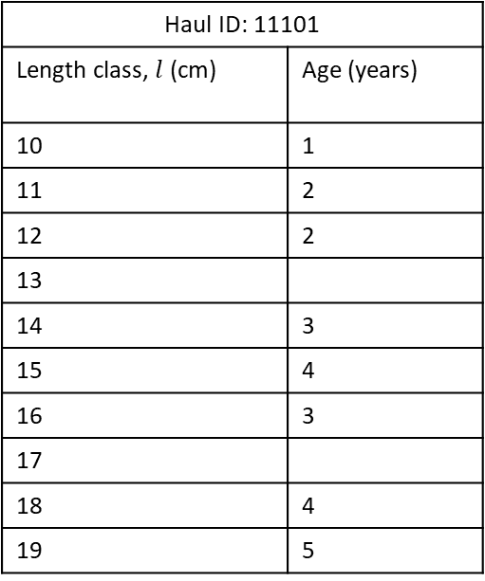

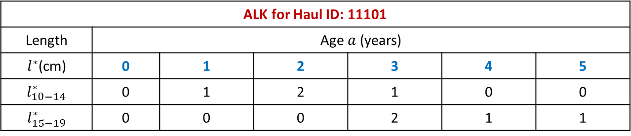
Haul-based ALK Estimator
Each trawl haul has an ALK
Few observed length classes in a single haul so
Length classes are pooled, $l^{∗}.$ First pooled length group consists of the five smallest length classes and so on
Search closest neighbour trawls in “air distance” for age-length compositions in the same pooled length group, if there are none
Fill in missing values using DATRAS approach
Accounts for the stratified sampling design and variation in age-length structures between trawl haul locations
Haul ID: 11101
Length class, $l$ (cm) | Age (years)
10 | 1
11 | 2
12 | 2
13
14 | 3
15 | 4
16 | 3
17
18 | 4
19 | 5
ALK for Haul ID: 11101
Length | Age $a$ (years)
$l^{∗}$(cm) | 0 | 1 | 2 | 3 | 4 | 5
$$l_{10−14}^{∗}$$ | 0 | 1 | 2 | 1 | 0 | 0
$$l_{15−19}^{∗}$$ | 0 | 0 | 0 | 2 | 1 | 1

Slide 13
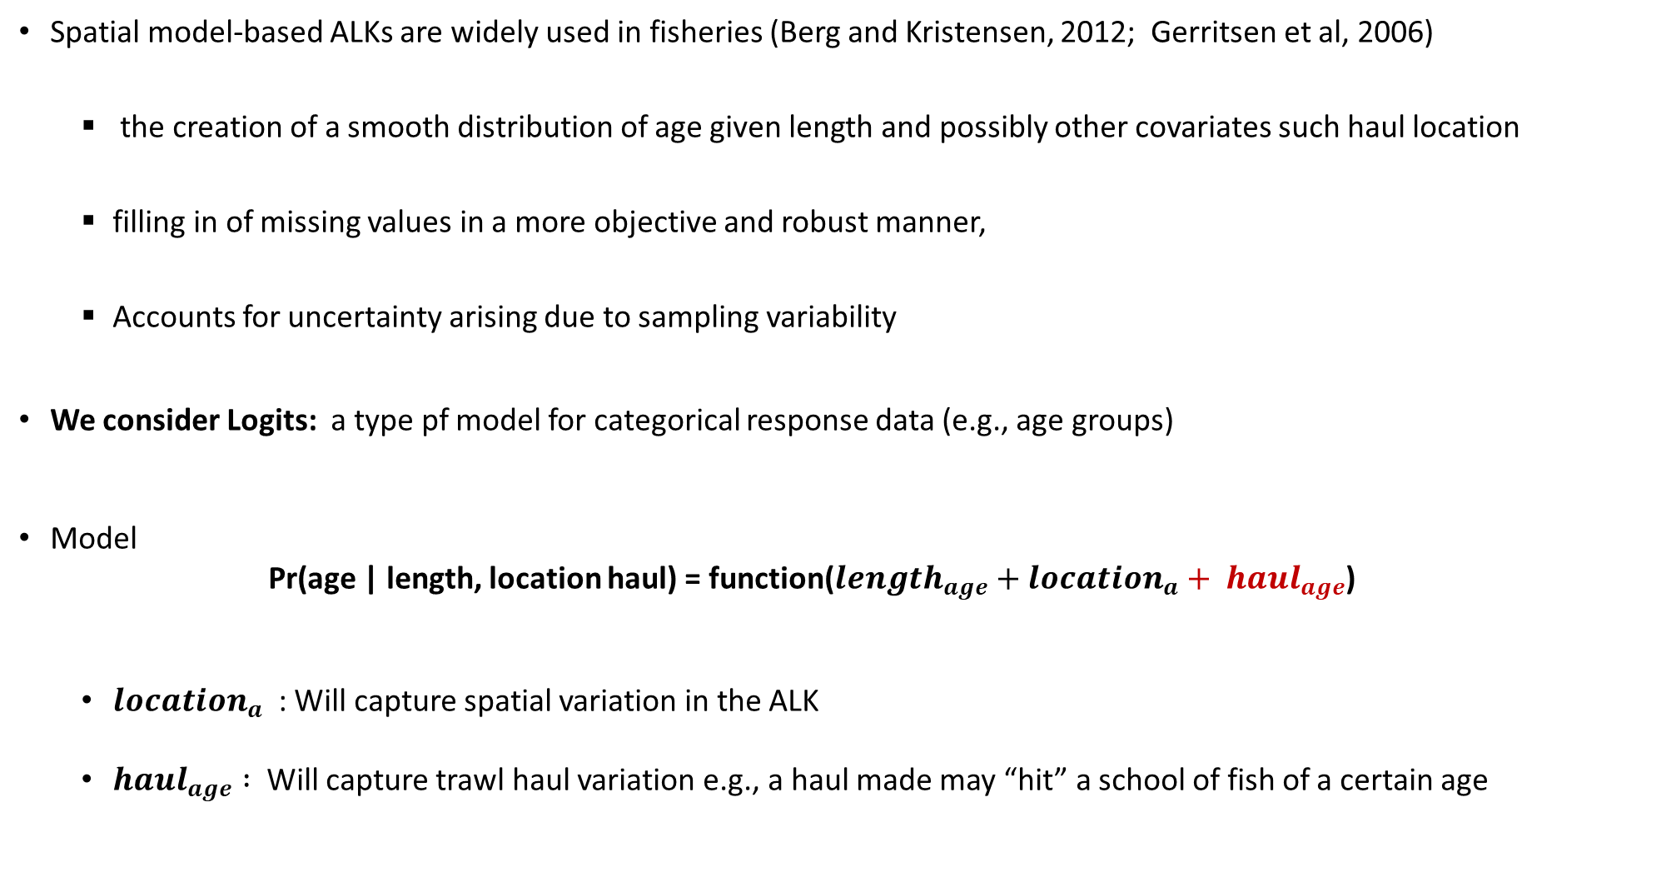
Model-based ALK Estimator
Spatial model-based ALKs are widely used in fisheries (Berg and Kristensen, 2012; Gerritsen et al, 2006)
the creation of a smooth distribution of age given length and possibly other covariates such haul location
filling in of missing values in a more objective and robust manner,
Accounts for uncertainty arising due to sampling variability
We consider Logits: a type pf model for categorical response data (e.g., age groups)
Model
Pr(age | length, location haul) = function(${length}_{age}+{location}_{a}+ {haul}_{age}$)
${location}_{a}$ : Will capture spatial variation in the ALK
${haul}_{age} :$ Will capture trawl haul variation e.g., a haul made may “hit” a school of fish of a certain age

Slide 14

Uncertainty Estimation
DATRAS bootstrap procedure
Given 4 rectangles in a RFA with trawl hauls
Pool all hauls together: $\left\{a, b, c, d, e, f, g, h, i, j\right\}$
Sample hauls from this pool with replacement, put them back into the sampling area: Does not preserve trawl haul positions
Given age information in a length class in the RFA:
$${Age}_{length 10 cm}= \left\{1, 1, 2, 1, 2, 1,2\right\}$$
Sample with replacement of these observations
${∗Age}_{length 10 cm}= \left\{1, 2, 2, 2, 2, 2,2\right\}$

Slide 15
Uncertainty Estimation
Stratified bootstrap procedure
Given 4 rectangles in a RFA with trawl hauls
Sample hauls with replacement, put them back into the sampling area
If there is only one trawl haul in the rectangle sample either that or one closest in “air distance”, that is
This preserves the both the trawl hauls within each rectangle and the age observations within each length class
Sample age observation as DATRAS suggested (on previous slide)

Slide 16
Uncertainty Estimation
Haul-based bootstrap procedure
After pooling length classes in trawl hauls and filling in missing age-length compositions
Sample with replacement as the Stratified bootstrap approach
This preserves the positions of trawl hauls in statistical rectangles
Provides an ALK for each trawl haul

Slide 17
Uncertainty Estimation
4. Model-based bootstrap procedure
Sample with replacement as the Haul-based bootstrap approach/Stratified approach
Uncertainty in the ALK is taken into account:
by the model (Logit)
Variance-covariance matrix is extracted from the estimated model in TMB.
This preserves the positions of trawl hauls in statistical rectangles
Provides an ALK for each trawl haul

Slide 18
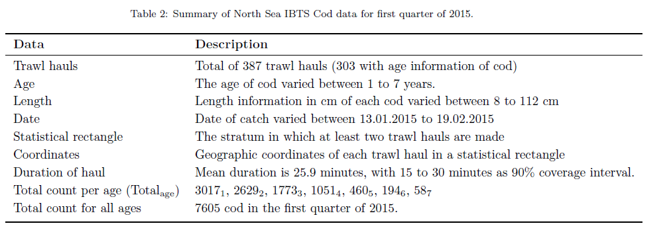
The North Sea Cod Data
Brief description of cod data in Q1 of 2015

Slide 19
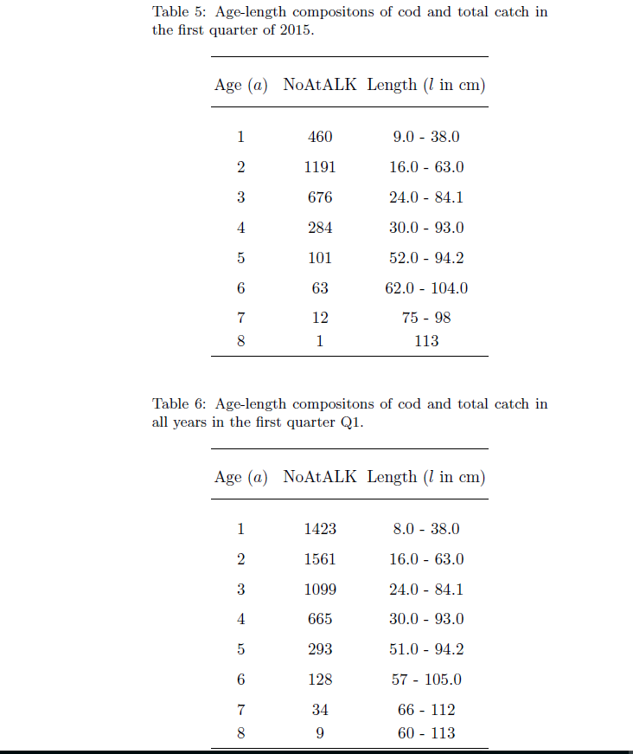
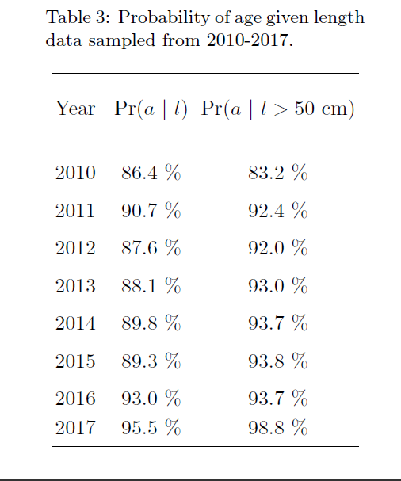
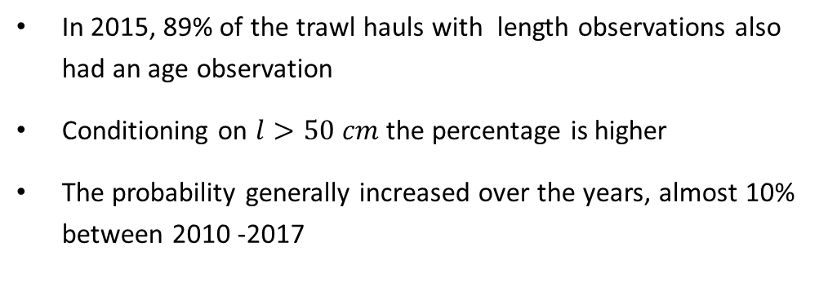
The North Sea Cod Data
Lower catch rates for larger age-length groups
Higher catch rates for smaller, younger fish
In 2015, 89% of the trawl hauls with length observations also had an age observation
Conditioning on $l>50 cm$ the percentage is higher
The probability generally increased over the years, almost 10% between 2010 -2017

Slide 20
The North Sea Cod Data
Lower catch rates for larger age-length groups
Higher catch rates for smaller, younger fish
In 2015, 89% of the trawl hauls with length observations also had an age observation
Conditioning on $l>50 cm$ the percentage is higher
The probability generally increased over the years, almost 10% between 2010 -2017

Slide 21
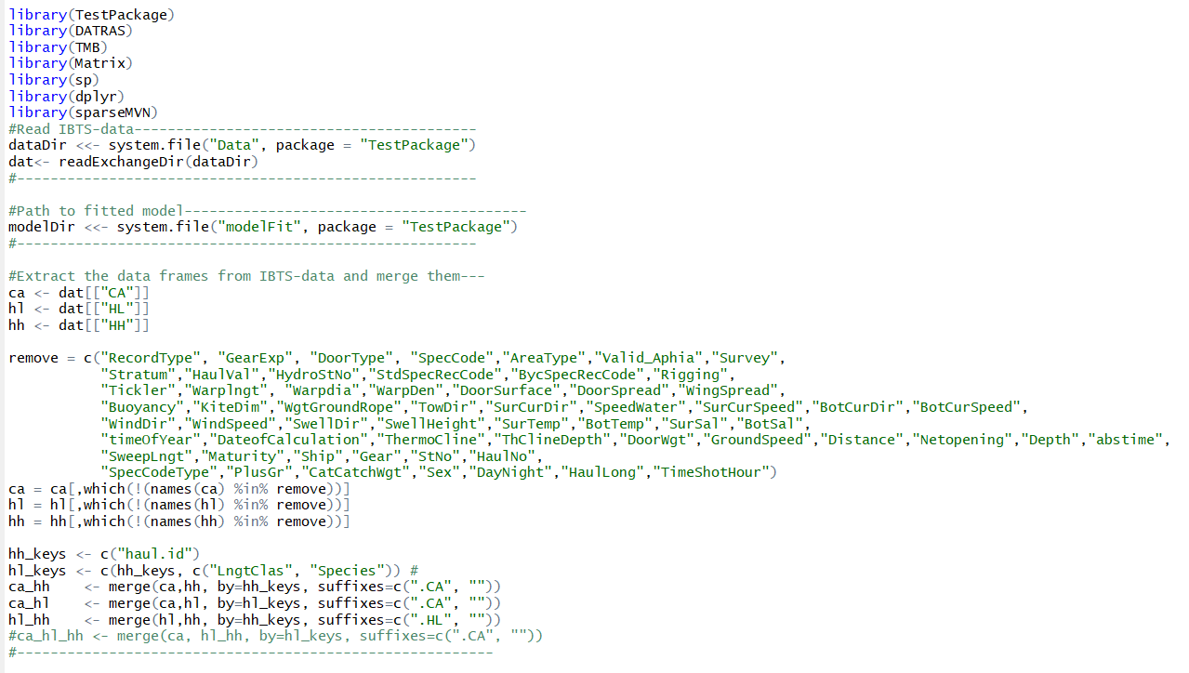
Reading DATRAS Data in R: DATRAS Suggestion Estimates are computed using the ca_hh data hl_hh dataframe

Slide 22
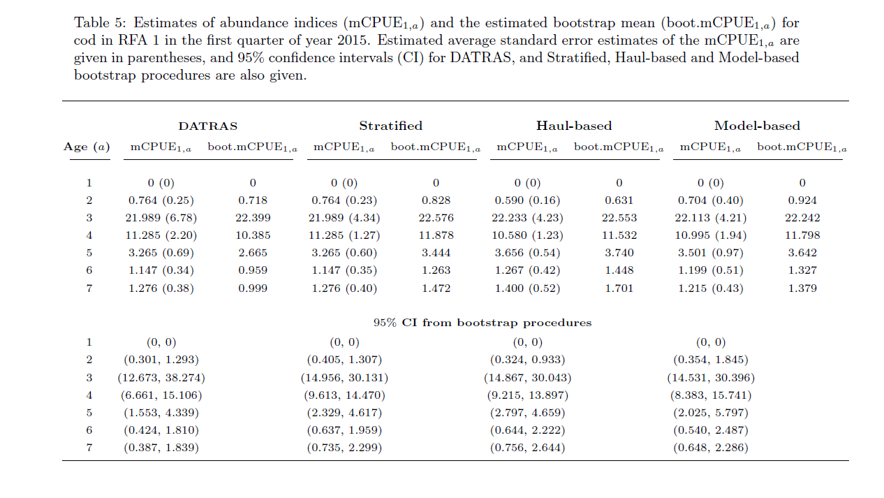
Results
Model-based ALK generally performs better in terms of uncertainty estimation. Accounts for Spatial differences in age-length structures
DATRAS procedure generally gave smaller estimates of uncertainty as it lacks the potential to account for spatial variation in the data
Estimated CPUE at age is captured within a 95% CI for all methods

Slide 23
Future work
Include trawl haul in the model-based ALK estimator
Derive an abundance-at-age estimator for the whole North Sea, and its variance estimator
Compare ALK estimators
Use ALK estimators in an assessment model, e.g. SAM or XSAM
Optimize sampling effort: removal of trawl hauls and otoliths to determine if there is any effect on the variance
As a means of justifying sampling effort e.g., number of days at sea and number of stations sampled and number of samples taken
Consider Hierarchical bootstrapping approach
Fully model-based approach for estimating abundance at age

