Slide 1

Uncertainty Estimation of the North Sea IBTS Abundance Indices
Natoya Jourdain
NSSKWG, April 27, 2018
Collaboration with Norwegian Computing Centre (NR)
Olav Breivik, Edvin Fuglebakk, Jon Helge Vølstad, Sondre Aanes and David Hirst

Slide 2
Overview
North sea IBTS:
Important data source for many stock assessments in the North sea
Sampling intensity of otoliths is quite high and the sampling procedure is ad hoc in some round fish areas
Our Aim:
Provide uncertainty estimates of abundance indices (input data level), not provided on DATRAS website
Develop ALK estimators that account for variation in age-length compositions
Optimizing survey designs with respect to stratification and subsampling for length and age
Uncertainty estimation forms the basis of evaluation of otolith sampling, i.e.,
Optimize sampling effort – otoliths and number of stations

Slide 3
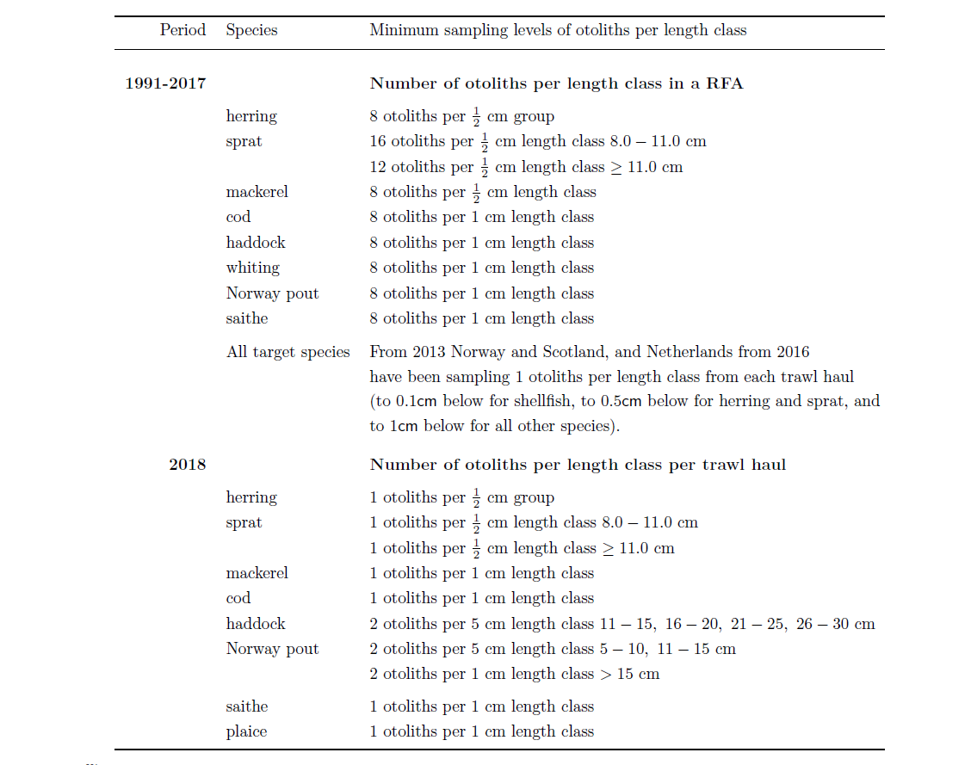
Otolith sampling by species

Slide 4
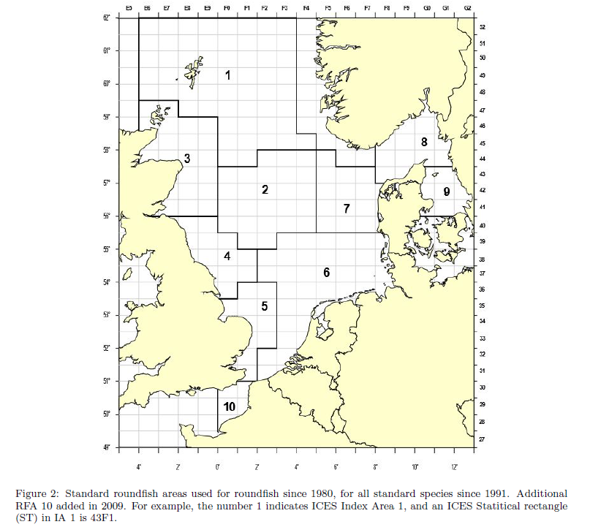
Actual survey design
Resampling of valid tows executed between 2000-2017
1 Depth stratified, semi-randomly
2 Proportion semi-randomized (From database of national safe tows or DATRAS or commercial fishing data)
3 Proportion opportunistic station selection (From database of national safe tows or DATRAS and from commercial data)
4 Fixed Stations
5 Proportion semi-randomized (new positions)
Expected survey design
Random sampling of trawl locations in statistical rectangle
Tows must be at least 10 nautical miles apart
Nation | Q1 | Q3
Denmark | 2, 3 | 2, 3
England | NA | 4
France | 2, 3 | NA
Germany | 2, 3 | 2, 3
Netherlands | 2, 3, 5 | NA
Norway | 2, 3 | 2, 3
Scotland | 2, 3, 5 | 2, 3, 5
Sweden | 4 | 1

Slide 5
Issues with non random design
It is impossible to know how well you are representing the population
Cannot calculate the probability of any member being selected for a sample
Clustered stations at edge of rectangles (catches are most likely homogeneous)
Variation in data within rectangle would not be captured
Difficult to calculate confidence intervals and identify bias but can be done based on assumptions
Design-based: randomization is assumed
Model-based: assumption of independent and identically distributed random variables are made
Parameter estimates must always be accompanied by their uncertainty
Stock assessment models cannot fixed uncertainty issues in assessment - issues must be addressed at the design level (IBTS)
Uncertainty comes from the design

Slide 6
Issues with non random design
It is impossible to know how well you are representing the population
Cannot calculate the probability of any member being selected for a sample
Clustered stations at edge of rectangles (catches are most likely homogeneous)
Variation in data within rectangle would not be captured
Difficult to calculate confidence intervals and identify bias
Parameter estimates must always be accompanied by their uncertainty
The uncertainty associated with survey estimates is an important element in the evaluation of population estimates
Stock assessment models cannot fixed uncertainty issues in assessment - issues must be addressed at the design level (IBTS)
Uncertainty comes from the design

Slide 7
ALK Estimators
Current ALK Estimators:
DATRAS ALK
Assumes age-length (ALK) compositions are the same over relatively large areas. If violated we would have
Biased estimates (Kimura 1977)
Underestimation of uncertainty
An aggregation of individual samples from a haul over a RFA
A single ALK is produced for a relatively large area (round fish area)
Imputation of missing samples is done by borrowing and interpolation/extrapolation
Berg et al., (2012) – spatial age-length key modelling (using GAMs)
Accounts for spatial variation in age-length structures between regions

Slide 8
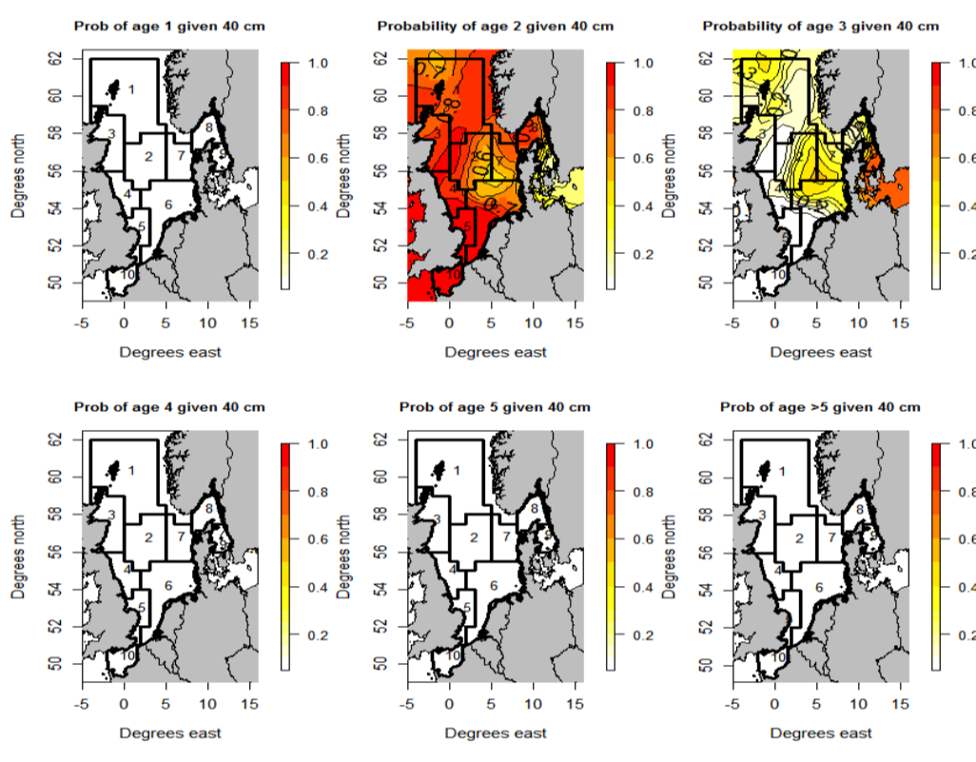
Distribution of cod of length 40cm clearly varies within Central North Sea and Northern North Sea (see 2 year of length 40 cm)

Slide 9
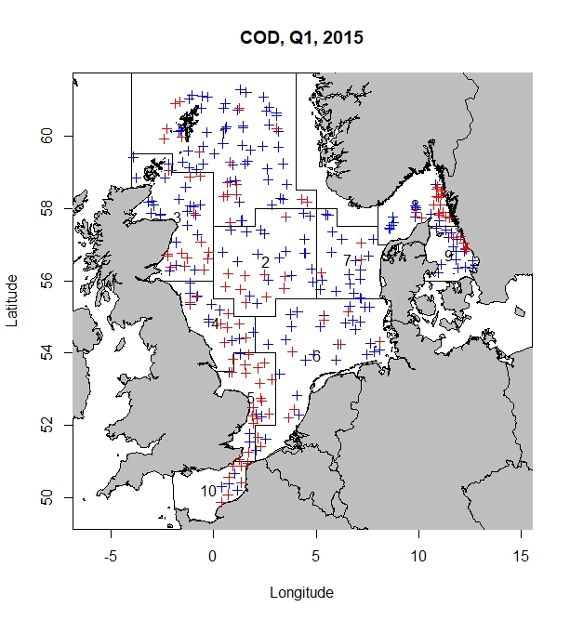
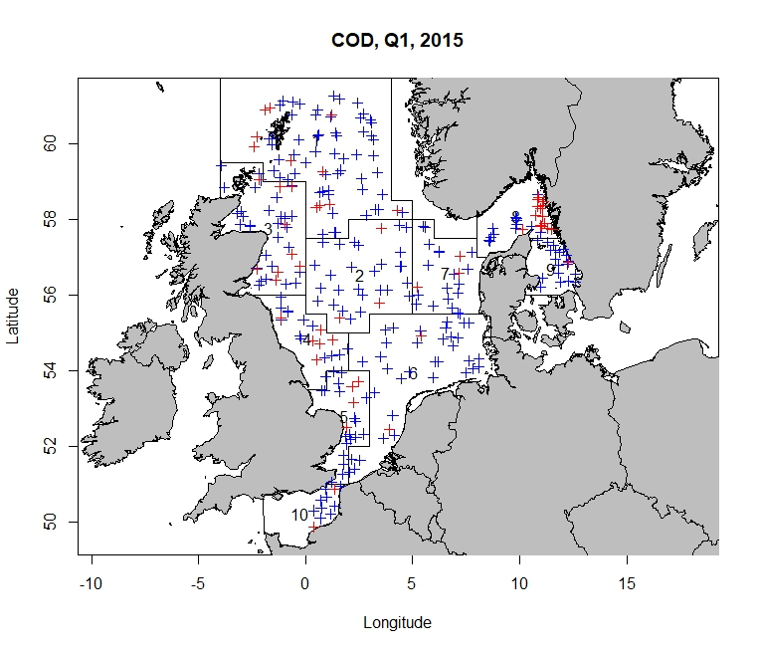
Our ALK Estimators:
Haul-based ALK (COD)
Each trawl haul has an ALK
We pooled length groups of 5 cm (first 5 length groups and so on) to reduce missing data
Red: hauls with missing age; Blue: hauls with both age and length data
length group = 1 cm length group = 5 cm

Slide 10
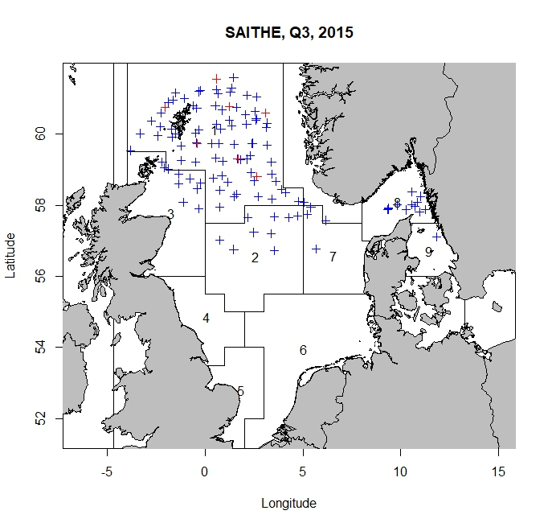
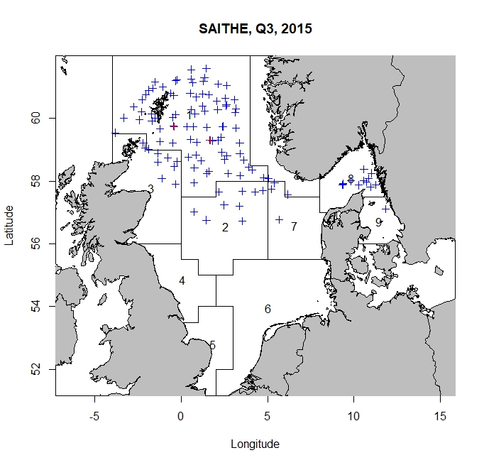
Our ALK Estimators:
Haul-based ALK (SAITHE)
Each trawl haul has an ALK
Missing age information per length class so we pooled length groups of 5 cm (first 5 length groups and so on)
If no age is in pooled length group we borrow from closest neighbour hauls (Stat rec, and RFA)
Red: hauls with missing age; Blue: hauls with both age and length data
length group = 1 cm length group = 5 cm

Slide 11
ALK Estimators
2) Our Model-based ALK
Berg et al. (2012) Model-based ALK
Uses logits for the probability of age
Uses Random Field Theory (RFT)
Recent body of mathematics defining theoretical results for smooth statistical maps
Values in a random field are usually spatially correlated in one way or another, i.e., adjacent values do not differ as much as values that are further apart
Linear predictor assumes a zero mean Gaussian spatial random field (models spatial effect)
Extended to include covariates such as haul (station) effect
capture haul variation – a haul may hit a school of fish of a certain age
Issues/ Solutions
Small number of observations implies error fields will not be smooth, hence violation of model assumption
One solution to this is sub-sampling
Alternatives – Different inference procedures
Pseudo-statistics which are much smoother than the corresponding t-statistics
False Discovery Rate (FDR)
Bayesian Inference
Used continuation ratio logits for the probability of age
Used GAM to model spatial effect
GAM models spatial effects as a smooth surface, predicting numbers-at-age at the haul level
Packages in gam allow automatic selection of the amount of smoothing
Can be extended to include covariates
Issues/solutions:
Overfitting - but can be reduced using cross-validation
Statistically challenging to estimate large numbers of smoothing parameters
Prediction error criteria (GCV, AIC) can undersmooth substantially – REML, which is less problematic, can be used

Slide 12
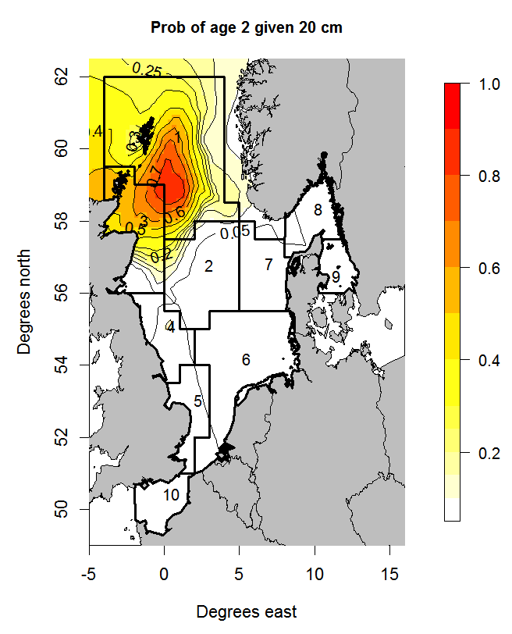
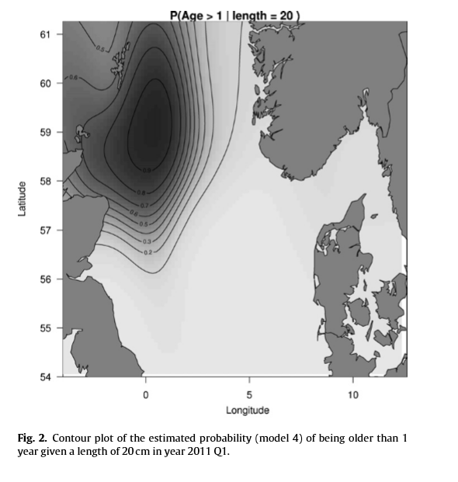
ALK Estimators
Our Model-based ALK
Berg et al. (2012) Model-based ALK
Figure shows Spatial pattern in the probability of being older than one year given 20 cm
Similar patterns at Berg et al. (2012)
A 20 cm haddock caught in this area is more likely to be 2 years
Spatial pattern in the probability of being older than one year given 20 cm
Spatial contrast in the data with a peak east of the Scottish coast
A 20 cm haddock caught in this area is more likely to be 2 years or older than 1 year old
Contour plot of the estimated probability of being 2 years given a length of 20cm in year 2011 Q1

Slide 13
RFT versus GAM
Which is the best approach?
Further analysis and model comparison are required
(Better) Fit to age data?
Improved precision?
RFT is simply an alternative approach to GAM

Slide 14
Survey Indices Estimators
DATRAS – Stratified Mean
Berg et al. (2014) Delta-GAM
Survey indices are computed by age and RFA (currently)
Proposed a separate ratio estimator for area (north sea) – to be implemented
Alternatively a combined ratio estimator can be used if deemed more appropriate
A comparison of COD estimates from Delta-GAM can then be made
Survey indices are computed by age and area (North sea) using the Delta- GAM - a more refined alternative to DATRAS
Models zeros and non-zeros separately
Corrects for effects: spatial position, possibly depth and time of day
Eliminates spatial stratification (through GAM)
Applies bootstrapping to estimate the distribution of the indices

Slide 15
Uncertainty Estimation
Berg et al. (2012)
Used bootstrapping to estimate uncertainty of abundance indices (not shown in paper)
Recommended that uncertainties due to ALK estimation be included in stock assessments either by
Integrating the ALK estimation within the stock assessment model
Estimate uncertainty on the derived indices outside of the model - can be done using bootstrapping
DATRAS bootstrap procedure (Naïve or simple nonparametric sampling)
Pool all hauls in a RFA, sample with replacement and put sampled hauls into relevant rectangles
Sample with replacement the pooled age with a given length in a RFA
Issues:
Ignores fine scale stratification at the first stage, hence overestimation of the uncertainty
Ignores age-length data collected at the haul level, hence underestimates the uncertainty
Biases in both direction
Stratified bootstrap procedure
Take a simple random sample with replacement from the original data in the given stratum (statistical rectangle); repeat independently across strata
An ALK is estimated for each haul

Slide 16
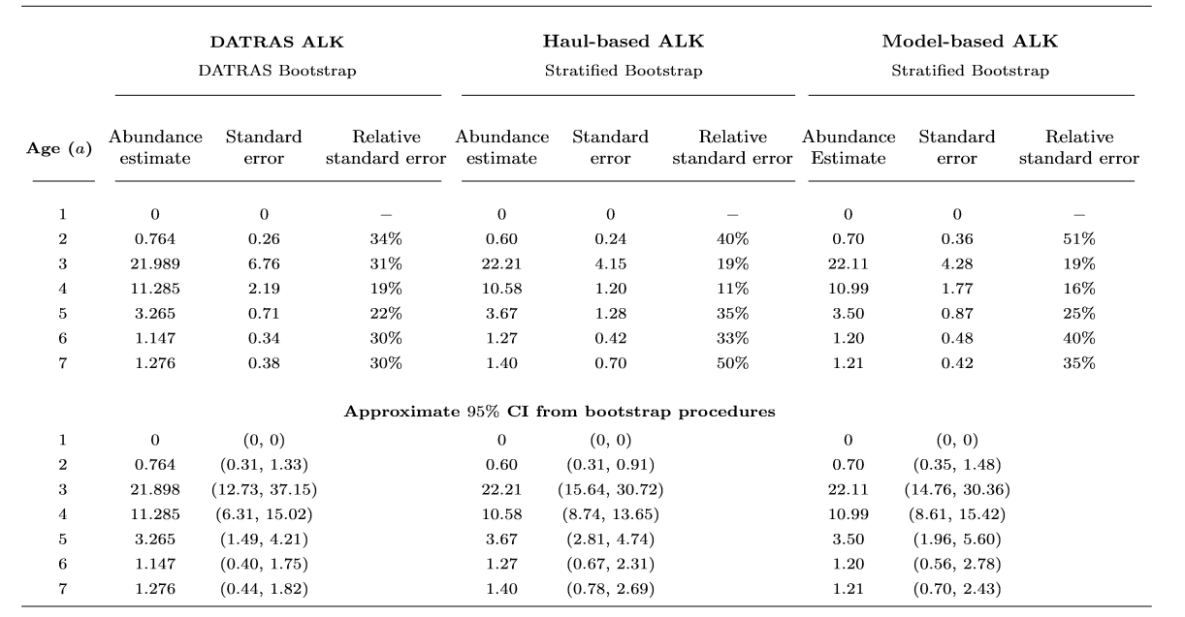
Some Results
400 bootstrap samples were drawn and average estimates and standard errors are computed
Table 3 shows estimated indices for cod and standard errors from the bootstrap procedures: DATRAS and Stratified
Relative standard errors are provided for comparison
Table 3: Indices Estimates and standard errors for Cod in Q1 of year 2015, with approximate 95% confidence intervals (CI) of the different bootstrap methods

Slide 17
Our Intentions
Optimize sampling effort
Reduce the number of otoliths sampled
Possibly reduce number of stations
Possibly look at alternative estimators for abundance indices as Berg et al. (2014) (?)
Full model-based approach
Estimates abundance indices and uncertainty
Alternative survey design (To improve the quality of survey results)?
Fully randomized survey design
Possibly conduct pilot study to determine random “safe tow” areas
New trawl to replace standard GOV (Robert Kynoch) - reduce net damage, suitable for rough bottom
Reduce number of strata (fine-grained) – minimize problems of too few or missing values
Current design does not address uncertainty issues in the data
Uncertainty issues must be addressed at input data level

Slide 18
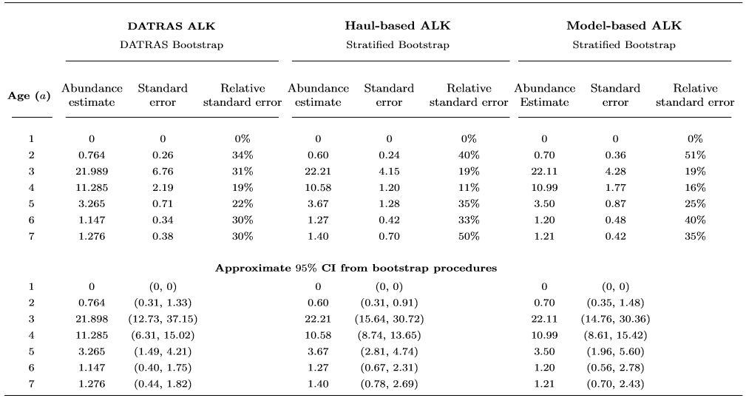
Some Results
400 bootstrap samples were drawn and average estimates and standard errors are computed
Table 3 shows estimated indices for cod and standard errors from the bootstrap procedures: DATRAS and Stratified
Relative standard errors are provided for comparison
Table 3: Indices Estimates and standard errors for Cod in Q1 of year 2015, with approximate 95% confidence intervals (CI) of the different bootstrap methods

Slide 19
Uncertainty Estimation
Berg et al. (2012)
Used bootstrapping to estimate uncertainty of abundance indices (not shown in paper)
Recommended that uncertainties due to ALK estimation be included in stock assessments either by
Integrating the ALK estimation within the stock assessment model
Estimate uncertainty on the derived indices outside of the model, and provide these uncertainties as input to stock assessment model along with the indices
This can be carried out using bootstrapping
Survey design needs to be readdressed to improve precision estimates (randomized survey design)
DATRAS bootstrap procedure
Pool all hauls in a RFA, sample with replacement and put sampled hauls into relevant rectangles
Sample with replacement the pooled age with a given length in a RFA
Issues:
Ignores fine scale stratification at the first stage, hence overestimation of the uncertainty
Ignores age-length data collected at the haul level, hence underestimates the uncertainty
This is a simple of Naïve bootstrap procedure which cannot be used for complex data structures

Slide 20
Uncertainty Estimation
Stratified bootstrap procedure
Take a simple random sample with replacement from the original data in the given stratum (statistical rectangle); repeat independently across strata
Preserves the location of the trawl hauls
ALK is calculated based on the this sample
Hierarchical – an alternative procedure (work-in-progress)

Slide 21
Uncertainty Estimation
Berg et al. (2012)
Used bootstrapping to estimate uncertainty of abundance indices (not shown in paper)
Recommended that uncertainties due to ALK estimation be included in stock assessments either by
Integrating the ALK estimation within the stock assessment model
Estimate uncertainty on the derived indices outside of the model, and provide these uncertainties as input to stock assessment model along with the indices
This can be carried out using bootstrapping
Survey design needs to be readdressed to improve precision estimates (randomized survey design)

Slide 22
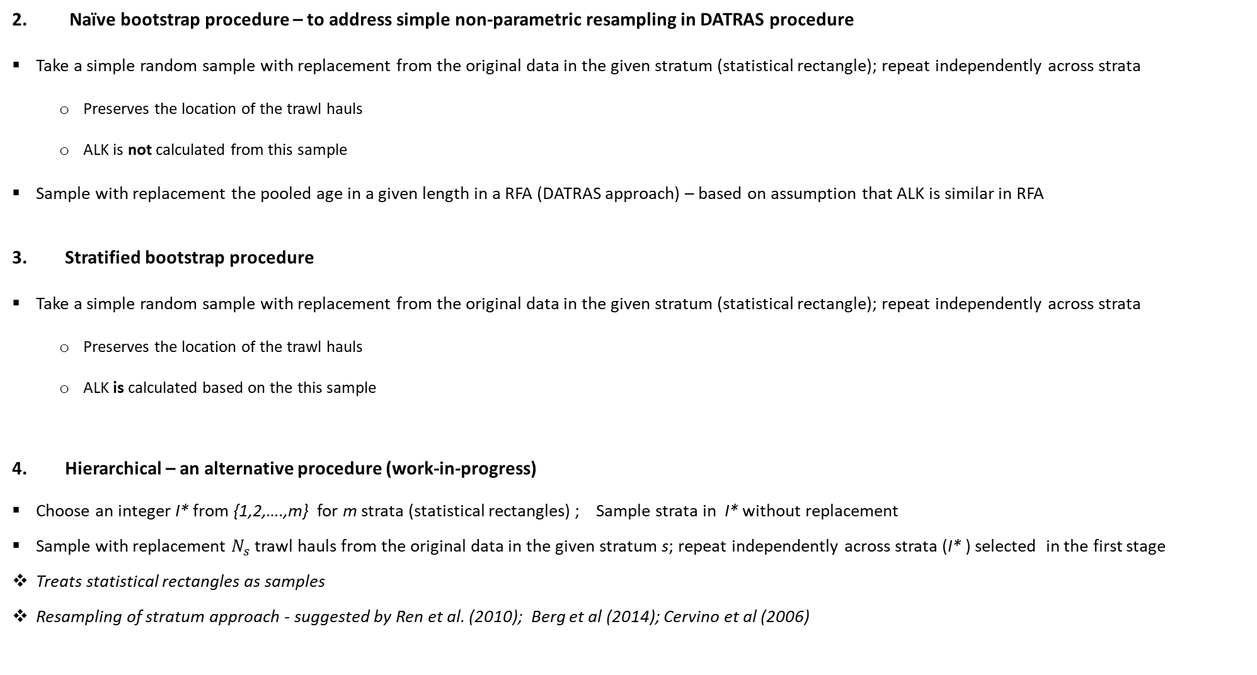
Uncertainty Estimation
Naïve bootstrap procedure – to address simple non-parametric resampling in DATRAS procedure
Take a simple random sample with replacement from the original data in the given stratum (statistical rectangle); repeat independently across strata
Preserves the location of the trawl hauls
ALK is not calculated from this sample
Sample with replacement the pooled age in a given length in a RFA (DATRAS approach) – based on assumption that ALK is similar in RFA
Stratified bootstrap procedure
Take a simple random sample with replacement from the original data in the given stratum (statistical rectangle); repeat independently across strata
Preserves the location of the trawl hauls
ALK is calculated based on the this sample
Hierarchical – an alternative procedure (work-in-progress)
Choose an integer I* from {1,2,….,m} for m strata (statistical rectangles) ; Sample strata in I* without replacement
Sample with replacement $N_{s}$ trawl hauls from the original data in the given stratum s; repeat independently across strata (I* ) selected in the first stage
Treats statistical rectangles as samples
Resampling of stratum approach - suggested by Ren et al. (2010); Berg et al (2014); Cervino et al (2006)

Slide 23
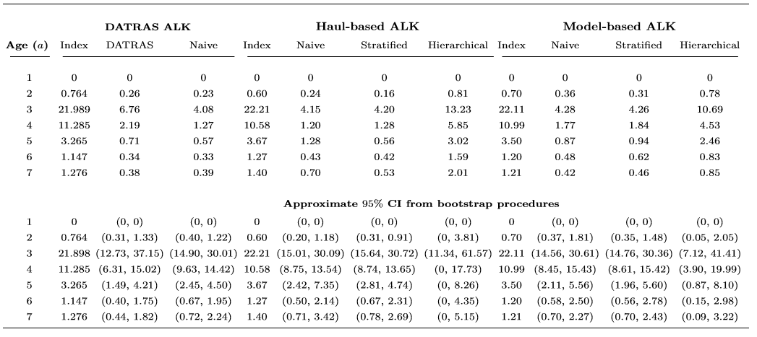
Some Results
400 bootstrap samples were drawn and average estimates and standard errors are computed
Table 3 shows estimated indices for cod and standard errors from the bootstrap procedures: DATRAS, Naïve, Stratified and Hierarchical
Design guidelines are not met, hence overestimation of variance may be a result (hierarchical, for example – though is considered the more conservative choice)
Table 3: Indices Estimates and standard errors for Cod in Q1 of year 2015, with approximate 95% confidence intervals (CI) of the different bootstrap methods

Slide 24
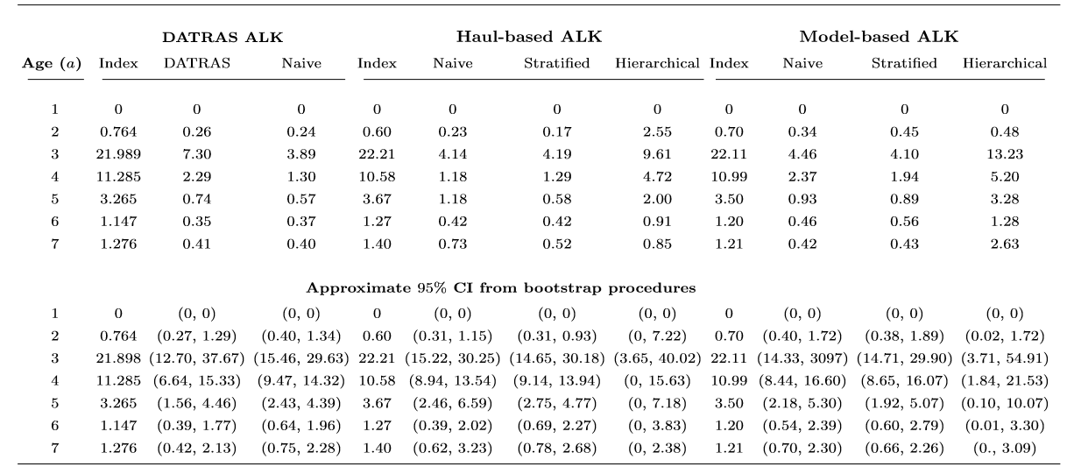
Some Results
200 bootstrap samples were drawn and average estimates and standard errors are computed
Table 3 shows estimated indices for cod and standard errors from the bootstrap procedures: DATRAS, Naïve, Stratified and Hierarchical
Design guidelines are not met, hence overestimation of variance may be a result (hierarchical for example) – though considered the more conservative choice
Table 3: Indices Estimates and standard errors for Cod in Q1 of year 2015, with approximate 95% confidence intervals (CI) of the different bootstrap methods

