Slide 1
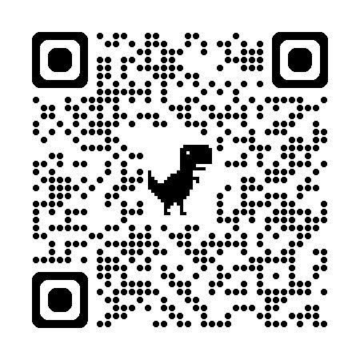
Foundations of Agentic AI
for Science & Engineering
AESCAPE 2026 · Introduction to Agentic Workflows
Nathaniel Trask
University of Pennsylvania
Sandia National Laboratories
September 8, 2026

Slide 2

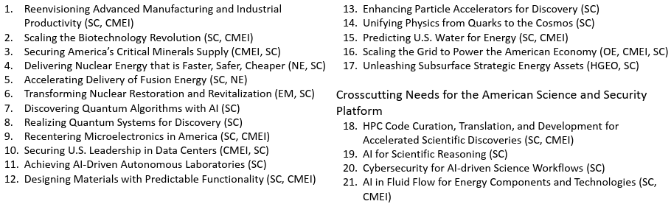
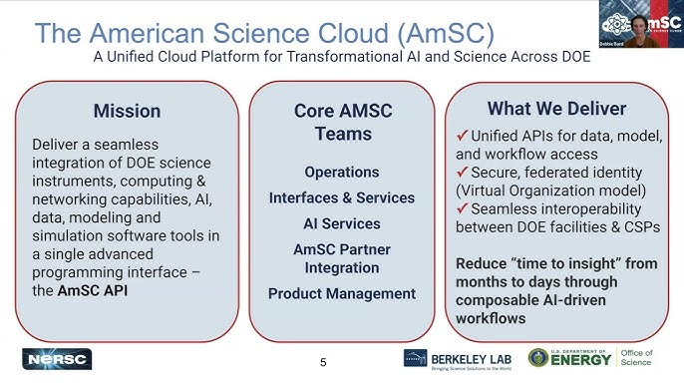
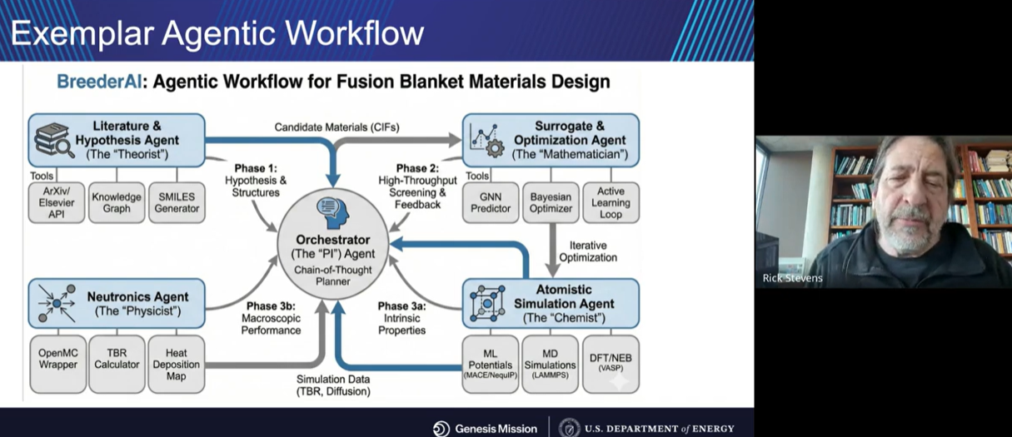
DOE’s Genesis Mission and the future of large-scale computing
Decoding the Genesis Mission – Rick Stevens

Slide 3

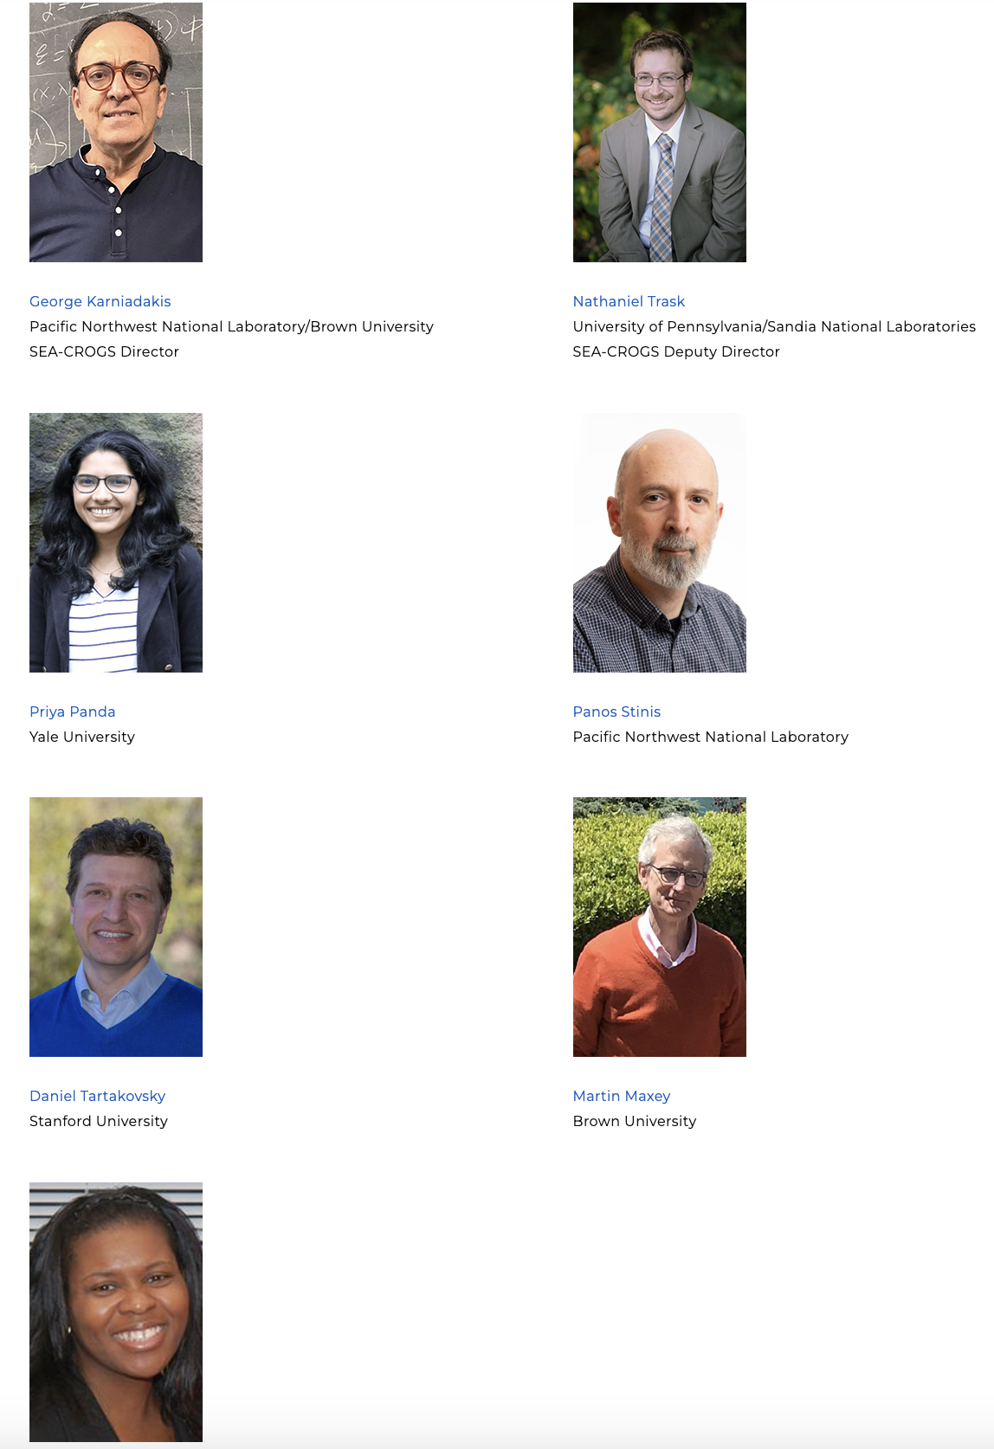
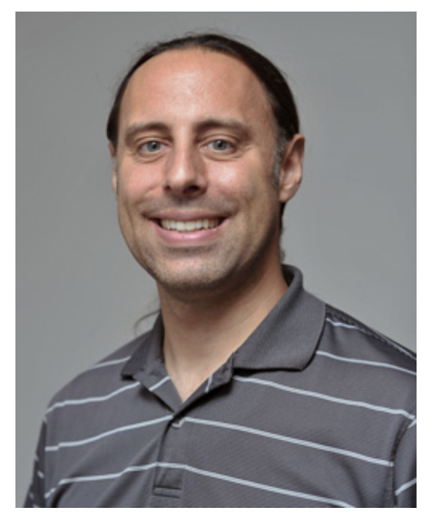
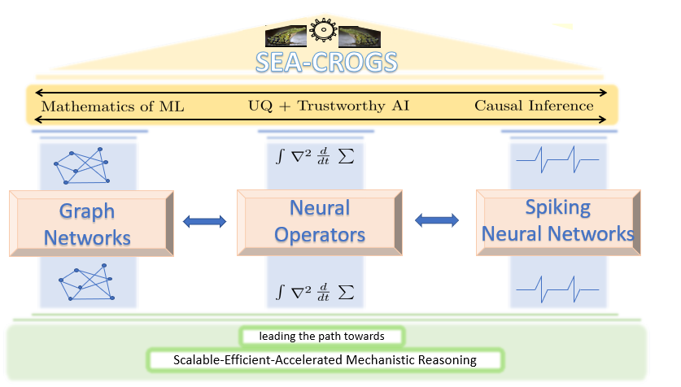



George Karniadakis
Nathaniel Trask
Brown/PNNL
SEA-CROGS Director
UPenn/SNL
SEA-CROGS Deputy Director
Eric Cyr
Martin Maxey
Panos Stinis
SNL
Brown
PNNL
Priya Panda
Daniel Tartakovsky
Mengjia Xu
USC
Stanford
NJIT
Houman Owhadi
Caltech

Slide 4
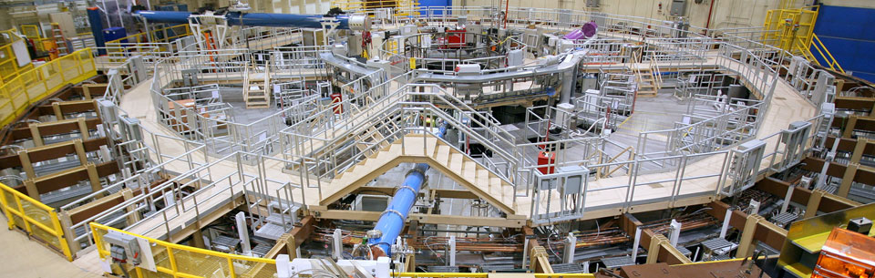
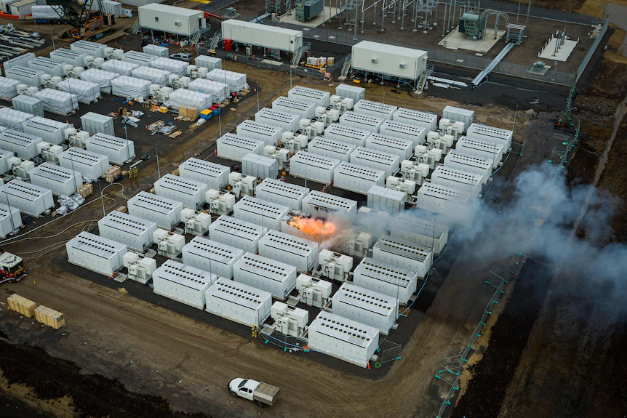
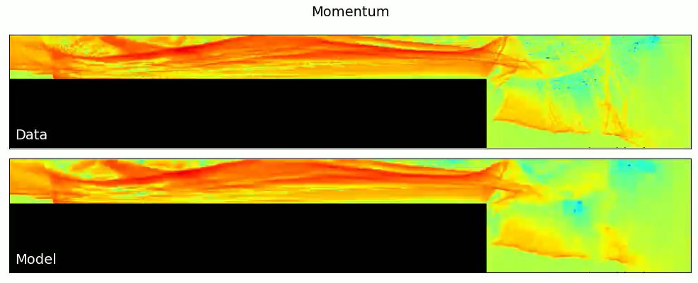
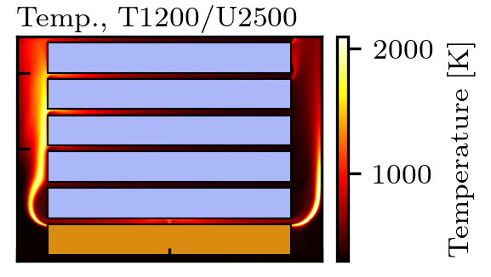
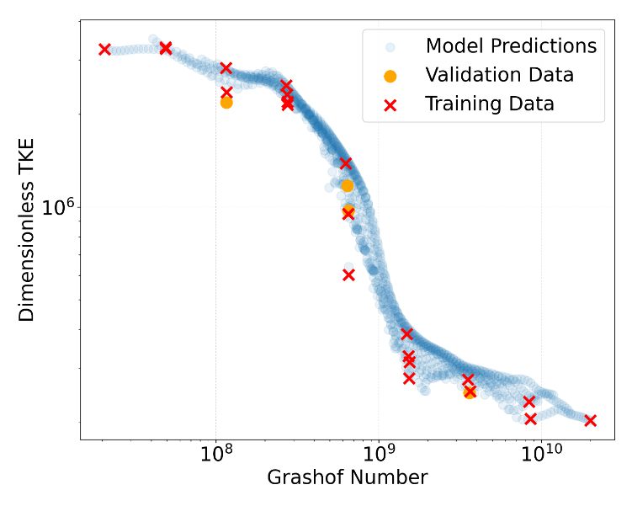
Adoption across DOE user facilities – pulsed power fusion and data centers
Simulation of components in fusion shot far outweighs the time available between experiments
Cascading failure poses a risk to energy storage system installations and first responders.
Battery rack thermal mgmt
Heat release from thermal runaway
What’s missing in current AI/ML? Guaranteed stability for long-time rollouts of chaotic dynamics, structure-preservation
What’s missing in current AI/ML? Need generalization across geometry, operating conditions from modest data, UQ, extreme physics
Kinch, Brooks, et al. "A Hybridizable Neural Time Integrator for Stable Autoregressive Forecasting." arXiv preprint arXiv:2604.21101 (2026).

Slide 5
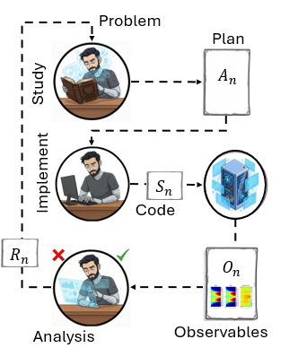
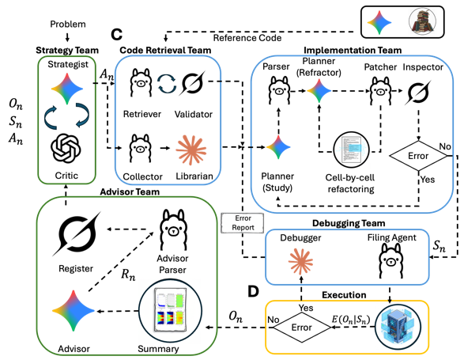
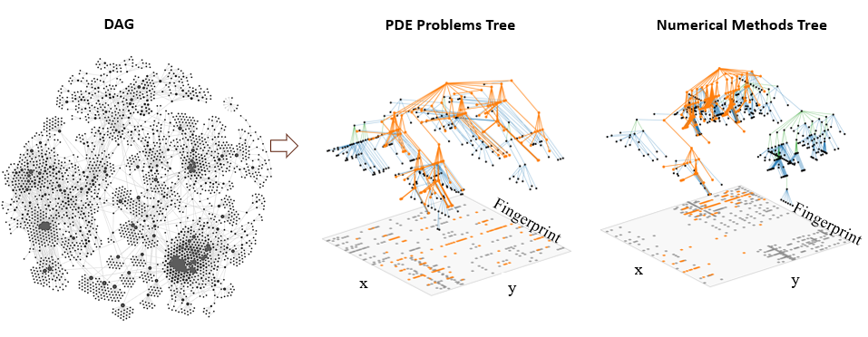

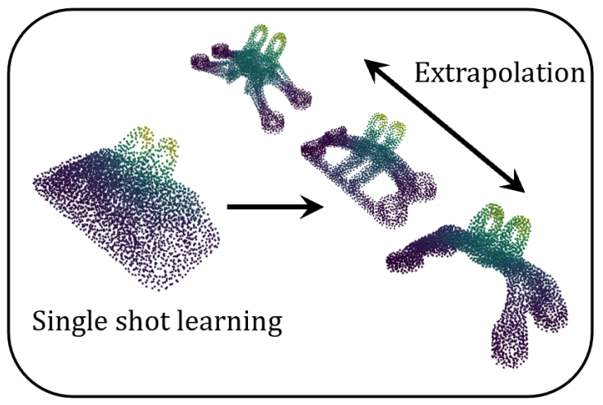
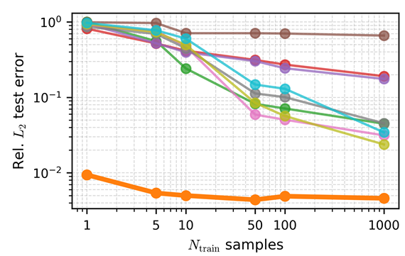
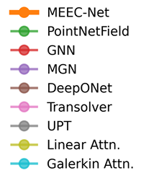

What’s next? Agentic systems that can design and reason about physics and geometry
Hierarchical Evolutionary Numerical Algorithms (HENA)
Graph Reduction to Adaptive Factored Trees (GRAFT)
Coordinate-free FEEC to generalize across unseen geometry (GeoNEW)
Meshfree Exterior Calculus (MEEC) for single-shot physics from point clouds
"ATHENA: Agentic Team for Hierarchical Evolutionary Numerical Algorithms." arXiv preprint arXiv:2512.03476 (2025).
"Structure-Preserving Learning Improves Geometry Generalization…” arXiv preprint arXiv:2602.02788 (2026).
“A meshfree exterior calculus…”. arXiv preprint arXiv:2605.08436.

Slide 6
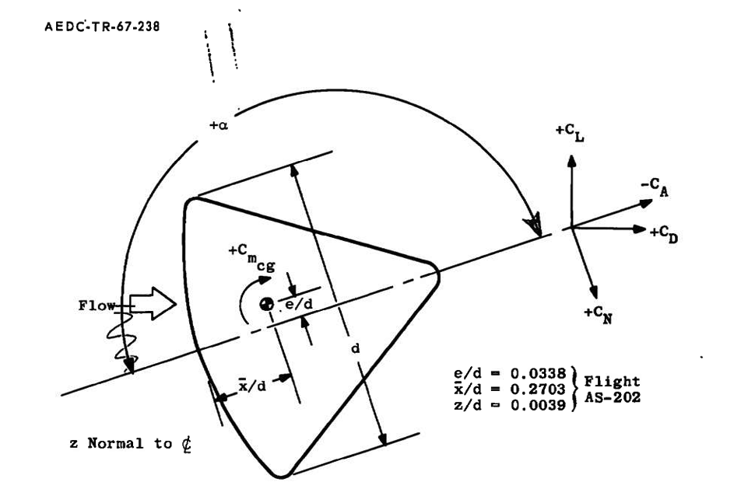
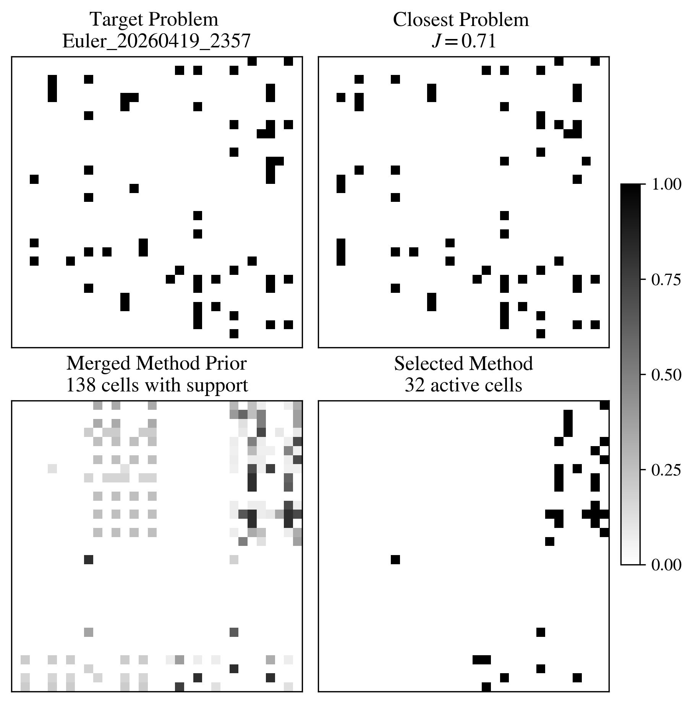
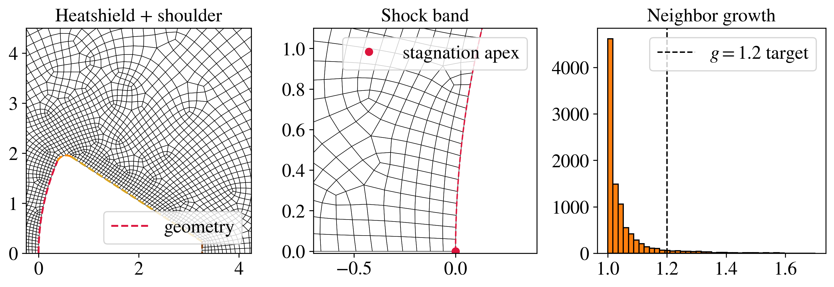
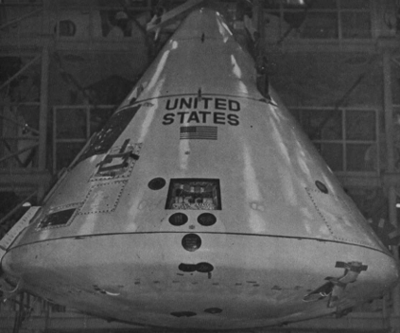
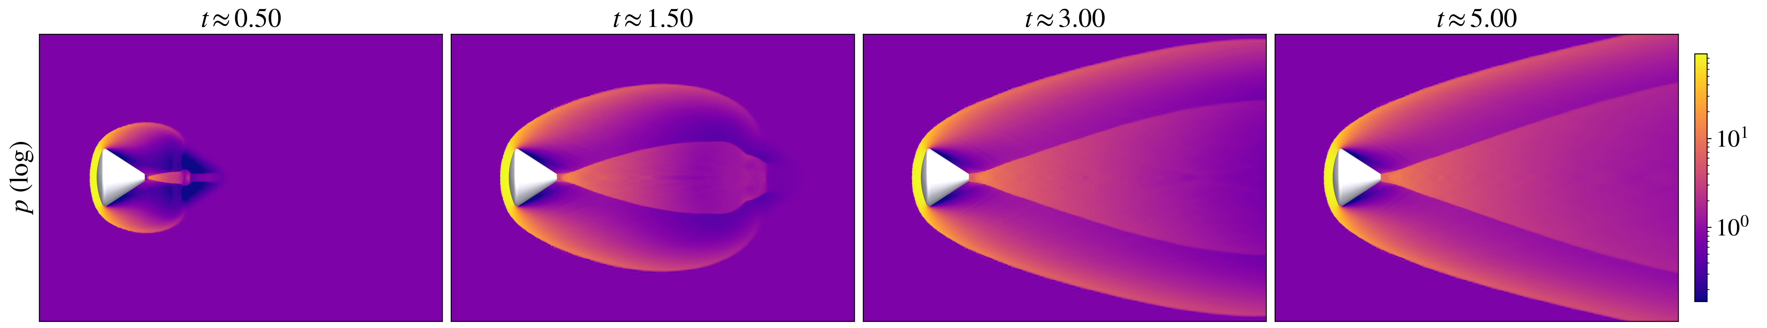
From an analyst’s sketch to simulation: re-entry vehicle at Mach 10
Input geometry from the report
Use fingerprints, and merged prior (action space) to identify the closest problem in the corpus and select optimal simulator, mesh, and problem setup
Generated mesh and self-audit quality target.
A
B
C
"ATHENA: Agentic Team for Hierarchical Evolutionary Numerical Algorithms." arXiv preprint arXiv:2512.03476 (2025).

Slide 7
Today
1. Foundations (Trask). Setting up an API, Agentic frameworks, steering some simple scientific computing workflows
2. Advanced topics (Koester). Constructing a production agentic framework
3. Agentic geometry (Owen). Incorporating agents into CAD/meshing
4. Structures + materials (Bessa). Using f3dasm for data-driven design and analysis of structures and materials
AESCAPE 2026 · Agentic AI · 7
Notes:
Frame the whole talk around the one question: who owns control flow.

Slide 8
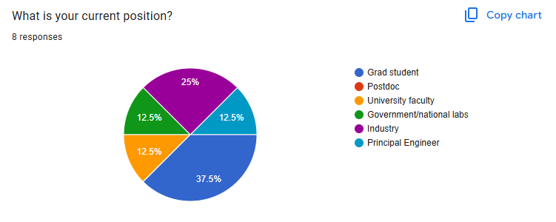
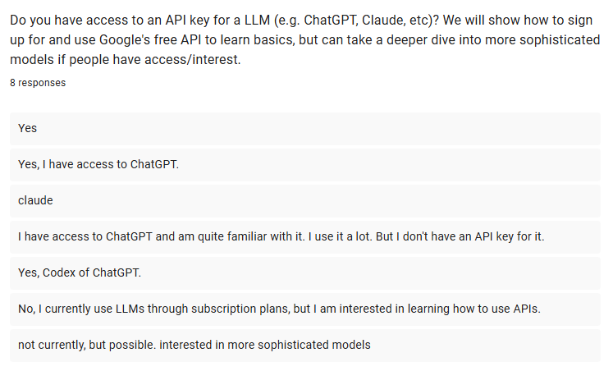
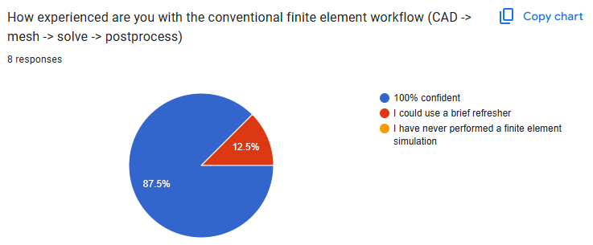
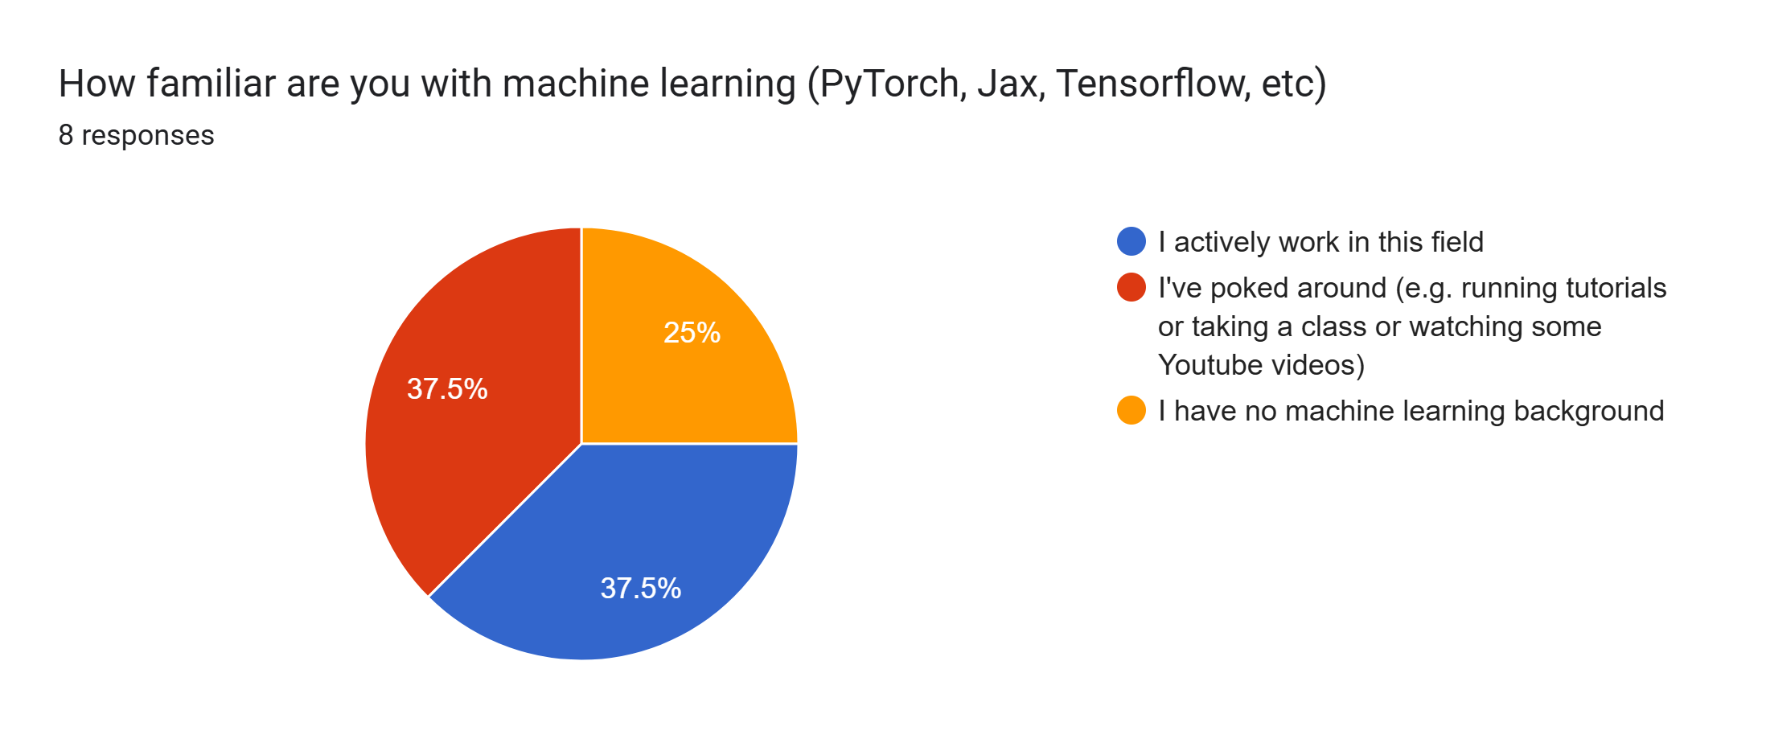
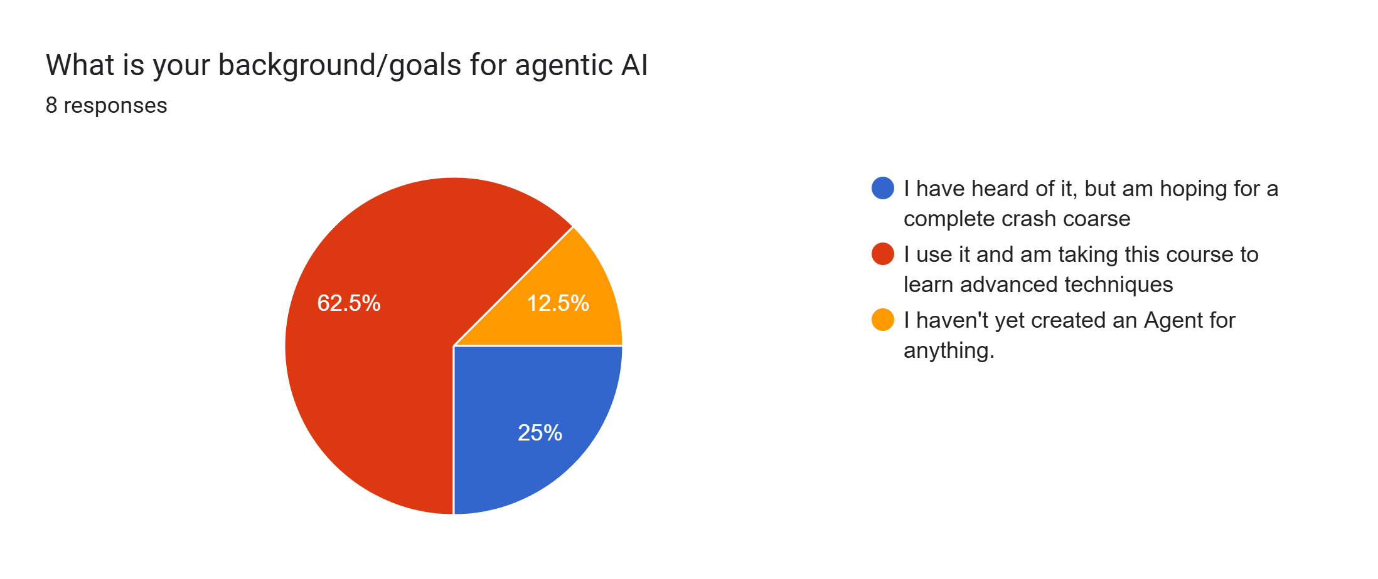
Background
AESCAPE 2026 · Agentic AI · 8
Notes:
Frame the whole talk around the one question: who owns control flow.

Slide 9
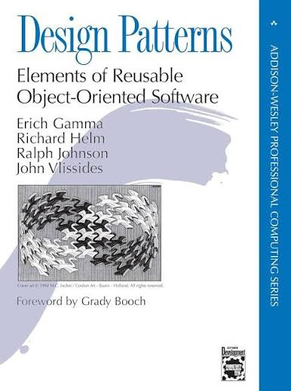
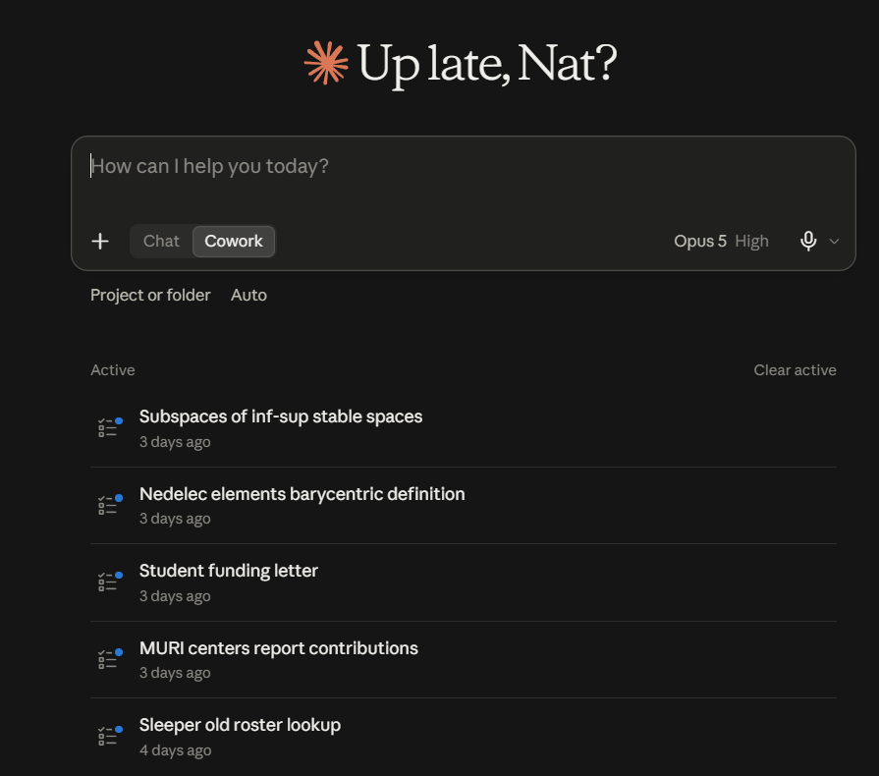
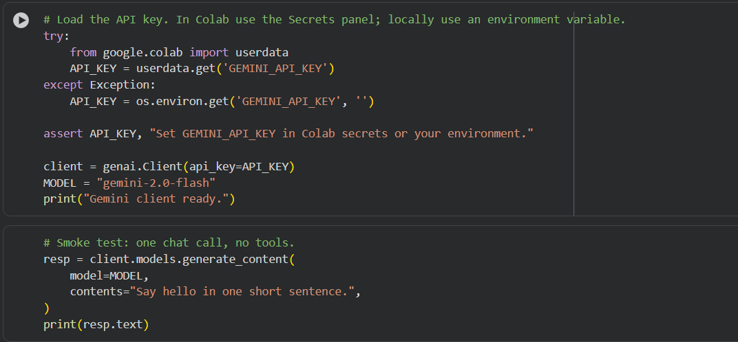
LLMs: chatbots vs API
We will be discussing how to incorporate agentic design patterns into your code. This is distinct from using cowork or other chat-based GUIs to automate tasks like writing code or generating reports
AESCAPE 2026 · Agentic AI · 9
Notes:
Frame the whole talk around the one question: who owns control flow.

Slide 10
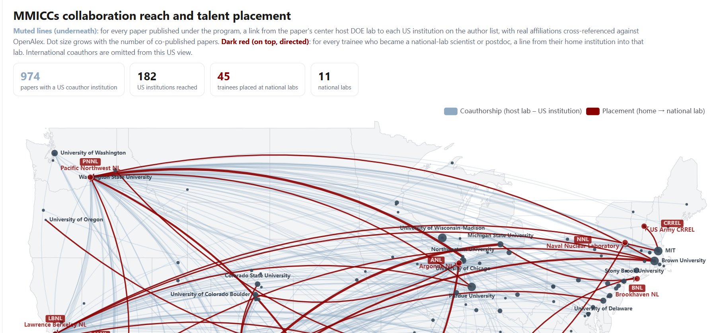
What agents look like at the commercial level now
https://natrask.github.io/DOE_PI_2026/
AESCAPE 2026 · Agentic AI · 10
Notes:
Frame the whole talk around the one question: who owns control flow.

Slide 11
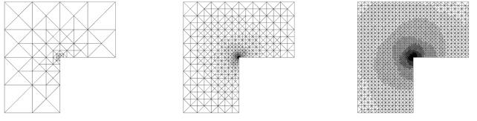
Today
1. Foundations. What an agent is. Tools, schemas, the loop.
2. Logging into an API. Free Gemini key and accessing other APIs
3. The framework zoo. ReAct, graphs (LangGraph), conversational multi-agent (AutoGen), MPC-style planning (and MCP).
4. Scientific computing as an exemplar.
CAD → mesh → solve → postprocess → remesh driven purely by agents
Primary takeaway: for any given problem, which agentic pattern should you reach for, and why?
AESCAPE 2026 · Agentic AI · 11
Notes:
Frame the whole talk around the one question: who owns control flow.

Slide 12
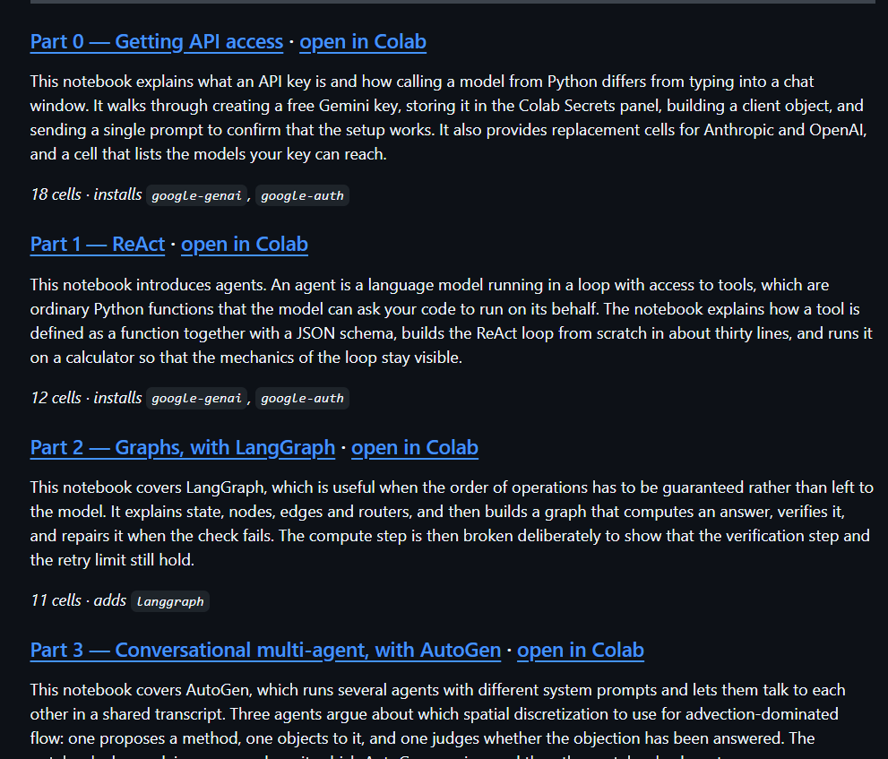
Today
AESCAPE 2026 · Agentic AI · 12
Notes:
Frame the whole talk around the one question: who owns control flow.

Slide 13
What is an LLM agent?
Agent = LLM + tools + a loop.
A traditional LLM takes text in, emits text out.
An agent is an LLM running in a loop with access to tools: ordinary Python functions it can ask us to run on its behalf.
Each turn, the model reads the running conversation and decides to either
emit a final text answer, or
call a tool with structured arguments.
When it calls a tool, we run the function and feed the result back as the next turn.
AESCAPE 2026 · Agentic AI · 13

Slide 14

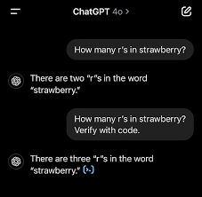
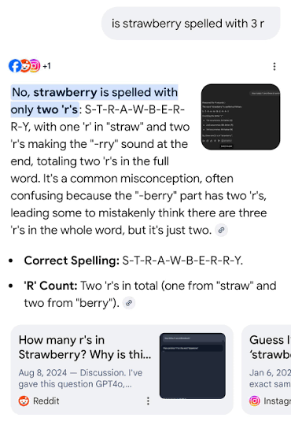
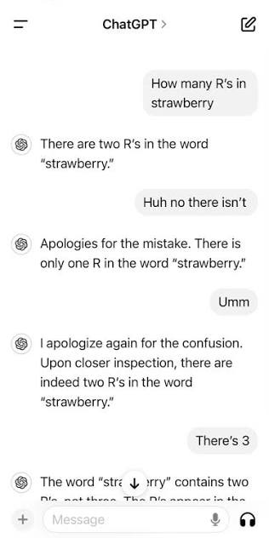
Tools allow us to switch an LLM from statistical inference on its training set to evaluating conventional code.
Math can be done on a calculator, text can be regexed, and high consequence engineering tasks can be launched through conventional HPC.
AESCAPE 2026 · Agentic AI · 14

Slide 15
ReAct as the simplest
function_call
(name, args)
LLM
reads messages,
emits text or tool call
Tools
Python functions
we control
result (dict)
appended as observation
when the model stops calling tools, it emits a final text answer and the loop exits
This is ReAct (Reason + Act), Yao et al. 2022 — the simplest agent there is.
AESCAPE 2026 · Agentic AI · 15

Slide 16
Tool syntax and specification
Two pieces: a Python function, and a JSON-schema description of its signature that you hand to the model.
Python function
JSON schema
def calculator(op, a, b):
ops = {"add": a + b, "sub": a - b,
"mul": a * b, "div": a / b}
return {"result": ops[op]}
{"name": "calculator",
"parameters": {
"type": "object",
"properties": {
"op": {"type": "string",
"enum": ["add","sub","mul","div"]},
"a": {"type": "number"},
"b": {"type": "number"}},
"required": ["op","a","b"]}}
name, description — decide whether the model picks this tool over the others. This is prompt engineering; use this to provide the model with plain English context to help it understand how the tool is meant to function.
properties — the typed argument list. enum restricts a string to a fixed set. Constrain aggressively: by forcing the model to only process inputs of a given type, you are keeping the Agent from doing something unexpected. For example – the above won’t attempt to add a string to a number
AESCAPE 2026 · Agentic AI · 16

Slide 17
The round trip
Each turn, the model emits either plain text (final answer) or a structured tool call.
1. The reply contains a function_call part:
response.candidates[0].content.parts[0].function_call
.name = "calculator"
.args = {"op": "mul", "a": 13, "b": 47}
2. We dispatch by name and run the Python function:
result = tool_fns[name](**args) # -> {"result": 611}
3. We send the result back as a function_response on the next turn:
Part.from_function_response(name="calculator", response={"result": 611})
The model then sees its own call, the result, and decides whether to call another tool or stop.
AESCAPE 2026 · Agentic AI · 17

Slide 18
Setting up your API
Free Gemini API key

Slide 19
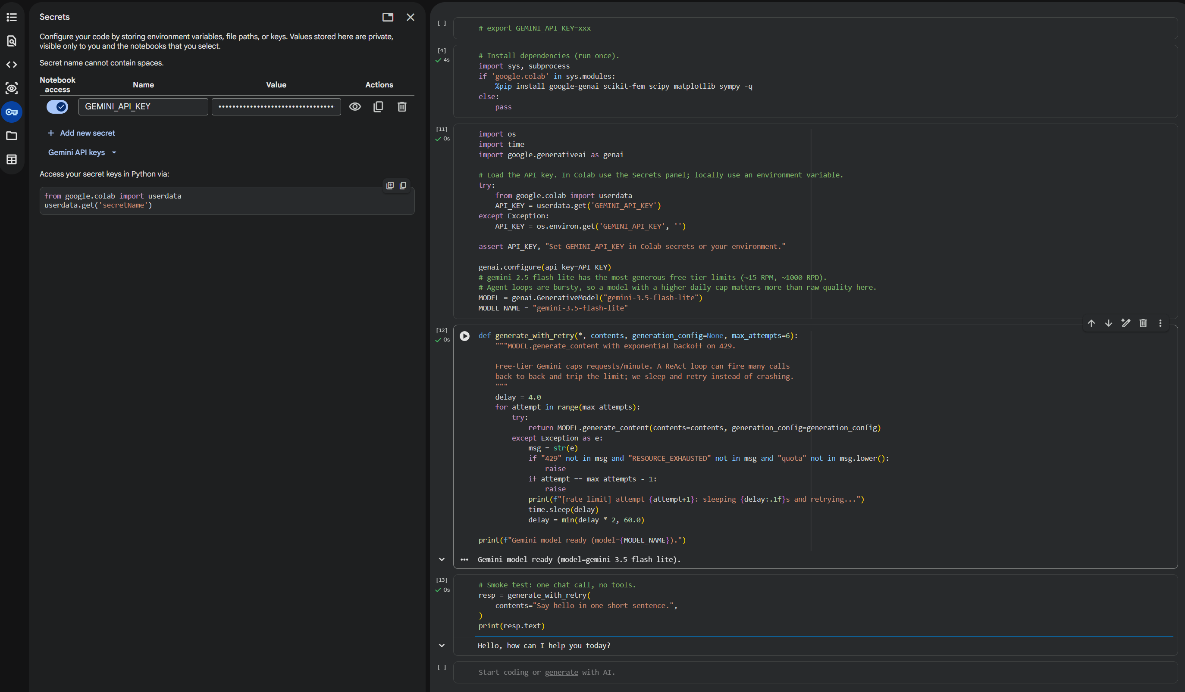
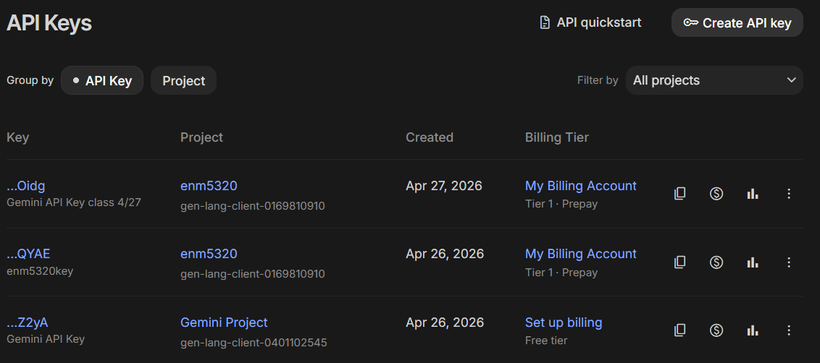
Setup: getting a key
1. Free, no credit card. Google AI Studio: aistudio.google.com/apikey. Sign in with any Google account. Use a project where billing has never been enabled to make sure you are not charged accidentally.
2. Bring your own. Anthropic (console.anthropic.com) or OpenAI (platform.openai.com/api-keys) both work (code hasn’t been tested)
3. In Colab: Secrets panel (key icon, left sidebar), add GEMINI_API_KEY.
Never paste a key into a notebook cell. It ends up in the .ipynb JSON, in your shell history, and in git. Use the secrets panel or an environment variable.
AESCAPE 2026 · Agentic AI · 19

Slide 20
The framework zoo
ReAct · LangGraph · AutoGen · MPC · MCP

Slide 21
Why not just ReAct?
ReAct is greedy. At each step the model sees the history and picks one action. That is exactly right when:
the tool interface is lightweight,
mistakes are cheap and recoverable, and
you cannot specify the procedure in advance.
It starts to hurt when:
you need a guarantee that step B always follows step A (audit, compliance, “always verify before reporting”),
genuinely different expertise needs different system prompts and different tools,
a wrong action is expensive and you own a cheap forward model that could have caught it, or
your tools live in someone else’s process — a solver, a CAD kernel, a database.
For each of these, different alternate patterns can make sense, so we will consider alternative agentic frameworks.
AESCAPE 2026 · Agentic AI · 21

Slide 22
Selecting the correct framework for a given task
Choosing a pattern is choosing how the logical flow is controlled.
ReAct
the model
decides
LangGraph
you decide,
in code
AutoGen
the conversation
decides
MPC
a simulator
decides
MCP
nobody —
it’s plumbing
more autonomy
more control
a transport,
not an architecture
MCP is its own thing and can be combined with the other four.
AESCAPE 2026 · Agentic AI · 22

Slide 23
Mapping this onto a conventional FEM workflow
CAD
mesh
solve
post
refine and repeat
What does this look like when an LLM is holding the mouse?
Three things have to change:
1. Every stage needs a JSON-callable signature.
2. Objects that can’t cross a JSON boundary (meshes, bases, matrices) need handles.
3. Every stage needs guardrails, because the caller is nondeterministic.
AESCAPE 2026 · Agentic AI · 23

Slide 24
Mapping this onto a conventional FEM workflow
CAD
mesh
solve
post
refine and repeat
Why would we even do this?
A lot of this can be done with simple bash scripts, but not everything and not fast. Some use cases:
Establishing automatic unit tests for e.g. manufactured solutions, convergence, patch tests, conservation principles
Automating design sweeps over geometry or other conditions
Generating large quantities of data for training other models
Establishing auditable provenance for high consequence workflows (medicine, aerospace)
Making real-time decisions augmented with simulation in fast-paced environments (defense, surgery)
AESCAPE 2026 · Agentic AI · 24

Slide 25
The zoo, on one slide
 | Control flow | Lookahead | Roles | Reach for it when
ReAct | model, step by step | none | one | open-ended, errors cheap
LangGraph | you, as a graph | none | many, fixed | you need guarantees
AutoGen | emergent, via chat | none | many, fluid | expertise must collide
MPC | simulator ranks plans | N steps | one + model | wrong actions are costly
MCP | orthogonal — how tools reach the agent, not how it decides
For each of these the sample code focuses on getting you a baseline that runs easily in Colab that you can hack on top of.
the syntax — what the code actually looks like
An exemplar – sometimes trite! Many of these patterns really only make sense at scale and I used minimal complexity examples
AESCAPE 2026 · Agentic AI · 25

Slide 26
Pattern 1 — ReAct
the model owns control flow

Slide 27
ReAct — syntax
No library needed – we can implement this ourselves using a for loop and a dispatch table.
contents = [user_prompt]
for step in range(max_steps):
resp = client.models.generate_content(
model=MODEL, contents=contents,
config=GenerateContentConfig(
system_instruction=system_prompt,
tools=[Tool(function_declarations=tool_schemas)]))
contents.append(resp.candidates[0].content)
calls = [p.function_call for p in resp.candidates[0].content.parts
if p.function_call]
if not calls:
return resp.text # final answer
for fc in calls:
result = tool_fns[fc.name](**dict(fc.args))
contents.append(Part.from_function_response(
name=fc.name, response=result))
Dependencies: one SDK. State: the contents list..
AESCAPE 2026 · Agentic AI · 27

Slide 28
ReAct — exemplar: adaptive mesh refinement
Why ReAct is the right call here:
The number of refinement cycles is not knowable in advance — it depends on observed error.
Every action is cheap and recoverable: a bad refinement just makes a mesh you discard (not OK in > 2D!).
The model must react to observations it could not have predicted (the error estimate after each solve).
The tool surface is small — six tools.
Greedy, one-step-at-a-time decision making makes this the right framework.
solve_poisson
loop
local_indicators
refine_by_threshold
tol met
stop
The model chooses the arrow to take at every step. Nothing in the code forces this order.
AESCAPE 2026 · Agentic AI · 28

Slide 29
Pattern 2 — Graphs (LangGraph)
you own the control flow

Slide 30
LangGraph — syntax
You declare a typed state, nodes that transform it, and edges. The LLM fills in nodes; the graph decides what runs next.
from langgraph.graph import StateGraph, END
from typing import TypedDict
class S(TypedDict):
mesh_id: int
error: float
attempts: int
def solve(s): return {"error": run_solver(s["mesh_id"]), ...}
def refine(s): return {"mesh_id": do_refine(s["mesh_id"]),
"attempts": s["attempts"] + 1}
def route(s): # <- control flow, in Python
if s["error"] < TOL: return "verify"
if s["attempts"] >= 6: return "give_up"
return "refine"
g = StateGraph(S)
g.add_node("solve", solve); g.add_node("refine", refine); g.add_node("verify", verify)
g.set_entry_point("solve")
g.add_conditional_edges("solve", route,
{"refine": "refine", "verify": "verify", "give_up": END})
g.add_edge("refine", "solve")
app = g.compile()
AESCAPE 2026 · Agentic AI · 30

Slide 31
LangGraph — guarantees follow from structured graph computation
What the graph guarantees:
verify always runs before a result is reported. The model cannot decide to skip it.
The retry count is bounded in code, not requested in the prompt.
State is typed and inspectable — you can log, checkpoint, and resume mid-run.
The control flow is a diagram you can show a reviewer, which matters when the answer feeds a design decision.
solve
retry
FAIL
refine
verify
END
Compare with the ReAct diagram: same boxes, but here the arrows are code. The model never sees them.
AESCAPE 2026 · Agentic AI · 31

Slide 32
LangGraph — exemplar: solve → verify → repair
The problem: you want an FEM result you can put in a daily report.
Requirement | Who enforces it
Every reported result is verified | the edge from solve to verify
At most 6 refinement attempts | the router, in Python
A failed check loops back to solve | a conditional edge
You can see which nodes ran, in order | the streamed path
None of these should depend on what the model happens to decide on the day.
Use a graph when the order of operations is a requirement.
AESCAPE 2026 · Agentic AI · 32

Slide 33
Pattern 3 — Conversational multi-agent (AutoGen)
the conversation owns control flow

Slide 34
AutoGen — syntax
You define participants with distinct system prompts and let them talk. Control flow emerges from who speaks next.
from autogen_agentchat.agents import AssistantAgent
from autogen_agentchat.teams import RoundRobinGroupChat
from autogen_agentchat.conditions import TextMentionTermination
modeler = AssistantAgent("modeler", model_client=client,
system_message="You propose discretizations. Be concrete and specific.")
analyst = AssistantAgent("analyst", model_client=client,
system_message="""You are a numerical analyst. Challenge the modeler's
proposal on stability, conditioning, and convergence rate. Do not be
agreeable; your value is in the objection.""")
critic = AssistantAgent("critic", model_client=client,
system_message="Judge the exchange. Say APPROVE only when convinced.")
team = RoundRobinGroupChat([modeler, analyst, critic],
termination_condition=TextMentionTermination("APPROVE"))
await team.run(task="Choose a discretization for advection-dominated flow.")
AESCAPE 2026 · Agentic AI · 34

Slide 35
AutoGen — exemplar: the design review
The problem: choosing a discretization for an advection-dominated problem. There is no single correct answer, and the reasoning is the deliverable.
A single ReAct agent asked “pick a discretization” produces a confident paragraph with no adversarial pressure on it.
Three agents with genuinely different objectives — propose, object, judge — produce a transcript in which the weaknesses are stated out loud.
The output is the argument, which a reviewer can audit faster than re-deriving the answer.
Reach for conversation when disagreement is the product.
One caution: agreement between agents is weak evidence, since they share a training corpus and a tendency to agree. Giving each role a different tool helps far more than giving it a different adjective.
AESCAPE 2026 · Agentic AI · 35

Slide 36
Pattern 4 — MPC-style planning
a simulator owns control flow

Slide 37
MPC — the idea, borrowed from control
Model Predictive Control, as you already know it:
state sₜ
plan
N candidates
simulate
forward model
act
first step only
re-plan from the new state
The agentic version swaps one box: the LLM proposes the candidate plans, and the simulator — not the LLM — ranks them.
The LLM proposes plausible candidates from context.
The simulator scores them against the forward model.
You commit only to the highest-ranking action, then re-plan with real feedback.
AESCAPE 2026 · Agentic AI · 37

Slide 38
MPC — syntax
No library needed. The pattern is the loop.
state = initial_state
for t in range(horizon):
# 1. LLM proposes N candidate action sequences (cheap, creative)
plans = llm_propose(state, history, n_candidates=5, lookahead=3)
# 2. The *simulator* scores each one (trusted, not creative)
scores = [world_model.rollout(state, plan) for plan in plans]
# 3. Commit to the first action of the best plan only
best = plans[argmax(scores)]
state = env.step(best[0]) # <- the only real action taken
# 4. Re-plan from the new state (closes the loop on reality)
The LLM does not choose which plan is best. It generates candidates; the forward model ranks them.
AESCAPE 2026 · Agentic AI · 38

Slide 39
MPC — exemplar: black-box optimization
The problem: find the launch angle maximizing range for a projectile under quadratic drag. The agent sees only evaluate(angle).
x'' = -c_d |v| x' y'' = -g - c_d |v| y'
v0 = 50 m/s c_d = 0.01 1/m g = 9.81 m/s^2
Without drag the optimum is 45°. With drag it drops to about 38°, so the obvious first guess is close but wrong.
Every evaluate call is a real ODE integration — the thing we are budgeting. We treat this as an oracle the LLM can’t see inside.
We have a cheap, trusted forward model: a surrogate fitted to what we have seen by fitting a polynomial to observations.
In the notebook the LLM proposes candidate angles and a quadratic surrogate decides which one is worth a real simulation.
The budget is ten evaluations, three of which are seed points.
AESCAPE 2026 · Agentic AI · 39
Notes:
Run the head-to-head cell live if time allows. Expect ReAct to vary run to run; MPC is much more stable because the surrogate does the deciding.

Slide 40
MPC — when it wins, and when it doesn’t
Reach for MPC when:
A wrong action is expensive or irreversible — burning budget, committing a mesh, running an experiment.
You have a cheap forward model you trust more than the LLM.
The system is non-Markovian, so looking N steps ahead genuinely differs from looking one step ahead.
Don’t bother when:
Simulating a plan costs about what executing it costs — then just execute and observe.
You have no forward model. Scoring candidates with the same LLM that proposed them costs more without adding information.
The problem is small and smooth, where the simulation provides a better result without adding AI slop on top of it.
For this projectile, scipy.optimize.minimize_scalar finds the same optimum with no model at all. Worth checking before reaching for an agent.
AESCAPE 2026 · Agentic AI · 40

Slide 41
Pattern 5 — MCP
a protocol for encapsulating simulators, experiments and other resources

Slide 42
MCP — Model Context Protocol
So far, every tool has been a Python function in the same process as the loop. For complex systems, resources may be non-colocated.
Your solver is: a compiled binary. On a cluster. Behind a scheduler. Written by someone else, in Fortran, in 1994. Licensed per seat.
ReAct agent
MCP
mesh server
LangGraph app
solver server
Claude / IDE
3D printing server
MCP standardizes the contract between the two sides: write your solver’s tool surface once, and any MCP-speaking client can drive it. This is argued by some to be the equivalent of publishing Github code alongside a paper ten years ago – if you build an MCP server you can ensure that your tool can be driven by an LLM.
AESCAPE 2026 · Agentic AI · 42

Slide 43
MCP — syntax
Server side: decorate the functions you want to expose.
from mcp.server.mcpserver import MCPServer
mcp = MCPServer(name="fem-tools")
@mcp.tool()
def solve_poisson(mesh_id: int) -> dict:
"""Solve -Laplacian(u) = 1 with u=0 on the boundary."""
u, basis = solve_poisson_on(MESH_REGISTRY[mesh_id])
return {"dofs": int(basis.N), "H1_error": h1_error(...)}
@mcp.tool()
def refine_by_threshold(mesh_id: int, theta: float = 0.5) -> dict:
"""Doerfler-mark and refine. theta in (0,1)."""
...
mcp.run(transport="stdio") # or "streamable-http"
The type hints and docstrings become the JSON schema. Notice this is the same information as the “what a tool is” slide — MCP does not change what a tool is, only how it can be accessed by an LLM.
AESCAPE 2026 · Agentic AI · 43

Slide 44
Choosing: a decision guide
If this is true of your problem… | start here
I can’t specify the procedure in advance, and mistakes are cheap | ReAct
Something must always happen (verify, log, approve), or a human signs off on the result | LangGraph
The roles need different tools and different incentives, and I want the disagreement on record | AutoGen
Actions are expensive or irreversible, and I own a forward model | MPC
My tools live in another process, language, or machine — or others need to reuse them | MCP (with any of the above)
AESCAPE 2026 · Agentic AI · 44

Slide 45
Scientific computing as a tool surface

Slide 46
scikit-fem: the whole workflow in 30 lines
from skfem import *
from skfem.helpers import dot, grad
@BilinearForm # weak form: a(u,v) = int grad u . grad v
def stiffness(u, v, w):
return dot(grad(u), grad(v))
@LinearForm # load: L(v) = int 1 * v
def unit_load(v, w):
return 1.0 * v
mesh = MeshTri.init_lshaped().refined(2) # "CAD" + mesh
basis = Basis(mesh, ElementTriP1()) # discretization
K = stiffness.assemble(basis) # assemble
b = unit_load.assemble(basis)
u = solve(*condense(K, b, D=mesh.boundary_nodes())) # solve
mesh.draw(); basis.plot(u) # post
We use scikit-fem because it is pip-installable in Colab and has a compact FEniCS-like syntax that is accessible without any complicated build process.
AESCAPE 2026 · Agentic AI · 46

Slide 47
Re-cutting the workflow as tools
The agent cannot hold a MeshTri object. It can hold an integer.
MESH_REGISTRY = {} # int -> mesh. The agent sees only the int.
NEXT_ID = [0]
def _register(mesh):
mid = NEXT_ID[0]; NEXT_ID[0] += 1
MESH_REGISTRY[mid] = mesh
return mid
def tool_solve_poisson(mesh_id: int):
m = MESH_REGISTRY.get(mesh_id)
if m is None:
return {"error": f"no mesh with id {mesh_id}"} # observation, not crash
u, basis = solve_poisson_on(m)
return {"mesh_id": mesh_id, "dofs": int(basis.N),
"H1_error": h1_error(m, u)}
The handle pattern generalises. Meshes, solver contexts, CAD bodies, open files, database cursors — anything with identity and no JSON representation gets an integer and a registry.
AESCAPE 2026 · Agentic AI · 47

Slide 48
Task: adaptive refinement on the L-shape
Poisson with uniform forcing:
−Δu = 1 in Ω, u = 0 on ∂Ω.
The re-entrant corner gives a singular solution
u ∼ r^(2/3) · sin(2θ/3),
so u ∈ H^(5/3−ε) but u ∉ H².
P1 elements, expected rates:
Uniform refinement: O(h^(2/3)) asymptotically. Pre-asymptotically you often see 0.7–0.95.
Adaptive refinement: optimal O(N^(−1/2)), i.e. rate 1 against h ∼ N^(−1/2).
Ω
re-entrant
corner
That gap between the two rates is what adaptive meshing buys you. We are going to make an agent rediscover it.
AESCAPE 2026 · Agentic AI · 48

Slide 49
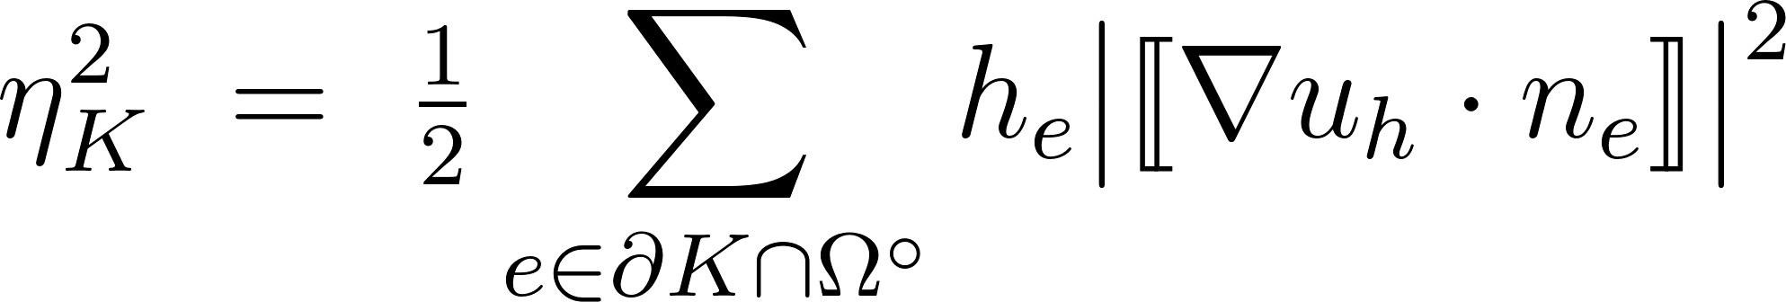
The process for adaptive FEM
1. A local error indicator ηₖ. For each element K, a computable proxy for how much error lives there. We use the gradient-jump indicator:
P1 gradients are discontinuous across element edges, and the size of the jump correlates with the local error.
2. Dörfler marking. Pick a bulk fraction θ ∈ (0,1). Mark the smallest set M whose squared indicators capture a fraction θ of the total:
Σ(K ∈ M) η²ₖ ≥ θ · Σ(K) η²ₖ
AESCAPE 2026 · Agentic AI · 49

Slide 50
Tools the FEM agent gets
Each takes a mesh_id and returns a dict.
solve_poisson(mesh_id) → {dofs, H1_error}
local_indicators(mesh_id) → summary stats of ηₖ
uniform_refine(mesh_id) → new mesh id
refine_by_threshold(mesh_id, theta) → Dörfler-mark and refine
check_convergence_rate() → log-log slope of the last 3 solves
stop(reason)
Guardrails, in the tools:
MAX_DOFS = 20000 — a refinement that would exceed it returns an error observation instead of allocating.
Every dispatch is try/except wrapped.
stop is the only terminal tool.
AESCAPE 2026 · Agentic AI · 50

