Slide 1

Foundations of Agentic AI
for Science & Engineering
AESCAPE 2026 · Introduction to Agentic Workflows
Nathaniel Trask
University of Pennsylvania
Sandia National Laboratories
September 8, 2026

Slide 2
Today
1. Foundations (Trask). Setting up an API, Agentic frameworks, steering some simple scientific computing workflows
2. Advanced topics (Koester). Constructing a production agentic framework
3. Agentic geometry (Owen). Incorporating agents into CAD/meshing
4. Structures + materials (Bessa). Using f3dasm for data-driven design and analysis of structures and materials
AESCAPE 2026 · Agentic AI · 2
Notes:
Frame the whole talk around the one question: who owns control flow.

Slide 3
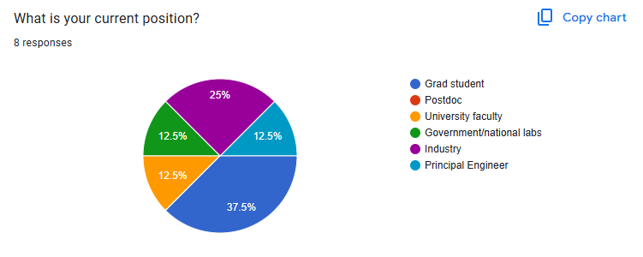
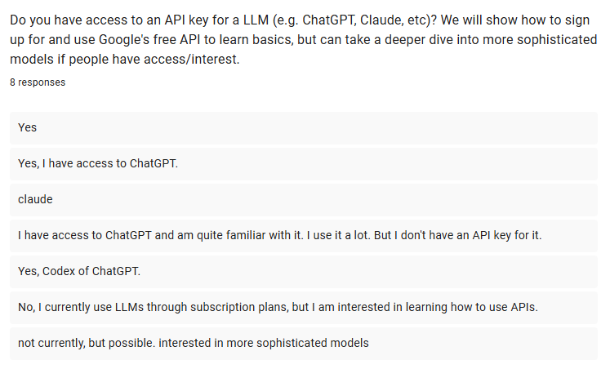
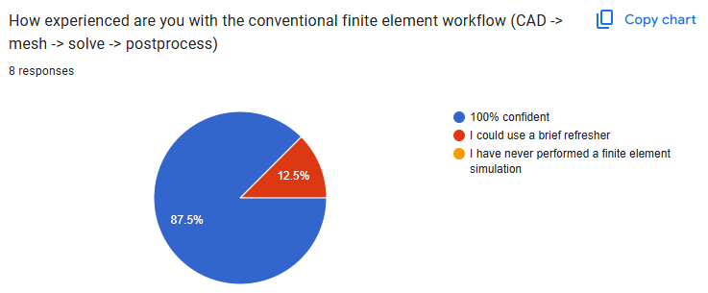
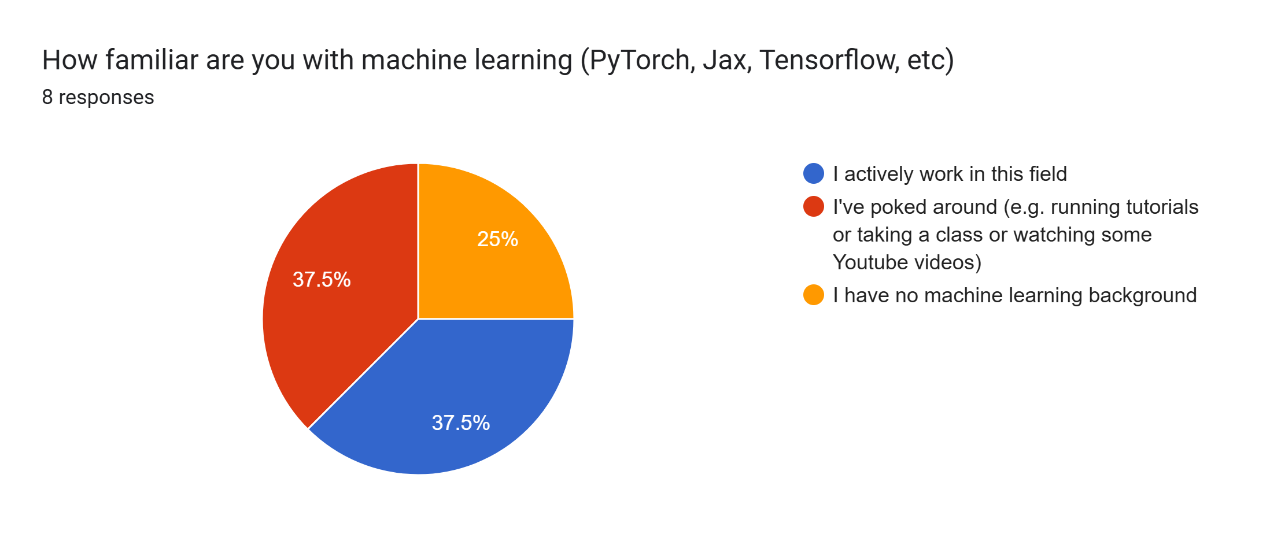
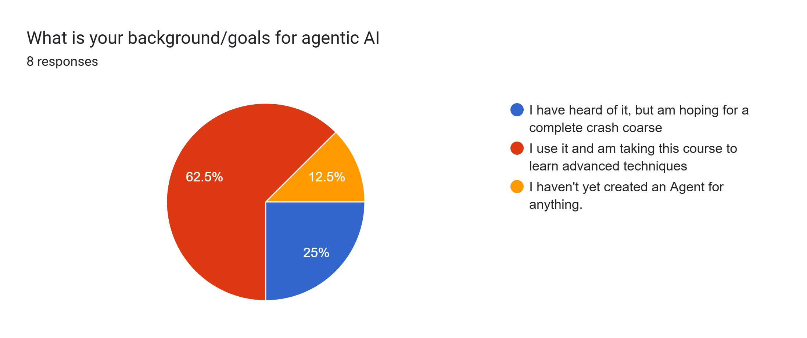
Background
AESCAPE 2026 · Agentic AI · 3
Notes:
Frame the whole talk around the one question: who owns control flow.

Slide 4
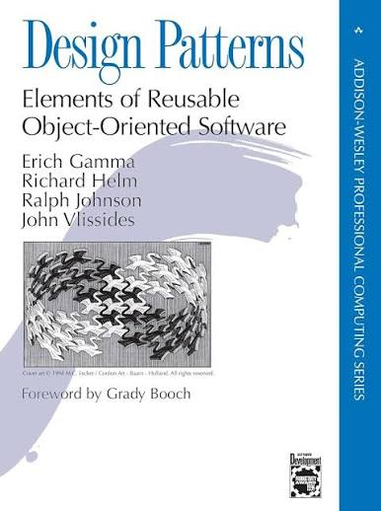
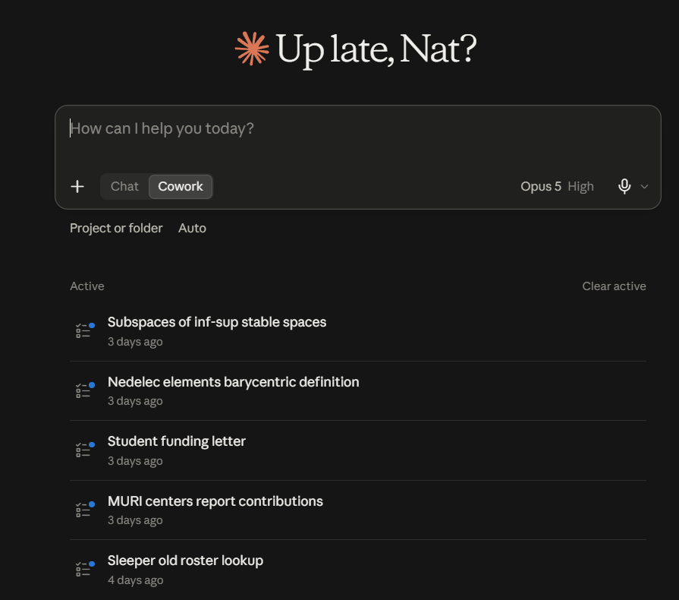
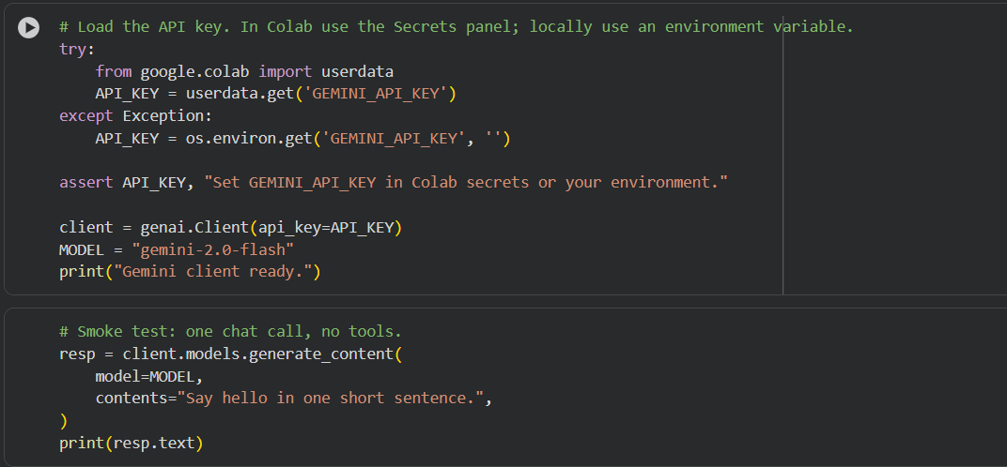
LLMs: chatbots vs API
We will be discussing how to incorporate agentic design patterns into your code. This is distinct from using cowork or other chat-based GUIs to automate tasks like writing code or generating reports
AESCAPE 2026 · Agentic AI · 4
Notes:
Frame the whole talk around the one question: who owns control flow.

Slide 5
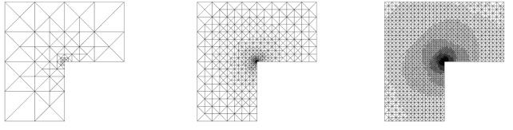
Today
1. Foundations. What an agent is. Tools, schemas, the loop.
2. Logging into an API. Free Gemini key and accessing other APIs
3. The framework zoo. ReAct, graphs (LangGraph), conversational multi-agent (AutoGen), MPC-style planning — and MCP.
4. Scientific computing as an exemplar.
CAD → mesh → solve → postprocess → remesh driven purely by agents
Primary takeaway: for any given problem, which agentic pattern should you reach for, and why?
AESCAPE 2026 · Agentic AI · 5
Notes:
Frame the whole talk around the one question: who owns control flow.

Slide 6
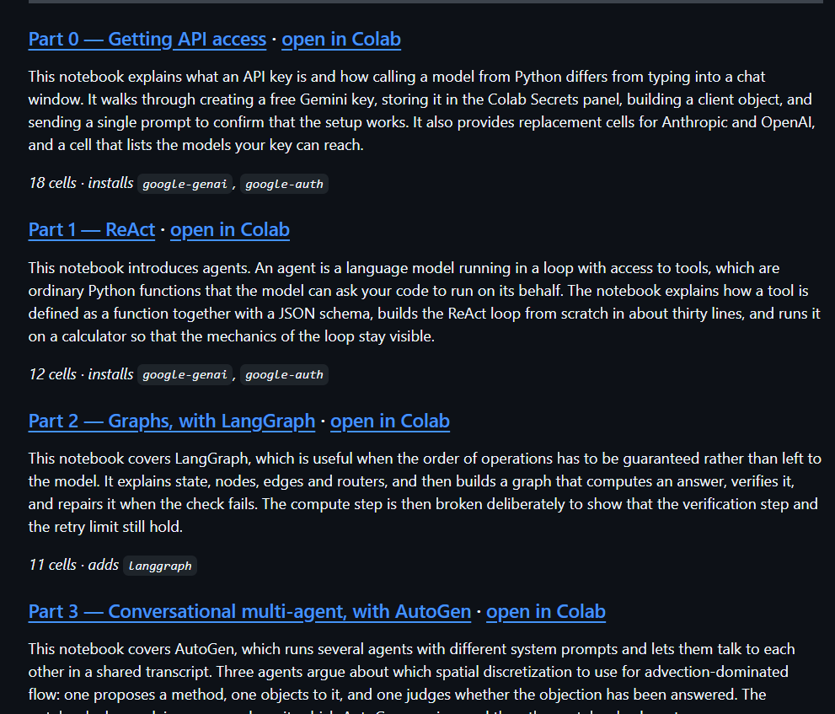
Today
AESCAPE 2026 · Agentic AI · 6
Notes:
Frame the whole talk around the one question: who owns control flow.

Slide 7
What is an LLM agent?
Agent = LLM + tools + a loop.
A traditional LLM takes text in, emits text out.
An agent is an LLM running in a loop with access to tools: ordinary Python functions it can ask us to run on its behalf.
Each turn, the model reads the running conversation and decides to either
emit a final text answer, or
call a tool with structured arguments.
When it calls a tool, we run the function and feed the result back as the next turn.
AESCAPE 2026 · Agentic AI · 7

Slide 8
ReAct as the simplest
function_call
(name, args)
LLM
reads messages,
emits text or tool call
Tools
Python functions
we control
result (dict)
appended as observation
when the model stops calling tools, it emits a final text answer and the loop exits
This is ReAct (Reason + Act), Yao et al. 2022 — the simplest agent there is.
AESCAPE 2026 · Agentic AI · 8

Slide 9

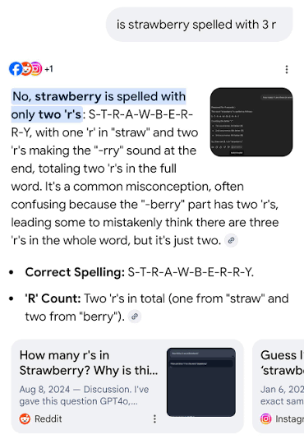
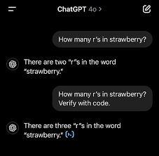
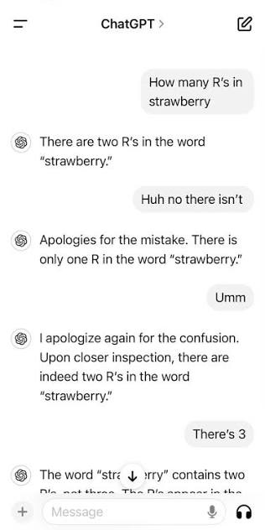
“How many R’s are in strawberry”
AESCAPE 2026 · Agentic AI · 9

Slide 10
Tool syntax and specification
Two pieces: a Python function, and a JSON-schema description of its signature that you hand to the model.
Python function
JSON schema
def calculator(op, a, b):
ops = {"add": a + b, "sub": a - b,
"mul": a * b, "div": a / b}
return {"result": ops[op]}
{"name": "calculator",
"description": "Evaluate a single arithmetic operation
"parameters": {
"type": "object",
"properties": {
"op": {"type": "string",
"enum": ["add","sub","mul","div"]},
"a": {"type": "number"},
"b": {"type": "number"}},
"required": ["op","a","b"]}}
name, description — decide whether the model picks this tool over the others. This is prompt engineering; use this to provide the model with plain English context to help it understand how the tool is meant to function.
properties — the typed argument list. enum restricts a string to a fixed set. Constrain aggressively: by forcing the model to only process inputs of a given type, you are keeping the Agent from doing something unexpected. For example – the above won’t attempt to add a string to a number
AESCAPE 2026 · Agentic AI · 10

Slide 11
The round trip
Each turn, the model emits either plain text (final answer) or a structured tool call.
1. The reply contains a function_call part:
response.candidates[0].content.parts[0].function_call
.name = "calculator"
.args = {"op": "mul", "a": 13, "b": 47}
2. We dispatch by name and run the Python function:
result = tool_fns[name](**args) # -> {"result": 611}
3. We send the result back as a function_response on the next turn:
Part.from_function_response(name="calculator", response={"result": 611})
The model then sees its own call, the result, and decides whether to call another tool or stop.
AESCAPE 2026 · Agentic AI · 11

Slide 12
Setting up your API
Free Gemini API key

Slide 13
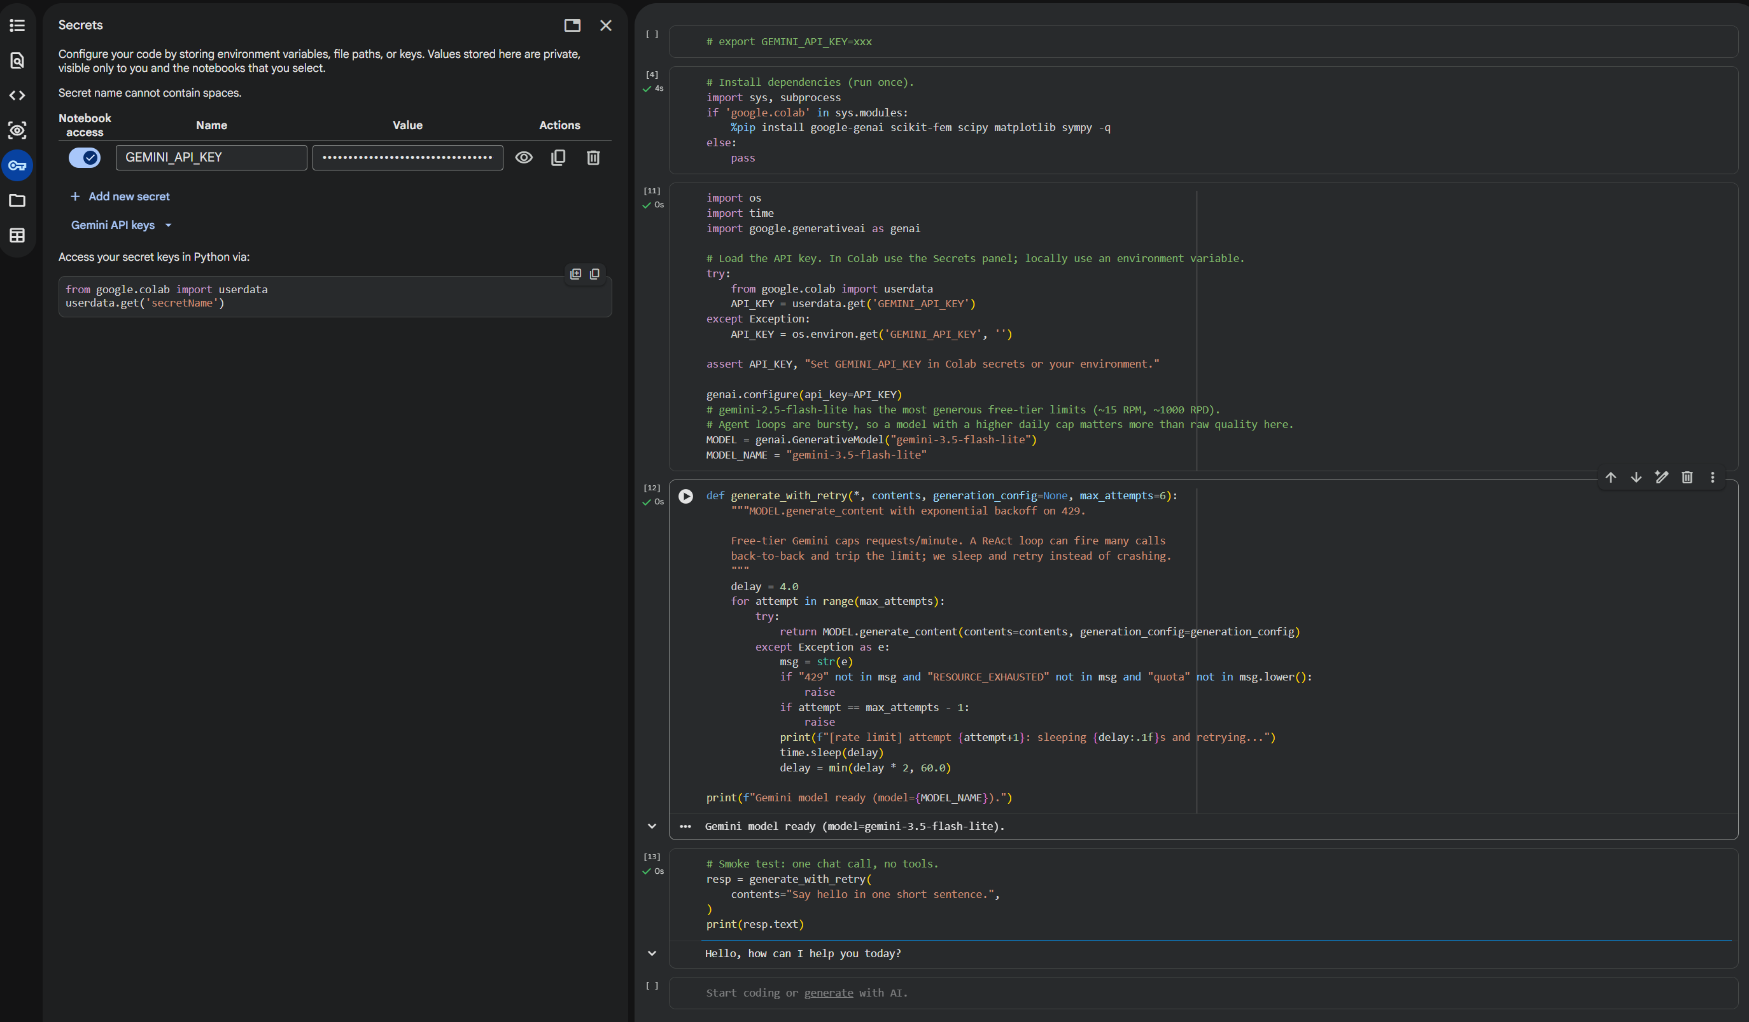
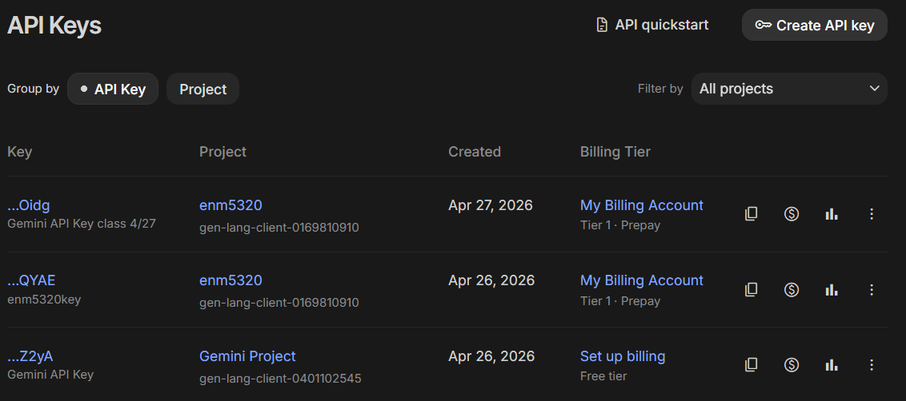
Setup: getting a key
1. Free, no credit card. Google AI Studio: aistudio.google.com/apikey. Sign in with any Google account. Use a project where billing has never been enabled to make sure you are not charged accidentally.
2. Bring your own. Anthropic (console.anthropic.com) or OpenAI (platform.openai.com/api-keys) both work.
3. In Colab: Secrets panel (key icon, left sidebar), add GEMINI_API_KEY.
Never paste a key into a notebook cell. It ends up in the .ipynb JSON, in your shell history, and in git. Use the secrets panel or an environment variable.
AESCAPE 2026 · Agentic AI · 13

Slide 14
Setup: getting a key
1. Free, no credit card. Google AI Studio: aistudio.google.com/apikey. Sign in with any Google account. Use a project where billing has never been enabled to make sure you are not charged accidentally.
2. Bring your own. Anthropic (console.anthropic.com) or OpenAI (platform.openai.com/api-keys) both work.
3. In Colab: Secrets panel (key icon, left sidebar), add GEMINI_API_KEY.
Never paste a key into a notebook cell. It ends up in the .ipynb JSON, in your shell history, and in git. Use the secrets panel or an environment variable.
AESCAPE 2026 · Agentic AI · 14

Slide 15
The framework zoo
ReAct · LangGraph · AutoGen · MPC · MCP

Slide 16
Why not just ReAct?
ReAct is greedy. At each step the model sees the history and picks one action. That is exactly right when:
the tool interface is lightweight,
mistakes are cheap and recoverable, and
you cannot specify the procedure in advance.
It starts to hurt when:
you need a guarantee that step B always follows step A (audit, compliance, “always verify before reporting”),
genuinely different expertise needs different system prompts and different tools,
a wrong action is expensive and you own a cheap forward model that could have caught it, or
your tools live in someone else’s process — a solver, a CAD kernel, a database.
For each of these, different alternate patterns can make sense – providing a different set of alternative frameworks to ReAct.
AESCAPE 2026 · Agentic AI · 16

Slide 17
Selecting the correct framework for a given task
Choosing a pattern is choosing how the logical flow is controlled.
ReAct
the model
decides
LangGraph
you decide,
in code
AutoGen
the conversation
decides
MPC
a simulator
decides
MCP
nobody —
it’s plumbing
more autonomy
more control
a transport,
not an architecture
MCP is its own thing and can be combined with the other four.
AESCAPE 2026 · Agentic AI · 17

Slide 18
The workflow you already know
CAD
mesh
solve
post
refine and repeat
Most of you do this daily. The question for the rest of the morning is not how it works — it is:
What does this look like when an LLM is holding the mouse?
Three things have to change:
1. Every stage needs a JSON-callable signature.
2. Objects that can’t cross a JSON boundary (meshes, bases, matrices) need handles.
3. Every stage needs guardrails, because the caller is nondeterministic.
AESCAPE 2026 · Agentic AI · 18

Slide 19
The zoo, on one slide
 | Control flow | Lookahead | Roles | Reach for it when
ReAct | model, step by step | none | one | open-ended, errors cheap
LangGraph | you, as a graph | none | many, fixed | you need guarantees
AutoGen | emergent, via chat | none | many, fluid | expertise must collide
MPC | simulator ranks plans | N steps | one + model | wrong actions are costly
MCP | orthogonal — how tools reach the agent, not how it decides
For each of the four architectures we will look at:
the syntax — what the code actually looks like
An exemplar – sometimes trite! So you have a working base to start hacking on top of
AESCAPE 2026 · Agentic AI · 19

Slide 20
Pattern 1 — ReAct
the model owns control flow

Slide 21
ReAct — syntax
No framework. A for loop and a dispatch table.
contents = [user_prompt]
for step in range(max_steps):
resp = client.models.generate_content(
model=MODEL, contents=contents,
config=GenerateContentConfig(
system_instruction=system_prompt,
tools=[Tool(function_declarations=tool_schemas)]))
contents.append(resp.candidates[0].content)
calls = [p.function_call for p in resp.candidates[0].content.parts
if p.function_call]
if not calls:
return resp.text # final answer
for fc in calls:
result = tool_fns[fc.name](**dict(fc.args))
contents.append(Part.from_function_response(
name=fc.name, response=result))
Dependencies: one SDK. State: the contents list. That’s it.
AESCAPE 2026 · Agentic AI · 21

Slide 22
ReAct — exemplar: adaptive mesh refinement
Why ReAct is the right call here:
The number of refinement cycles is not knowable in advance — it depends on observed error.
Every action is cheap and recoverable: a bad refinement just makes a mesh you discard (not OK in > 2D!).
The model must react to observations it could not have predicted (the error estimate after each solve).
The tool surface is small — six tools.
Greedy, one-step-at-a-time decision making makes this the right framework.
solve_poisson
loop
local_indicators
refine_by_threshold
tol met
stop
The model chooses the arrow to take at every step. Nothing in the code forces this order.
AESCAPE 2026 · Agentic AI · 22

Slide 23
Pattern 2 — Graphs (LangGraph)
you own control flow

Slide 24
LangGraph — syntax
You declare a typed state, nodes that transform it, and edges. The LLM fills in nodes; the graph decides what runs next.
from langgraph.graph import StateGraph, END
from typing import TypedDict
class S(TypedDict):
mesh_id: int
error: float
attempts: int
def solve(s): return {"error": run_solver(s["mesh_id"]), ...}
def refine(s): return {"mesh_id": do_refine(s["mesh_id"]),
"attempts": s["attempts"] + 1}
def route(s): # <- control flow, in Python
if s["error"] < TOL: return "verify"
if s["attempts"] >= 6: return "give_up"
return "refine"
g = StateGraph(S)
g.add_node("solve", solve); g.add_node("refine", refine); g.add_node("verify", verify)
g.set_entry_point("solve")
g.add_conditional_edges("solve", route,
{"refine": "refine", "verify": "verify", "give_up": END})
g.add_edge("refine", "solve")
app = g.compile()
AESCAPE 2026 · Agentic AI · 24

Slide 25
LangGraph — what you actually bought
Guarantees, not suggestions:
verify always runs before a result is reported. The model cannot decide to skip it.
The retry count is bounded in code. No prompt can talk it into a seventh attempt.
State is typed and inspectable — you can log, checkpoint, and resume mid-run.
The control flow is a diagram you can show a reviewer, which matters when the answer feeds a design decision.
solve
retry
FAIL
refine
verify
END
Compare with the ReAct diagram: same boxes, but here the arrows are code. The model never sees them.
AESCAPE 2026 · Agentic AI · 25

Slide 26
LangGraph — exemplar: solve → verify → repair
The problem: you want an FEM result you can put in a report.
Requirement | Who enforces it
Every reported result is verified | the graph, not the prompt
At most 6 refinement attempts | the router, in Python
A failed verification triggers repair, not a retry | a conditional edge
The whole run is reproducible from a checkpoint | typed state
None of these are things you want a language model deciding on a given Tuesday. When “it usually does the right thing” is not good enough, you stop asking and start wiring.
Reach for a graph when the control flow is a requirement, not a choice.
AESCAPE 2026 · Agentic AI · 26

Slide 27
Pattern 3 — Conversational multi-agent (AutoGen)
the conversation owns control flow

Slide 28
AutoGen — syntax
You define participants with distinct system prompts and let them talk. Control flow emerges from who speaks next.
from autogen_agentchat.agents import AssistantAgent
from autogen_agentchat.teams import RoundRobinGroupChat
from autogen_agentchat.conditions import TextMentionTermination
modeler = AssistantAgent("modeler", model_client=client,
system_message="You propose discretizations. Be concrete and specific.")
analyst = AssistantAgent("analyst", model_client=client,
system_message="""You are a numerical analyst. Challenge the modeler's
proposal on stability, conditioning, and convergence rate. Do not be
agreeable; your value is in the objection.""")
critic = AssistantAgent("critic", model_client=client,
system_message="Judge the exchange. Say APPROVE only when convinced.")
team = RoundRobinGroupChat([modeler, analyst, critic],
termination_condition=TextMentionTermination("APPROVE"))
await team.run(task="Choose a discretization for advection-dominated flow.")
AESCAPE 2026 · Agentic AI · 28

Slide 29
AutoGen — exemplar: the design review
The problem: choosing a discretization for an advection-dominated problem. There is no single correct answer, and the reasoning is the deliverable.
A single ReAct agent asked “pick a discretization” produces a confident paragraph with no adversarial pressure on it.
Three agents with genuinely different objectives — propose, object, judge — produce a transcript in which the weaknesses are stated out loud.
The artifact is not the answer. It is the argument, which a human can audit far faster than they can re-derive.
Reach for conversation when disagreement is the product.
Caveat worth stating plainly: this pattern is the easiest of the four to fool yourself with. Three LLMs agreeing is not three experts agreeing — they share a prior. Distinct tools per role helps far more than distinct adjectives in the system prompt.
AESCAPE 2026 · Agentic AI · 29

Slide 30
Pattern 4 — MPC-style planning
a simulator owns control flow

Slide 31
MPC — the idea, borrowed from control
Model Predictive Control, as you already know it:
state sₜ
plan
N candidates
simulate
forward model
act
first step only
re-plan from the new state
The agentic version swaps one box: the LLM proposes the candidate plans, and the simulator — not the LLM — ranks them.
The LLM contributes what it is good at: proposing plausible candidates from context.
The simulator contributes what it is good at: being right.
You commit only to the first action, then re-plan with real feedback.
AESCAPE 2026 · Agentic AI · 31

Slide 32
MPC — syntax
No library needed. The pattern is the loop.
state = initial_state
for t in range(horizon):
# 1. LLM proposes N candidate action sequences (cheap, creative)
plans = llm_propose(state, history, n_candidates=5, lookahead=3)
# 2. The *simulator* scores each one (trusted, not creative)
scores = [world_model.rollout(state, plan) for plan in plans]
# 3. Commit to the first action of the best plan only
best = plans[argmax(scores)]
state = env.step(best[0]) # <- the only real action taken
# 4. Re-plan from the new state (closes the loop on reality)
Note what the LLM never does: it never decides which plan is best. It generates hypotheses; the forward model adjudicates. That division is the entire value of the pattern.
AESCAPE 2026 · Agentic AI · 32

Slide 33
MPC — exemplar: black-box optimization
The problem: find the launch angle maximizing range for a projectile under quadratic drag. The agent sees only evaluate(angle).
x'' = -c_d |v| x' y'' = -g - c_d |v| y'
v0 = 50 m/s c_d = 0.01 1/m g = 9.81 m/s^2
Without drag the optimum is 45°; with drag it shifts lower. The model’s prior is almost right, which is the interesting case.
Every evaluate call is a real ODE integration — the thing we are budgeting.
We have a cheap, trusted forward model: a surrogate fitted to what we have seen.
In the notebook we run ReAct vs. MPC head to head on the same budget and count evaluations to a fixed tolerance.
This is the honest way to answer “when would I reach for one over the other” — measure it, don’t assert it.
AESCAPE 2026 · Agentic AI · 33
Notes:
Run the head-to-head cell live if time allows. Expect ReAct to vary run to run; MPC is much more stable because the surrogate does the deciding.

Slide 34
MPC — when it wins, and when it doesn’t
Reach for MPC when:
A wrong action is expensive or irreversible — burning budget, committing a mesh, running an experiment.
You have a cheap forward model you trust more than the LLM.
Actions compose, so looking N steps ahead genuinely differs from looking one step ahead.
Don’t bother when:
Simulating a plan costs about what executing it costs — then just execute and observe.
You have no forward model. Then MPC degenerates into the LLM grading its own homework, which is worse than ReAct because it is slower and equally wrong.
The problem is convex and small. Use scipy.optimize and go home.
The uncomfortable baseline. For the projectile, minimize_scalar finds the optimum in ~19 evaluations with no LLM at all. We run it in the notebook. If an agent cannot beat scipy, that is worth knowing — and worth saying out loud.
AESCAPE 2026 · Agentic AI · 34

Slide 35
Pattern 5 — MCP
not an architecture at all

Slide 36
MCP — the problem it solves
So far, every tool has been a Python function in the same process as the loop. That does not survive contact with a real simulation stack.
Your solver is: a compiled binary. On a cluster. Behind a scheduler. Written by someone else, in Fortran, in 1994. Licensed per seat.
ReAct agent
MCP
mesh server
LangGraph app
solver server
Claude / IDE
CAD server
MCP standardizes the contract between the two sides: write your solver’s tool surface once, and any MCP-speaking client can drive it — your notebook today, a colleague’s LangGraph pipeline tomorrow, a desktop assistant after that.
AESCAPE 2026 · Agentic AI · 36

Slide 37
MCP — syntax
Server side: decorate the functions you want to expose.
from mcp.server.fastmcp import FastMCP
mcp = FastMCP("fem-tools")
@mcp.tool()
def solve_poisson(mesh_id: int) -> dict:
"""Solve -Laplacian(u) = 1 with u=0 on the boundary."""
u, basis = solve_poisson_on(MESH_REGISTRY[mesh_id])
return {"dofs": int(basis.N), "H1_error": h1_error(...)}
@mcp.tool()
def refine_by_threshold(mesh_id: int, theta: float = 0.5) -> dict:
"""Doerfler-mark and refine. theta in (0,1)."""
...
mcp.run() # now speaks MCP over stdio or HTTP
The type hints and docstrings become the JSON schema. Notice this is the same information as the “what a tool is” slide — MCP does not change what a tool is, only who can reach it.
AESCAPE 2026 · Agentic AI · 37

Slide 38
Choosing: a decision guide
If this is true of your problem… | start here
I can’t specify the procedure in advance, and mistakes are cheap | ReAct
Something must always happen (verify, log, approve), or a human signs off on the result | LangGraph
The roles need different tools and different incentives, and I want the disagreement on record | AutoGen
Actions are expensive or irreversible, and I own a forward model | MPC
My tools live in another process, language, or machine — or others need to reuse them | MCP (with any of the above)
Start at the top. Every row down is more machinery, more failure surface, and more code you own. Earn each step.
AESCAPE 2026 · Agentic AI · 38

Slide 39
Scientific computing as a tool surface

Slide 40
scikit-fem: the whole workflow in 30 lines
from skfem import *
from skfem.helpers import dot, grad
@BilinearForm # weak form: a(u,v) = int grad u . grad v
def stiffness(u, v, w):
return dot(grad(u), grad(v))
@LinearForm # load: L(v) = int 1 * v
def unit_load(v, w):
return 1.0 * v
mesh = MeshTri.init_lshaped().refined(2) # "CAD" + mesh
basis = Basis(mesh, ElementTriP1()) # discretization
K = stiffness.assemble(basis) # assemble
b = unit_load.assemble(basis)
u = solve(*condense(K, b, D=mesh.boundary_nodes())) # solve
mesh.draw(); basis.plot(u) # post
Pure Python, pip-installable, runs in Colab. Small enough to read in one sitting, real enough to show genuine convergence behaviour — which is why we use it rather than a production code.
AESCAPE 2026 · Agentic AI · 40

Slide 41
Re-cutting the workflow as tools
The agent cannot hold a MeshTri object. It can hold an integer.
MESH_REGISTRY = {} # int -> mesh. The agent sees only the int.
NEXT_ID = [0]
def _register(mesh):
mid = NEXT_ID[0]; NEXT_ID[0] += 1
MESH_REGISTRY[mid] = mesh
return mid
def tool_solve_poisson(mesh_id: int):
m = MESH_REGISTRY.get(mesh_id)
if m is None:
return {"error": f"no mesh with id {mesh_id}"} # observation, not crash
u, basis = solve_poisson_on(m)
return {"mesh_id": mesh_id, "dofs": int(basis.N),
"H1_error": h1_error(m, u)}
This handle pattern is the single most reusable idea in the talk. Meshes, solver contexts, CAD bodies, open files, database cursors — anything with identity and no JSON representation gets an integer and a registry.
AESCAPE 2026 · Agentic AI · 41

Slide 42
Task: adaptive refinement on the L-shape
Poisson with uniform forcing:
−Δu = 1 in Ω, u = 0 on ∂Ω.
The re-entrant corner gives a singular solution
u ∼ r^(2/3) · sin(2θ/3),
so u ∈ H^(5/3−ε) but u ∉ H².
P1 elements, expected rates:
Uniform refinement: O(h^(2/3)) asymptotically. Pre-asymptotically you often see 0.7–0.95.
Adaptive refinement: optimal O(N^(−1/2)), i.e. rate 1 against h ∼ N^(−1/2).
Ω
re-entrant
corner
The gap between those two rates is the entire point of adaptive meshing. We are going to make an agent rediscover it.
AESCAPE 2026 · Agentic AI · 42

Slide 43
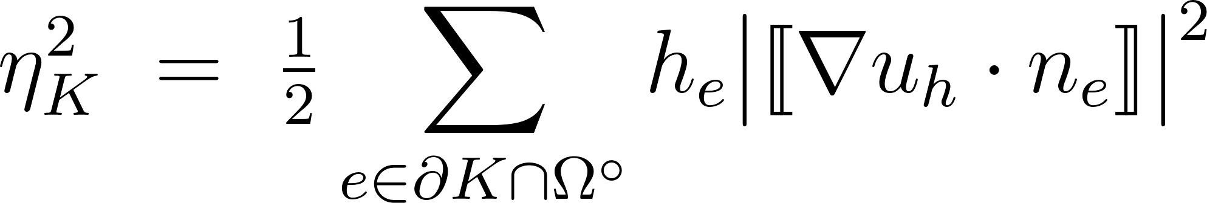
The process for adaptive FEM
1. A local error indicator ηₖ. For each element K, a computable proxy for how much error lives there. We use the gradient-jump indicator:
P1 gradients are discontinuous across element edges, and the size of the jump correlates with the local error.
2. Dörfler marking. Pick a bulk fraction θ ∈ (0,1). Mark the smallest set M whose squared indicators capture a fraction θ of the total:
Σ(K ∈ M) η²ₖ ≥ θ · Σ(K) η²ₖ
AESCAPE 2026 · Agentic AI · 43

Slide 44
Tools the FEM agent gets
Each takes a mesh_id and returns a dict.
solve_poisson(mesh_id) → {dofs, H1_error}
local_indicators(mesh_id) → summary stats of ηₖ
uniform_refine(mesh_id) → new mesh id
refine_by_threshold(mesh_id, theta) → Dörfler-mark and refine
check_convergence_rate() → log-log slope of the last 3 solves
stop(reason)
Guardrails, in the tools:
MAX_DOFS = 20000 — a refinement that would exceed it returns an error observation instead of allocating.
Every dispatch is try/except wrapped.
stop is the only terminal tool.
AESCAPE 2026 · Agentic AI · 44

