Slide 1
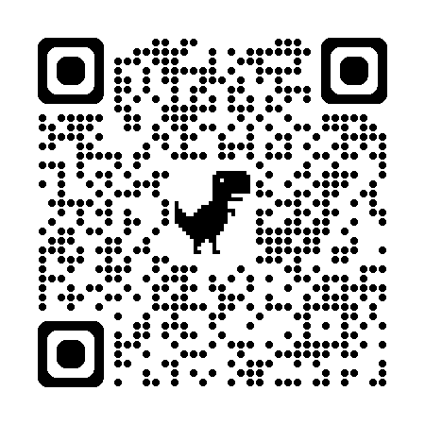

Introduction to Scientific Computing
ENGR1050 – Lecture 22
Fall 2026
Nat Trask
University of Pennsylvania
Final projects
Numerical optimization

Slide 2
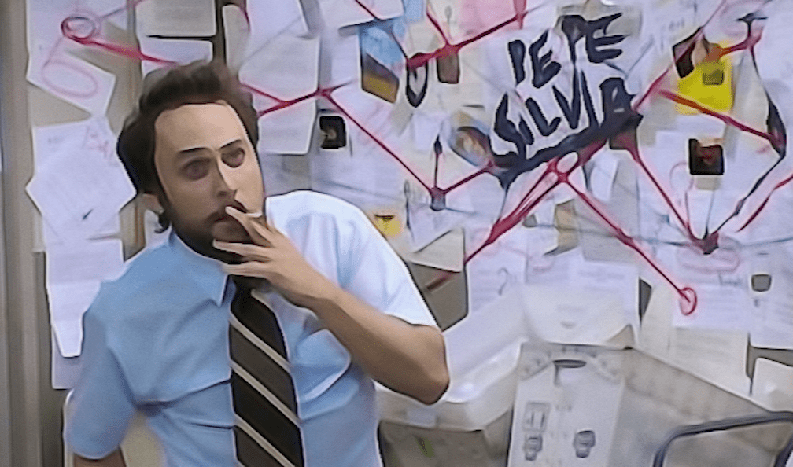
Final projects
Get orders in now
Numerical optimization
Precursor to machine learning, next lecture

Slide 3
Final projects
Groups of 1-4, $~25/person budget
Build a GitHub website to showcase your project
In-person presentations on the last day of class
Project
Invent something!
Order 1-2 new components
Use LLMs to teach yourself how to wire and use components

Slide 4
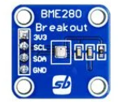
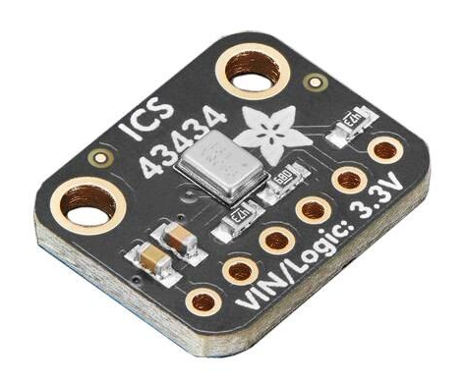
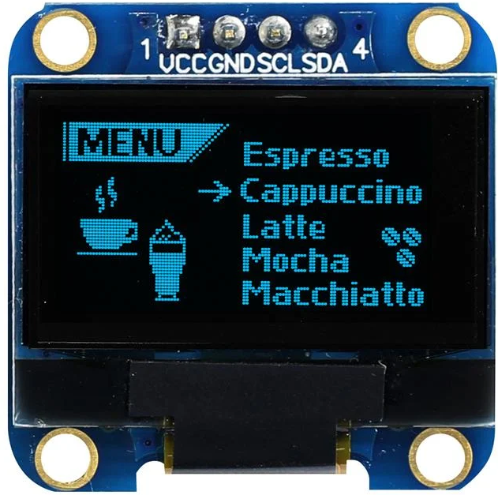
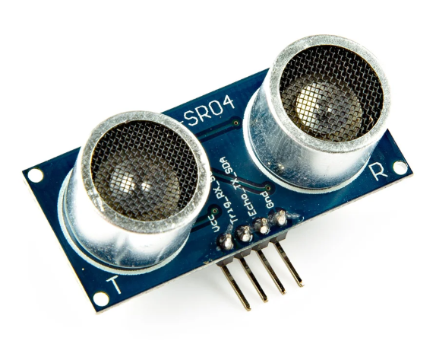
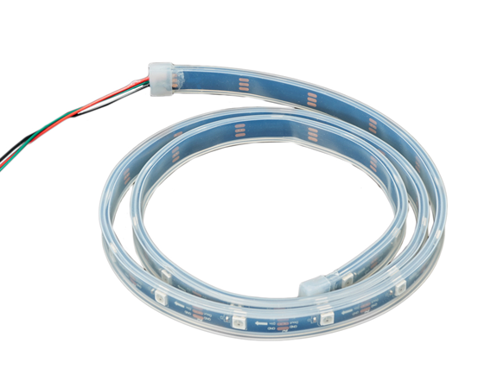
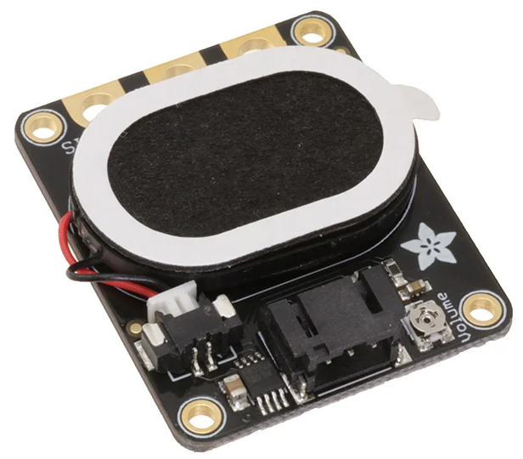
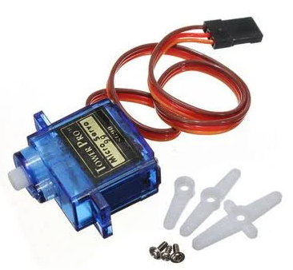
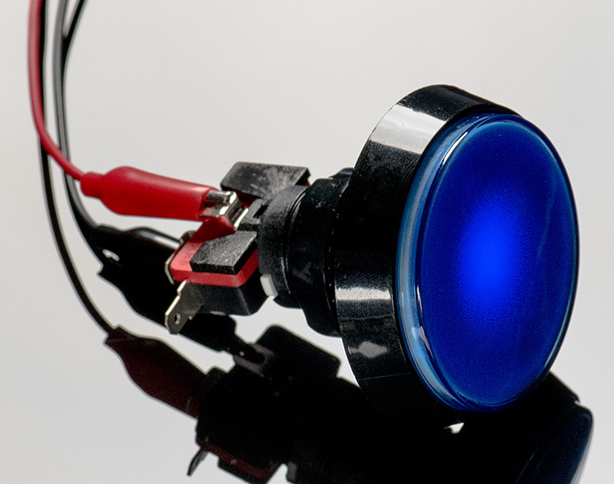
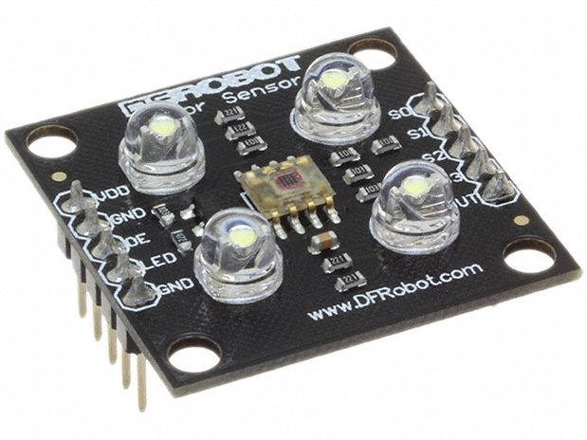
Examples of sensors
BME280
Pressure/temp/ humidity sensor
~$16
WEA012864DBPP3N00003
LCD display
~$8
6049
Digital microphone
~$5
HC-SR04
Ultrasonic rangefinder
~$7
1528-4801-ND
Targetable LED strip
~$13
3885
Speaker
~$8
SEN-101
Color detector
~$8
SG90
Microservo motor
~$4
Arcade button
Same as our buttons
~$6

Slide 5
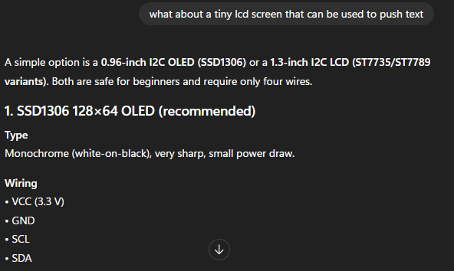
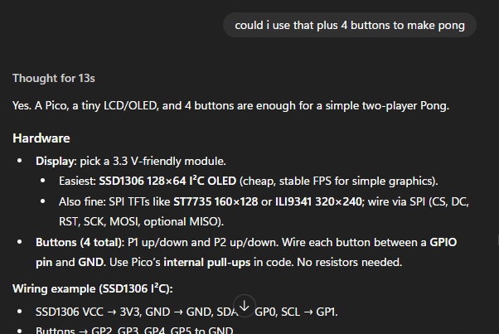
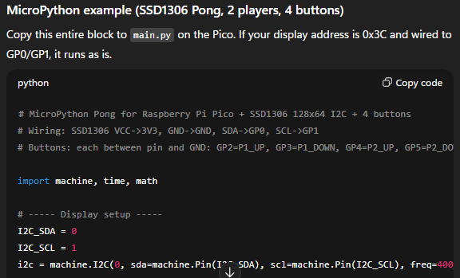
Expected difficulty: Gemini/GPT are your friends

Slide 6
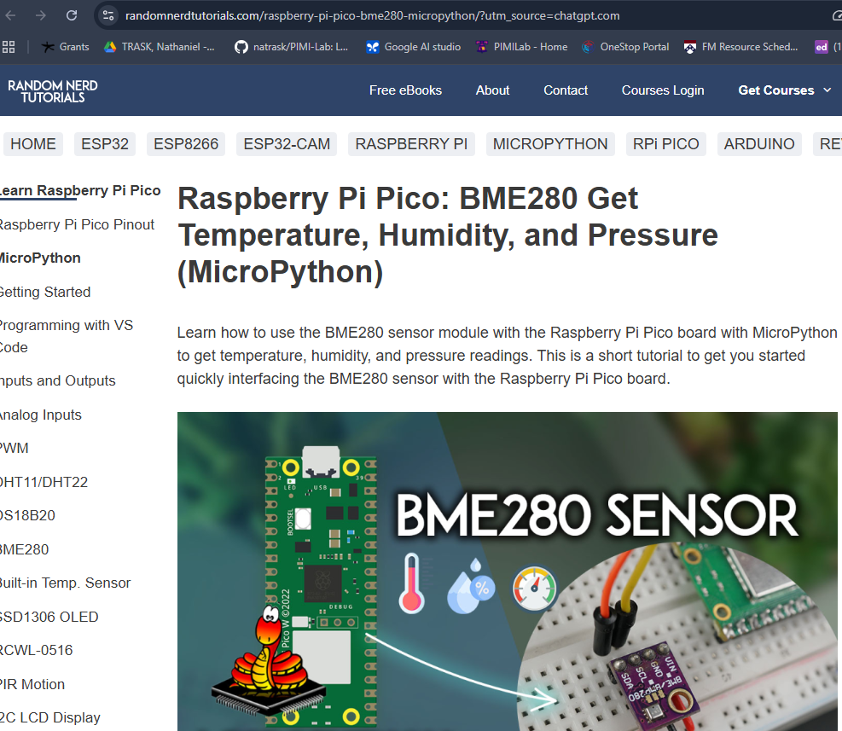

Slide 7
Some ideas
Audio visualizer
6049
Digital microphone
~$5
1528-4801-ND
Targetable LED strip
~$13
Theramin
HC-SR04
Ultrasonic rangefinder
~$7
3885
Speaker
~$8
Weather station
BME280
Pressure/temp/ humidity sensor
~$16
WEA012864DBPP3N00003
LCD display
~$8

Slide 8
Some ideas
https://randomnerdtutorials.com/projects-raspberry-pi-pico
https://how2electronics.com/raspberry-pi/raspberry-pi-pico-w-projects
https://www.dusuniot.com/blog/top-raspberry-pi-blogs

Slide 9
Grading Criteria
Independently make something
Make a video showing that you figured out how to make your components go and post it on your website
Must have python (even if a simple while loop to make circuit go)
No penalty for ambition
Build up your portfolio of design projects
Orders in by 11/18
Website due end of finals

Slide 10
Other options (no ordering required)
Make the 1D helicopter buttons so it goes up and down
Generate/find a dataset and use machine learning on it
Any other programming project is fair game, just run by Prof. Trask in OH to help dial in difficulty

Slide 11

Survey to get feedback
https://forms.gle/v7ebrYxueYxTTXpS9

Slide 12
Numerical Optimization

Slide 13
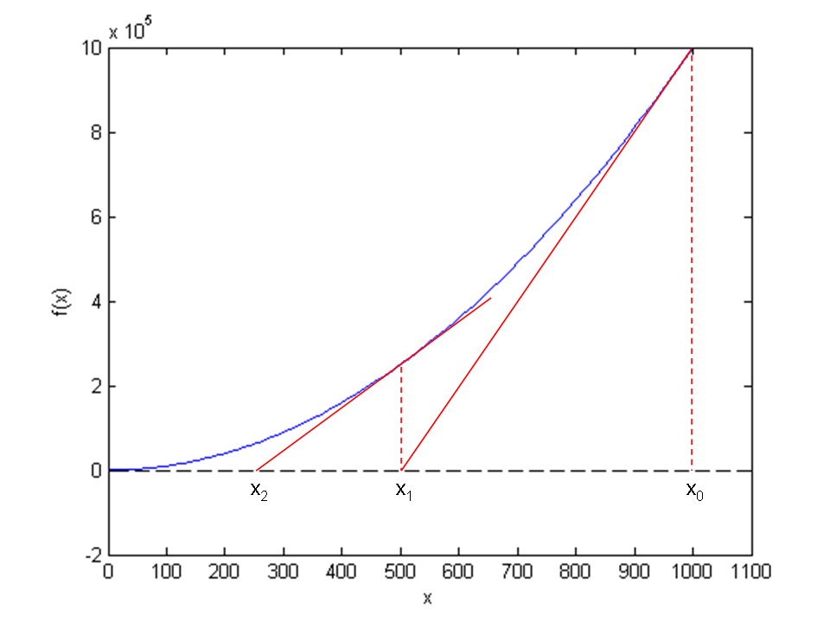
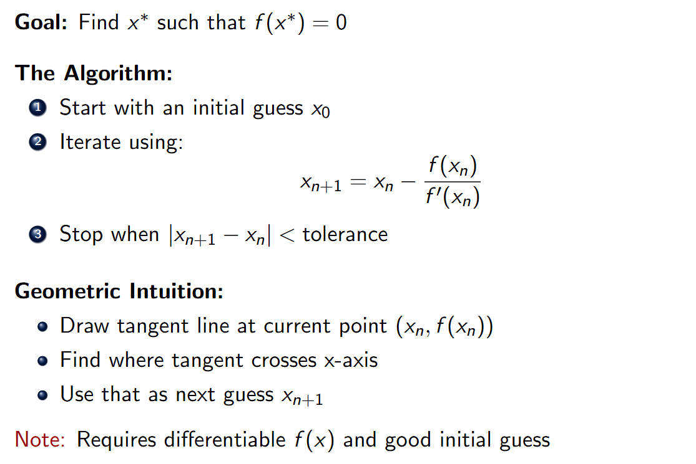

Newton’s method to solve nonlinear equations

Slide 14
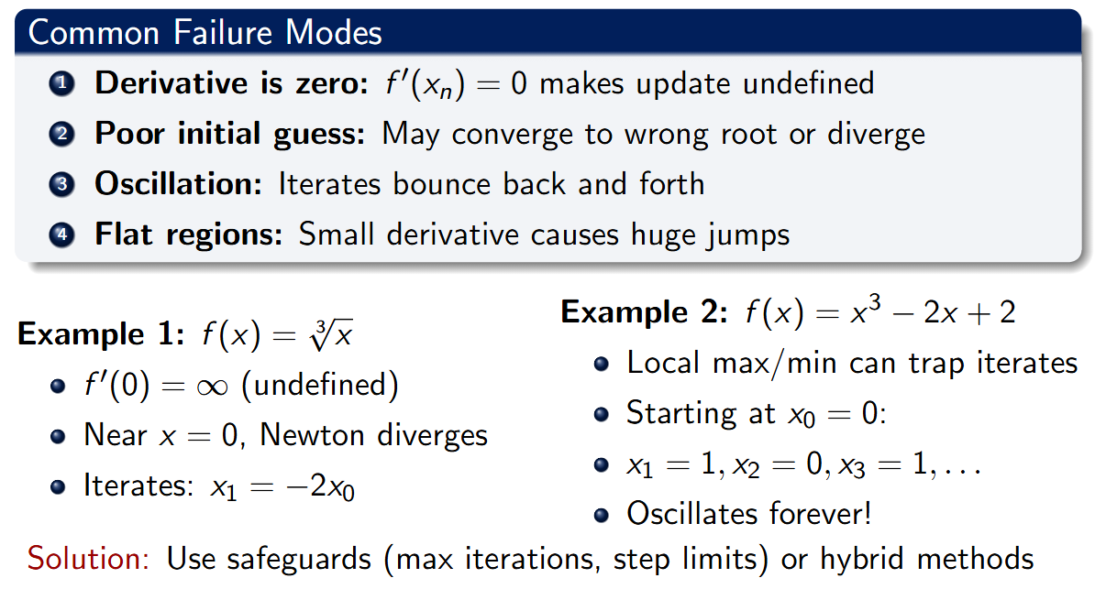
Newton is not guaranteed to converge!

Slide 15
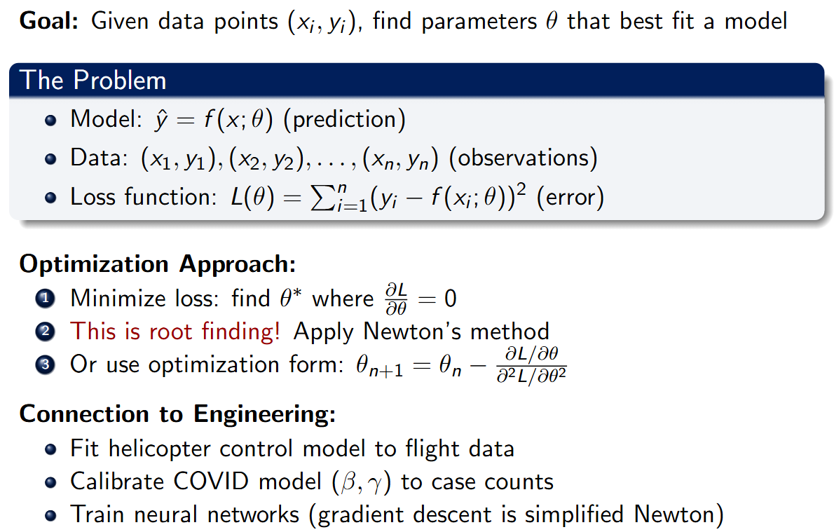
Supervised learning

Slide 16
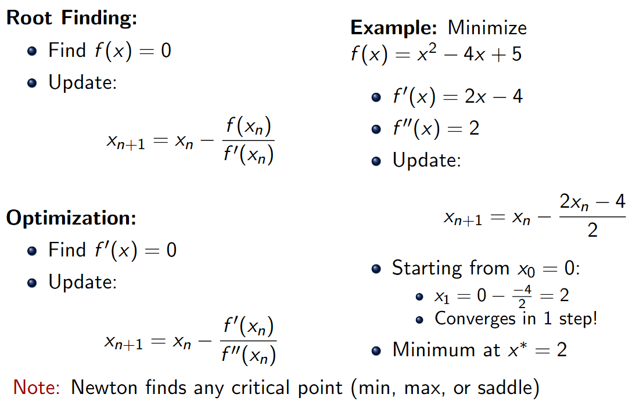
Applying Newton to optimize a function

Slide 17
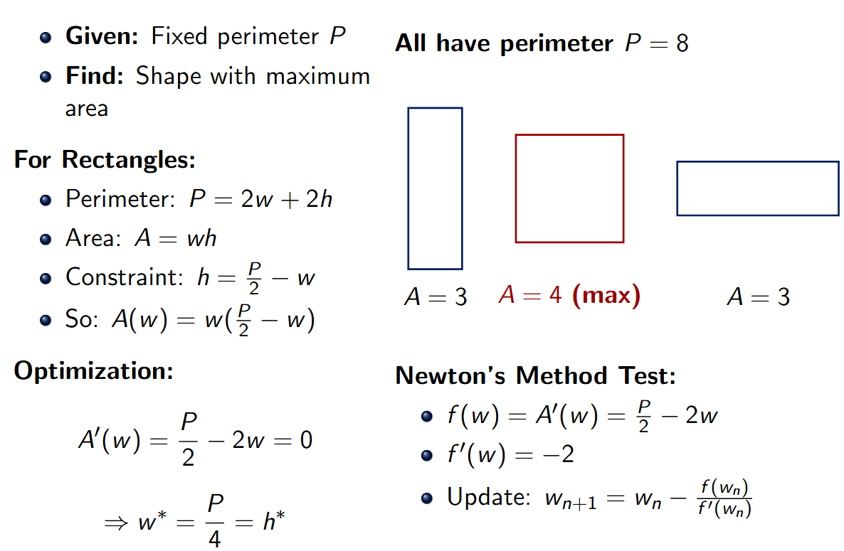
Today’s exercise: implement Newton, use the isoperimetric problem to check
Submit on Canvas

Slide 18
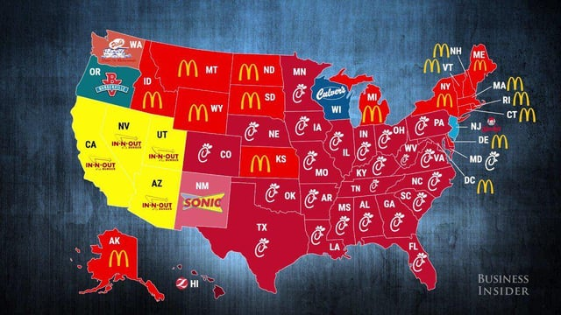
Next homework out, due Monday

