Slide 1
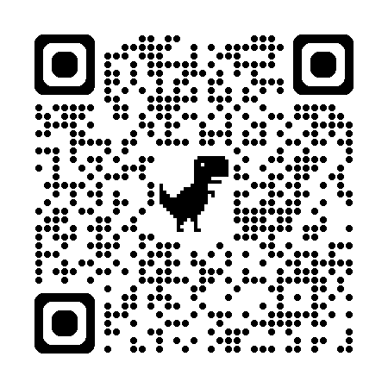

Introduction to Scientific Computing
ENGR1050 – Lecture 1
Fall 2025
Nat Trask
University of Pennsylvania

Slide 2
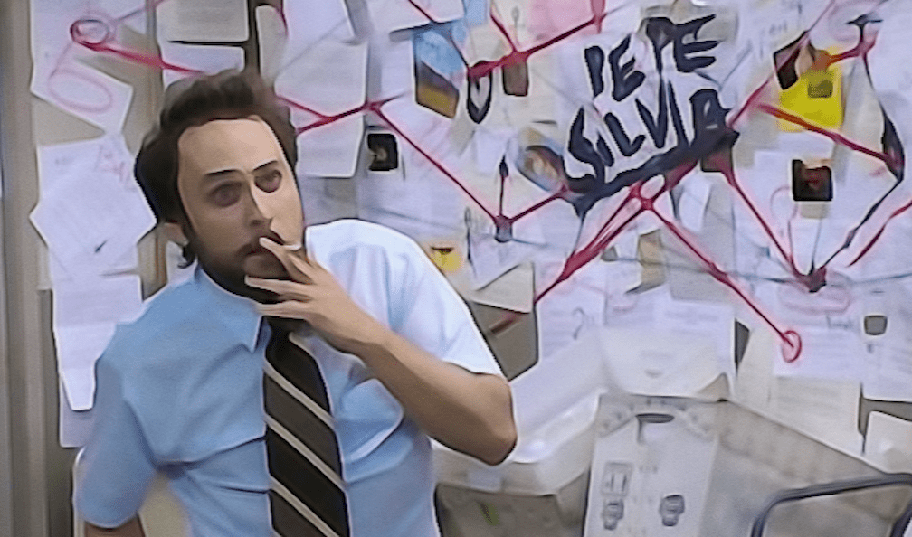
Computing
What is it
Course Organization
Syllabus, Schedule, Gameplan
Hello World
Submit a dummy assignment to make sure you have a working environment

Slide 3
Who am I?

Slide 4




About me
I joined Penn as an Associate Prof in August 2023
I was senior staff at Sandia National Laboratories 2016-2023, and hold a joint faculty appointment still
I earned my Ph.D. in Applied Mathematics at Brown University in 2015, and hold dual Bachelor degrees in Mechanical Engineering and Applied Mathematics from University of Massachusetts.
I’ve run a consulting simulation business since 2010.
My research focuses on integrating AI/ML with simulation to predict extreme physics

Slide 5
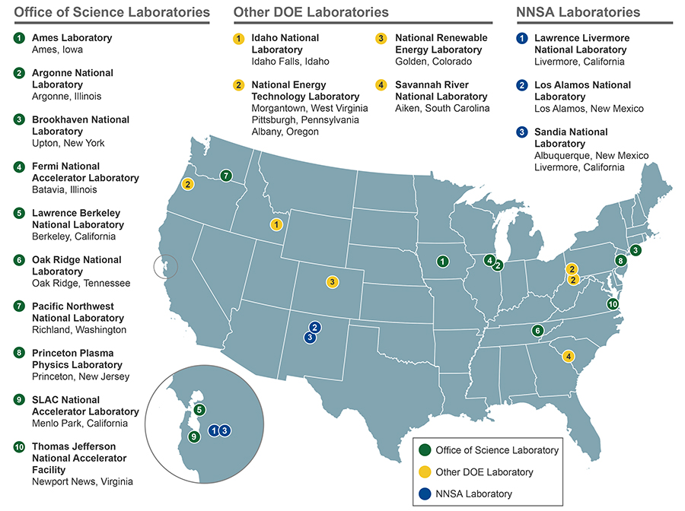

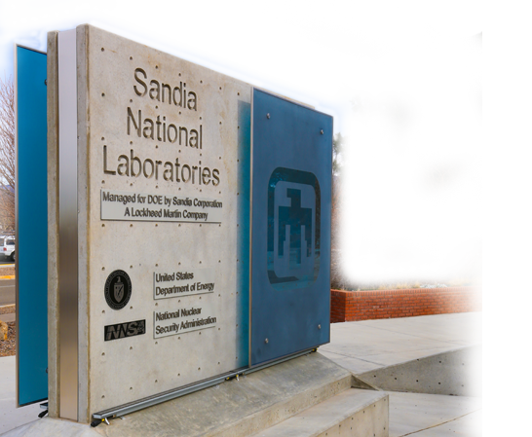
Department of Energy and the National Lab Complex
What is a national laboratory?
Funders of science in US:
DoD $120B/yr
NIH $33B/yr
DoE $19B/yr
NSF $8B/yr
(2023 numbers)
Sandia Albuquerque

Slide 6
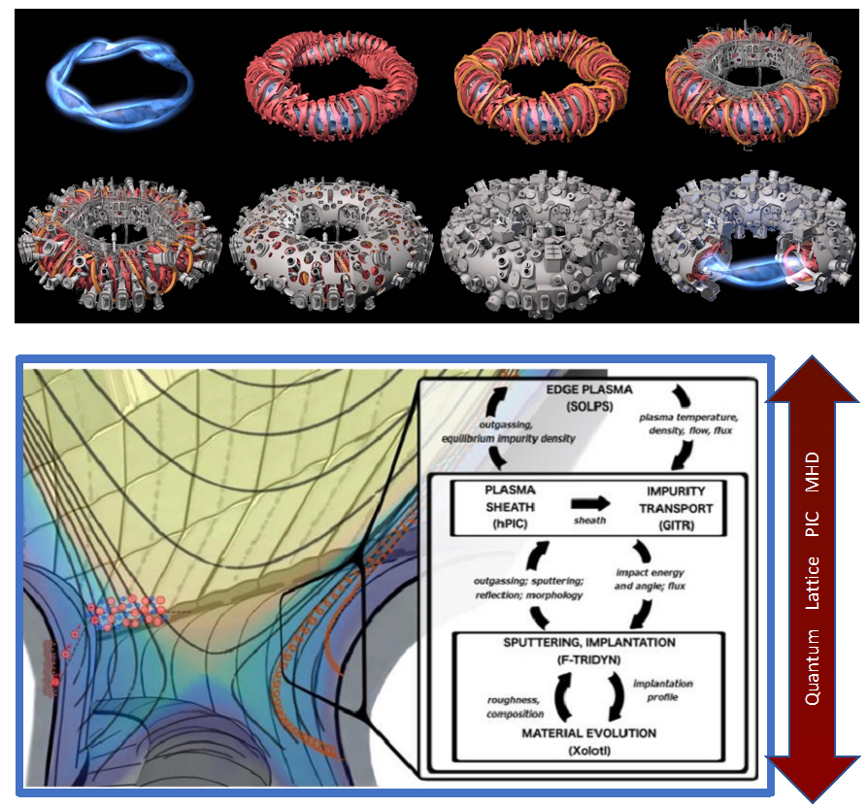
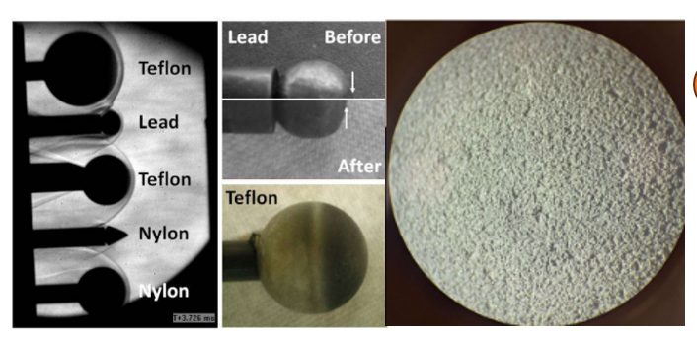
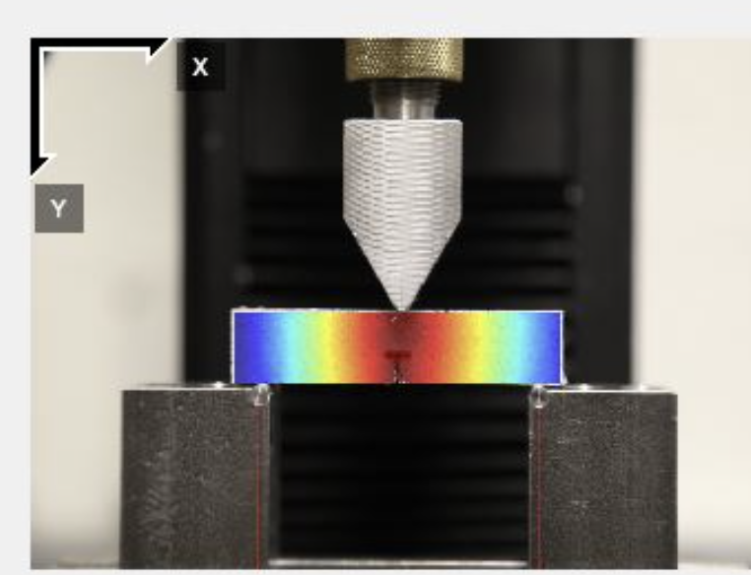
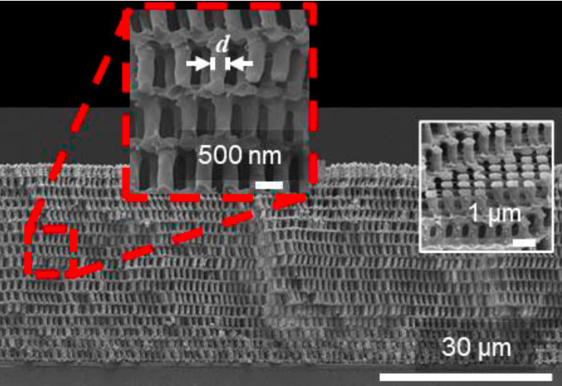
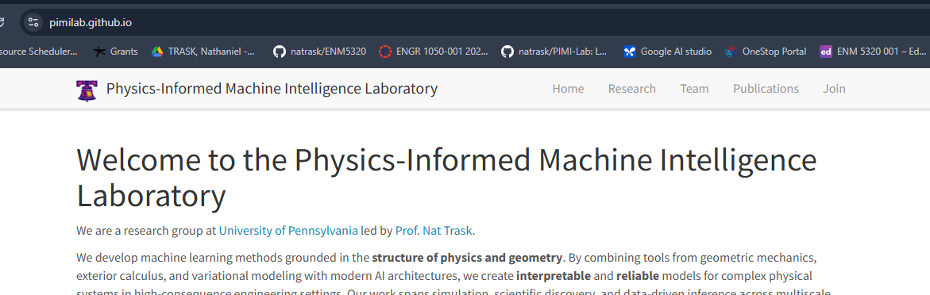
My research: AI/ML for extreme physics systems

Slide 7
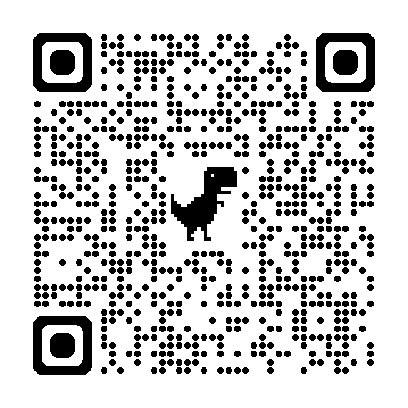
Who are you?
https://forms.gle/Umy16mfbfLs4cYU9A

Slide 8
What is scientific computing, and why are we learning how to do it?
(It is not the same as normal computing)

Slide 9
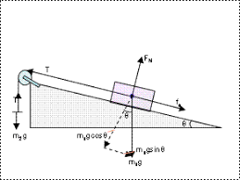
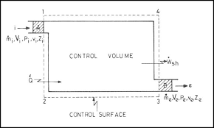
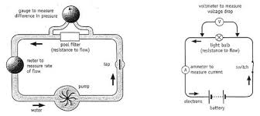
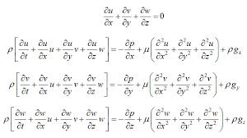
Scientific computing is programming to solve models of physical systems
Free body diagrams
Control volume analysis
Circuit models
Differential equation models
During your degree, you will learn to build mathematical models that describe the behavior of physical systems and let you optimize their design

Slide 10
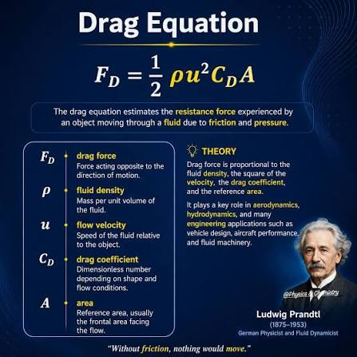
Analytical models vs experiments, computation, and statistical models
Analytical models are
Good at:
Giving closed form expressions
Interpretability
Exploring qualitative regimes
Bad at:
Handling real world complexity
Limited by the math we can work out by hand!

Slide 11
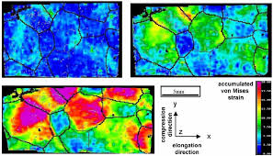
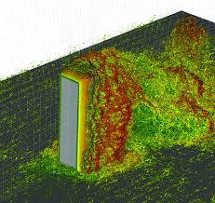
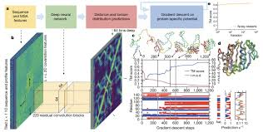
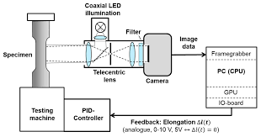
Analytical models vs experiments, computation, and statistical models
When we can’t get an analytical model?
Experimental methods
Computational methods
Statistical/AI methods

Slide 12
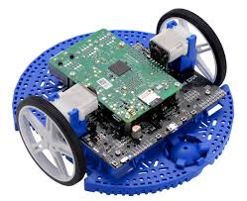
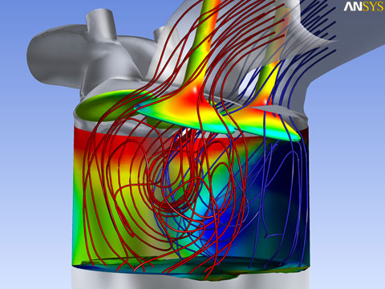

Scientific computing, from the big to the small
Microcontrollers
Small computers controlling engineering systems and robotics
Industrial Computation
Simulations for industrial design that run on a desktop workstation
Supercomputing
Solving the biggest open problems in science + AI
consuming the power of
16000 homes

Slide 13
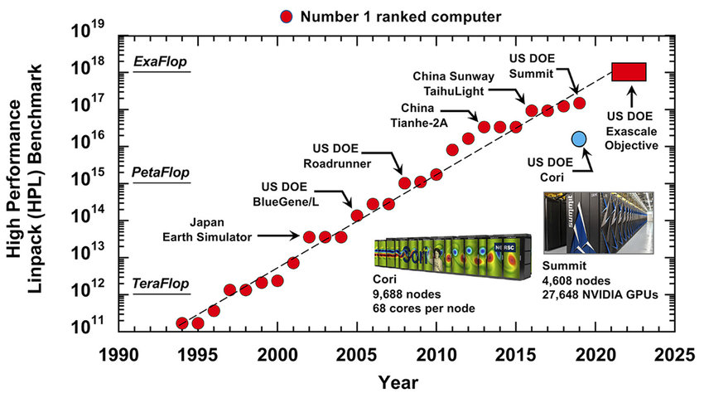
Big: Supercomputers represent the largest scientific problems that can be solved

Slide 14
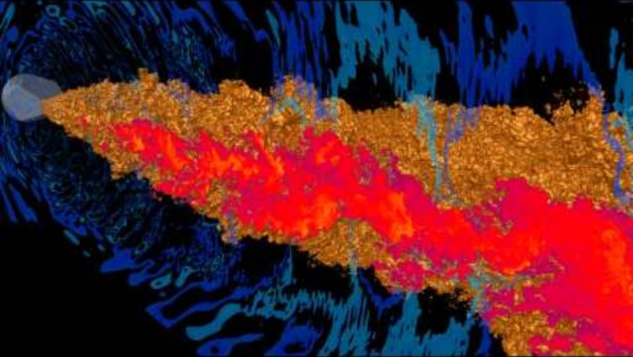
Massive scale turbulence simulation

Slide 15
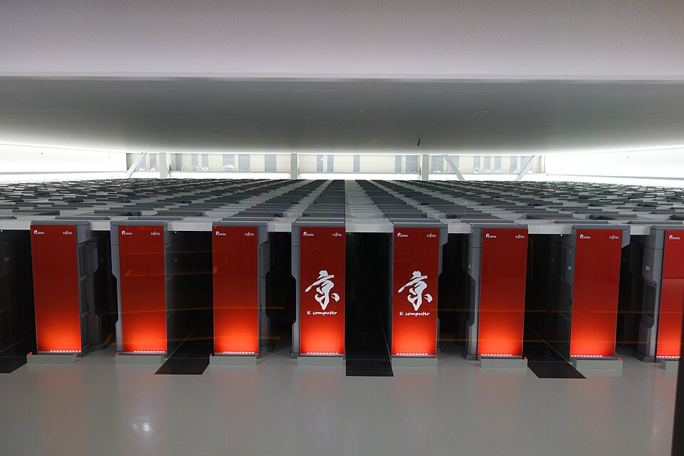

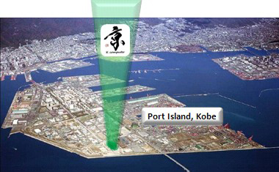
Supercomputers represent the largest scientific problems that can be solved

Slide 16
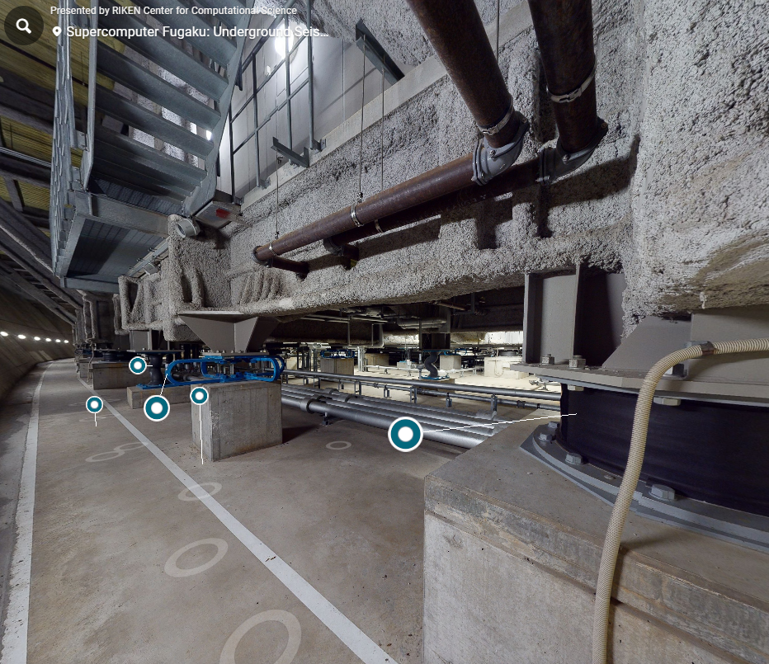
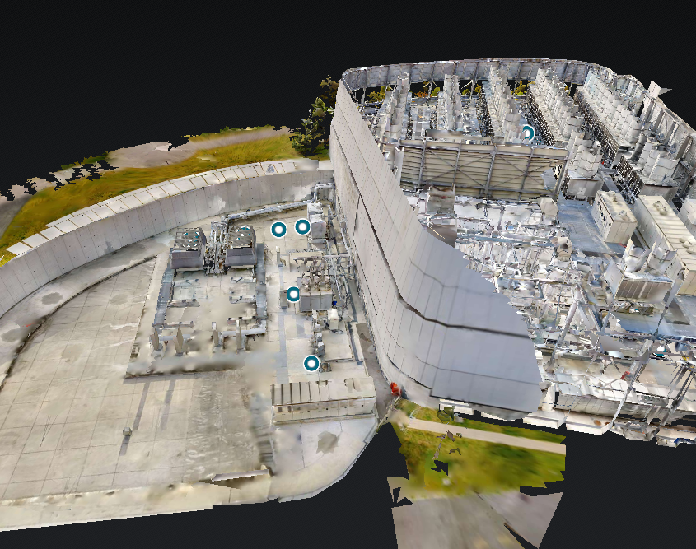
Supercomputers represent the largest scientific problems that can be solved
Virtual tour of earthquake isolation system
Virtual tour of cooling and power plant

Slide 17
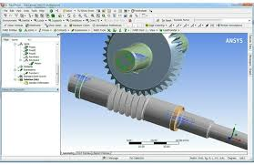
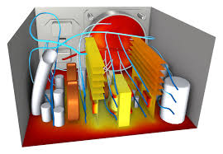
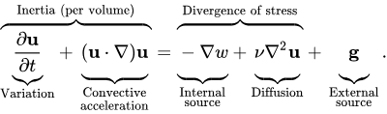


Medium: computational fluid/solid mechanics + electromagnetism
Mathematical model describes flow
Conservation of mass/momentum/energy
CAD geometry gives discrete model
Map equations onto something we can solve on a computer

Slide 18
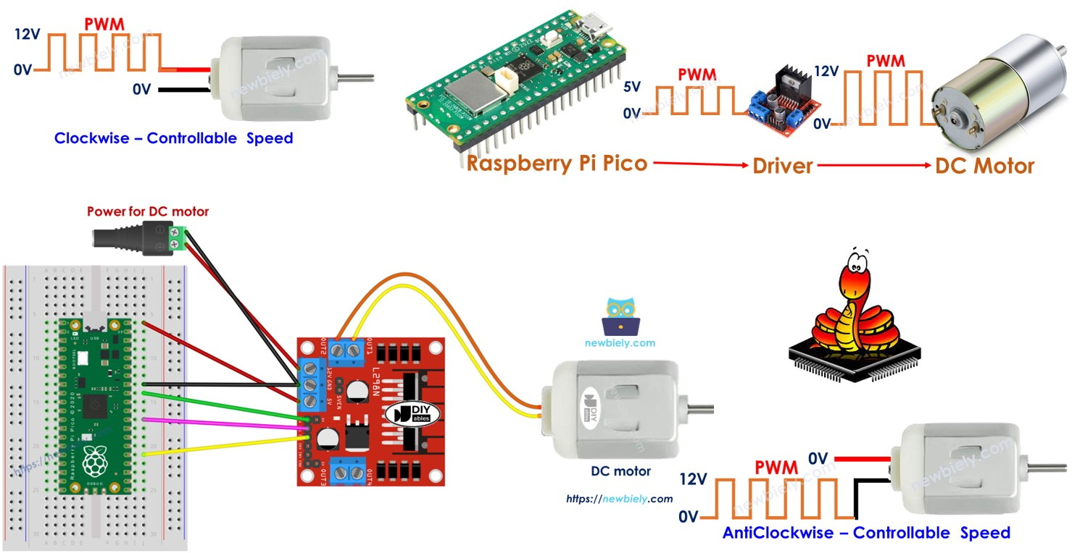
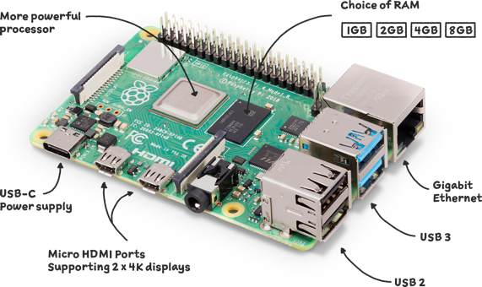
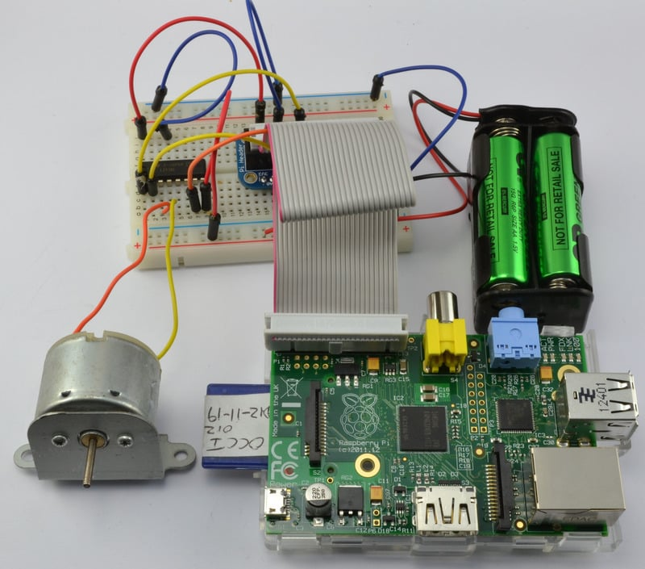
Small: Microcontrollers for robotics
Lightweight computers integrated with sensors
Useful for robotics, prototyping designs,

Slide 19
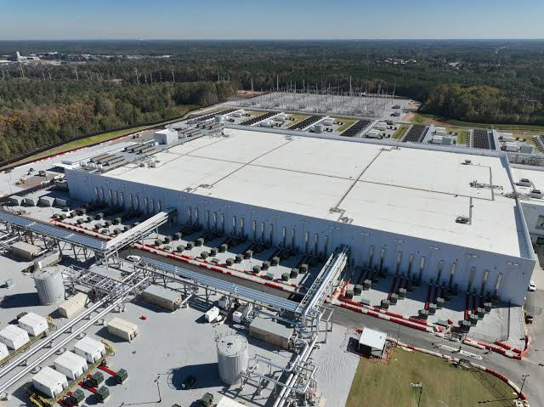
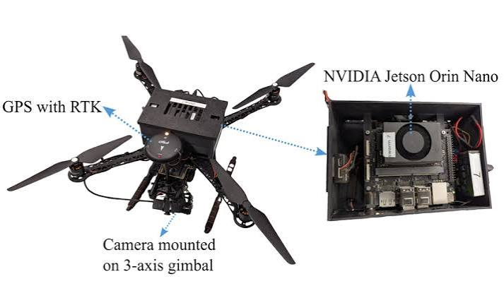
The future: AI for science and engineering
Massive AI models consuming a city’s worth of power
AI-driven coding, scientific discovery, and beyond
Compact AI chips small enough to fly on a drone
Smart sensing and control telling engineered systems what to do

Slide 20
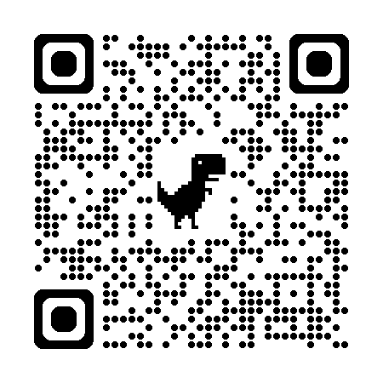
How is this course organized?
All material is on the course Github:
https://natrask.github.io/engr1050-fall2026
All assignments are submitted through canvas:
https://canvas.upenn.edu/courses/1950130/assignments/syllabus

Slide 21
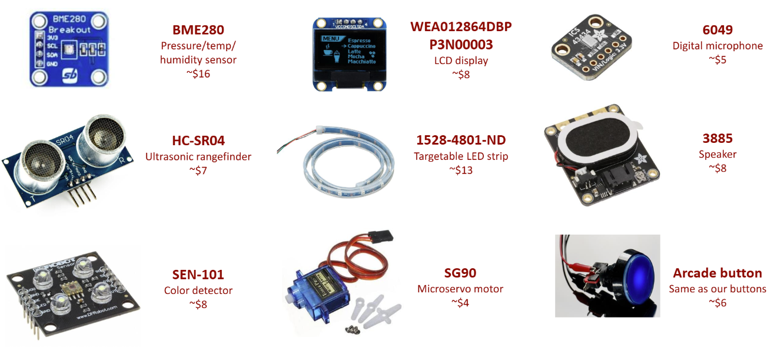
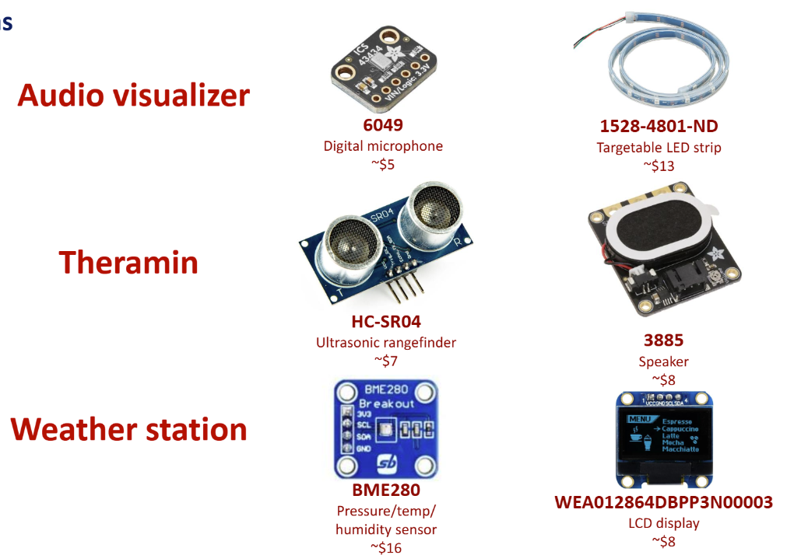
How is this course organized?
Part 1:
Python basics
Goal: Comfortable reading and interpreting code
Exam 1
Part 2:
Simulators and robots
Goal: Get practice deploying basics
Exam 2
Part 3:
Machine learning + AI
Goal: Learn how AI works and how to use it to code
Exam 3
Final Project

Slide 22
Types of lectures that we’ll do
Groupwork days
Short guidance (<30m) on new material, what to do
Break into groups of 2-5
I+TA will float around answering questions
Periodic check-ins to stay on task
Submit work on canvas when complete
Coding demo days
Slides introducing new concepts
Blackboard for derivations
Live coding where I will step through how to approach a problem
Labwork days
Meet in the GM lab in Towne
Will be listed ahead of time on course calendar with reminder on Ed
Working with microcontrollers
Some free lectures at end of semester to work on final projects w/ groups
“Exam” days
Closed book
Problems taken primarily from HW and in-class exercises
Pencil and paper written exams
Easy if you have done material on your own

Slide 23
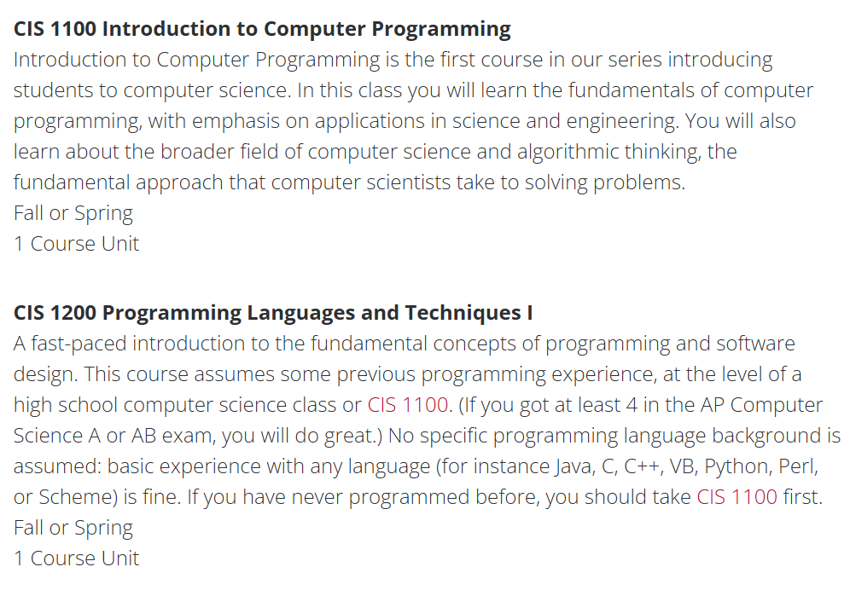
Should I take this or should I take the CIS equivalent
Satisfies the same requirement for some majors
This class is more hands on
Tailored to specific needs of engineering majors
Scientific computing, differential equations, Arduino, hands-on
CIS1100/1200 sets up for higher-level CIS sequence
If you plan to take upper level CIS classes, ENGR1050 may not be best option
Happy to discuss if you have questions.
If you need a course substitution form filled, bring it to my office hours

Slide 24
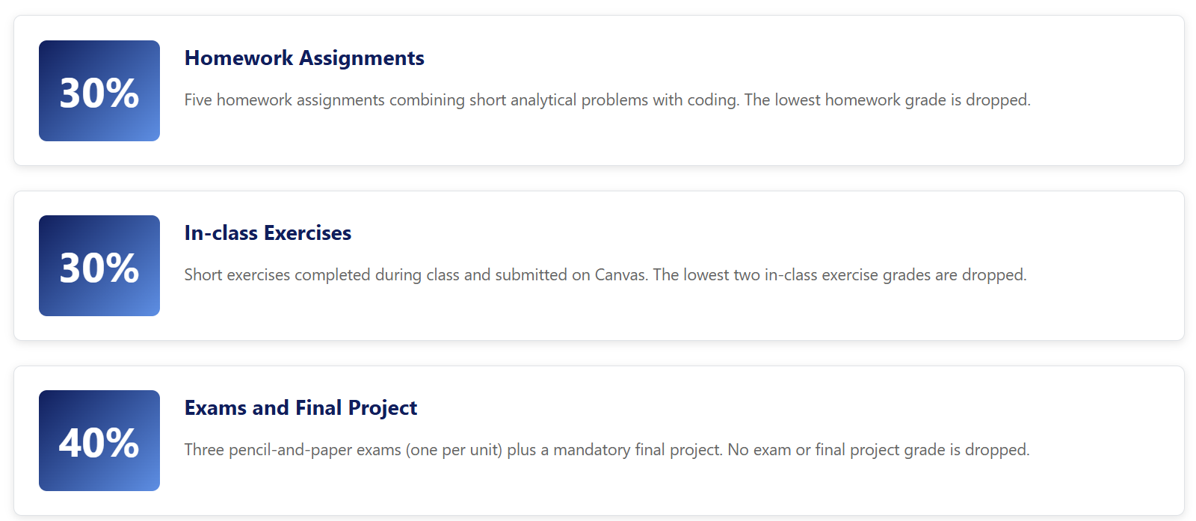
Grading policy

Slide 25
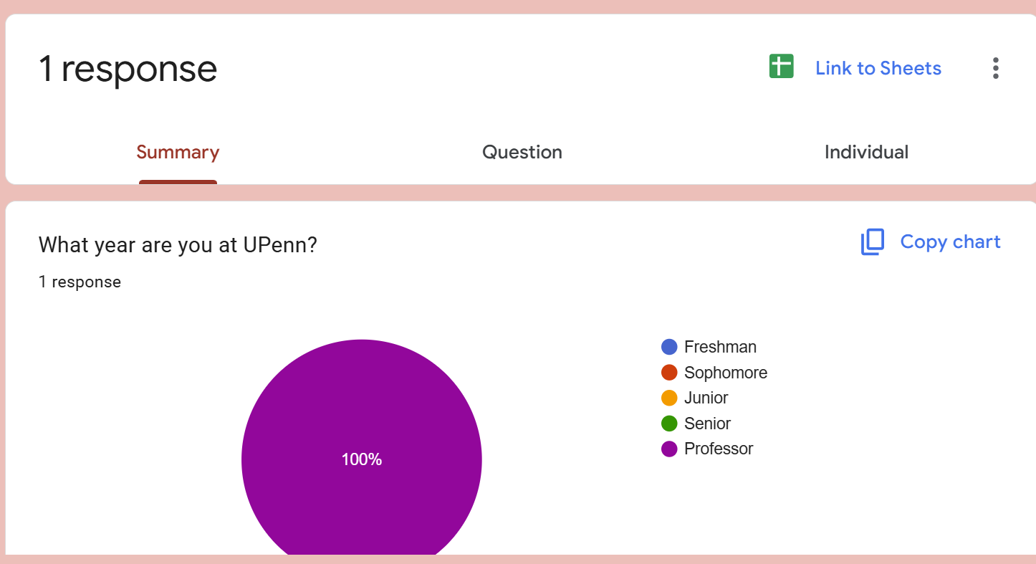
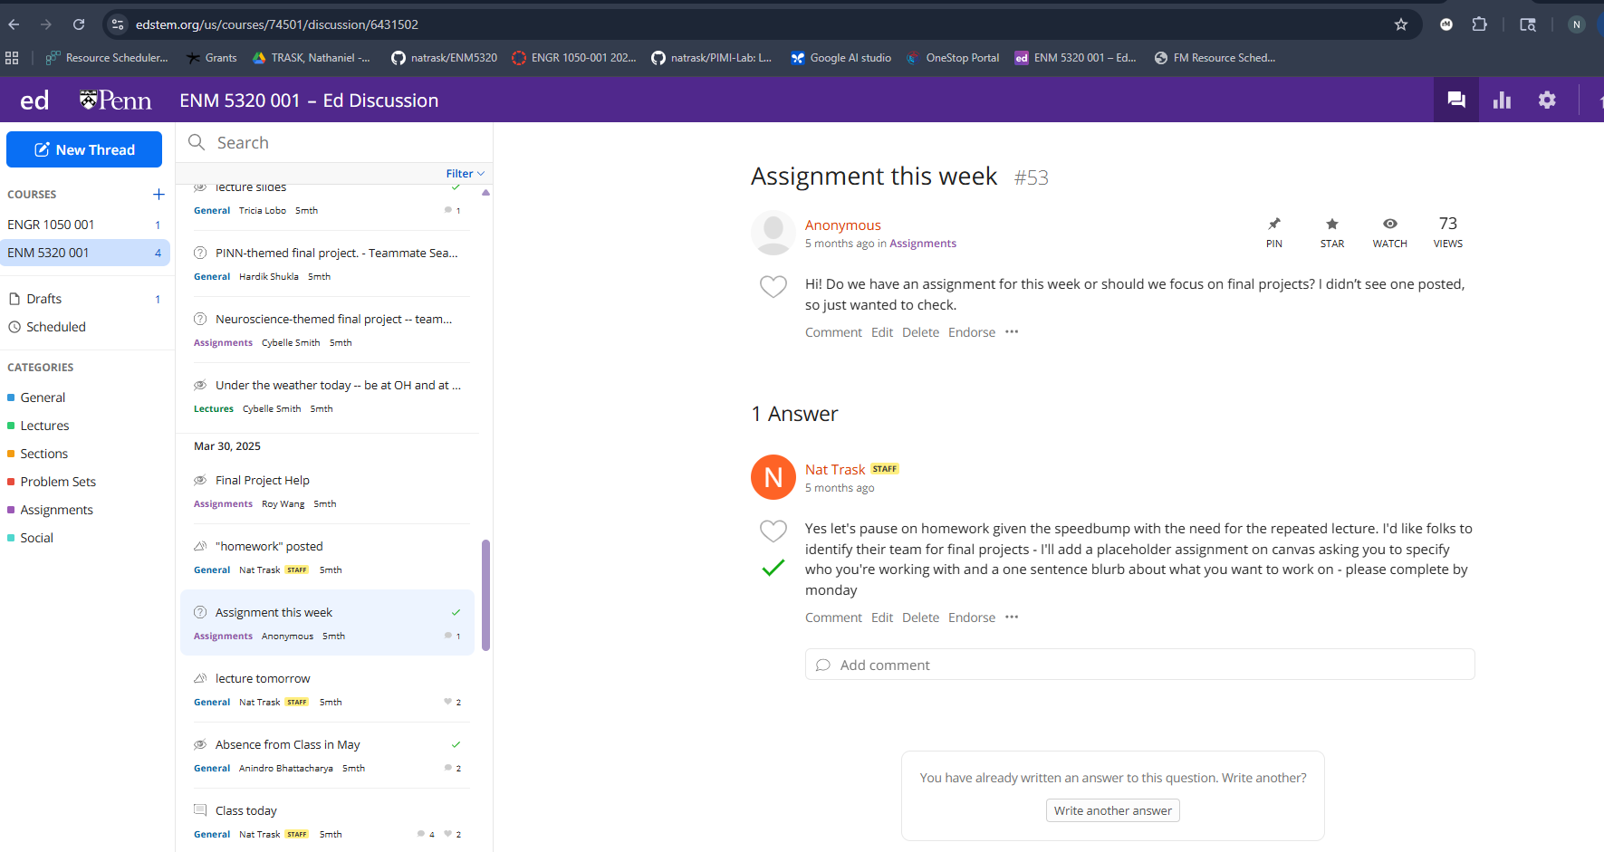
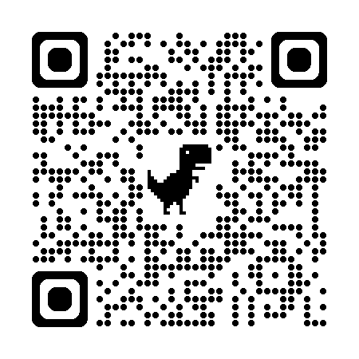
Communication with Prof. Trask outside of class
1. Office hours!
2. Surveys
3. Ed messages
(Do not count on me responding to any email)
Responses through surveys

Slide 26
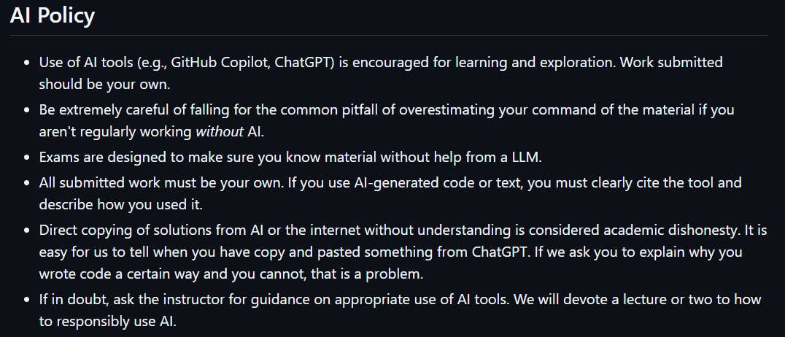
AI policy

Slide 27
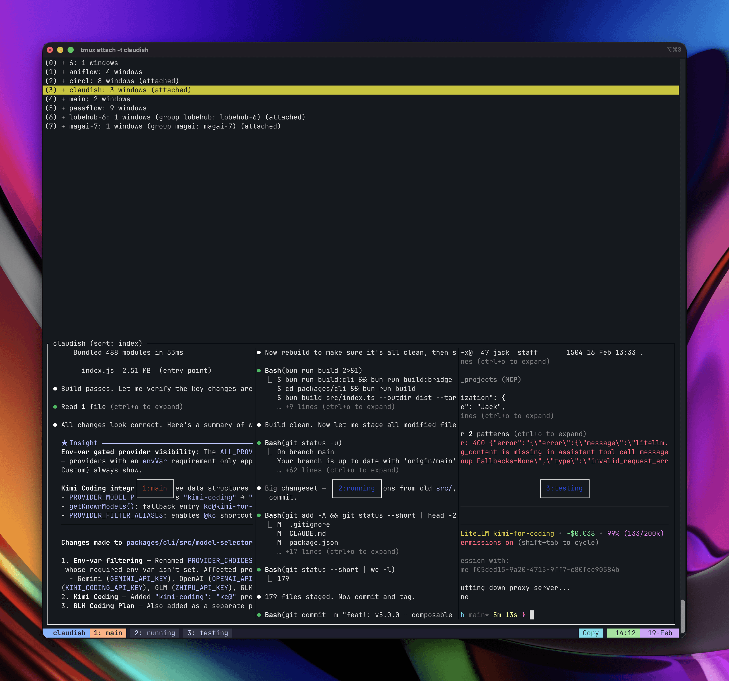
Advice: Be patient, build muscle memory, and wait for the structured AI boot camp
Section 1: Basics
Learn the basic Python syntax
Do many exercises/etudes/drills to internalize patterns
Beware this exam!
Section 2:
Build simple simulators
Build simple robots
Get practice applying the basics
Hold off on AI until you at least get through one round of programming!
Section 3:
Open the AI floodgates
Implement the basic methods of AI
Learn how to responsibly use AI-assisted coding tools
Learn about pitfalls
Learn how to learn with AI

Slide 28
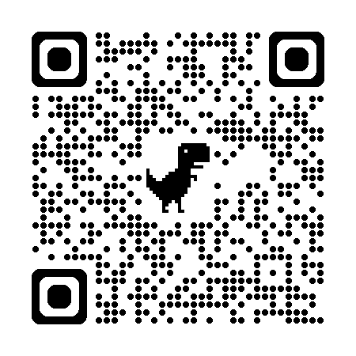
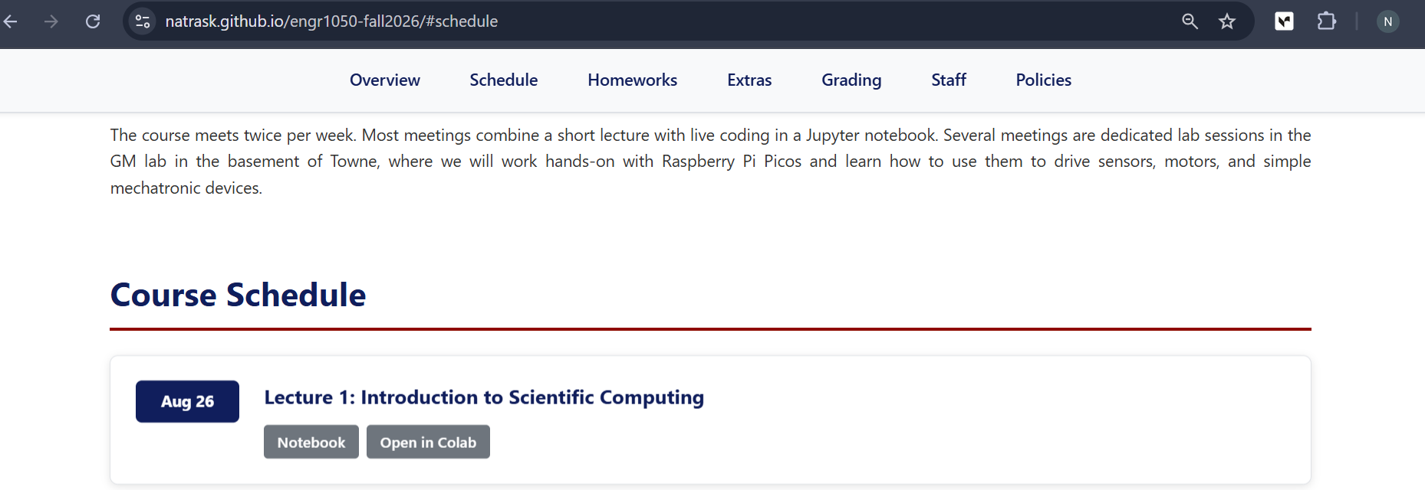
Rest of class, we will be working through a jupyter notebook

Slide 29
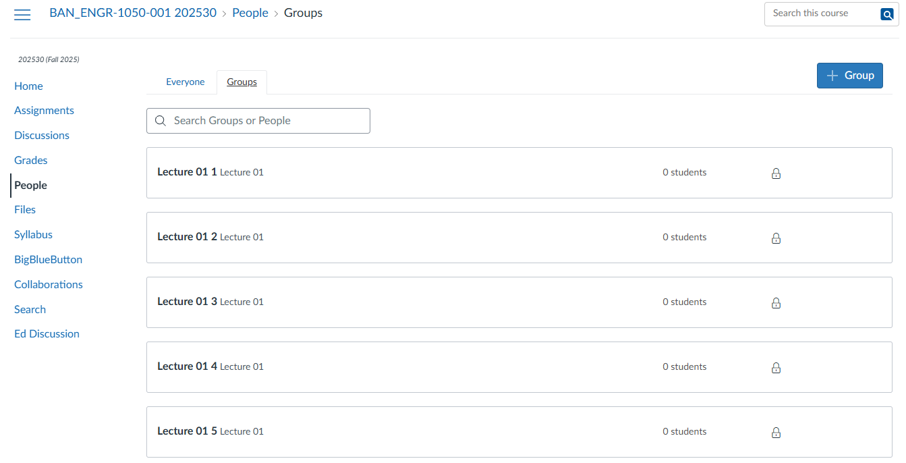
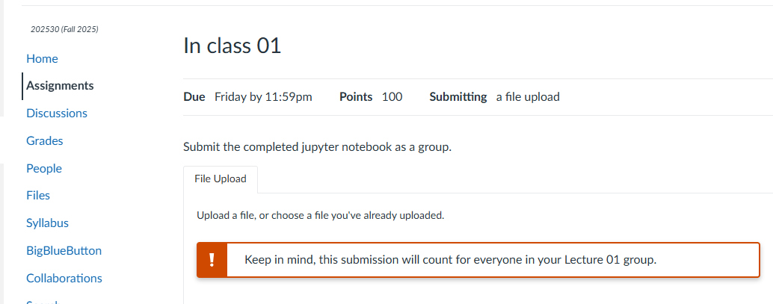
Group work submission on canvas
Step 1: Join group
Open canvas
Click people tab
Choose group (Lecture 1)
Identify an empty group slot
Have everyone in your group join the same one
You are now a group!
Step 2: Submit to canvas
One group member needs to submit
Automatically distributed across whole group
Double check that it shows up as submitted for everyone in group

