Slide 1
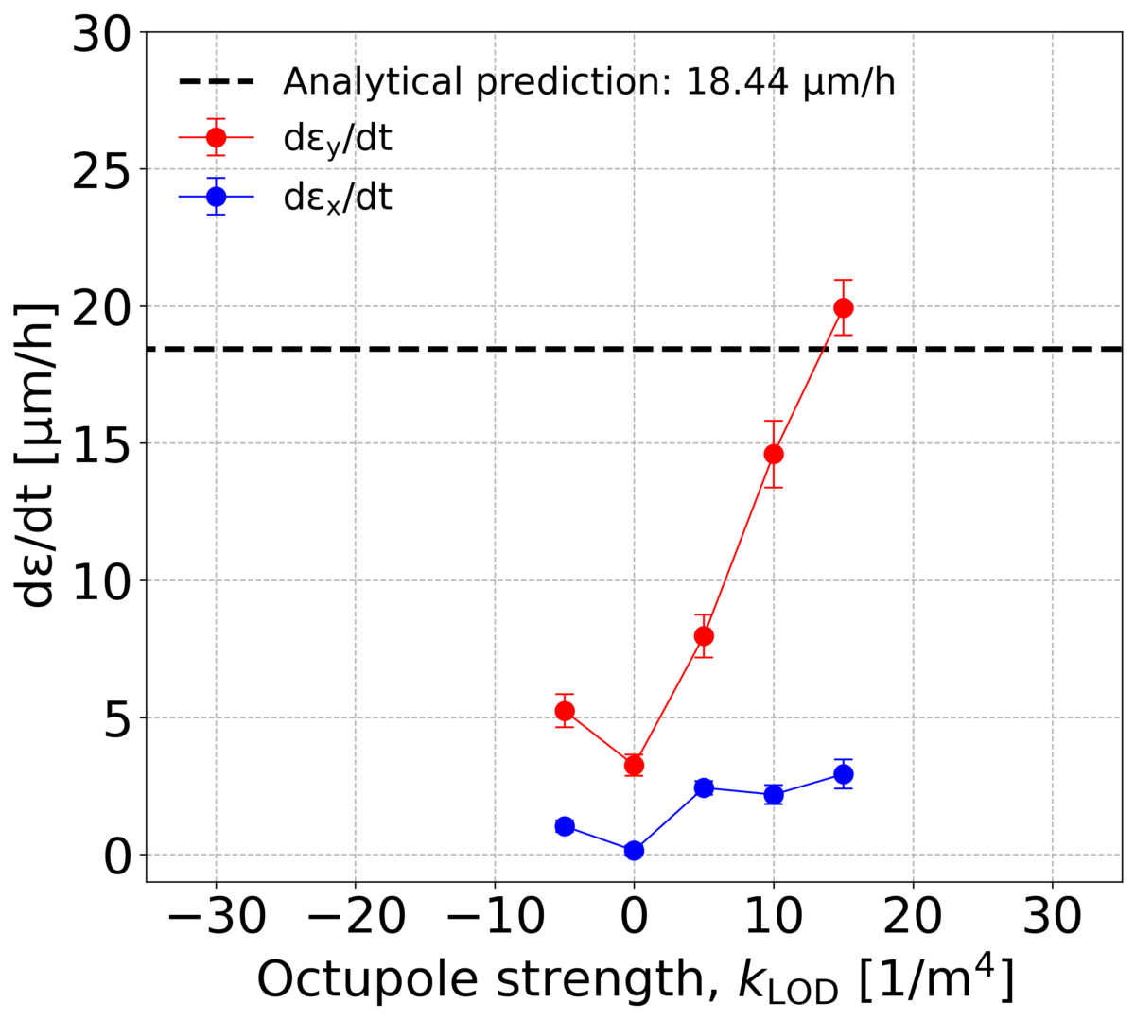
No measurements:
vertical instability

