Slide 1
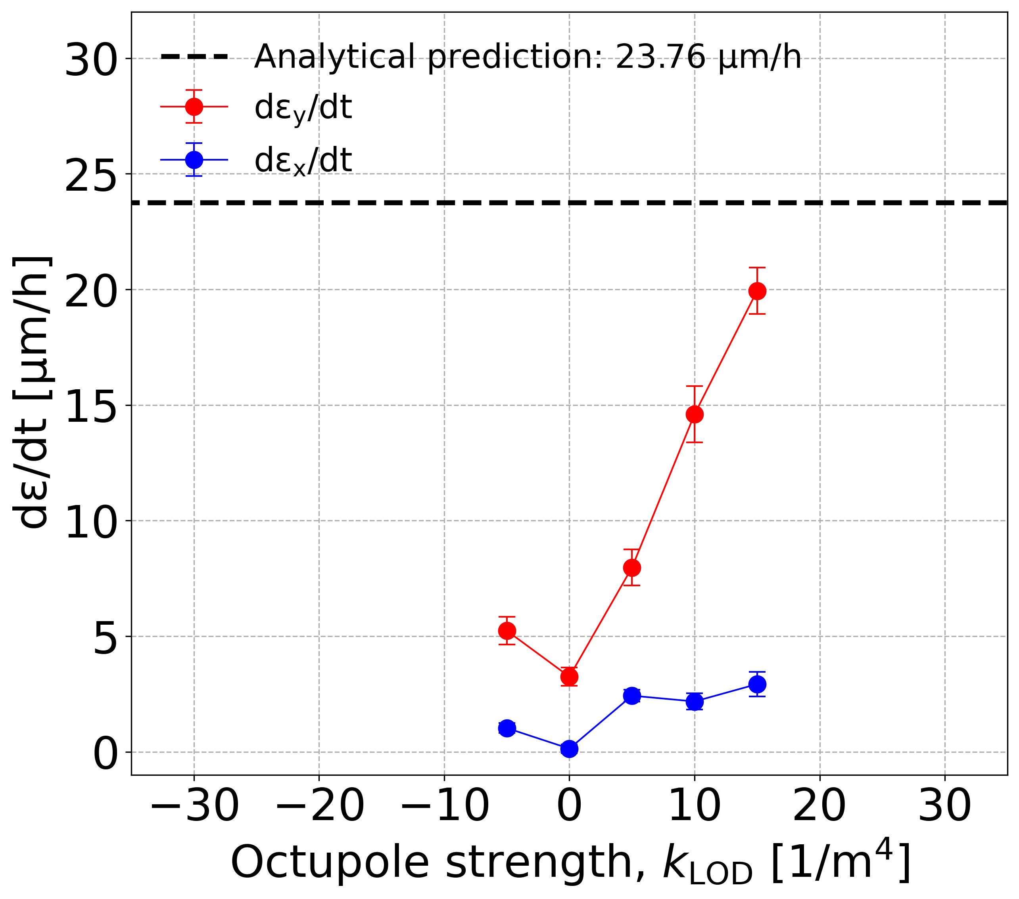
No measurements:
horizontal instability

