Slide 1


Institute of Physics and Technology
Intellectual Data Analysis
Practice 8: Image Generation with Neural Nets
Dr. Nataliya K. Sakhnenko
Please review Lectures 12-13 before this practical
1
1
1
1
1
1
1
1

Slide 2
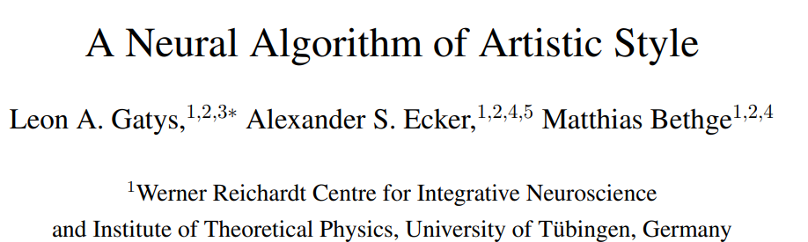
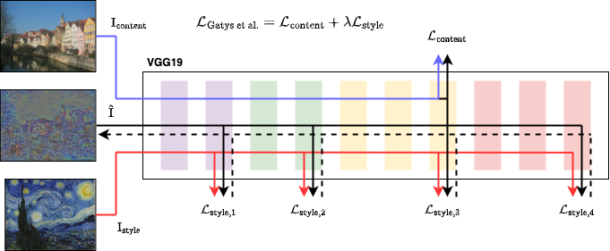
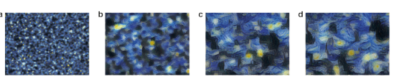
Neural Style Transfer
https://docs.pytorch.org/tutorials/advanced/neural_style_tutorial.html
2015
2

Slide 3
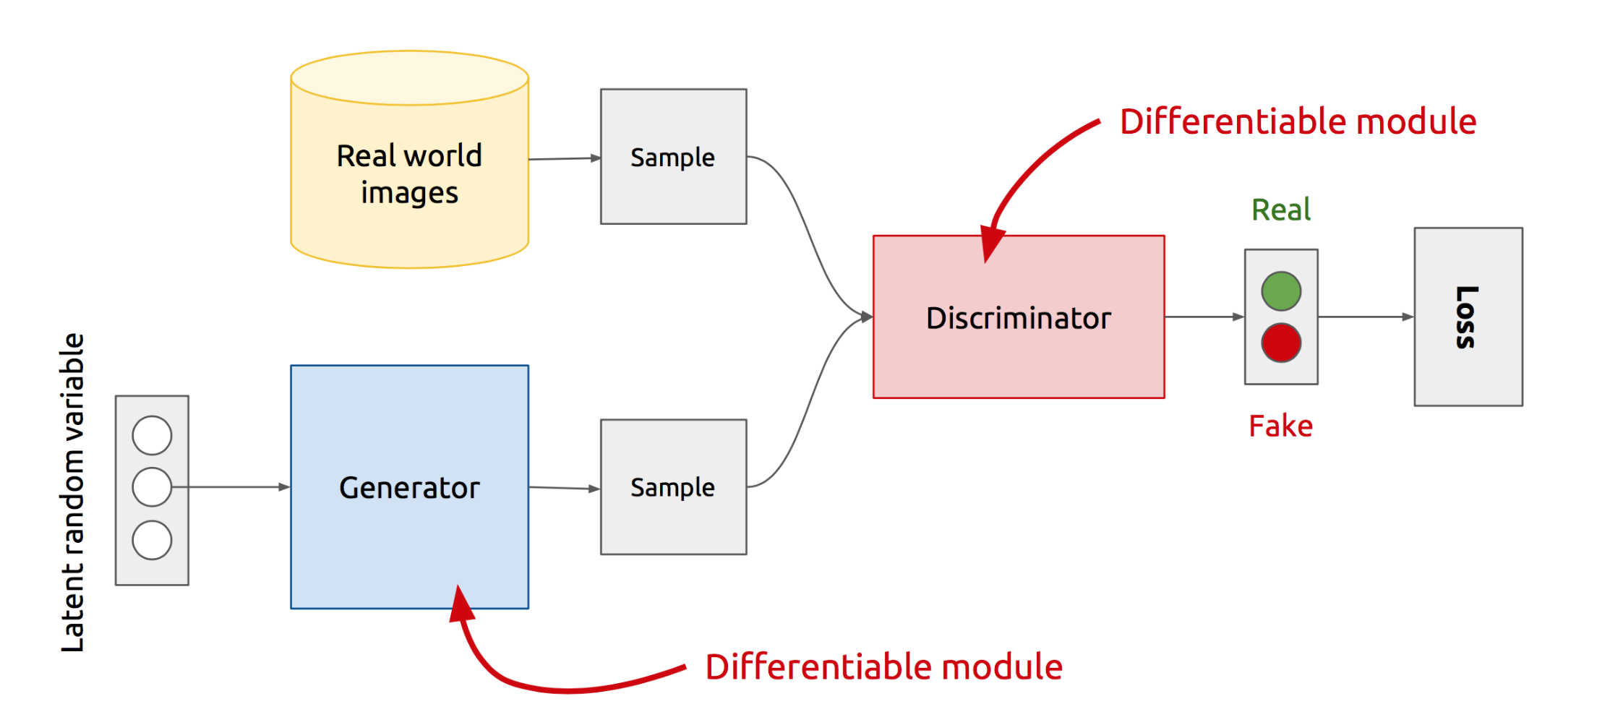
GAN’s Architecture
x
D
D(x)
G
z
G(z)
D(G(z))
  Generator: generate fake samples, tries to fool the Discriminator
  Discriminator: tries to distinguish between real and fake samples
  Train them against each other
  Repeat this and we get better Generator and Discriminator
Z is some random noise (Gaussian/Uniform).
Z can be thought as the latent representation of the image.
3

Slide 4
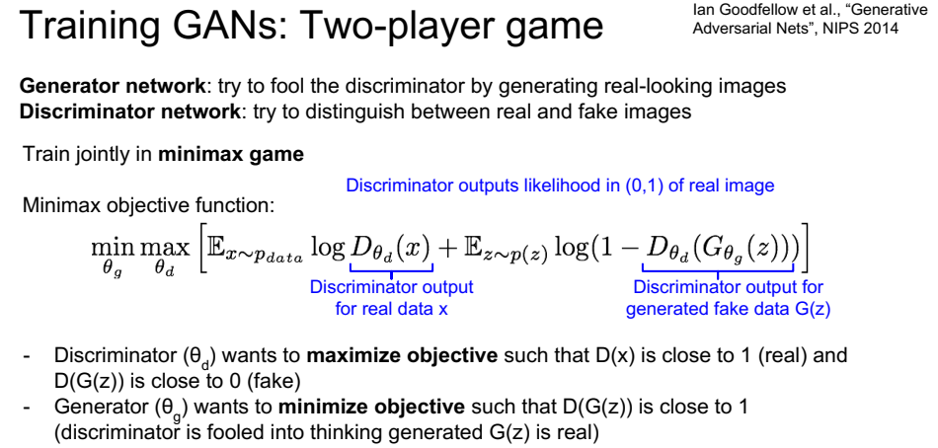
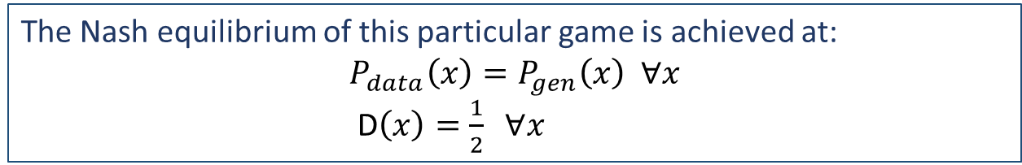
The Nash equilibrium of this particular game is achieved at:
$$P_{data}\left(x\right)=P_{gen}\left(x\right) ∀x$$
  D$\left(x\right)=\frac{1}{2} ∀x$
4

Slide 5
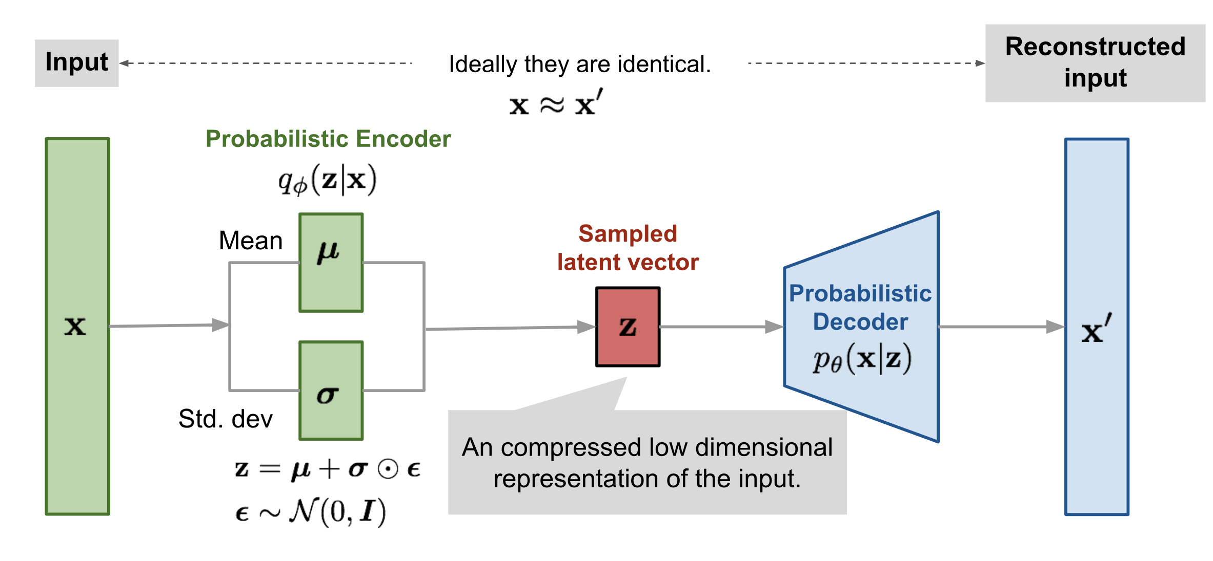
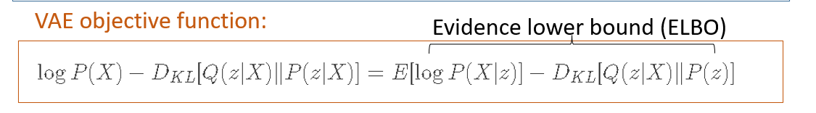
Variational autoencoder (VAE)
5

Slide 6
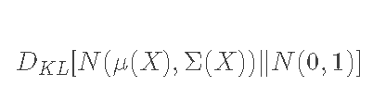
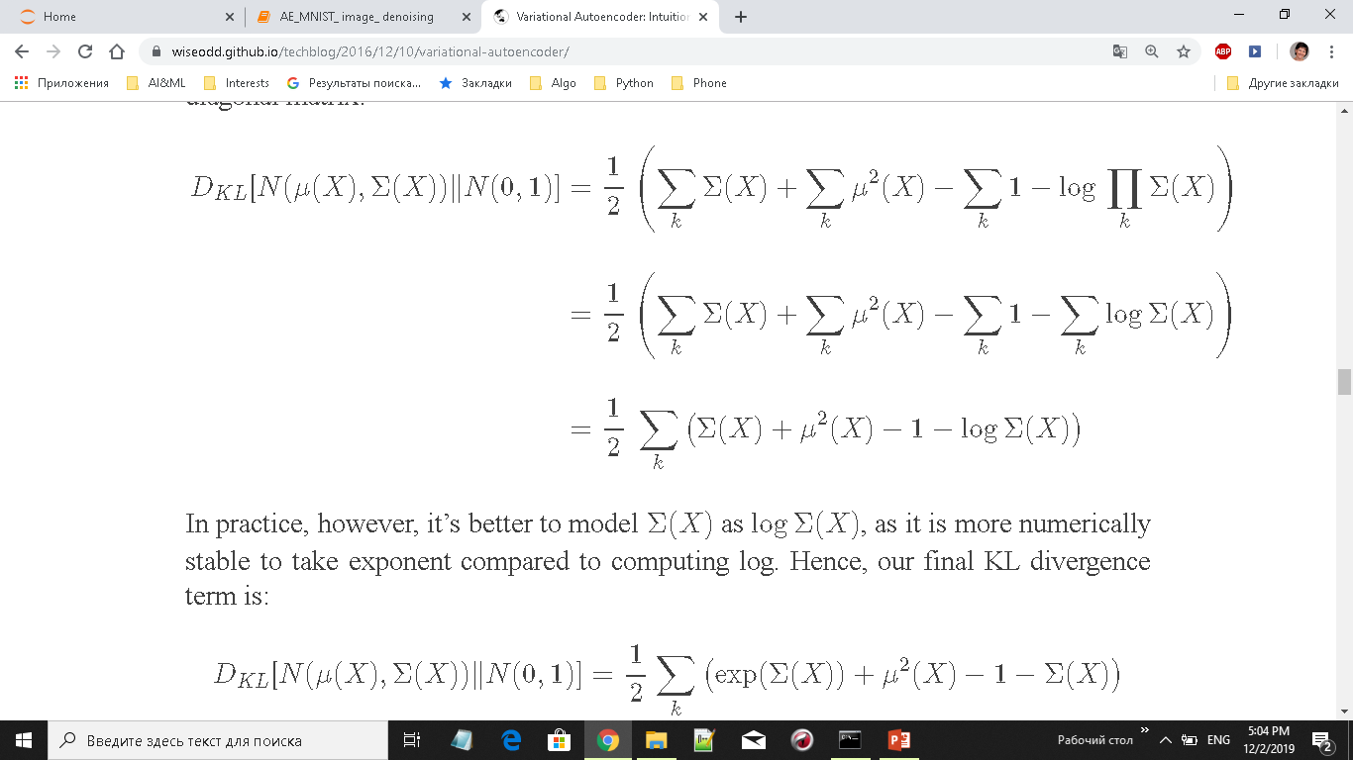
VAE intuition
The easiest choice for P(z)is N(0,1). Hence, we want to make Q(z|X) to be as close as possible to N(0,1) so that we could sample it easily.
We also want Q(z|X) to be Gaussian with parameters μ(X) and Σ(X). The KL divergence between those two distribution could be computed in closed form!
https://wiseodd.github.io/techblog/2016/12/10/variational-autoencoder/
6

Slide 7
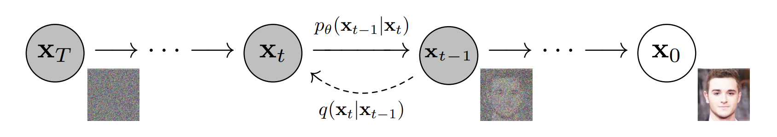
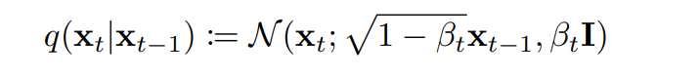
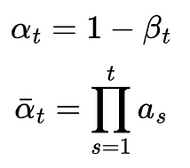

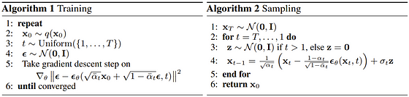
Denoising Diffusion Probabilistic Models
The forward process:
7

