Slide 1


PROTON 2.1: Synthesizing Ranking Functions
via fine-tuned locally hosted LLM (Competition
Contribution)
Diganta Mukhopadhyay¹, Ravindra Metta^{1,2,} Hrishikesh Karmarkar¹, Kumar Madhukar³,
1. TCS Research. 2. TUM. 3. IIT-D
May 5, 2025
Notes:
<number>

Slide 2
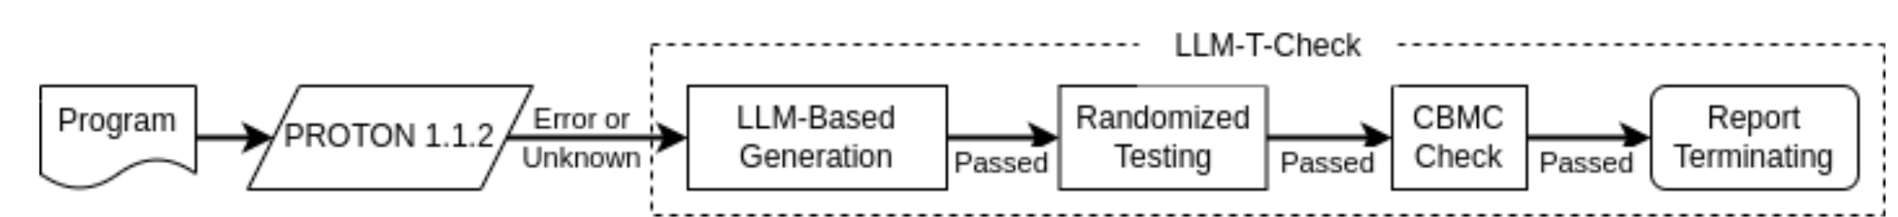
LLM based Ranking Function Synthesis
PROTON 1.1.2 fails to find termination of 123 benchmarks [2]
LLMs were recently used for synthesizing invariants [4, 5]
Based on this, we integrate an LLM based ranking function synthesis into PROTON
If PROTON 1.1.2 fails to find (non-)termination, then invoke LLM-T-Check
Online LLMs: pre-trained on huge data-sets and hence offer good performance, But, Significant cost and privacy concerns with online LLMs
Locally hosted LLMs: very poor out-of-the-box performance (returns a definition of an invariant when asked to generate one for a program)
<number>

Slide 3
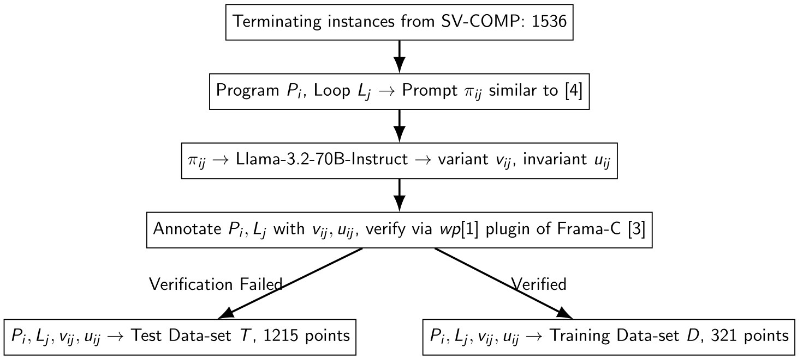
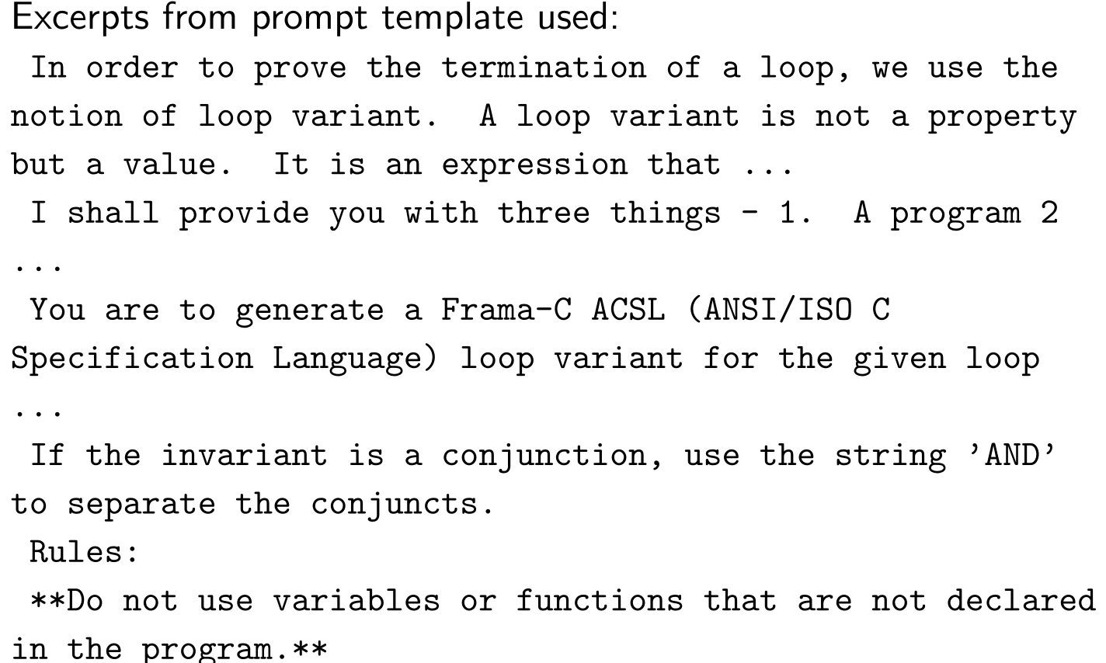
Training Data Set
[4] Adharsh Kamath et al. “Finding Inductive Loop Invariants using Large Language Models”. In: CoRR abs/2311.07948 (2023). doi: 10.48550/ARXIV.2311.07948. ArXiv:311.07948.
[5] Adharsh Kamath et al. “Leveraging LLMs for Program Verification”. In: FMCAD. 2024, pp. 107–118. doi: 10.34727/2024/isbn.978-3-85448-065-5\_16.
<number>

Slide 4
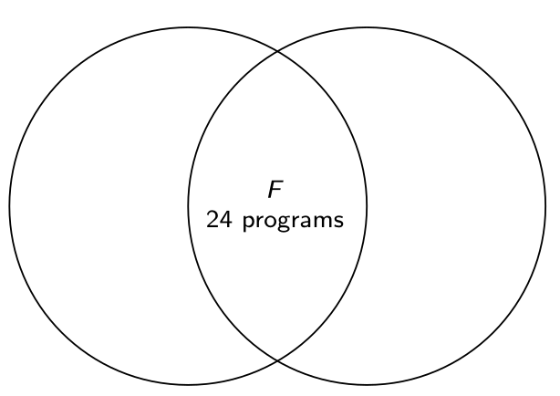
Fine-tuning
Only 24 programs (F ) in D, out of 123 that PROTON 1.1.2 could not solve
▶ These may be under-represented
during fine-tuning
▶ So, focus on these more (set F)
D,
321 programs
E:
123 programs
▶ Pick program from F with probability 0.7, D − F with 0.3
▶ Compare output of Llama-1B against vij , uij to get loss
▶ Fine-tune all parameters of Llama-1B to minimize
<number>

Slide 5
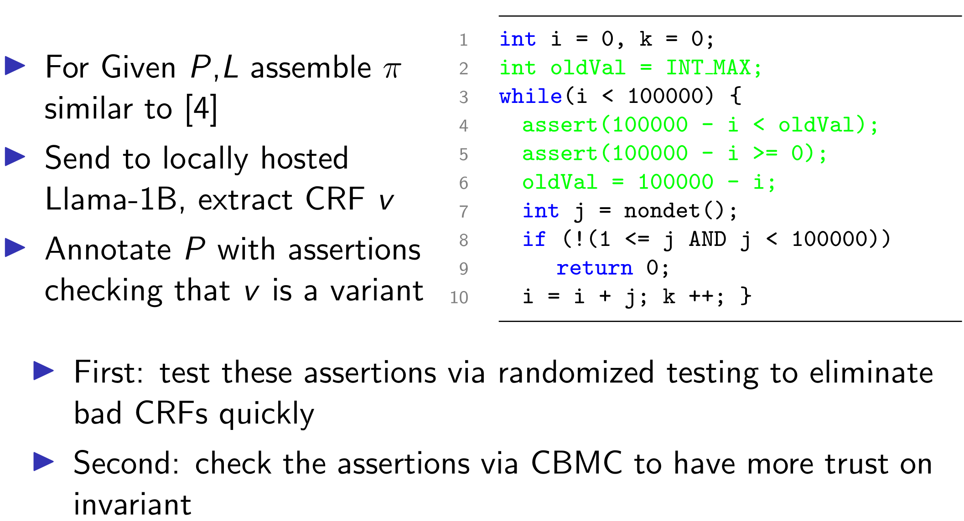
Tooling ...
<number>

Slide 6
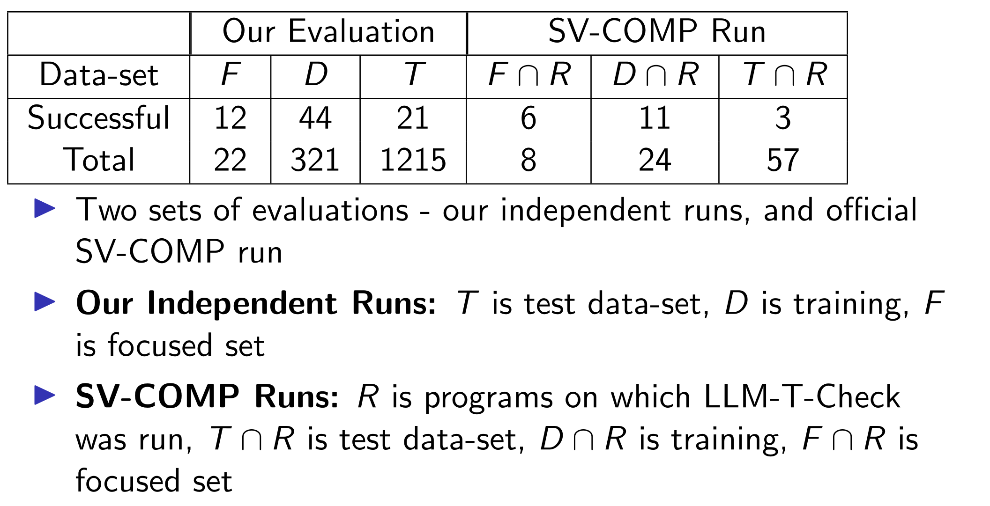
Experiments
<number>

Slide 7
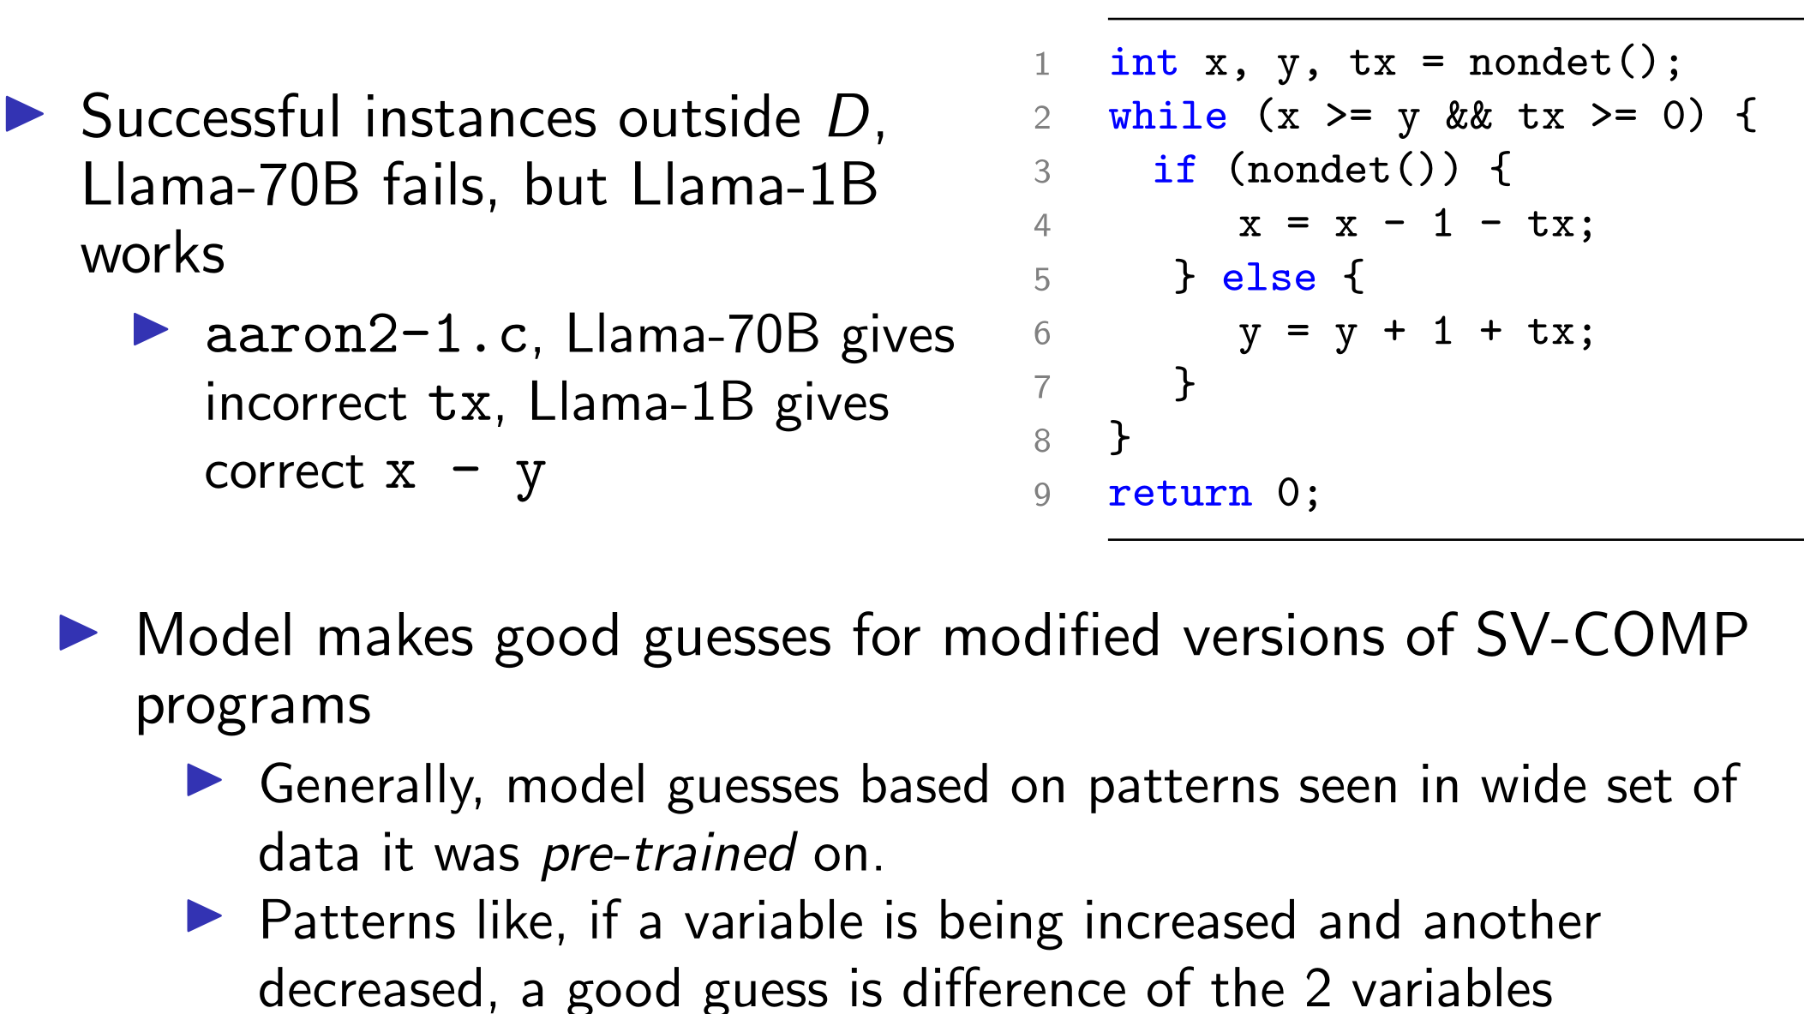
Does this Model generalize?
<number>

Slide 8
Thank you

Slide 9
References
[1] Patrick Baudin et al. WP Plug-in Manual. url: http://frama-c.com/download/frama-c-wp-manual.pdf.
[2] C Bounded Model Checker. https://github.com/diffblue/cbmc.
[3] Loı̈c Correnson et al. Frama-C User Manual. url: http://frama-c.com/download/frama-c-user-manual.pdf.
[4] Adharsh Kamath et al. “Finding Inductive Loop Invariants using Large Language Models”. In: CoRR abs/2311.07948 (2023). doi: 10.48550/ARXIV.2311.07948. ArXiv:311.07948.
[5] Adharsh Kamath et al. “Leveraging LLMs for Program Verification”. In: FMCAD. 2024, pp. 107–118. doi: 10.34727/2024/isbn.978-3-85448-065-5\_16.
[6] Ravindra Metta et al. “PROTON: PRObes for Termination Or Not (Competition Contribution)”. In: TACAS. 2024, pp. 393–398. doi: 10.1007/978-3-031-57256-2\_27.

