Slide 1
Ethereum Based Fraud Detection
Piyush Nayak (232004130)
Sanjay Nayak (832000624)
Department of Computer Science
Texas A&M University
College Station

Slide 2
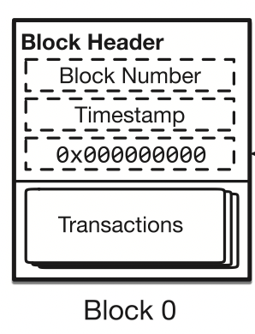
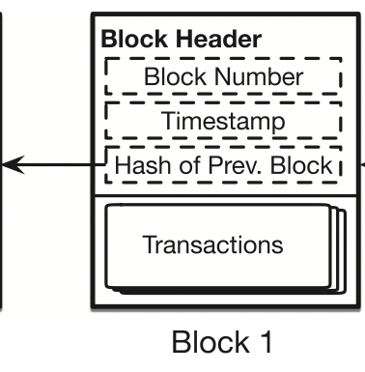
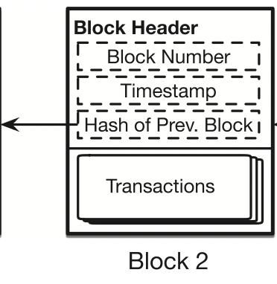
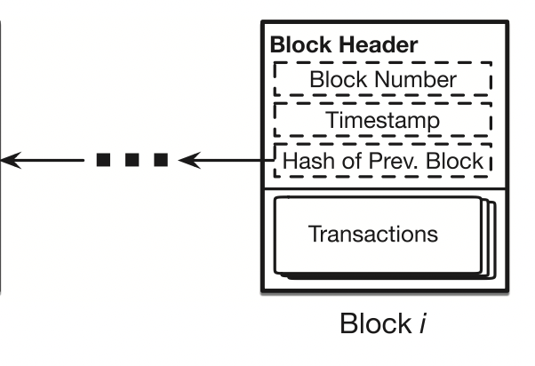
Blockchain
“A blockchain is a mechanism to reach agreement on the order of events among a set of entities.”
Features of blockchain
Decentralized P2P system
Holds information which is ordered & immutable
Working of Blockchain
A block is a batch of transactions
Each block also has a block header which has - a block number, timestamp and a cryptographic hash of the contents of the previous block
Blocks are chained together to become a blockchain

Slide 3
What is Ethereum?
Ethereum introduced by Vitalik Buterin and formally specified by Gavin Wood in 2014 with smart contracts as its fundamental building block
Smart contracts are small computer programs behaving like traditional contracts in digital world
With a current market cap of $193 billion dollars, Ethereum is the second largest digital currency in world after Bitcoin
Ethereum is programmable in nature allowing users to build applications
Ethereum uses proof-of-stake consensus to add blocks

Slide 4

Is fraud detection necessary?
Cryptocurrency has contributed a lot to finance owing to its cheaper, faster and more secure features
It possesses the potential to disrupt the payment industry
Ethereum, especially due to its smart contracts is being accepted more as a reliable form of transaction medium
Due to the anonymity of blockchain and high cash flows, it has also become the target of fraudsters

Slide 5


How can we detect fraud?
Establish a manual workforce who scan through transactions and detect them
Set up coherent machine designed infrastructure which can detect fraud in real time
Notes:
Not possible

Slide 6

How can we detect fraud?
Establish a manual workforce who scan through transactions and detect them
Set up coherent machine designed infrastructure which can detect fraud in real time
Notes:
Not possible

Slide 7
Design Process
Source data
Pre-Processing of data
Build heuristic models to look for the best features
Start training with various models
Model comparison and hyperparameter tuning
Final Testing and output delivery

Slide 8
How does the data look like?
The Ethereum fraud detection dataset has been sourced from Kaggle. It has been developed by Vagif Aliyev
There are 9,841 rows and 51 columns in the dataset
The 51 columns collectively describe each transaction
50 of the columns describe the transaction’s features, whereas the FLAG column define it is a fraud transaction or not

Slide 9
Data Preprocessing
Null value treatment is carried out on the data
Necessary features are kept which add in clarity to the data, while the rest are removed
Features with “0” covariance were weeded out
Pair plots were used to filter out features with very low distribution
Data was divided into train and test with an 80-20 ratio

Slide 10
Feature Selection
SMOTE is used to cure the imbalance in the dataset, with 78:22 non fraudulent to fraudulent transactions
Min-Max scaler is used to preserve the shape of the original distribution
Recursive Feature Elimination is used to check for the final set of features
15 features are chosen at the end which would be treated as the independent variables

Slide 11
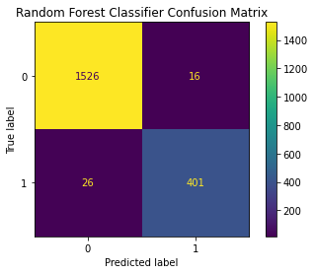
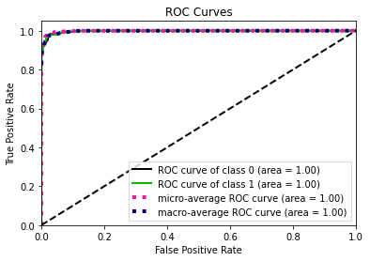
Random Forest(Depth – 100)
Accuracy | Precision (Class : Fraud) | Recall (Class : Fraud)
97.866 | 0.96 | 0.94

Slide 12
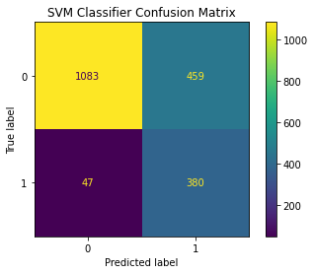
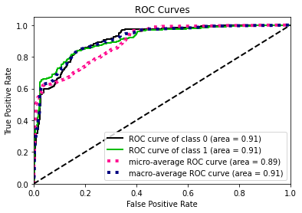
Support Vector Machine
Accuracy | Precision (Class : Fraud) | Recall (Class : Fraud)
74.301 | 0.45 | 0.89

Slide 13
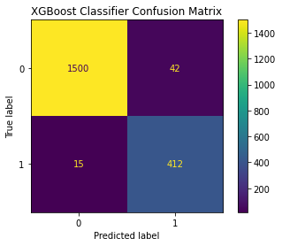
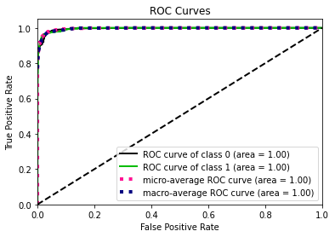
XGBoost Classifier
Accuracy | Precision (Class : Fraud) | Recall (Class : Fraud)
97.105 | 0.91 | 0.96

Slide 14
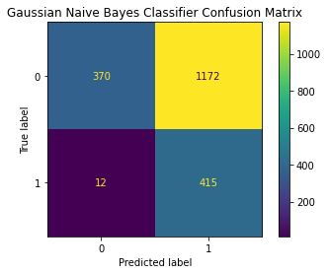
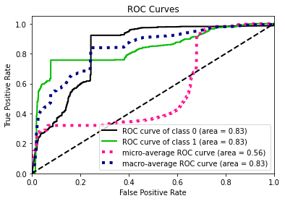
Naive Bayes
Accuracy | Precision (Class : Fraud) | Recall (Class : Fraud)
41.34 | 0.27 | 0.96

Slide 15
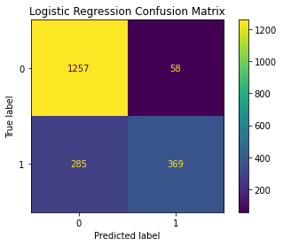
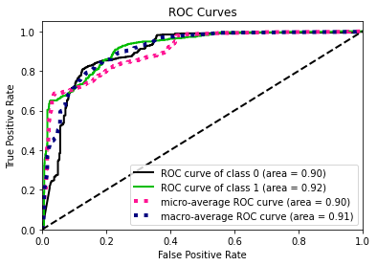
Logistic Regression (PyTorch)
Accuracy | Precision (Class : Fraud) | Recall (Class : Fraud)
82.843 | 0.86 | 0.56

Slide 16
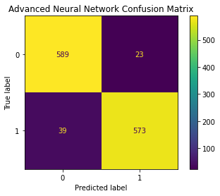
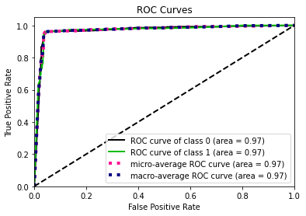
Advanced Neural Networks
Accuracy | Precision (Class : Fraud) | Recall (Class : Fraud)
95.752 | 0.96 | 0.95

Slide 17
Model Analysis
Model Name | Accuracy | Precision (Class : Fraud) | Recall (Class : Fraud)
Random Forest | 97.866 | 0.96 | 0.94
SVM | 74.301 | 0.45 | 0.89
XGBoost Classifier | 97.105 | 0.91 | 0.96
Naïve Bayes | 41.34 | 0.27 | 0.96
Logistic Regression (Pytorch) | 82.843 | 0.86 | 0.56
Advanced Neural Network | 95.752 | 0.96 | 0.95

Slide 18
“Thank You”

Slide 19
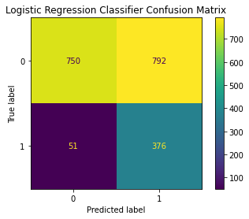
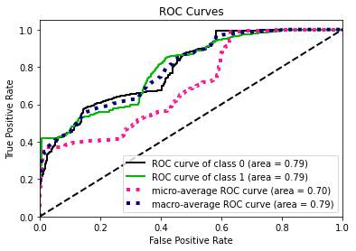
Vanilla Logistic Regression
Accuracy | Precision (Class : Fraud) | Recall (Class : Fraud)
57.186 | 0.32 | 0.88

Slide 20
Appendix

Slide 21
LogisticRegression(
(linear): Linear(in_features=15, out_features=2, bias=True)
(sigmoid) : Torch.Sigmoid(in_features=15, out_features=2
)

Slide 22
my_Model(
(layer_1): Linear(in_features=15, out_features=20, bias=True)
(relu): ReLU()
(batchnorm1): BatchNorm1d(20, eps=1e-05, momentum=0.9, affine=True, track_running_stats=True)
(layer_2): Linear(in_features=20, out_features=8, bias=True)
(relu): ReLU()
(batchnorm2): BatchNorm1d(8, eps=1e-05, momentum=0.9, affine=True, track_running_stats=True)
(dropout): Dropout(p=0.1, inplace=False)
(layer_out): Linear(in_features=8, out_features=2, bias=True)
(sigmoid): Sigmoid()
)

