Slide 2
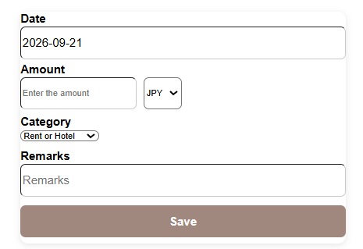
Input
Calendar
Summary
History
Setting

Slide 3
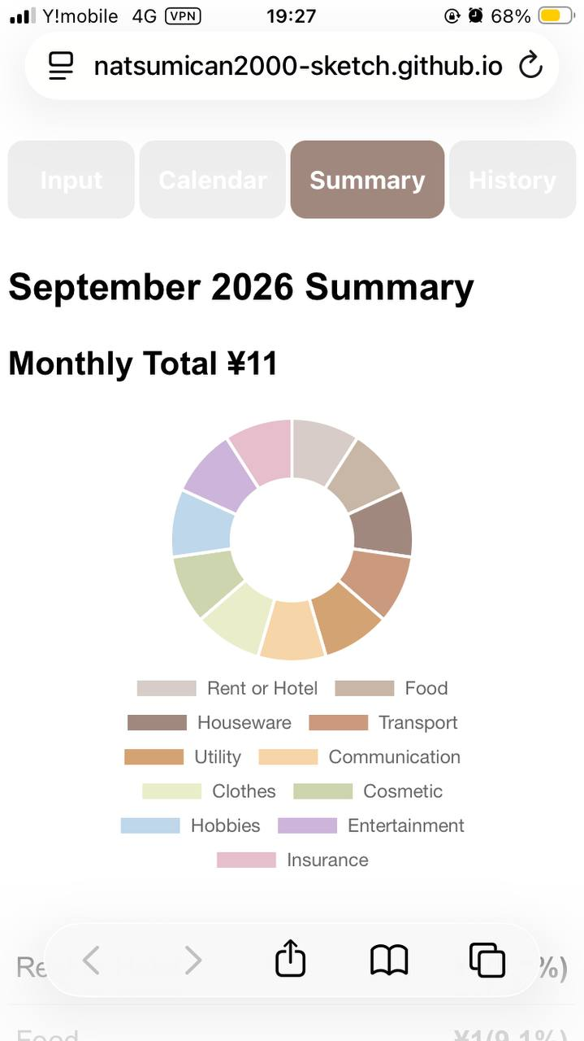
Remarks
YYYY-MM-DD
X,XXX JPY
Remarks
YYYY-MM-DD
Category
Amount
Currency
Rate
Edit
Delete
X,XXX JPY

