Slide 1
研究報告 2020/○○/○○ 中川夏

Slide 2
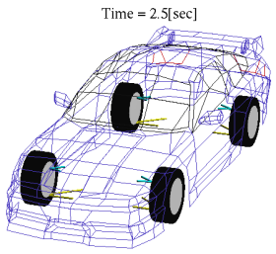
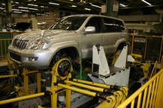
Analysis
result
Measurement
result
Simulation
Hardware

Slide 3
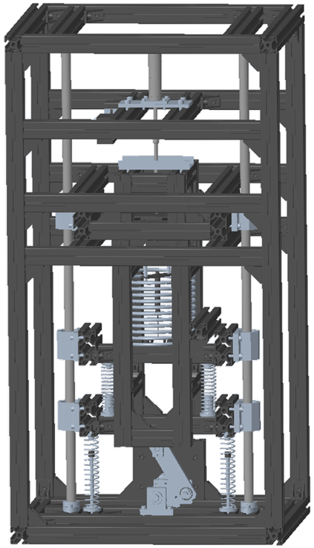
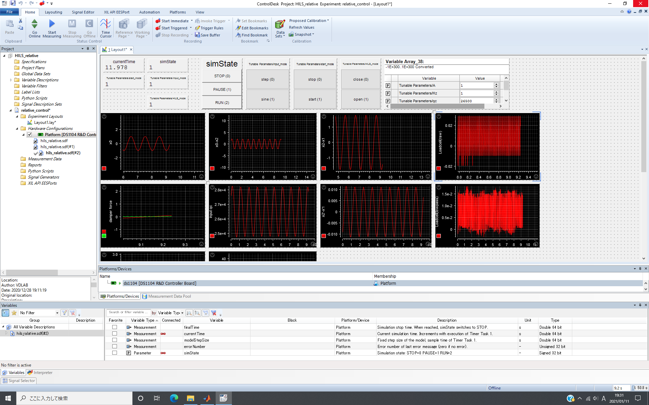
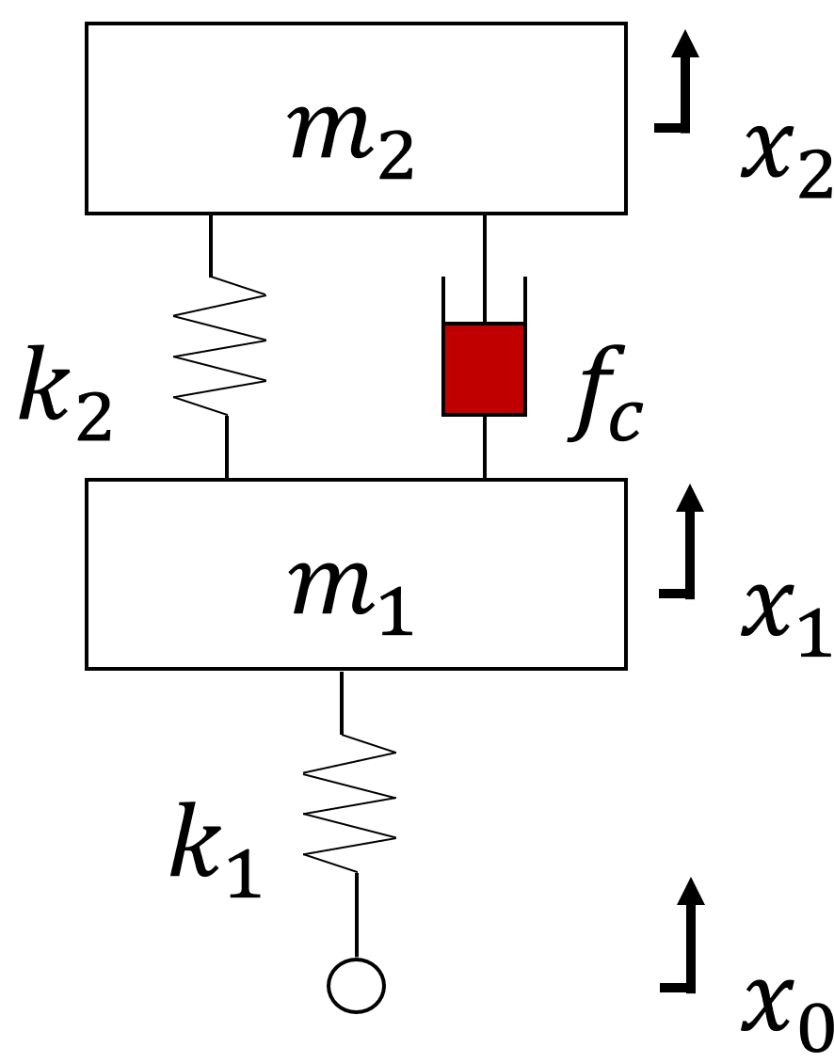
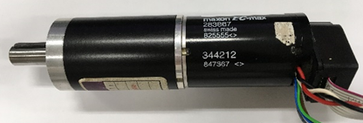
Monitoring
Testing machine
Analysis model
Actuator
Hardware
Simulation

Slide 4
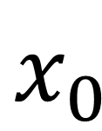

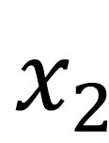
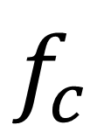
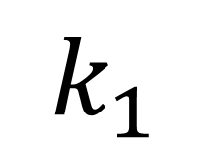
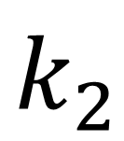

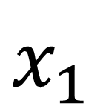
$${ m}_{2}$$
$$x_{2}$$
$$k_{2}$$
$$f_{c}$$
$${ m}_{1}$$
$$x_{1}$$
$$k_{1}$$
$$x_{0}$$

Slide 5
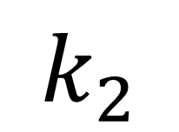
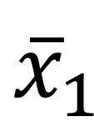
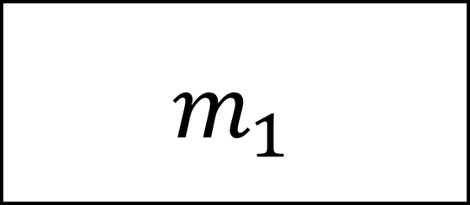
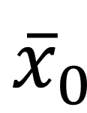
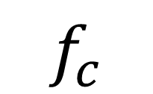
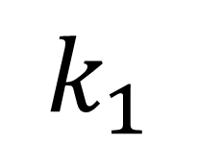
$$k_{2}$$
$$f_{c}$$
$${ m}_{1}$$
$${\overline{x}}_{1}$$
$$k_{1}$$
$${\overline{x}}_{0}$$

Slide 6
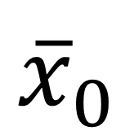
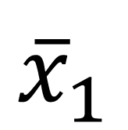
$${\overline{x}}_{1}$$
$${\overline{x}}_{0}$$

Slide 7

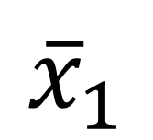
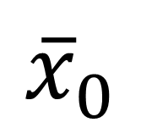


Loadcell
Damper
Laser sensor
Suspension
Stroke
$$c_{2}$$
$$k_{2}$$
$${\overline{x}}_{1}$$
Unsprung
mass
$$k_{1}$$
$${\overline{x}}_{0}$$
Road input
Actuator

Slide 8
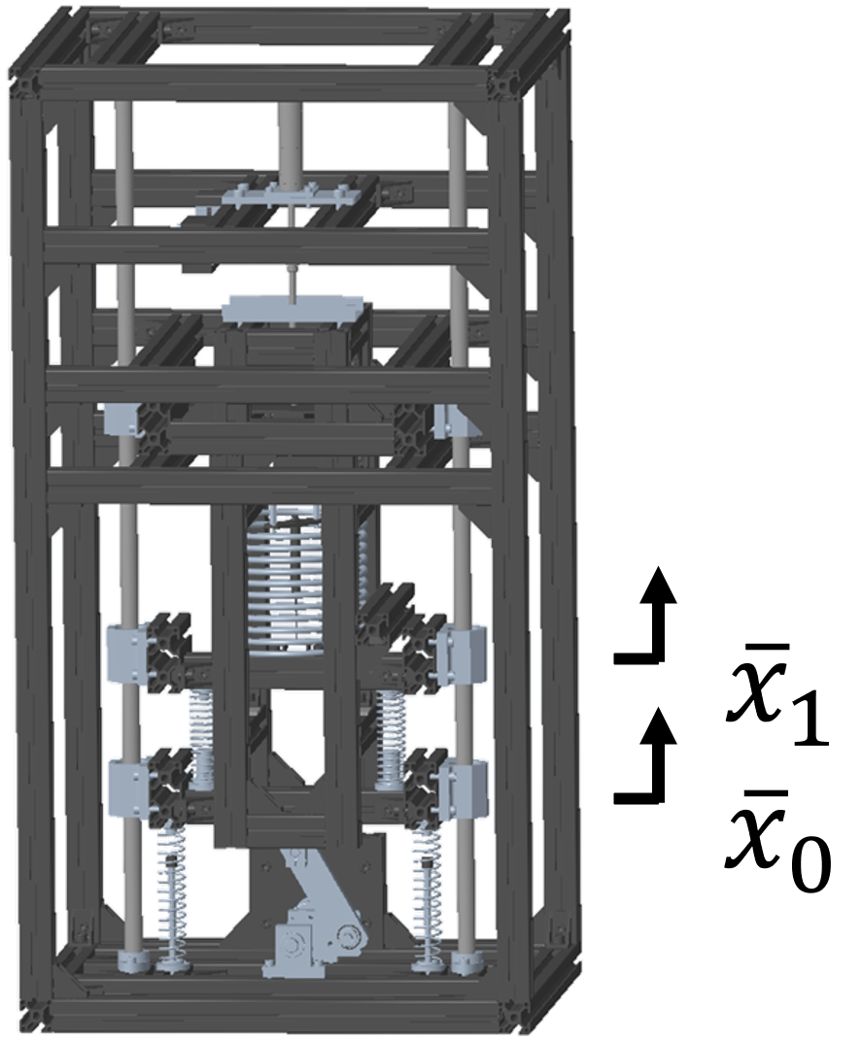
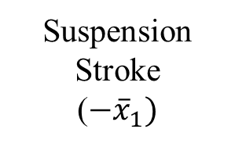


Analysis result
Actuator input
Suspension
Stroke
($−{\overline{x}}_{1})$
Road input($x_{0})$
Actuator control
method
Analysis model
Testing machine
Damper force($f_{c})$

Slide 9
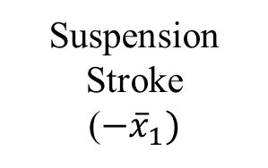


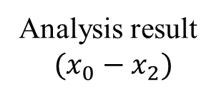
Suspension
Stroke
($−{\overline{x}}_{1})$
Analysis result
$$(x_{0}−x_{2})$$
Road input($x_{0})$
Analysis model
Testing machine
Damper force($f_{c})$

Slide 10
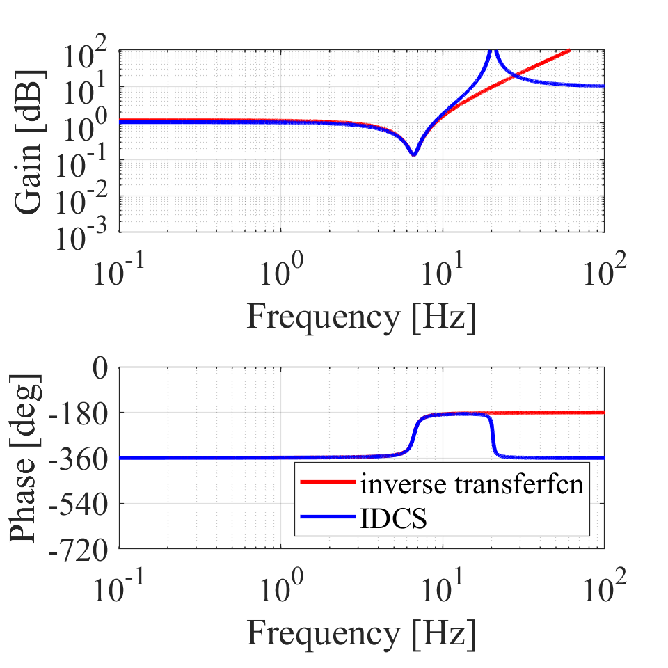
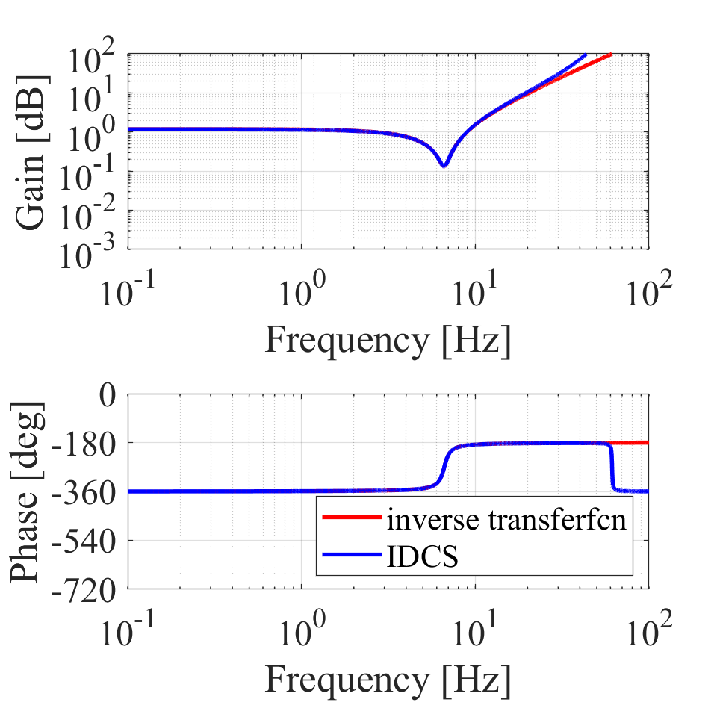
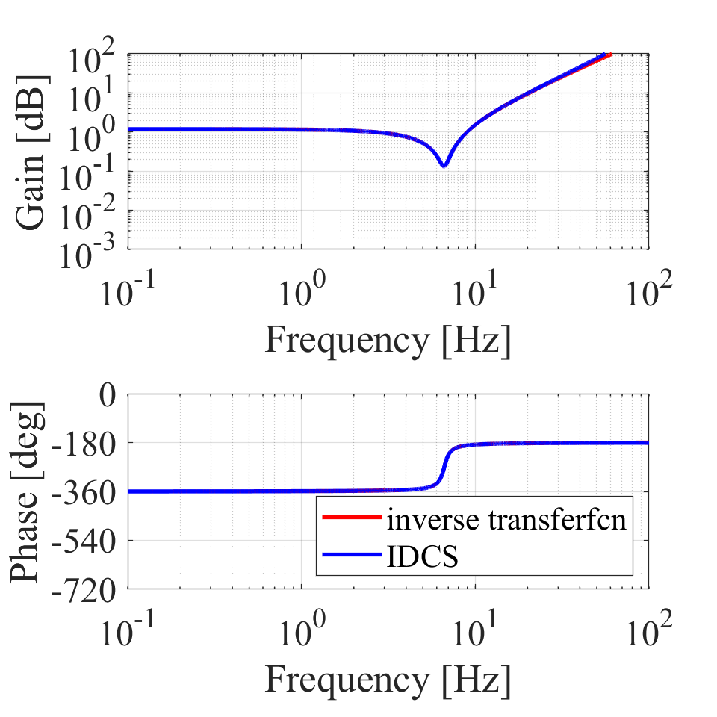
K = 10
K = 100
K = 500

Slide 11
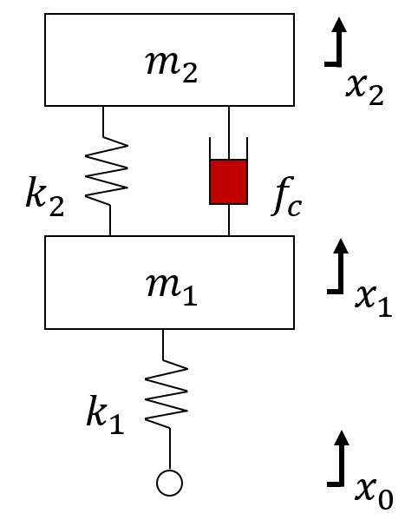
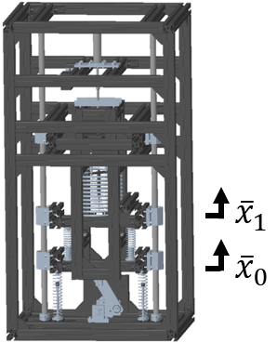

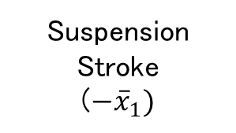

Analysis result
Actuator input
Suspension
Stroke
($−{\overline{x}}_{1})$
Road input($x_{0})$
IDCS
controller
Analysis model
Testing machine
Damper force($f_{c})$

Slide 12
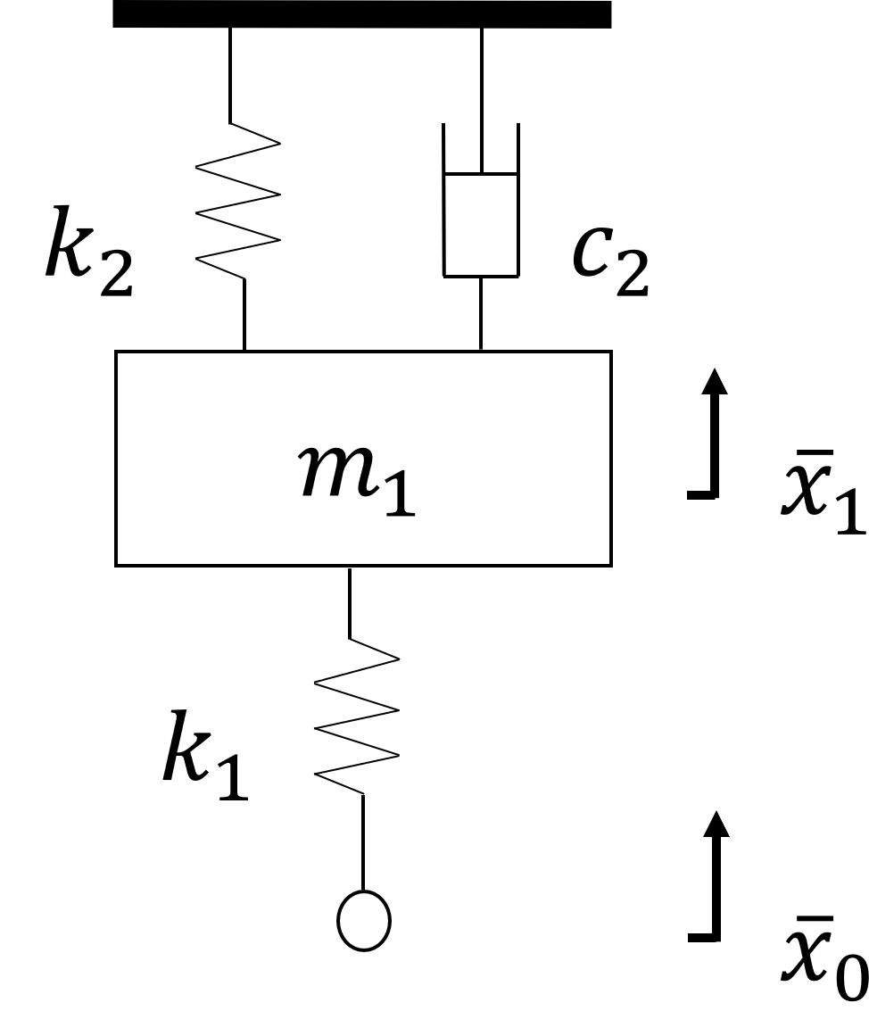
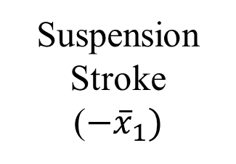
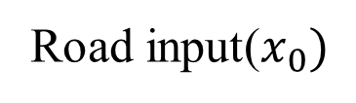
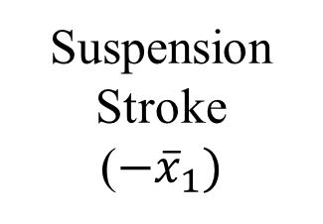
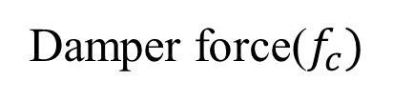
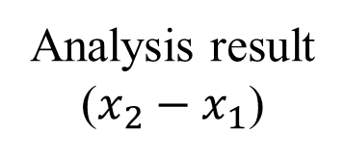
Analysis result
($x_{2}−x_{1}$)
Actuator input
Suspension
Stroke
($−{\overline{x}}_{1})$
Road input($x_{0})$
K
Analysis model
Hardware model
IDCS
Suspension
Stroke
($−{\overline{x}}_{1})$
Damper force($f_{c})$
Testing machine

Slide 13
Suspension
Stroke
($−{\overline{x}}_{1})$
Analysis result
$$(x_{0}−x_{2})$$
Road input($x_{0})$
Analysis model
Hardware model
Damper force($f_{c})$

Slide 14
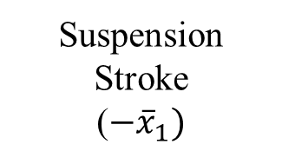

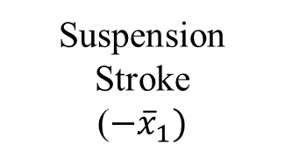

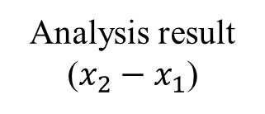
Analysis result
($x_{2}−x_{1}$)
Actuator input
Suspension
Stroke
($−{\overline{x}}_{1})$
Road input($x_{0})$
K
Analysis model
Hardware model
IDCS
Suspension
Stroke
($−{\overline{x}}_{1})$
Hardware model
Damper force($f_{c})$

