Slide 1
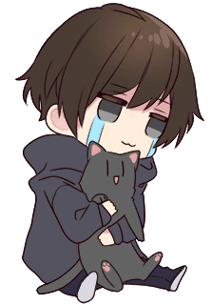
Attention!
This peep will ignore any random friend request, sadly D:
Please at least contact me via comment
or PM, so I can accept the request...

