Slide 1

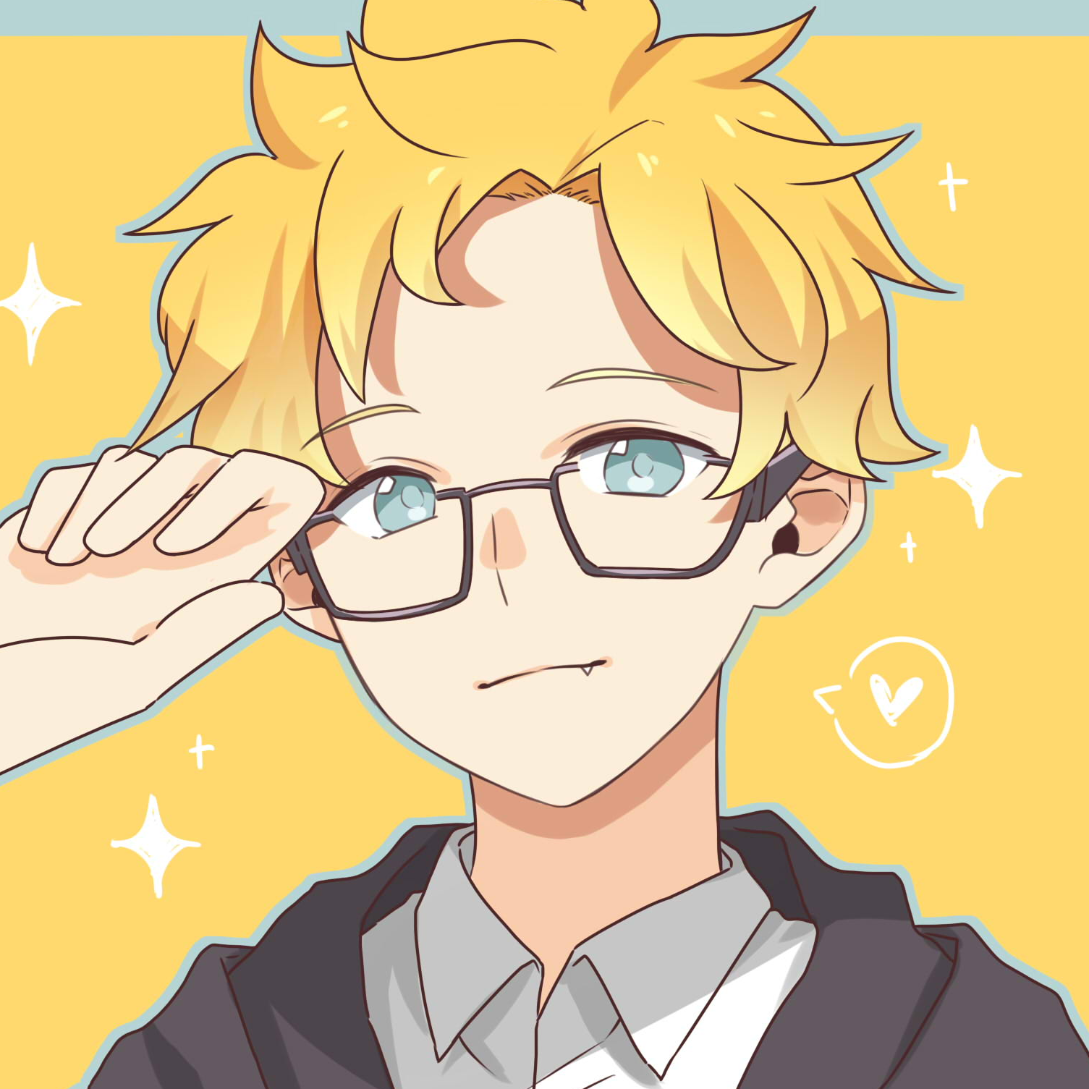
































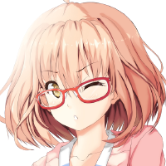

Disclaimer
This user will ignore all random friend request.
Please considering to contact the user first before sending request.
DYNAMIC
Natsu Tadama @nattadasu
Send a DM
me.
I am Natsu Tadama (aliased, but you can also find my real name easily tbh), pronounced as /natsɯ/ /tadama/ in IPA, and I am "he/him." 19 years old, and also Islamic Communication and Broadcasting student in ███ ██-██████ █████ ████, Aceh, Indonesia. Came from Indonesia, so if you notice I spoke so weirdly (like this sentence lol), please forgive me and correct my spelling :’)
Talking about myself, I would say that I have become as an otaku (not weeaboo, see more for the definitions :v) since February 2016 with my not-so-first anime called "Tokyo Ghoul." However, my first anime I have watched by myself and not broadcasted on television is... Guess what? ITS KISS X SIS (OVA) IN 2009. :feelsproudman:
I can speak in more than 5 languages: Acehnese, Indonesian, Malay, English, Arabic, and Japanese... With some plot twists, I can read the Cyrillic alphabet and Hangul. I love learning foreign languages, especially Japanese, video editing, watching anime (sometimes, donghua) and western cartoon, and creating internet sites using HTML. Now I have an open source project regarding database of information on animation shows from various countries and sites. You can see my project here (Indonesian). Oh, Fun fact: I am also Fudanshi, hehehe.
Btw, I do have a ton of pseudonyms aside from my legal name thou, and its related to Japanese names; Natsu TADAMA, Alex TOMATSU, Nikolay Tolenka, Ryuusei NEKONE, and Ryuusei RYUUZAKI.
Anime List
Cards
Clubs
Blogs
Information
Name | Natsu Tadama
Also Known As | Alex Tomatsu, Nikolay Tolenka
Address | Aceh, Indonesia
Joined to MyAnimeList | Mar 11, 2016
Birthday | Jun 4, 2001
Languages | Acehnese, Indonesia, English, Arabic, Japanese
Email | nattadasu@nattadasu.my.id
Discord | nattadasu#3867
s̛̼̦͕̃̃́͒͢ͅo̡̢͕͐̔͑̚͢m̮̼̝͔̲͆̽̎͆̕e̢̙͗̾̂͢t͕͋h͕̭̭̰͂͒͘̚i̖͙͚̐̚͠ng͔͚̜̭͋̃́̈́ ̳̈ṙ̺͙̲͑̚͘͜á̜̜̌͊͢ǹ̳̣̚d̩̠͐͝o̜̺̪̿̌̃m̧̛̲̠͒̉ | TXkgcGhvbmUgKGFuZCBXQSkgbnVtYmVyIGlzICgrNjIpIDg1MSA1NTMxLTUxNTEsIHRoeCBtZSBsYXRlcg==
User Website
Favorite Genres
Badge
Now Playing
View my badges and level
on mal-badges
Fi Hagat
7
Nancy Ajram
Occupation
The Newbie Club
Graphic Designer
March 2020 - Present
FOUNDER OF
Get Connected
Designed by Natsu Tadama in Aceh, Indonesia. Inspired from Apple designs, under Creative Commons BY-SA-NC 4.0 License. © 2020, Natsu Tadama (legal name: Sultan Iskandar Maulana) Latest update: 4:00 PM Western Indonesian Time (WIB, Asia/Jakarta, UTC+7), 6 July 2020.
DYNAMIC
LAYOUT
VERSION 1

