Slide 1

Dentist Booking
By Laewtae
Waranthorn Chansawang 6432154921
Nattapong Anansomsin 6431317721

Slide 2
Fuctional Requirements
The system shall allow a user to register by specifying the name, telephone number, email, and password.
After registration, the user becomes a registered user, and the system shall allow the user to log in to use the system by specifying the email and password. The system shall allow a registered user to log out.
After login, the system shall allow the registered user to book only ONE session by specifying the date and the preferred dentist. The dentist list is also provided to the user. A dentist information includes the dentist’s name, years of experience, and area of expertise.
The system shall allow the registered user to view his booking.
The system shall allow the registered user to edit his booking.
The system shall allow the registered user to delete his booking.
The system shall allow the admin to view any bookings.
8. The system shall allow the admin to edit any bookings.
9. The system shall allow the admin to delete any bookings.

Slide 3
Non-Functional Requirements
• Security:
• The system shall authenticate users using username-password
• The system shall be able to keep user’s transactions confidential.
• Performance: • The system shall response to a request in 3 seconds.
• Usability:
• The system shall be used and test via Postman.

Slide 4
Constraints
The system shall be a web API.
The frontend part of the application is not required.
The development team shall develop the backend system as REST APIs.
The database system can be either MongoDB Atlas or MySQL.

Slide 5
Additional Requirement
The system will send confirmation emails upon successful reservation.

Slide 6
Code ที่แก้ไป
แก้จาก Hospital -> Dentist
models
controllers
config.env
Dentist
appointments
User
auth
dentist

Slide 7
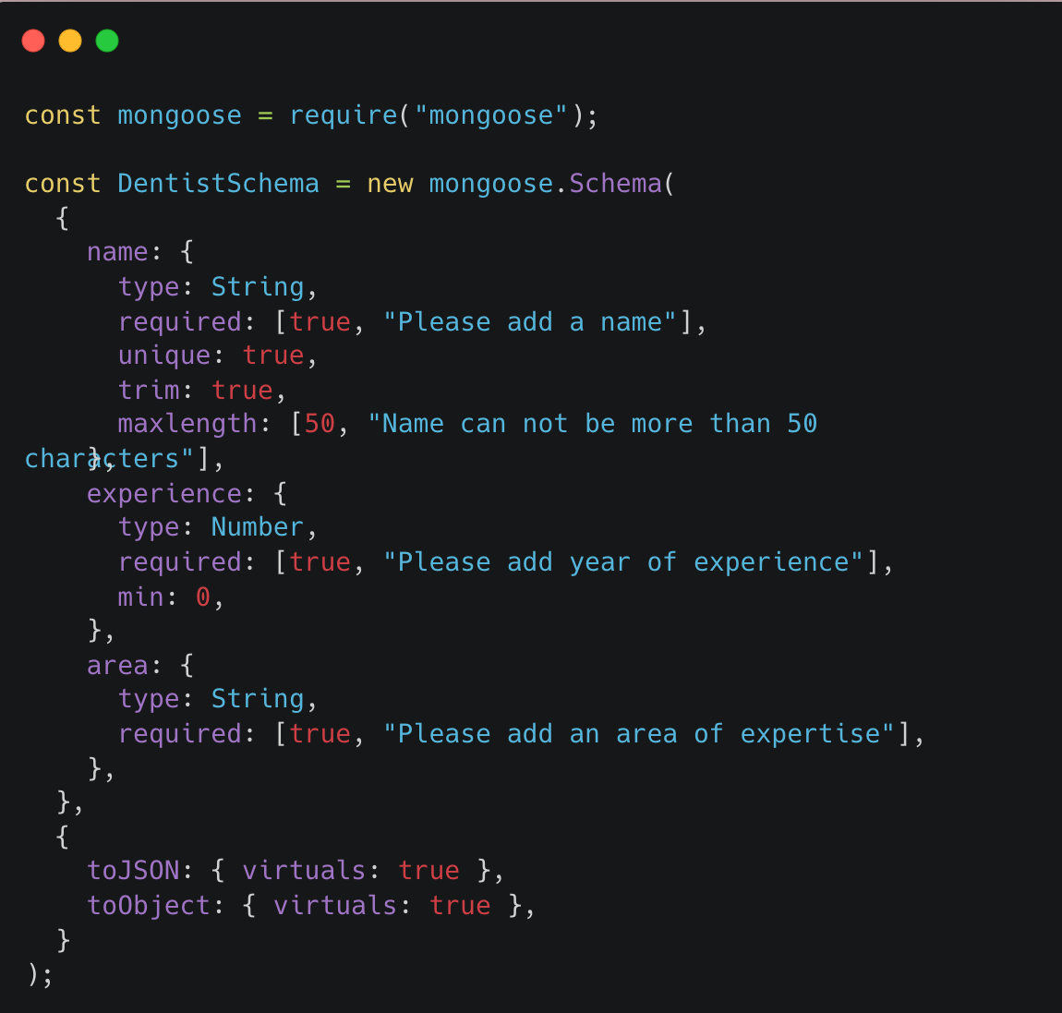
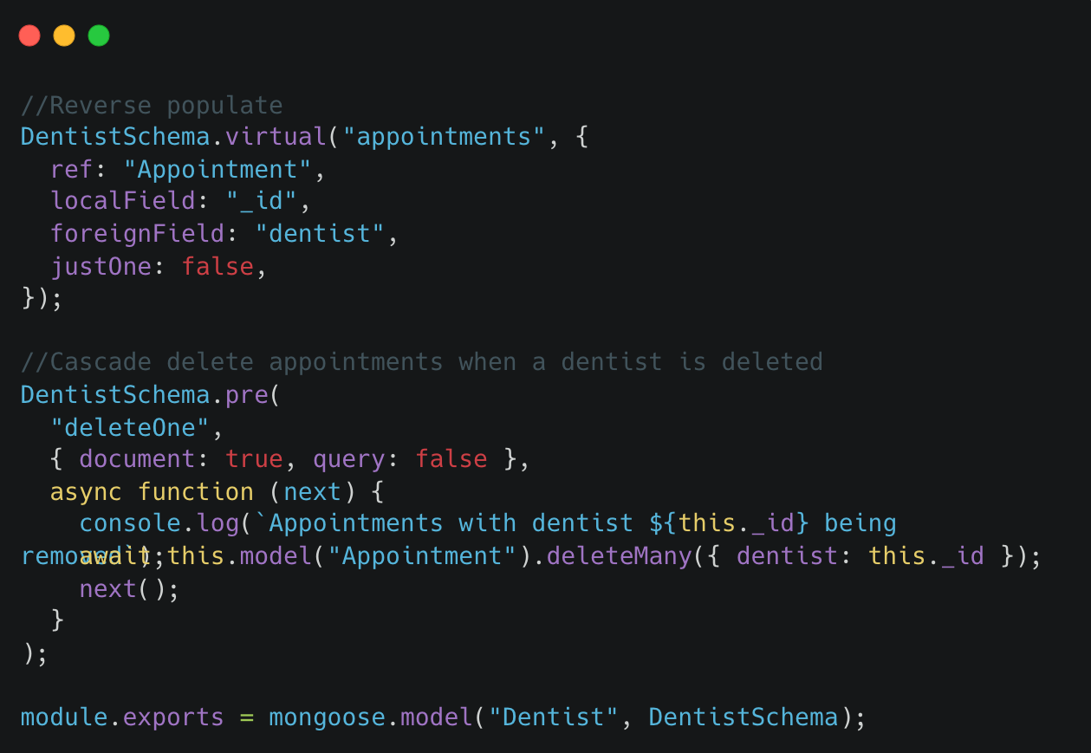
models/Dentist.js
Modify from model/Hospital.js

Slide 8
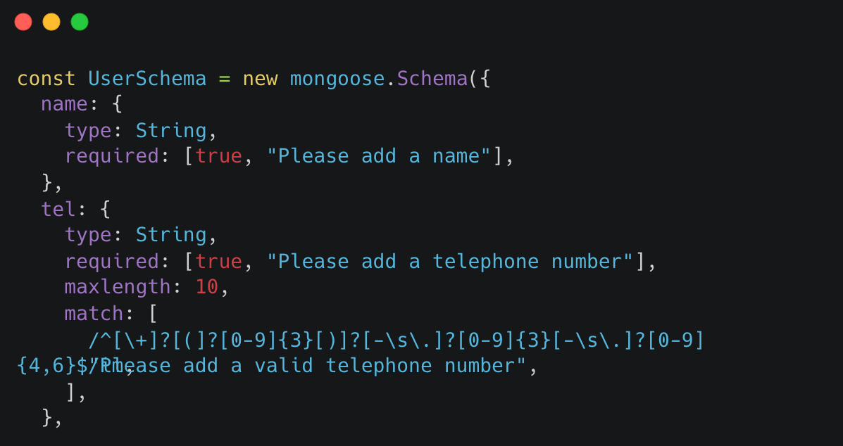
models/User.js

Slide 9
controllers/appointments.js

Slide 10
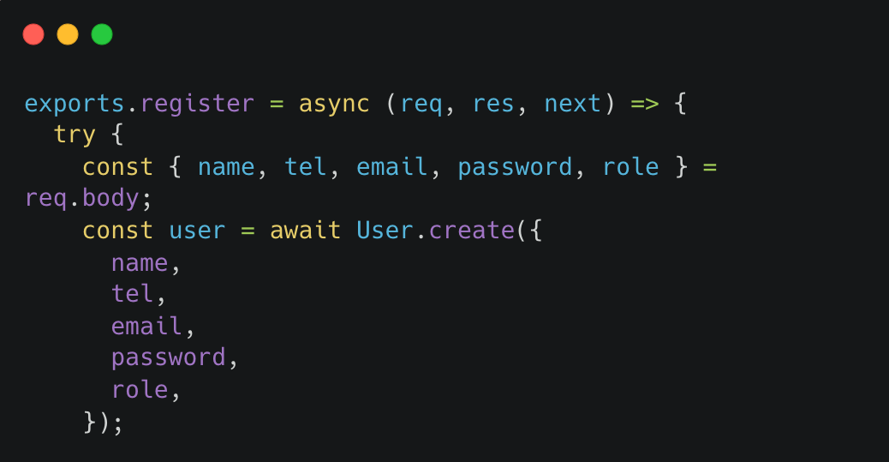
controllers/auth.js

Slide 11
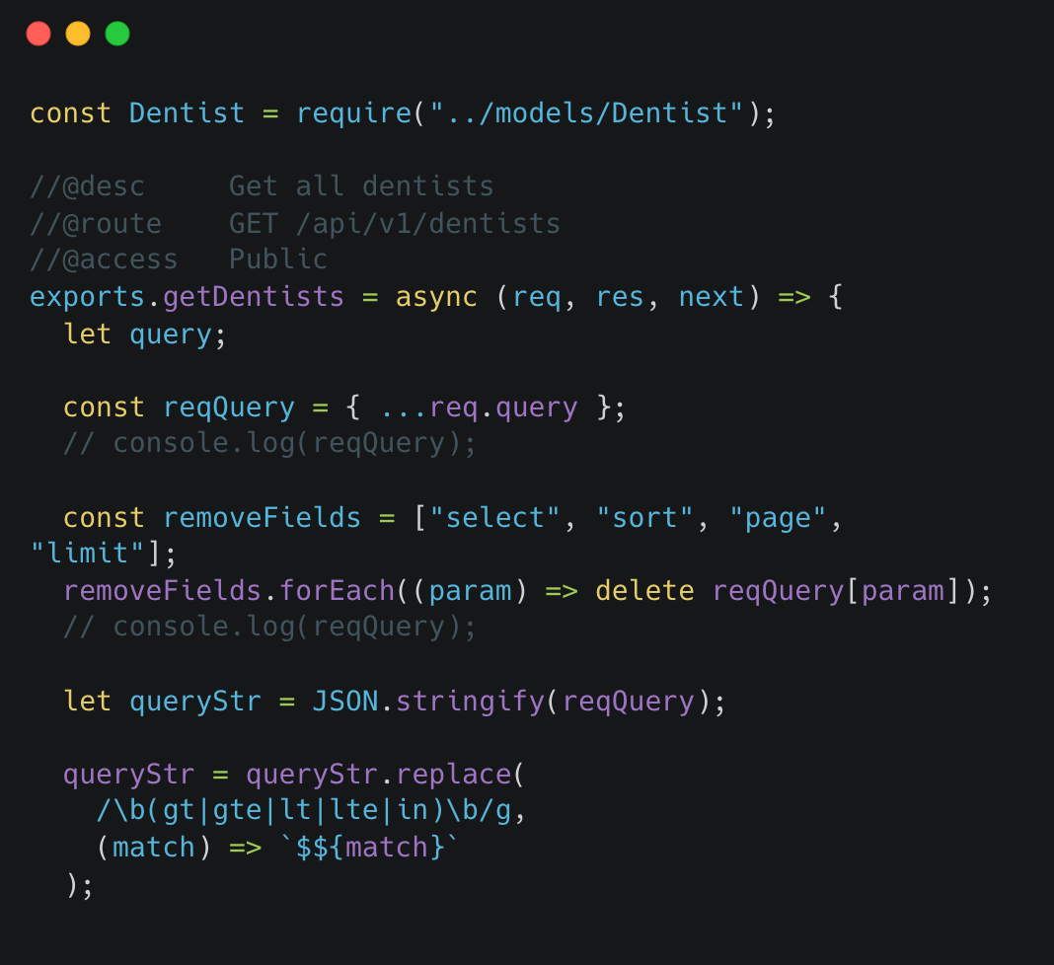
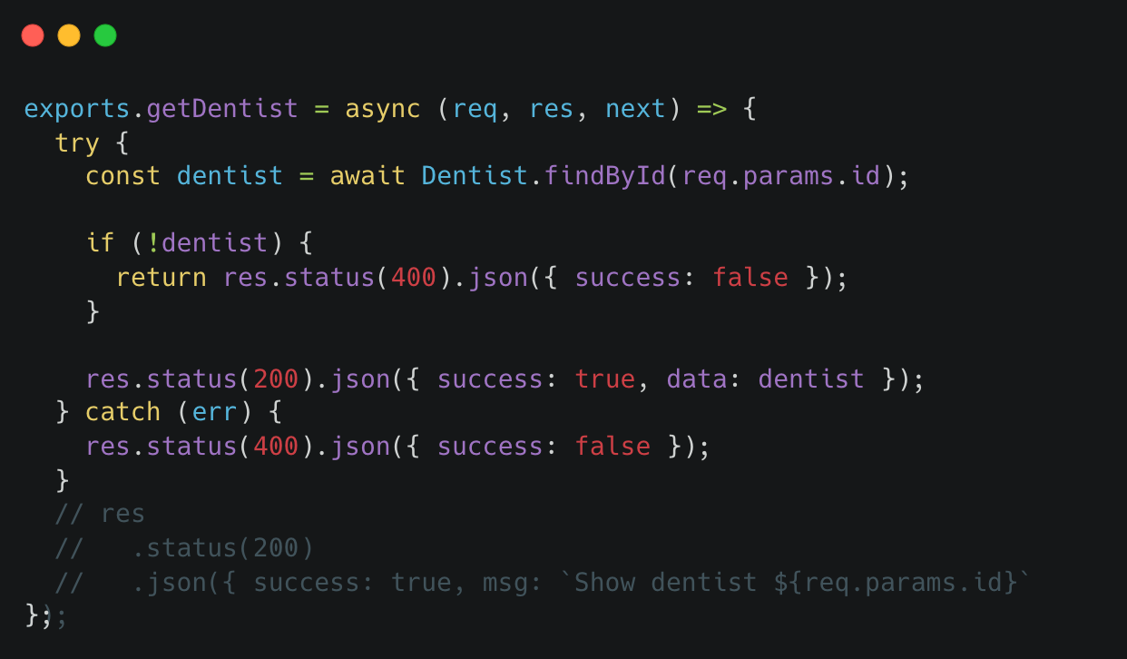
controllers/dentists.js

Slide 12
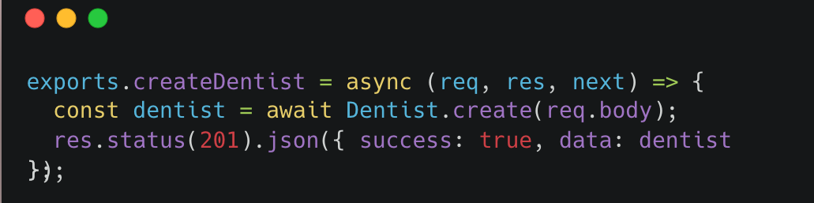
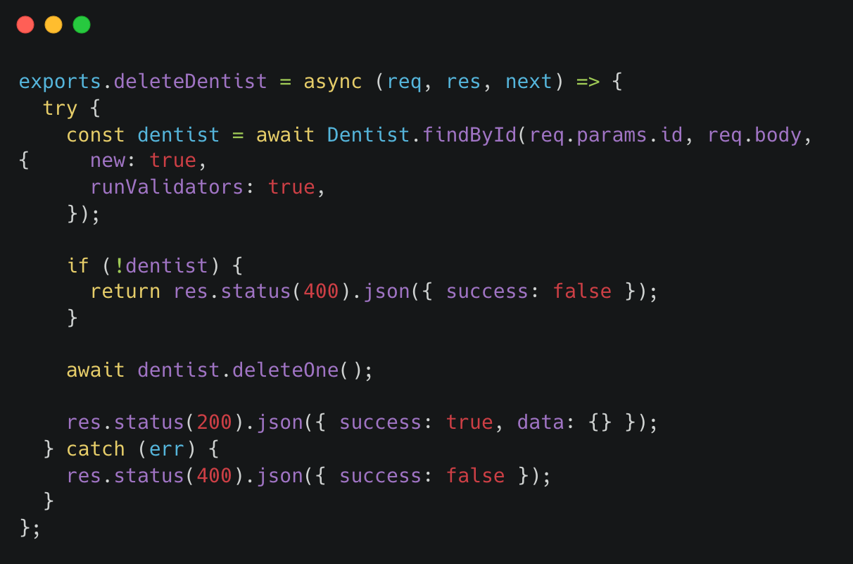
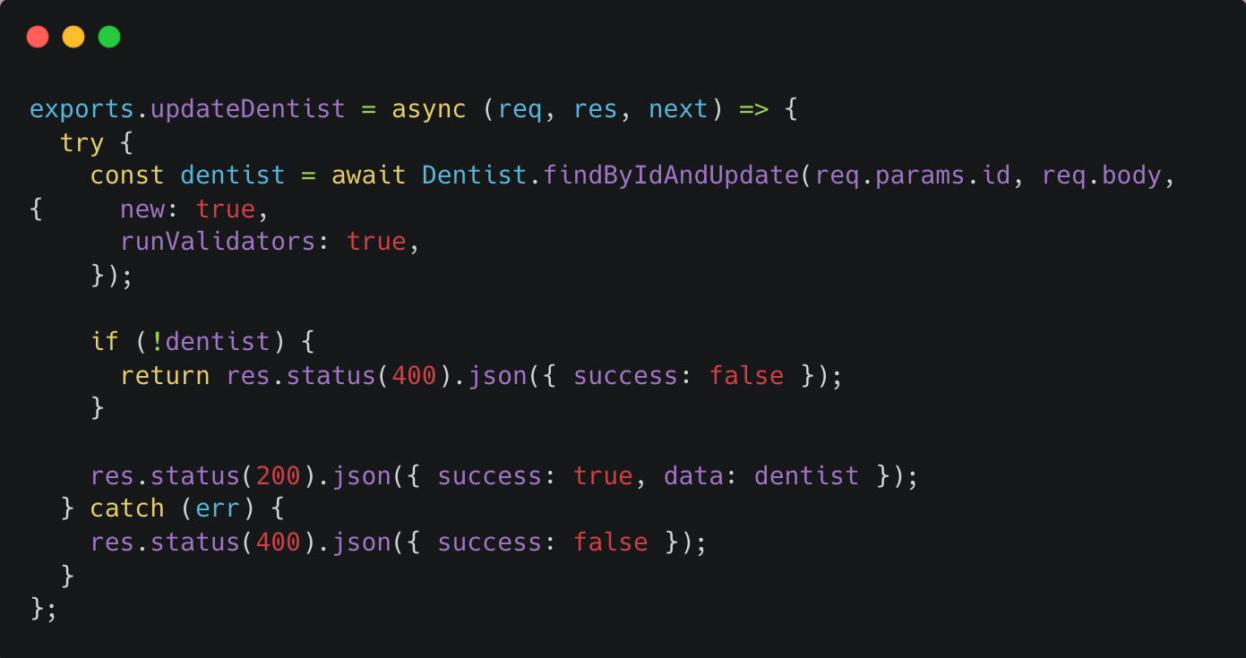
controllers/dentists.js

Slide 13
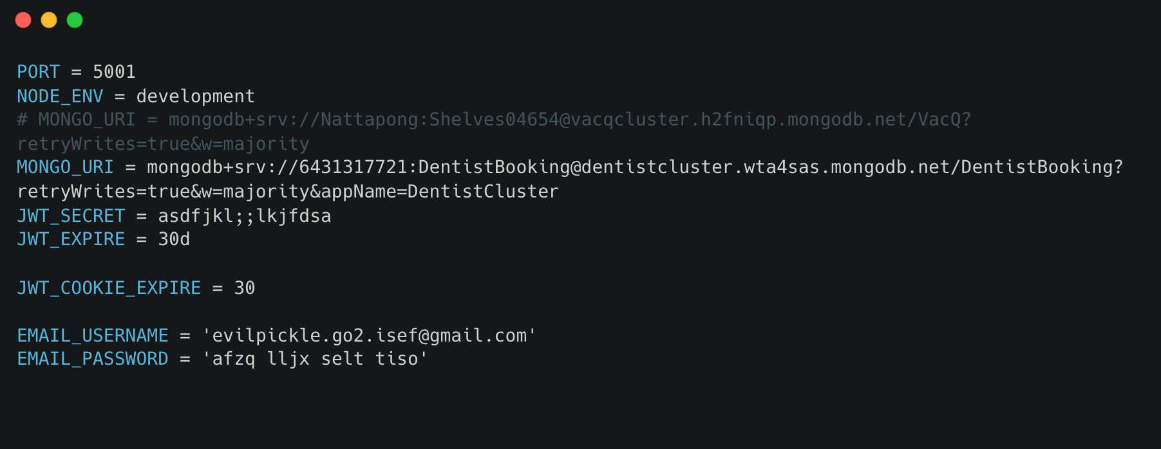
config.env
Connect to new database
Add username & password for email to send

Slide 14
Additional Requirement
The system will send confirmation emails upon successful reservation.

Slide 15

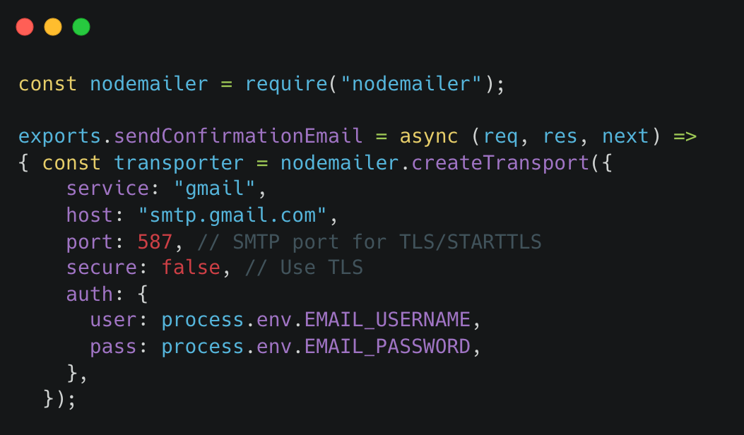
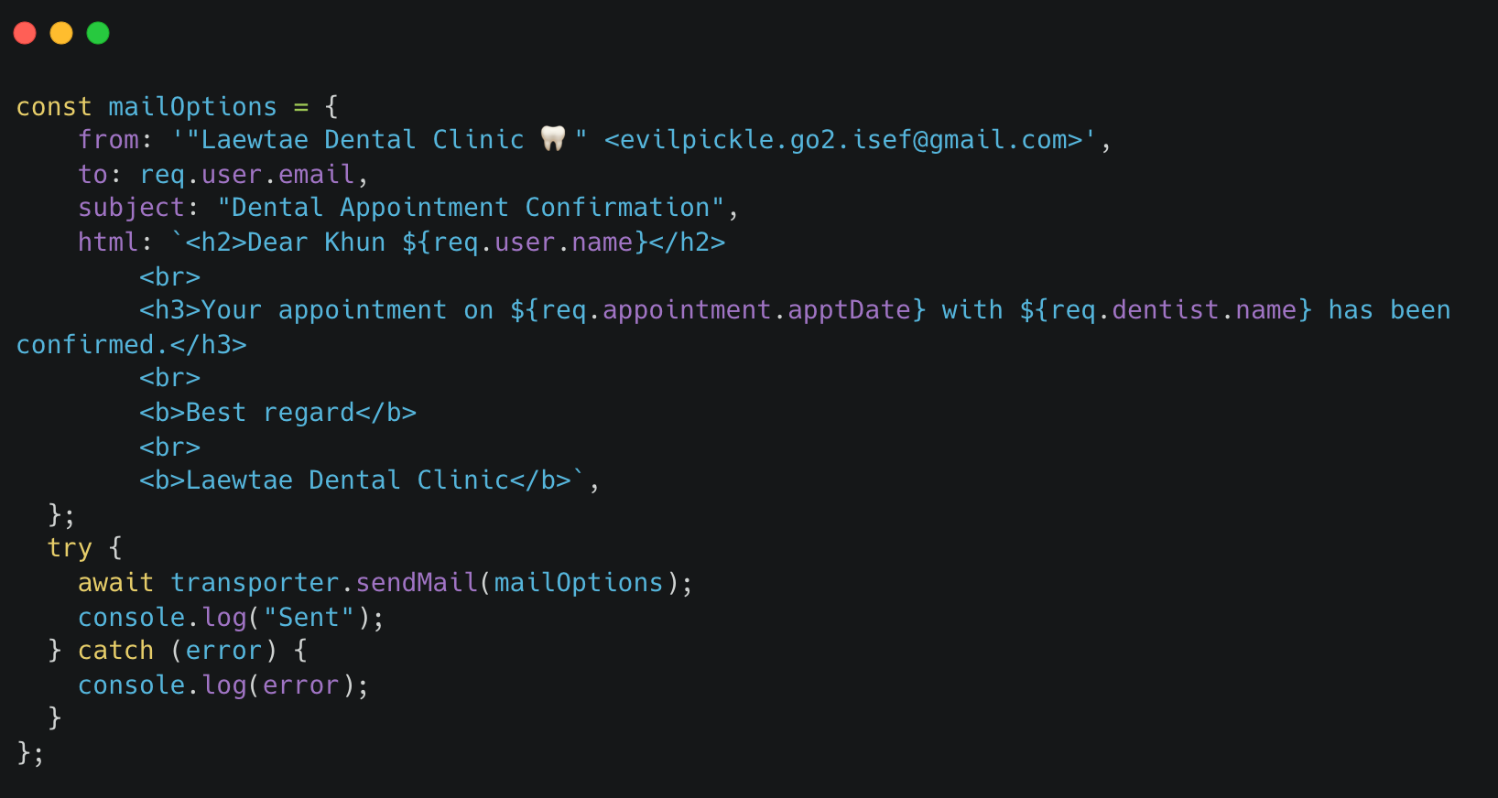
middleware/mail.js

Slide 16
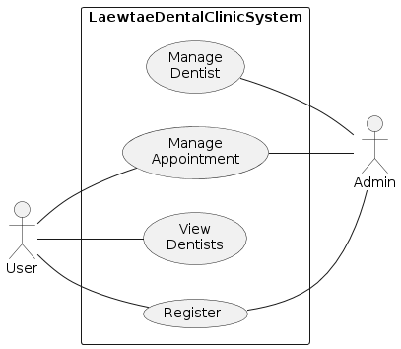
Use Case Diagram

Slide 17
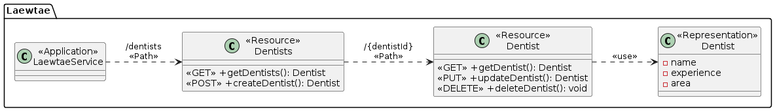
Class Diagram

Slide 18
Sequence Diagram

Slide 19
การแบ่งงานในทีม
แก้ function ให้ตรงตาม requirement
เพิ่ม additional
Document และVDO
แก้ตัวแปรจาก Hospital ให้เป็น Dentist
จัดการไฟล์ให้เป็น Module
Runner

Slide 20

VDO Link
https://youtu.be/B-8vtgVCui0

Slide 21
THANK YOU

