Slide 1

Dentist Booking
By แล้วแต่
Waranthorn Chansawang 6432154921
Nattapong Anansomsin 6431317721

Slide 2
Fuctional Requirements
The system shall allow a user to register by specifying the name, telephone number, email, and password.
After registration, the user becomes a registered user, and the system shall allow the user to log in to use the system by specifying the email and password. The system shall allow a registered user to log out.
After login, the system shall allow the registered user to book only ONE session by specifying the date and the preferred dentist. The dentist list is also provided to the user. A dentist information includes the dentist’s name, years of experience, and area of expertise.
The system shall allow the registered user to view his booking.
The system shall allow the registered user to edit his booking.
The system shall allow the registered user to delete his booking.
The system shall allow the admin to view any bookings.
8. The system shall allow the admin to edit any bookings.
9. The system shall allow the admin to delete any bookings.

Slide 3
Non-Functional Requirements
• Security:
• The system shall authenticate users using username-password
• The system shall be able to keep user’s transactions confidential.
• Performance: • The system shall response to a request in 3 seconds.
• Usability:
• The system shall be used and test via Postman.

Slide 4
Constraints
The system shall be a web API.
The frontend part of the application is not required.
The development team shall develop the backend system as REST APIs.
The database system can be either MongoDB Atlas or MySQL.

Slide 5
Additional Requirement
The system will send confirmation emails upon successful reservation.

Slide 6
Code ที่แก้ไป
แก้จาก Hospital -> Dentist
แก้จาก Appointment -> Booking
models
controllers
config.env
Dentist.js
booking
User.js
auth
dentist

Slide 7
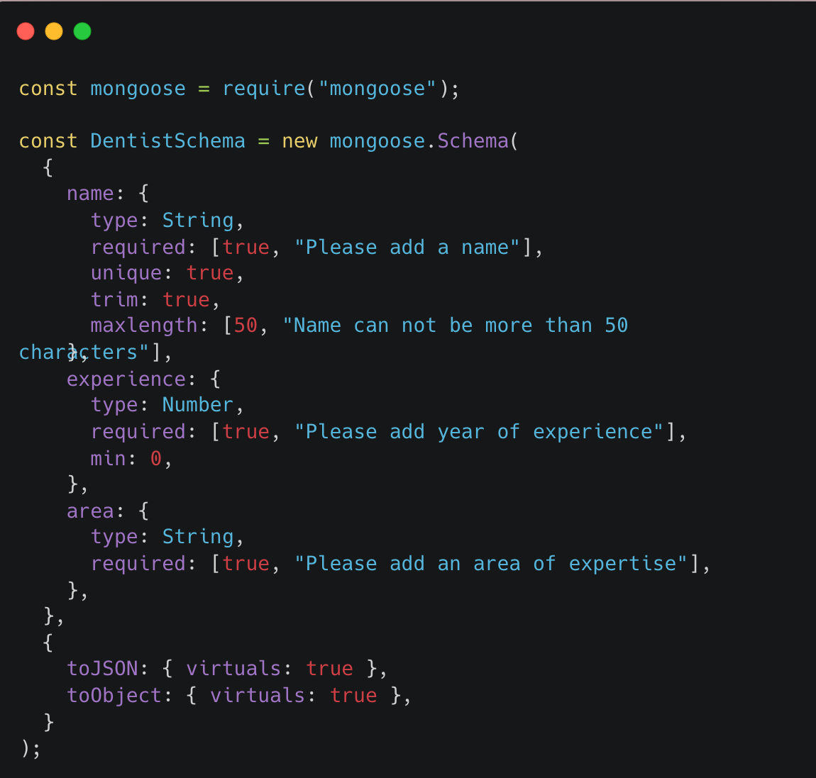
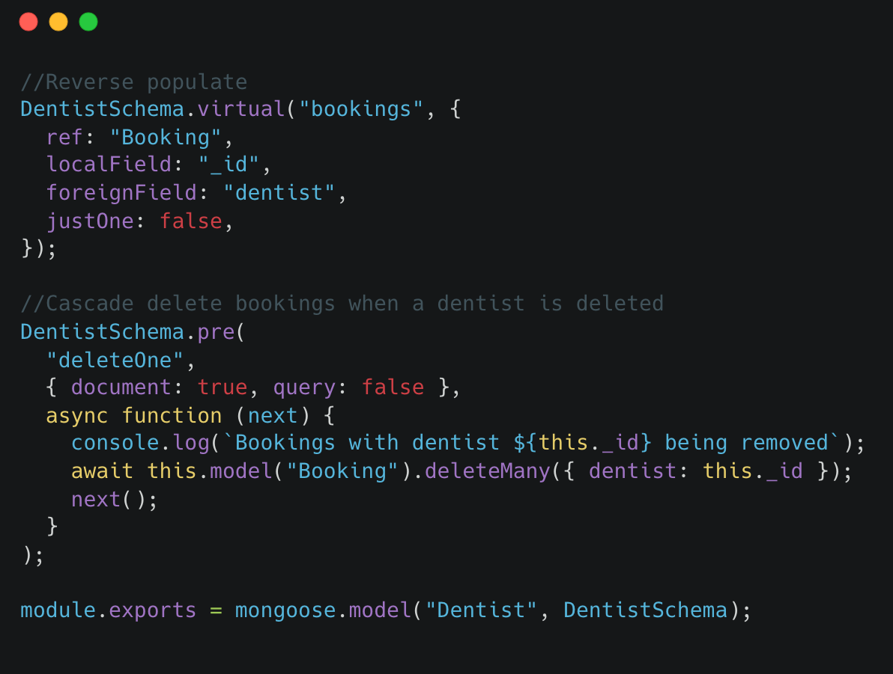
models/Dentist.js
Modify from model/Hospital.js to model/Dentist.js

Slide 8
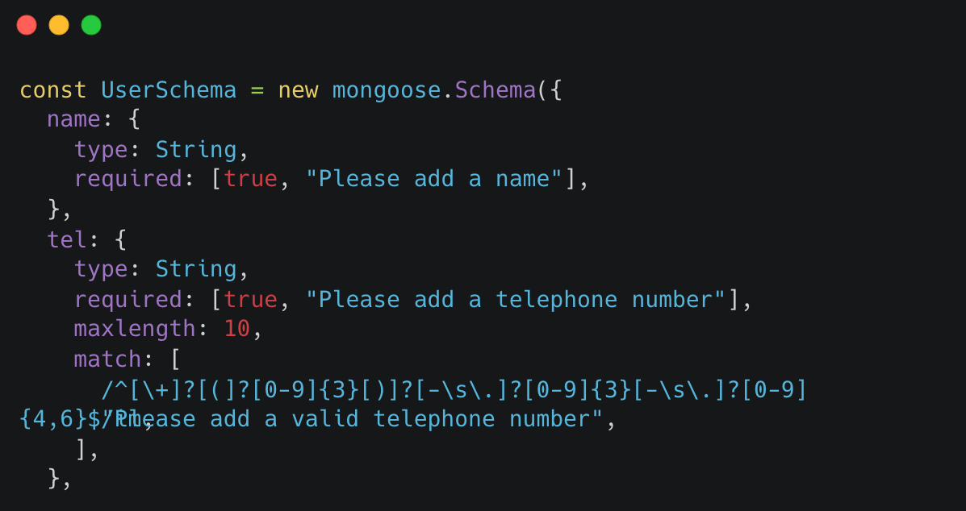
models/User.js
Add tel for user

Slide 9
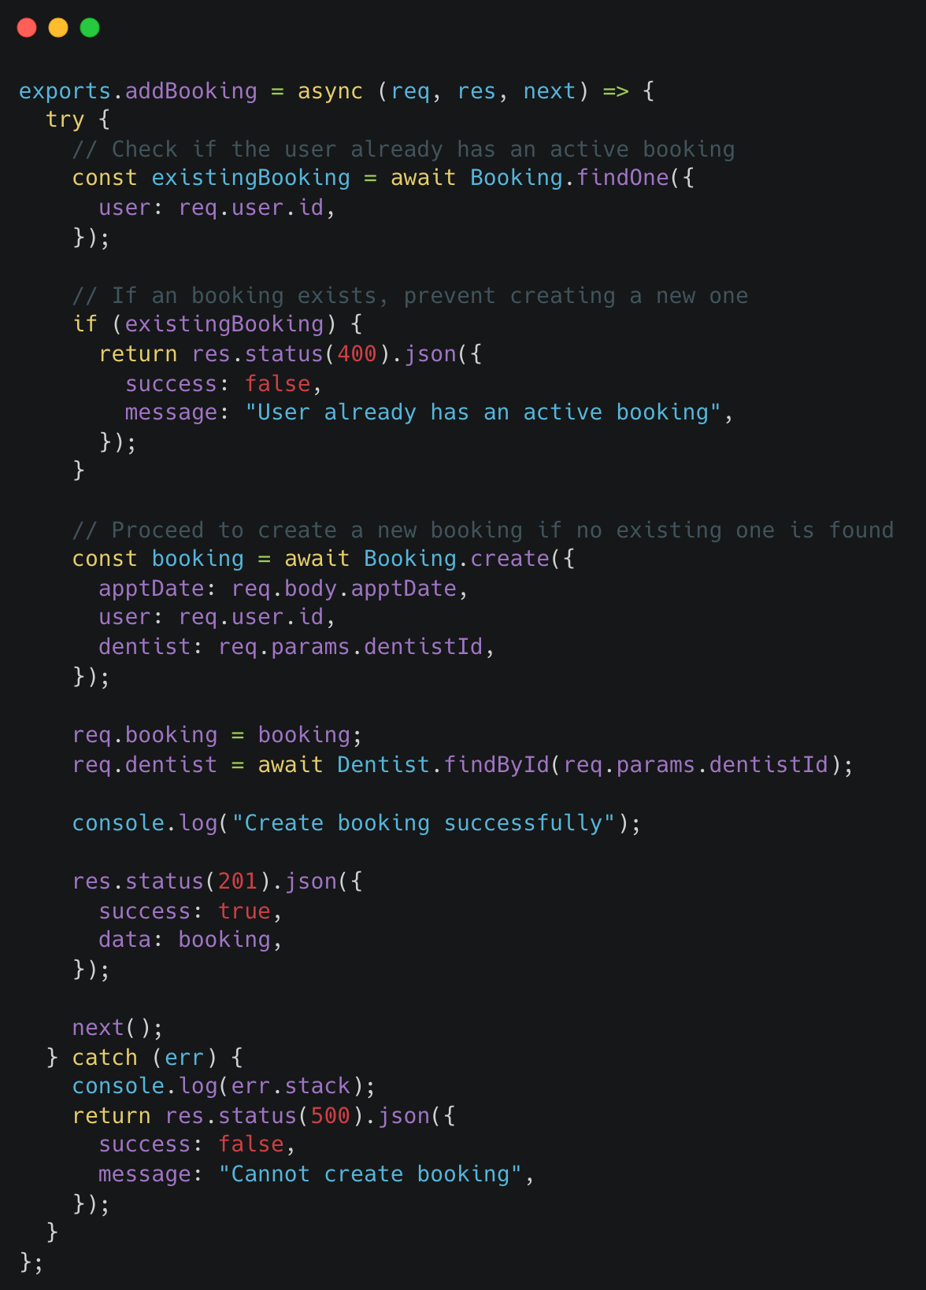
controllers/booking.js
Modify from controllers/appointments.js to controllers/booking.js
Modify addBooking for the requirement “After login, the system shall allow the registered user to book only ONE session by specifying the date and the preferred dentist. The dentist list is also provided to the user. A dentist information includes the dentist’s name, years of experience, and area of expertise.”

Slide 10
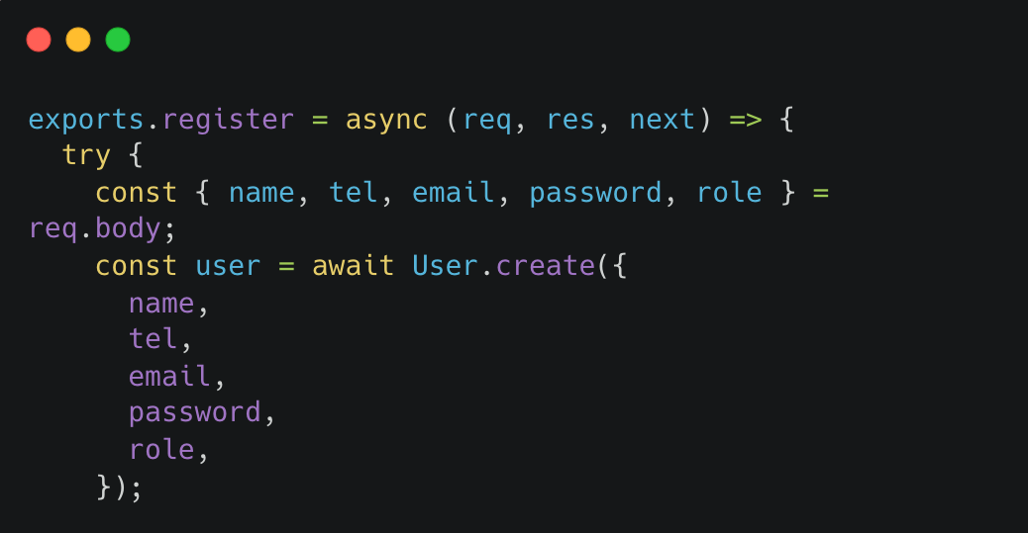
controllers/auth.js
Add tel for user

Slide 11
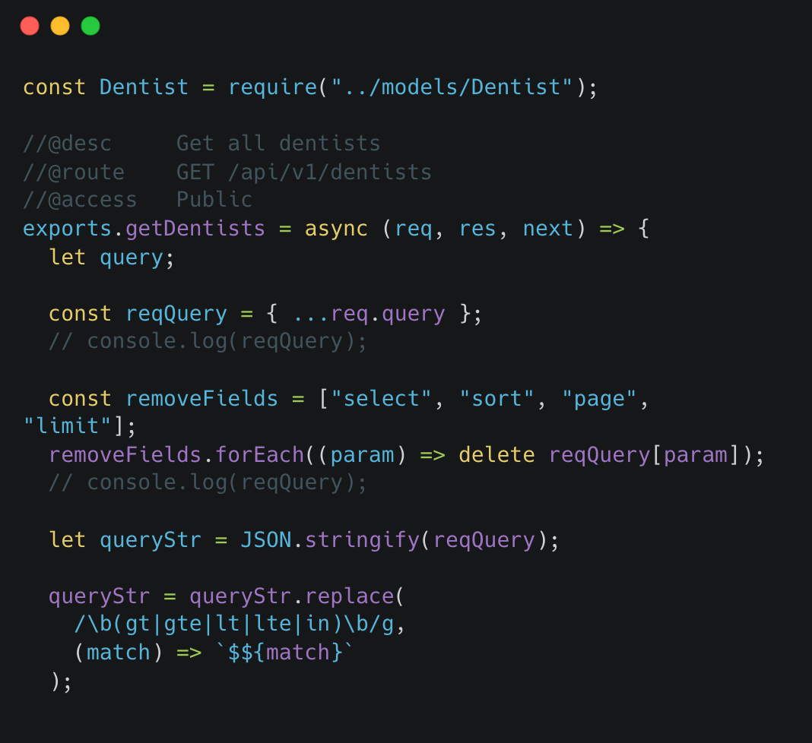
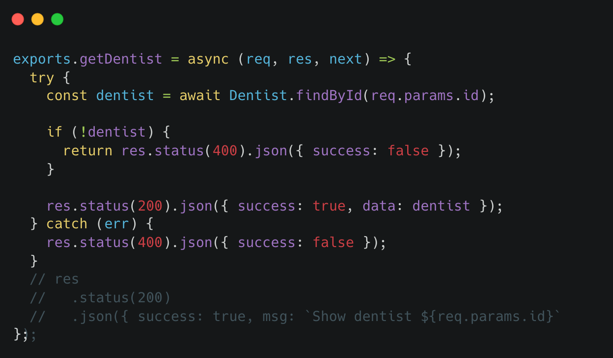
controllers/dentists.js
Change Hosptital(s) to Dentist(s)
Change hosptital(s) to dentist(s)

Slide 12
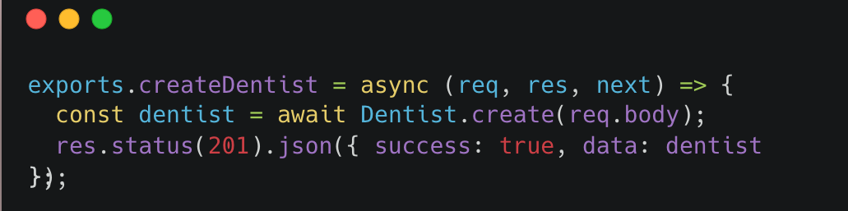
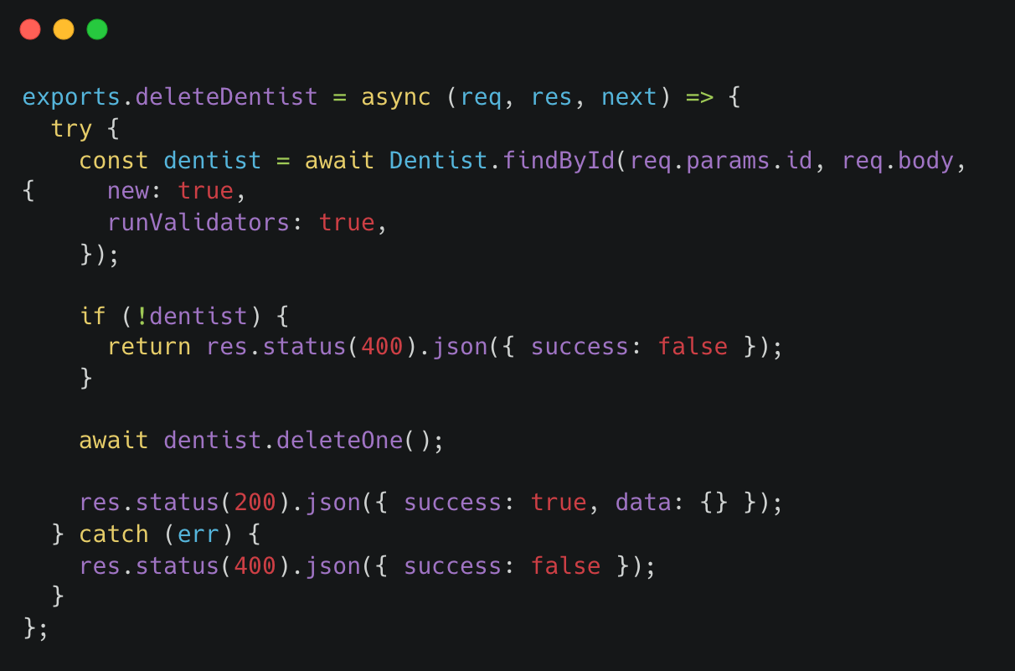
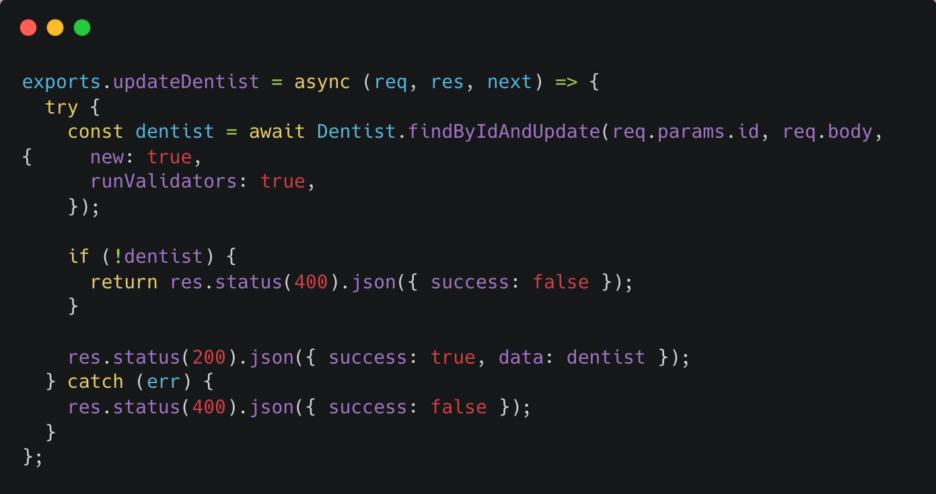
controllers/dentists.js

Slide 13
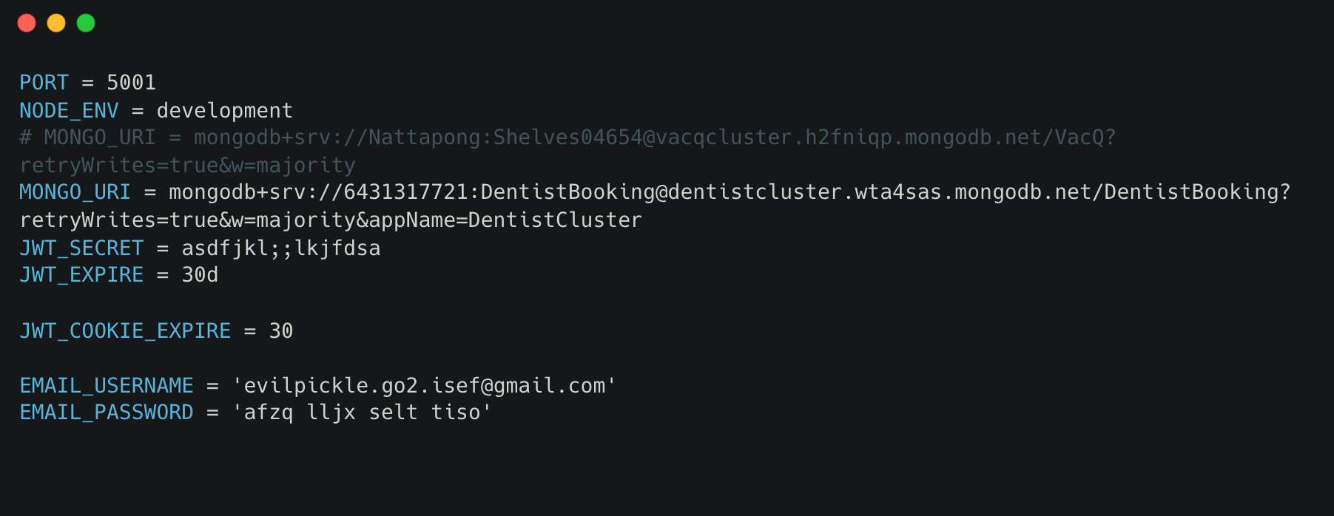
config.env
Connect to new database
Add username & password for email to send

Slide 14
Additional Requirement
The system will send confirmation emails upon successful reservation.

Slide 15
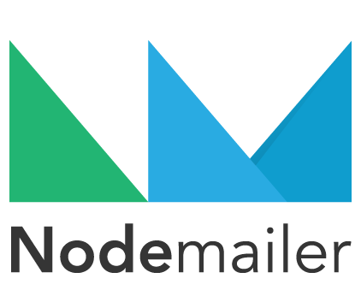

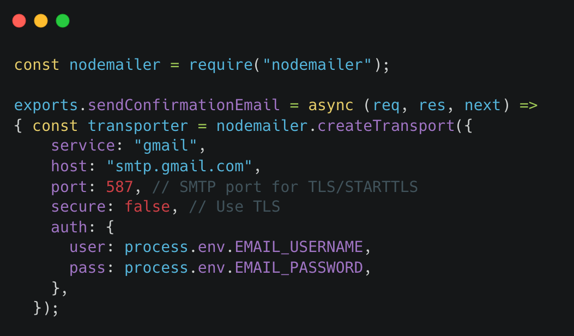
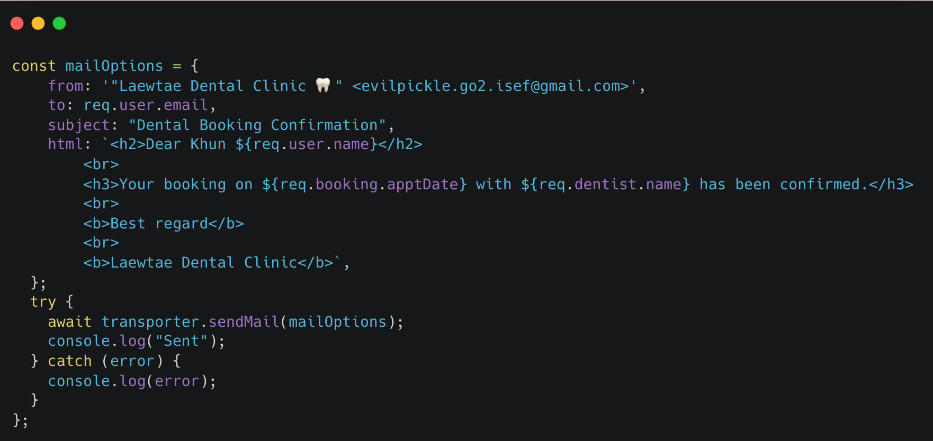
middleware/mail.js
Using Gmail and Nodemailer

Slide 16
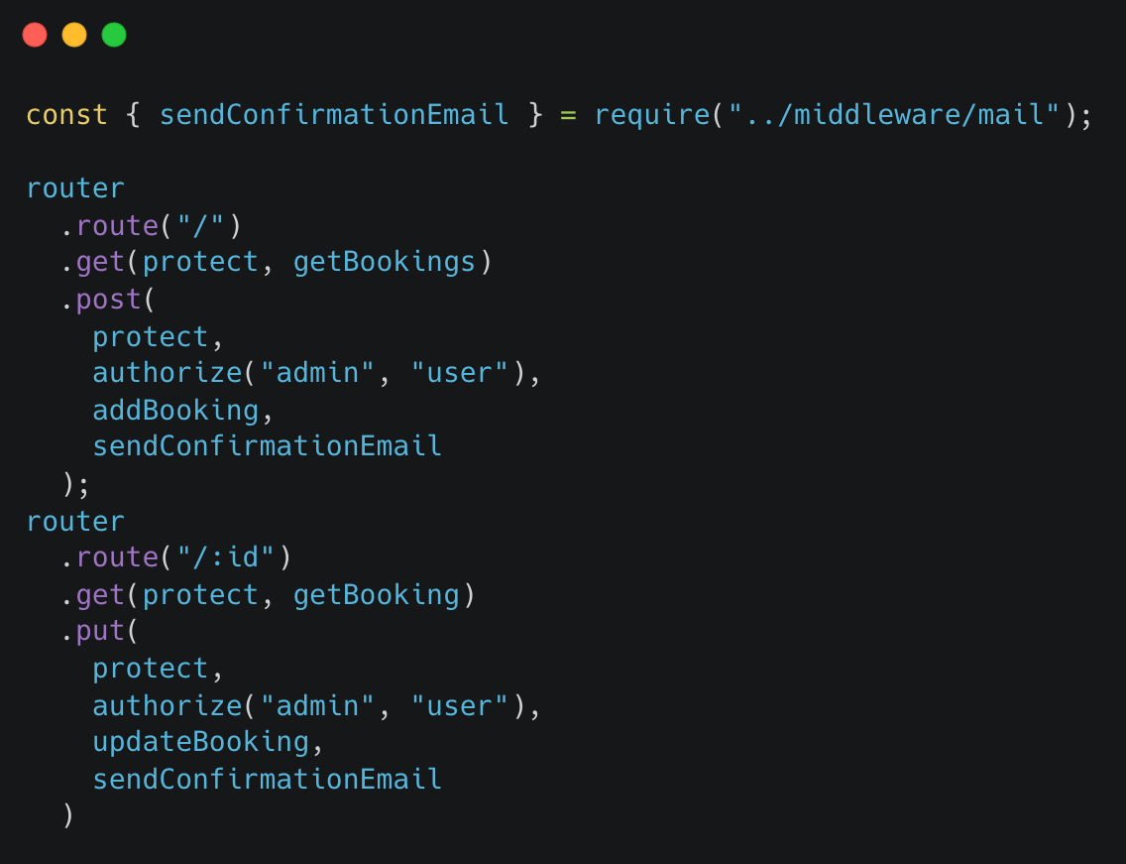
routes/booking.js
Add sendConfirmationEmail to router of addBooking and updateBooking

Slide 17
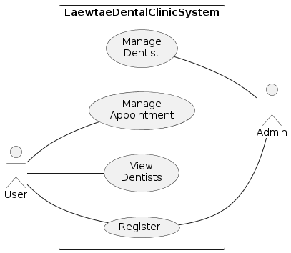
Use Case Diagram

Slide 18
Class Diagram

Slide 19
Sequence Diagram

Slide 20
การแบ่งงานในทีม
Waranthorn Chansawang 6432154921
Nattapong Anansomsin 6431317721
แก้ function ให้ใช้งานได้ตรงตาม requirement
เพิ่ม Additional Requirement
ทำ Document และVDO
แก้ไฟล์และตัวแปรจาก Hospital ให้เป็น Dentist
จัดการไฟล์ Additional Requirement ให้เป็น Module
ทำ Runner

Slide 21

VDO Link
https://youtu.be/sCq5MmsQzfU

Slide 22
THANK YOU

