Slide 1
Operations Intelligence Analyst Challenge

Slide 2
Context and Methodology
The dataset covers transactions processed by CloudWalk’s payment system between January and March 2025, containing detailed transactional information such as transaction date, entity, product, payment method, installment type, and transaction value.
The goal of this analysis was to extract insights on payment performance and supporting operational decision-making.
For the analysis, the tools used were:
Google Sheets for initial data cleaning and preparation;
Looker Studio for creating KPIs, visualizations, and extracting insights to support business recommendations.

Slide 3
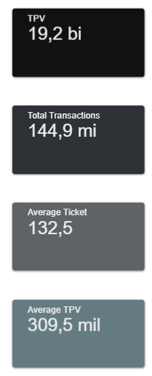
KPIs and Metrics
Notes:
An

Slide 4
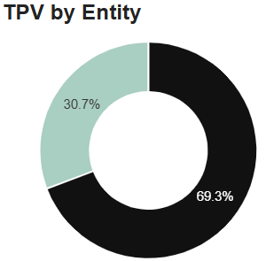
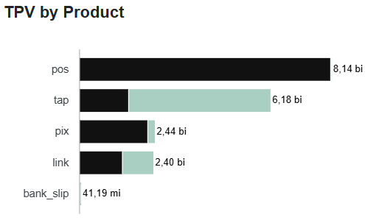
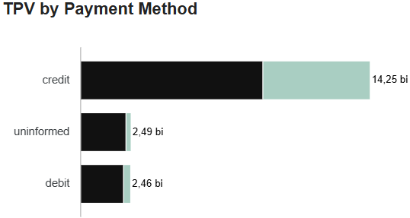

Total Payment Volume (TPV)
The TPV is highly concentrated in PJ, representing 69.3% of total TPV, approximately 13.3 billion. Meanwhile, PF account for 30.7%, or about 5.9 billion and indicates that CloudWalk’s transaction base is mainly driven by business clients.
Credit is the preferred and most profitable payment channel across all entities. Optimizing credit transaction efficiency and costs could result in a great and positive financial impact.
The product with the highest TPV is POS reaching 8.14 bi, predominantly from PJs clients and for PF clients, the leading product is TAP, totaling 4.59 billion. Other products like PIX (2.44 bi) and LINK (2.40 bi) also have a significant amount. Therefore, the company have a diversity portfolio regarding payment methods even though each client has their preferred PIX and Link show potential for future growth and should continue to be monitored.
TPV by Entity
TPV by Product
TPV by Payment Method

Slide 5
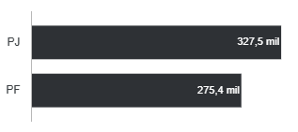
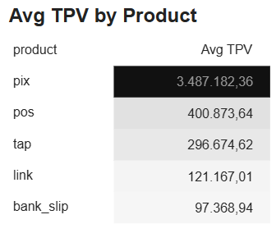
Average TPV
Average TPV by Entity
Analyzing the Average TPV by Entity, PJ clients continues to outperform PF clients, with an average TPV of 327.5 thousand compared to 275.4 thousand for PF.
Reaffirming that the CloudWalk’s transaction base is mainly driven by business clients.
Average TPV by Product
Looking into the Average TPV by Product, it is notable how PIX, reaching approximately 3.48 million, stands out overwhelmingly as the product with the highest average transaction volume.
This may suggests that PIX is primarily used for high-value transfers rather than frequent, smaller purchases.
It demonstrates a promising opportunity for CloudWalk to capture even more TPV growth in the future while maintaining such a strong average transaction value.

Slide 6
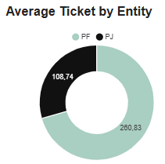
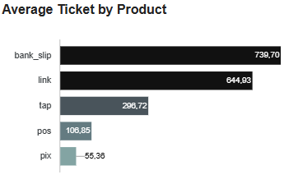
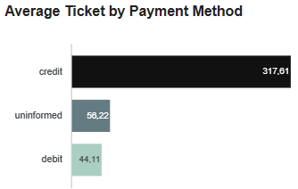
Average Ticket
When analyzing the Average Ticket by Entity, PF present a higher value 260.83 compared to PJ, which average 108.74. This indicates that, on average, individual customers perform fewer but higher-value transactions, while business clients (PJ) operate with larger volumes but smaller ticket sizes per transaction.
Observing the Average Ticket by Product, the products with the highest average values are Bank Slip (739.70) and Link (644.93), which typically involve higher-value transactions; POS and PIX are used for more frequent, lower-value transactions and LINK is an intermediate
Average Ticket by Payment Method, Credit remains the leading method, with an average ticket of 317.6. This reinforces that credit-based transactions are associated with higher-value purchases.
Average Ticket by Entity
Average Ticket by Product
Average Ticket by Payment Method

Slide 7
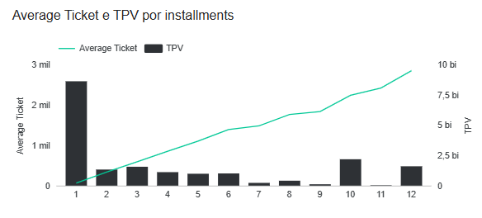
Installments Analysis
Average Ticket and TPV by Installments
When analyzing Average Ticket and TPV by Installments, the highest TPV occurs in 1 installments transactions. It demonstrates that most of the total payment volume is concentrated in immediate, one-time payments. Confirming a preference for upfront payments in lower-value transactions.
However, as the number of installments increases, the TPV tends to decrease, but the Average Ticket rises sharply suggesting that higher-value purchases are almost always made through credit installments.
Encouraging the use of longer installment plans could increase overall TPV.

Slide 8
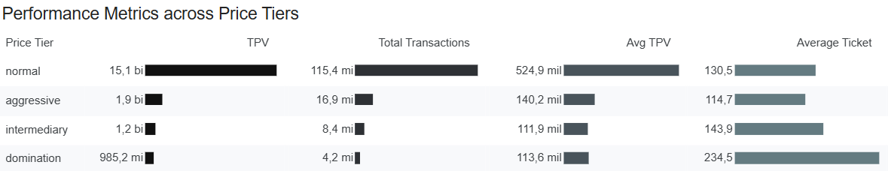
Price Tier Analysis
Performance Metrics across Price Tiers
Performance Metrics across Price Tiers follow similar patterns regarding TPV, Total Transactions, and Average TPV with the Normal tier leading across all three metrics. It shows that the majority of CloudWalk’s activity occurs within the standard pricing model.
But Average Ticket metric behaves differently, reaching the highest level under the Domination tier (R$234.5). So as the price tier increases, clients tend to process fewer but higher-value payments — possibly reflecting premium segments, higher-risk operations.
A balanced strategy could combine maintaining high TPV in the Normal tier while developing tailored offers for higher tiers to increase profitability.

Slide 9
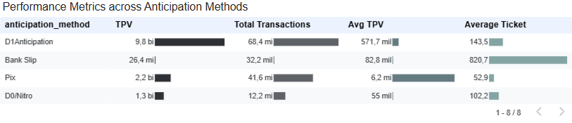
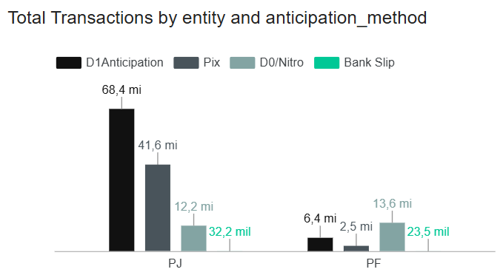
Anticipation Methods Analysis
Performance Metrics across Anticipation Methods
Total Transactions by Entity and Anticipation Methods
Analyzing the Performance Metrics across Anticipation Methods, we can see that D1 Anticipation clearly dominates, reaching R$9.8 billion in TPV and 68.4 million transactions and representing the main anticipation mechanism used by CloudWalk’s clients
Other methods such as Pix (R$2.2 billion TPV) and D0/Nitro (R$1.3 billion TPV) also contribute significantly, but with smaller transaction volumes. Bank Slip, although representing a very small share in TPV, shows the highest Average Ticket (R$820.7).
Breaking down Total Transactions by Entity and Anticipation Method, PJ clients are clearly more active in anticipation usage, especially under D1 Anticipation, while PF clients tend to use Pix and Bank Slip. This segmentation suggests opportunities to expand anticipation products tailored to each client type — for example, optimizing D0/Nitro conditions for PF and premium D1 Anticipation packages for PJ.

Slide 10
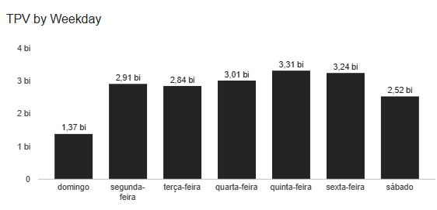
Weekday Analysis
When analyzing TPV by Weekday, a clear pattern emerges between weekdays and weekends.
During the workweek (Monday to Friday), TPV values remain consistently high — ranging from R$2.84 billion on Tuesday to R$3.31 billion on Thursday, which is the peak of weekly activity.
In contrast, on weekends there is a sharp decline, with Saturday at R$2.52 billion and Sunday dropping to only R$1.37 billion, the lowest level of the week.
This indicates that most transactions and payment volumes occur during business days, reflecting the commercial nature of CloudWalk’s client base, companies whose operations are concentrated on weekdays.
Marketing or operational strategies could focus on stimulating weekend activity, such as offering discounted fees or faster settlement options for Saturday and Sunday processing.
TPV by Day of the Week

Slide 11
Bot Proposal
General Structure:
Data Connection and Extraction
Establish a secure connection with the transactional database;
Automatically extract daily data updates related to TPV, transactions, and average ticket.
Analysis and Comparison
Calculate the main KPIs (TPV, transactions, and average ticket);
Perform daily, weekly, and monthly growth comparisons;
Identify trends or anomalies in performance.
Alert Definition
Set alert thresholds based on variations or deviations from historical averages;
Automatically notify users when significant changes are detected (e.g., TPV drop or variations in ticket value).
Geração e Envio dos relatórios
Automatically generate daily KPI summary reports;
Define delivery platforms such as email, Microsoft Teams, or Slack;
Schedule deliveries for specific times or trigger them when alert thresholds are reached.
Daily updates and insights on Total Payment Volume and Average Ticket

