Slide 1


CHANGING THE WORLD OF CREDIT CARD
UltimateCloud Credit Card
Anselme Borgeaud, Eduardo Moreno, Mevluet Polat, Peerawan Wiwattananon
AI FANTASTIC FOUR

Slide 2
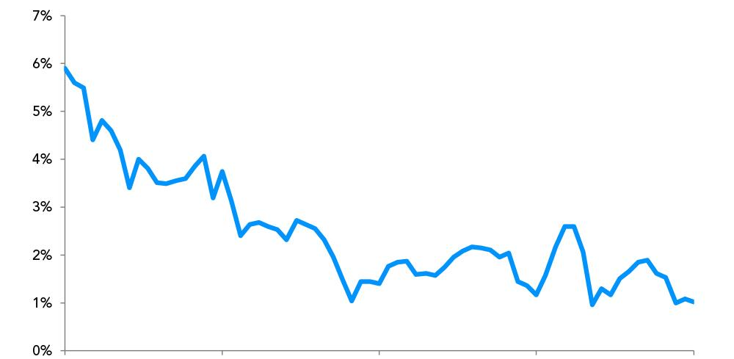

Decline in Income
Income
Constant income decline in the past 5 Quarters.
Q1/2020
Q2/2020
Q3/2020
Q4/2020
Q1/2021
AI FANTASTIC FOUR

Slide 3
Points to discuss:
Table of Contents
Tackle the Markets
Food For Thoughts: Take Home
AI FANTASTIC FOUR Workflow
Analyses
Conclusions
Outlook
AI FANTASTIC FOUR

Slide 4
……... seek the most useful customer segmentation, to improve the marketing campaign.
AI FANTASTIC FOUR

Slide 5
Take home
Two marketing campaigns:
Large buyers (commissions)
Large cash-advance takers (interest rate)
Buyers - stimulate their purchases
Cash-advance takers - send more (e-)mail checks
AI FANTASTIC FOUR

Slide 6




AI Fantastic Four Workflow
Global Analyses
Detailed Analyses
Credit Limit
Purchase Amount
Payment Rate
Payments
…..
….
Machine Learning Models
AI FANTASTIC FOUR

Slide 7
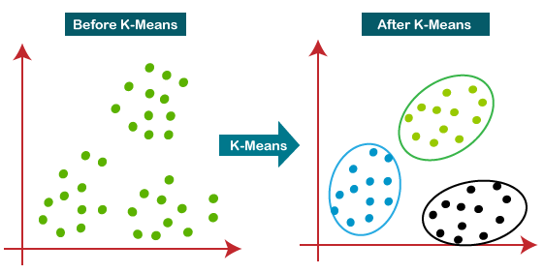
Analysis
Customer Segmentation with Clustering Algorithms
Input Data
ML Clustering Algorithms
K-Means
Silhouette Method
Agglomerative Clustering
...
AI FANTASTIC FOUR

Slide 8
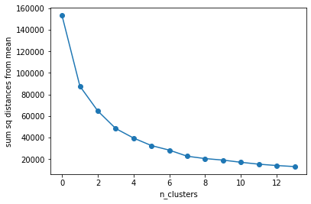
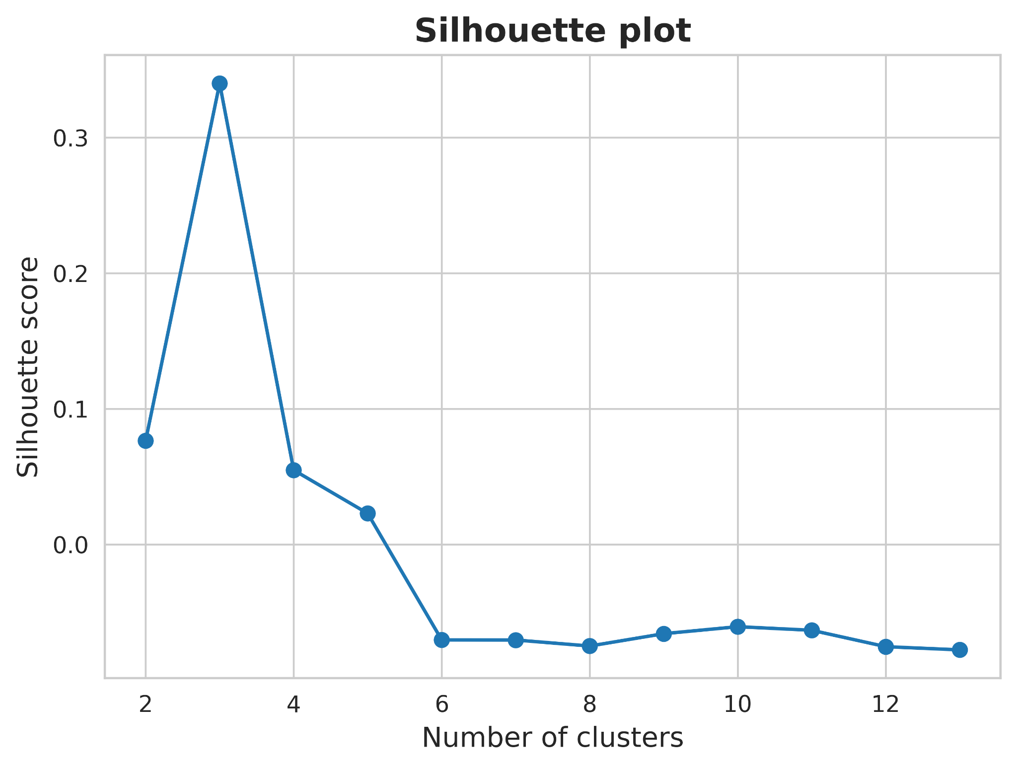
Analysis
Customer Segmentation with Clustering Algorithms
K-Means
Possible number of clusters
AI FANTASTIC FOUR

Slide 9
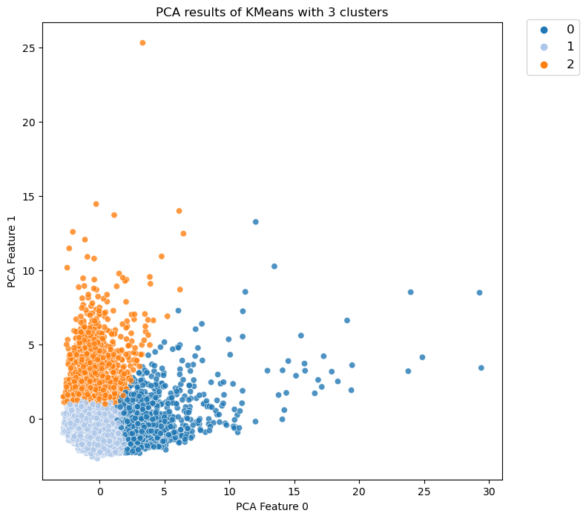
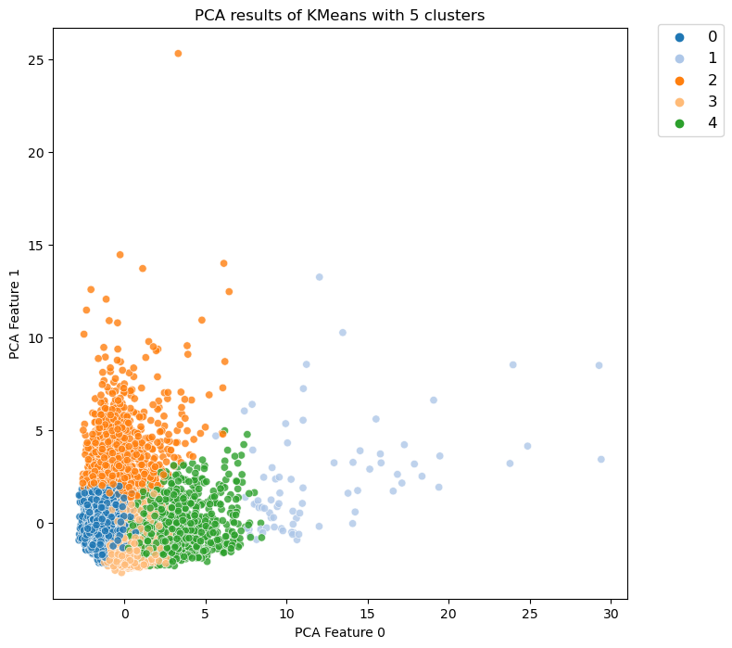
Analysis
Customer Segmentation with Clustering Algorithms
AI FANTASTIC FOUR

Slide 10
Analysis
Customer Segmentation with Clustering Algorithms
Remarks:
Number of possible clusters: 3 - 5
Baseline with 3 clusters
Deeper analysis into customer segmentation with 5 clusters
AI FANTASTIC FOUR

Slide 11
Two revenue streams
Commissions on purchases
Interest on cash advances
AI FANTASTIC FOUR

Slide 12
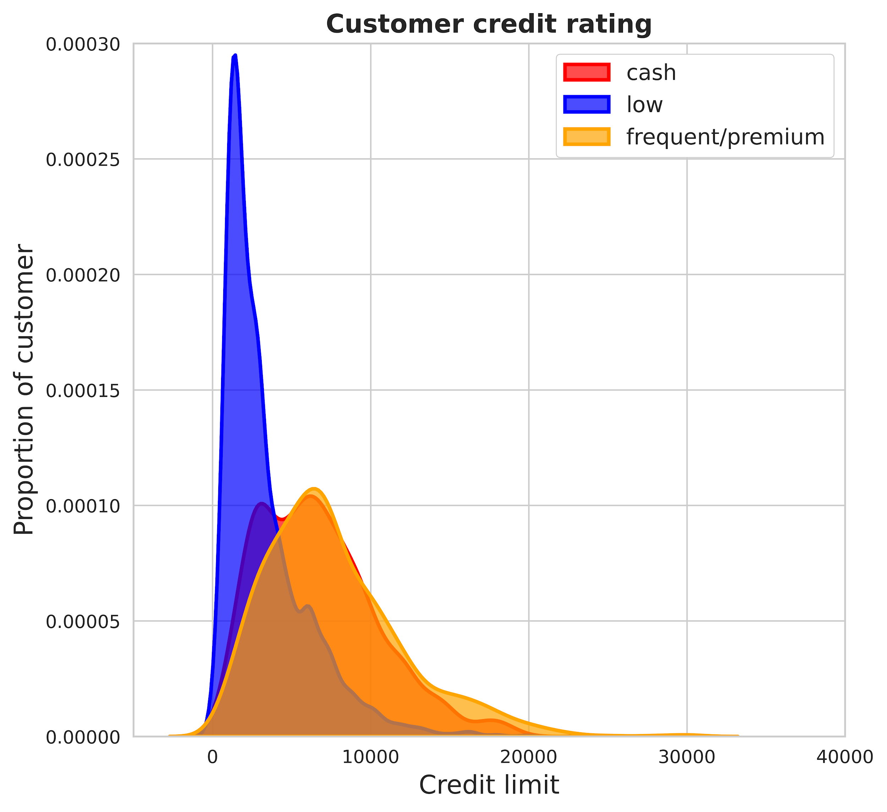
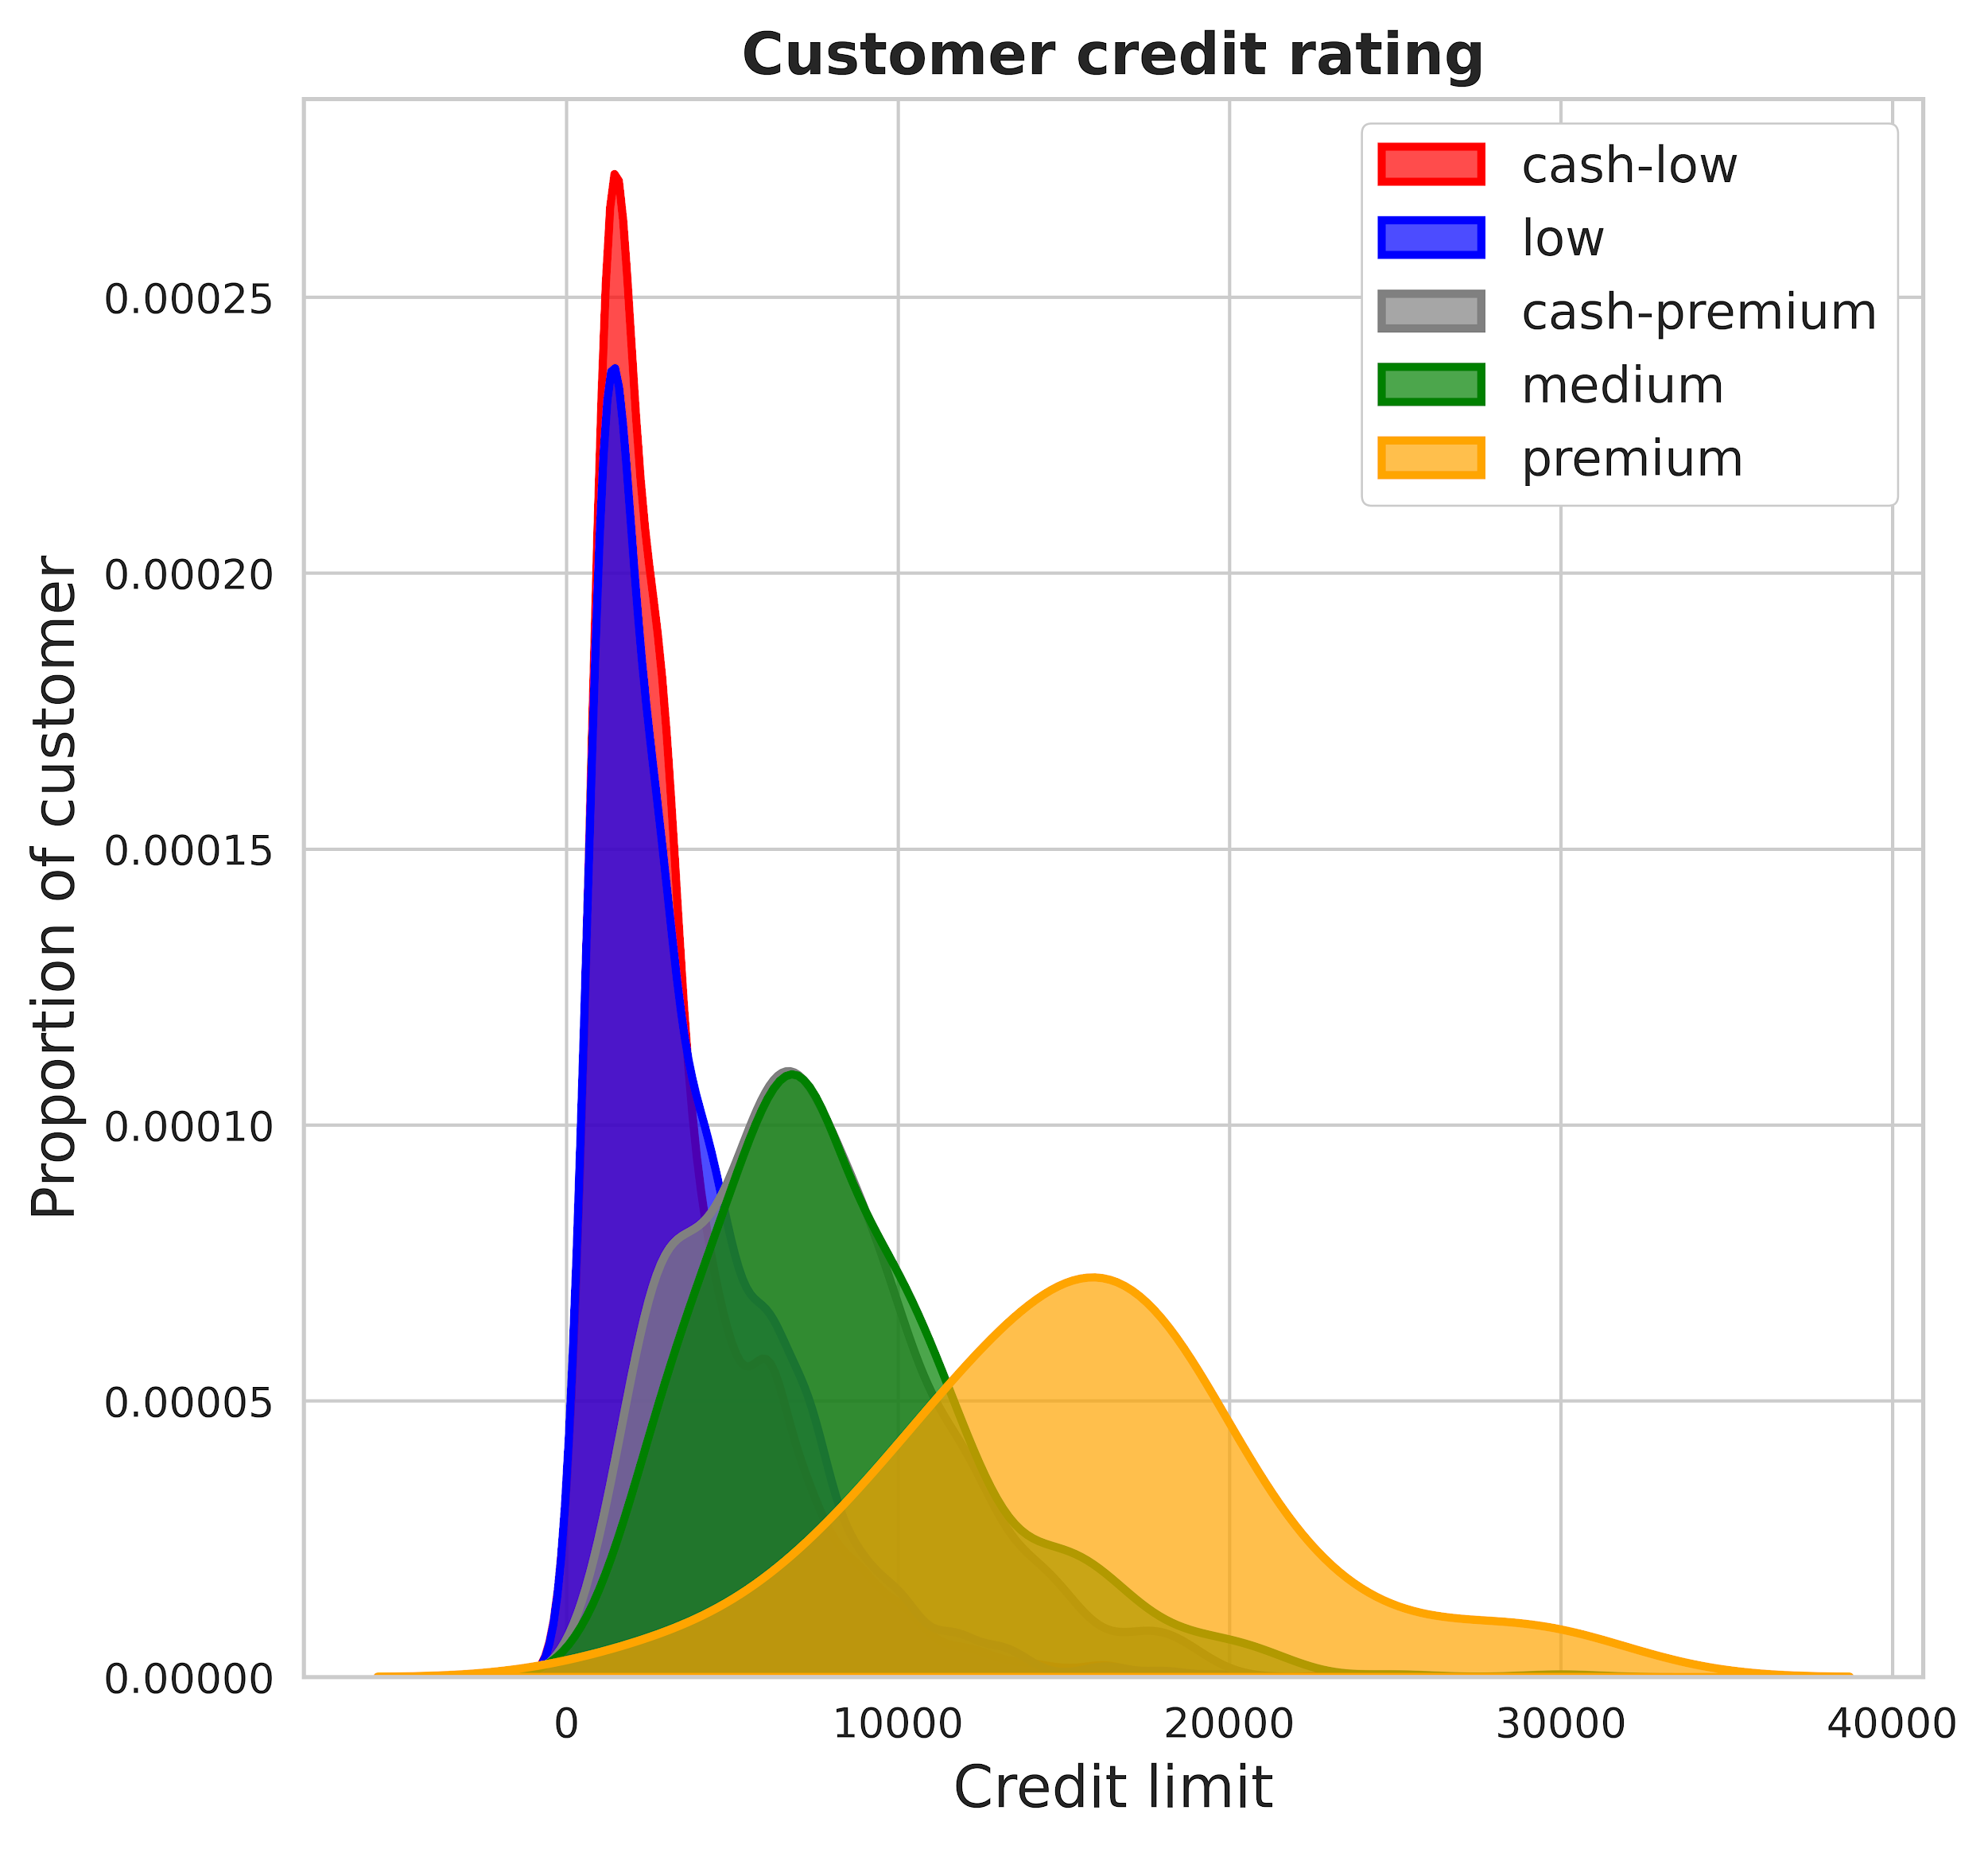
Credit risk
AI FANTASTIC FOUR

Slide 13
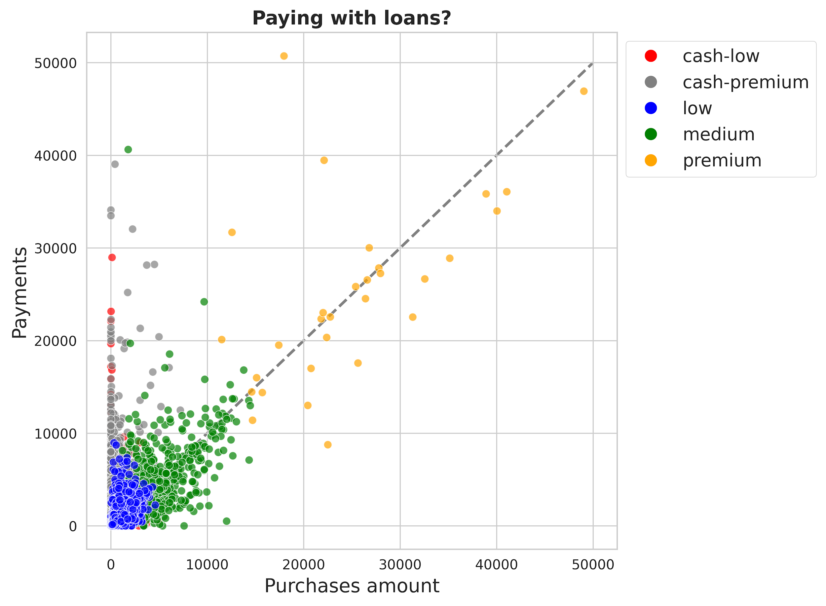
Large buyers & loan-takers
Medium & premium | largest buyers no cash advances
Cash-premium | largest cash advances medium purchases
Cash-low | 73% use only cash advances
AI FANTASTIC FOUR

Slide 14
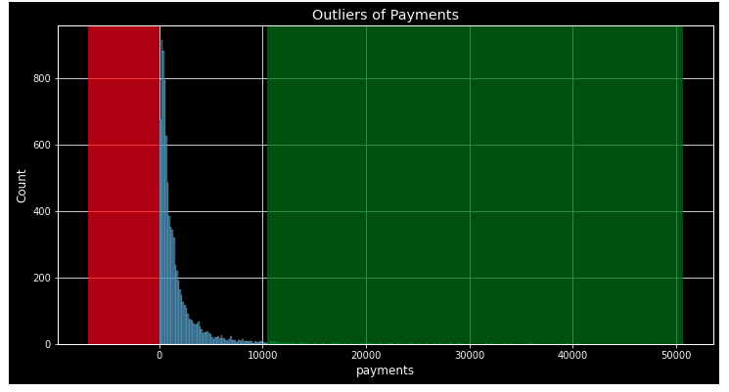
Outliers
Who are the outliers according to 3 Sigma?
All customers with a payment more than 10’400 CHF are outliers
Number of Outliers is 148
Ratio of Outliers is 1.8%
Average Payment of Outliers is 17421 CHF
Outcome: Trace / Verify / Monitor each payment to avoid fraudulant payments
AI FANTASTIC FOUR

Slide 15
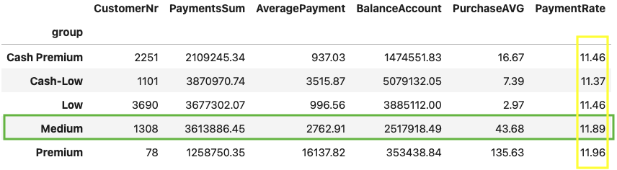
Groups
Considerations
Medium
Similar Sum of Payments as other top two groups
High Average of Purchases
Sum of Payments is higher than the Balance Account -> Installments
Focus of installments contracts with duration of 12 months
AI FANTASTIC FOUR

Slide 16
Points to
Ponder
Recommendations
Capture cost per payment
Capture number of contacts per payment or per customer
Cost of balance account
Number of failed payments / installments
Cost of paid or received commission per payment
AI FANTASTIC FOUR

Slide 17
Conclusions
Focus on Medium/Premium group - stimulate their purchases
Focus on Cash-advance takers - stimulate them to take more cash advance
Focus on 12 months repayment installment contract group
Trace/monitor payment > 10,400 CHF (could be fraudulent payment or a new Platinum group)
Capture more data (cost of payment, number of contacts with customers)
AI FANTASTIC FOUR

Slide 18
ULTIMATE CLOUD CREDIT CARD
Changing the World of Credit Card
AI FANTASTIC FOUR

