Slide 1
PURCHASE PREDICTION

Slide 2
TABLE OF CONTENTS
01
02
03
04
PROBLEM UNDERSTANDING
METHOD/APPROACH
WORKFLOW
ANSWER
05
DISCUSSION

Slide 3
UNDERSTANDING THE PROBLEM
Problem
Solution
Data
Know in advance which customers are likely to purchase next month
Build a model to predict which customers make at least 1 purchase in a given month
Customer transactions over 5-month period (from 02/2018 to 06/2018)

Slide 4

METHODS/APPROACH
Train data:
- Features: Get features from 2 previous months of transaction.
- Label: If customer purchase this month => label = ‘Y’, otherwise ‘N’
Test data: Get features from the most 2 recent months of transaction.
t-2 |  | t-1 |  | t
Feb | + | Mar | => | Apr
Mar | + | Apr | => | May
Apr | + | May | => | Jun
TRAIN DATA
NON-LABELED DATA FOR PREDICTION
Apr | + | May | => | PREDICTION
Used to get features
Used to get label

Slide 5
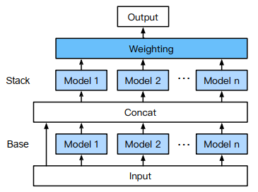
METHODS/APPROACH
Model: Use autogluon – Auto machine learning framework
Fast implementation
+ Automated features engineering.
+ Automated training multiple models, includes: LightDBM, Xgboost, Neural Network, etc.
Could get high performance
+ Ensemble multiple models
+ Multi-layer stacking models trained with final output
+ Automated k-fold bagging
=> Use as a benchmark for other models.

Slide 6
WORKFLOW
Learning Algorithm
Dataset
Train Data
Trained Model
Feature
Engineering
Data processing
Non-labled Data
Prediction
Result

Slide 7
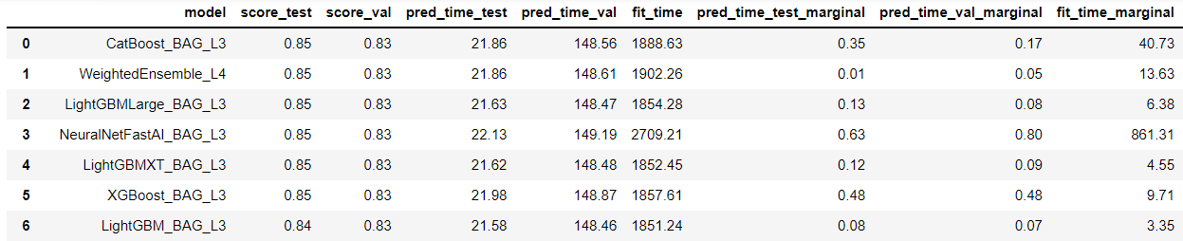
ANSWER
50.3%
49.7%
Train data: 25 features, 38518 samples (19390 label = ‘Y’, 129128 label = ‘N’)
34666 | 3852 | 12875
Train&Dev data
Test data
Non-labeled data
Model performance: Accuracy = 85%
Result: Use model to predict and get 6878 customers most likely to purchase in July
=> Store manager could use this model to predicts which customers most likely to purchase next month.

Slide 8
DISCUSSION
Future works to improve model performance:
- Divide data into smaller periods to capture the change in customer behavior. Eg: 8 weeks (or 8 periods) instead of 2 months (or 2 periods)
- Get new features: Difference between from t-1 and t-2 features
- Build other models (manually): Deep neural network, Xgboost, LightGBM
- Get more data:
# Train&Dev data | Test Accuracy
30814 | 82%
32740 | 83%
34666 | 85%
Include ‘csn’ as a feature increase accuracy by 10% (85% vs 75%) => Overfitting to ‘csn’ ???, need more analyst here.

Slide 9
DISCUSSION
Other thoughts: Applying the model this way might not bring much benefit to the store manager because customers who intend to purchase next month will continue to buy whether or not he send them the promotional email
=> Store manager should concentrates on finding which customers wouldn’t purchase next month (rather than who purchase). By studying those customers and/or sending them appropriate promotional email, he could understands why customers churn then improves his business.

Slide 10
THANK YOU!

