Slide 1
Taxonomic classification of ants (Formicidae) from images using deep learning
Marijn JA Boer
marijn.boer@naturalis.nl
February 6th, 2018
Supervisor: dr. Rutger Vos

Slide 2
Ant Taxonomy
Ants
Diverse
Global

Slide 3
Importance?
Need to know species because?
Important to ecosystems
Bioindicator
Richness surrogate?

Slide 4
Identifying ants
Is hard because:
…
…

Slide 5
But… computer vision!
Machine learning
Conventional ways:
Wing outline
Color
Etc.

Slide 6
Examples
Previous research on these simple computer vision projects using machine learning.

Slide 7
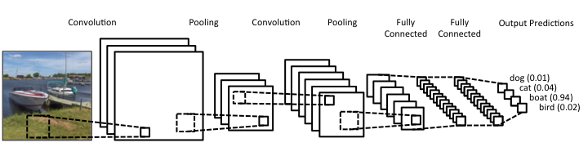
But… deep learning!
More promising
What is deep learning?
What is a CNN?

Slide 8
Example research using DL

Slide 9
FormicID Project
What is the aim of this project?
Naturalis aim
CNN multi-view

Slide 10
Questions

Slide 11
Problems

Slide 12
Approach
Scalable
Comprehensible
How to start?
Python

Slide 13

AntWeb

Slide 14
FormicID-97
DB summary

Slide 15
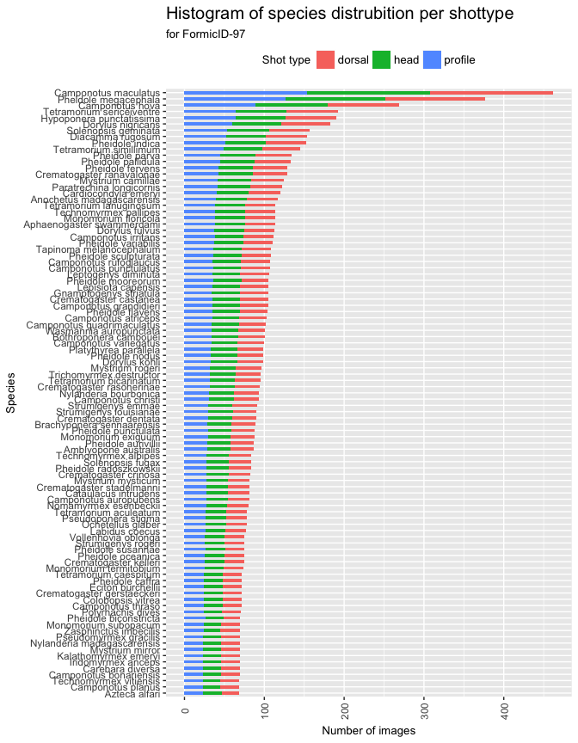
Species distribution
Switch axis!

Slide 16
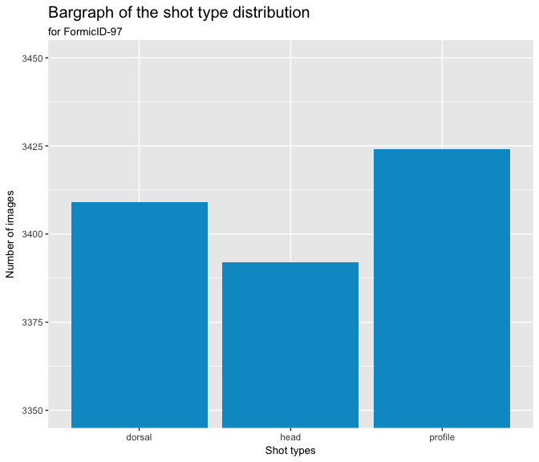
Shot type distribution

Slide 17
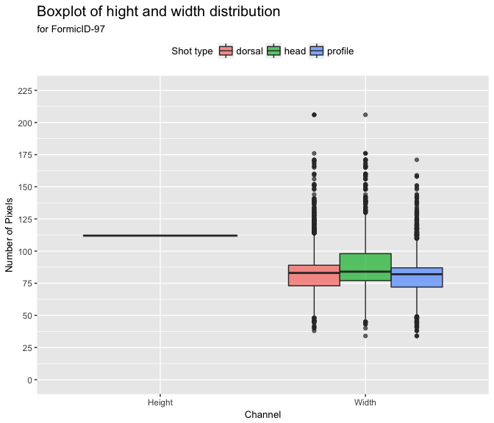
Image dimensions

Slide 18
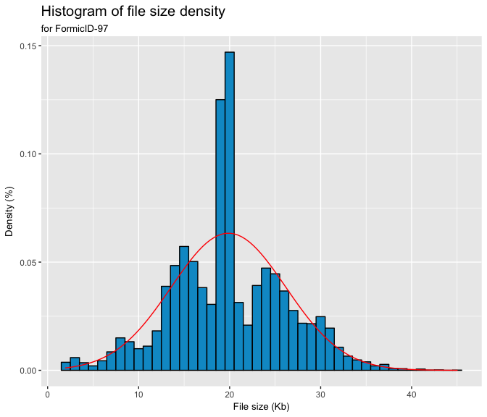
File size

Slide 19
Network architecture
Existing one
Examples…
…
New one
With these options:
…
…

Slide 20
Testing
First training
Validation
Then training
Top-1
Top-5
Then evalution of the results and increase complexity.

Slide 21
Timeline

Slide 22
Thanks!

