Slide 1
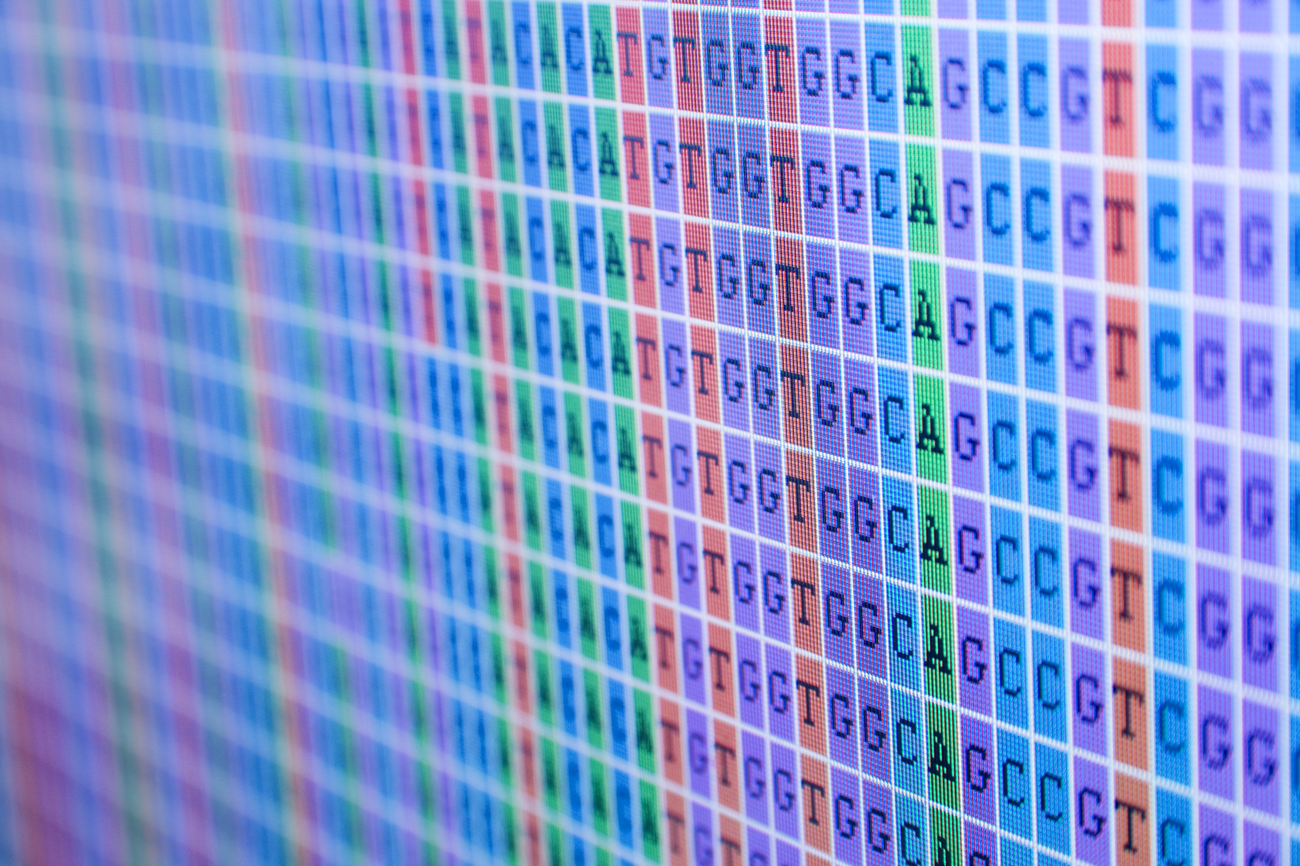
Automated and reproducible analysis of NGS data
11 September 2012, 9.30-10.30
Notes:
This introduces the course, i.e. what is NGS? What are the problems? What can we address in this workshop? What will we address in this workshop? Ref: http://dx.doi.org/10.1093/bib/bbq063

Slide 2
About the instructors
Darin London
Rutger Vos
Darin London studied biology at Texas Tech University in the United States, graduating with a Masters of Science in 1999. He has been supporting biological research with computational support for 12 years, starting at GlaxoSmithKline in 2000, then moving to the European Bioinformatics Institute to work on the Biomart system, and finally coming to the Institute for Genome Sciences and Policy at Duke University, Durham, USA in 2005. He has developed automated analysis pipelines to help researchers analyze over 25Tb of Vertebrate NGS data (GAII and HiSeq), mostly involving research work on the Encyclopedia of DNA Elements (ENCode). Darin has taught numerous workshops on programming and automation with the Perl programming language, including the phyloinformatics workshops at the NESCent, Durham, USA, and the GTPB (PHYLOINF09).
Rutger Vos studied biology at the University of Amsterdam, where he graduated in 2000. He did his PhD research under professor Arne Mooers at Simon Fraser University in Vancouver, Canada, defending his thesis in 2006. He contributed to several open-source scientific software development projects while continuing his research career as a postdoc at UBC and at the University of Reading. In Spring of 2012 he started working as the bioinformaticist of the Naturalis Biodiversity Center in a role where he combines novel research with bioinformatics contributions to various research programmes within the organization. In his spare time he contributes to various open source software projects (TreeBASE, Bio::Phylo, NeXML) and is co-PI of the PhyloTastic project. In addition Rutger has taught bioinformatics workshops in the US, Japan, China, Kenya and once before at GTPB (PHYLOINF09).

Slide 3
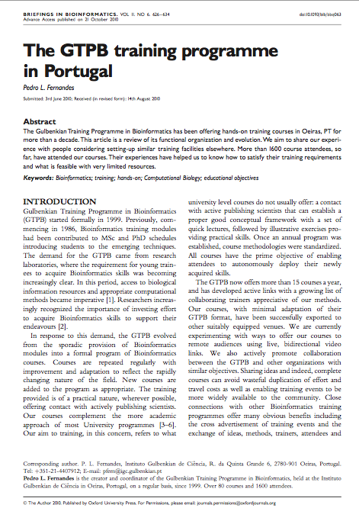
About the workshop
Four days, four sessions each day
Brief introduction at each session
Exercises on a UNIX-like system (Ubuntu)
Supplementary materials: https://github.com/naturalis/arangs
Course website: http://gtpb.igc.gulbenkian.pt/bicourses/ARANGS12/

Slide 4
Next Generation Sequencing
Current platforms
Notes:
Brief historical background

Slide 5
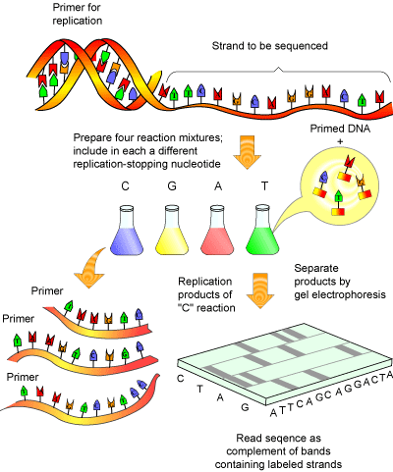
The past (?)
Analyses glued together in ad hoc ways
Sanger sequencing
Smaller data volumes
Fewer remote data resources
Hypothesis-driven

Slide 6
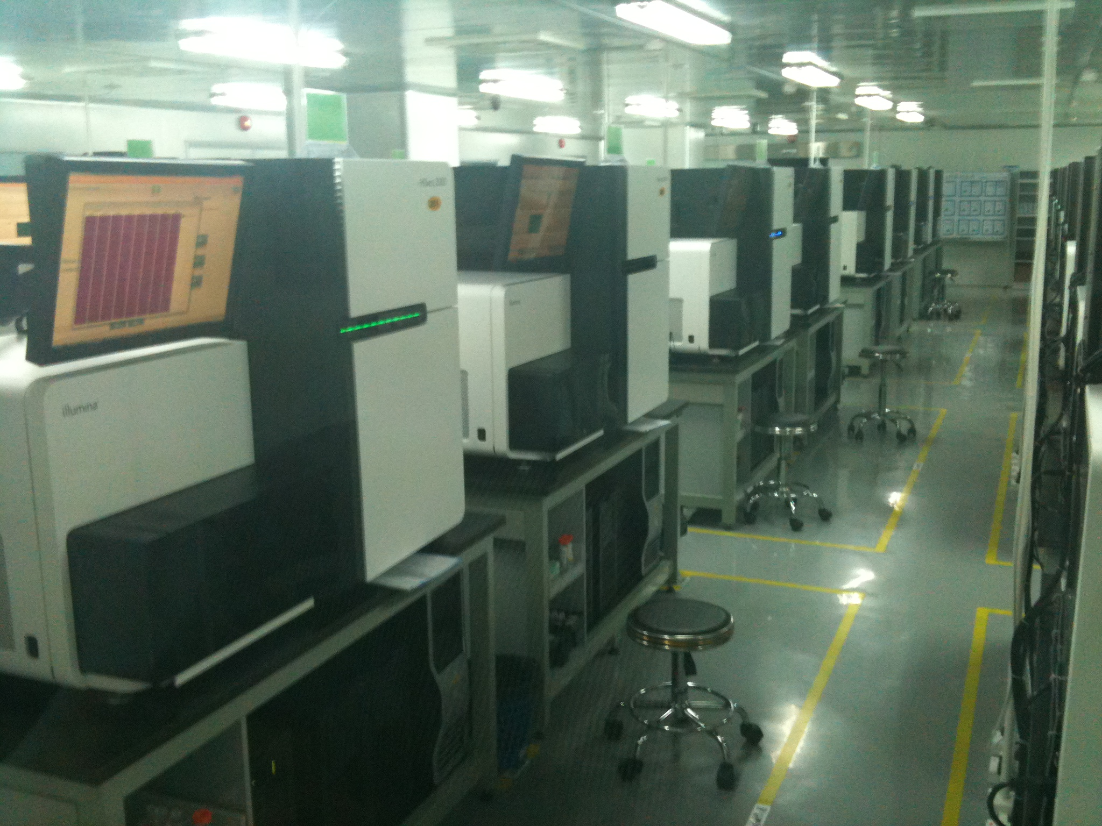
The present
Graphical or text-based workflow tools
“Next generation” sequencing
Large data sets
Many remote data resources
“Data-driven”

Slide 7
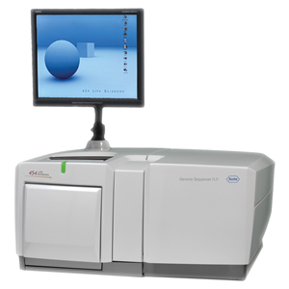
NGS – Roche 454 pyrosequencing
Pyrosequencing
Genome Sequencer FLX
“Emulsion PCR”
Bead with primer in each droplet
Each bead is placed in a well with luciferase
Plate is analyzed by fiber-optic chip
Notes:
millions of 200-400bp

Slide 8
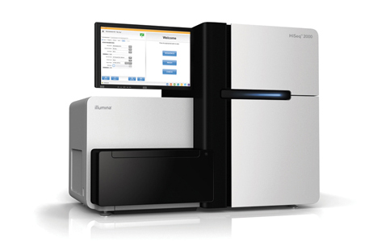
NGS – Illumina/Solexa
Reversible dye-terminator seq
HiSeq2000 (BGI)
DNA attaches to primer on slide and is amplified
4 RT-bases are added
Camera detects labeled nucleotides
Next 1-base cycle
Notes:
hundreds of millions of 50-100bp reads

Slide 9
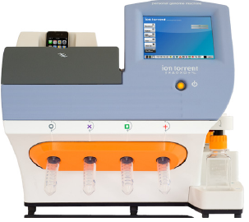
NGS – IonTorrent
Ion semiconductor sequencing
Ion Torrent PGM
“sequencing by synthesis”
Not light-based, sensor detects H+ ions during synthesis
Longer reads
Notes:
200 bp

Slide 10
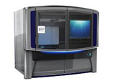
NGS – SOLiD Sequencing
Oligonucleotide ligation and detection
SOLiD 5500 Genetic Analyzer
Beads with DNA fragments
Universal adapter attached to fragments
PCR product attaches to slide
Fluorescent probes ligate to the primer
Notes:
Sequencing by ligation is a DNA sequencing method that uses the enzyme DNA ligase to identify the nucleotide present at a given position in a DNA sequence. Unlike most currently popular DNA sequencing methods, this method does not use a DNA polymerase to create a second strand. Instead, the mismatch sensitivity of a DNA ligase enzyme is used to determine the underlying sequence of the target DNA molecule.

Slide 11
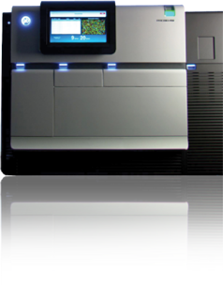
NGS - PacBio
Single molecule realtime
PacBio RS
“sequencing by synthesis”
Detects fluorescent dye molecules as they are cleaved off during synthesis
Very long reads
Higher error rates

Slide 12
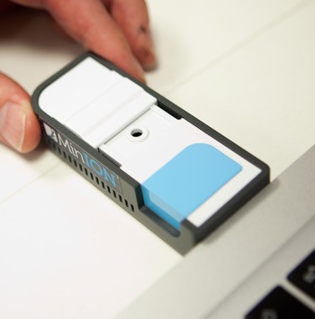
The future
“Next-next generation” sequencing (MinION?)
Smaller data sets?
Semantic web?
Back to hypotheses?

Slide 13
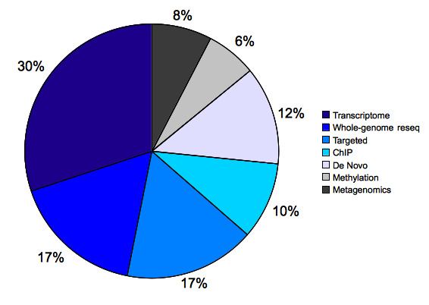
NGS applications
Whole genome sequencing
Transcriptome
Amplicon sequencing
Metagenomics
CHiP-seq
Methyl-seq
Etc.

Slide 14
The informatics problem
A lot of data
New formats
New steps in analyses
New tools

Slide 15
What we will cover
Best practices
Standardized project organization
Projects fully 'runnable' without user intervention
No loss of data, metadata or source code through versioning
Technologies
NGS platforms
File formats
UNIX-like systems, executables
Programming with OS toolkits
Revision control systems
Workflow environments (visual and CLI)
Use cases / exercises
Installing NGS tool(kit)s
File validation and conversion
Reference indexing
Alignment against reference
Exploring the aligned genome
Handling annotations
Extracting loci by coordinates and names
Building your own workflow tools

Slide 16
Resources
Comparison document http://tinyurl.com/NGSComparison
Glossary document: http://tinyurl.com/NGSGlossary
Supplementary materials: https://github.com/naturalis/arangs

