Slide 1
Programming toolkits
Notes:
Introduce open source bioinformatics programming toolkits: bioperl, biopython, bioruby, bioconductor. Exercise: install as non-root
<number>

Slide 2
Object-oriented programming
Different from imperative programming, object-oriented programming models domain concepts (e.g. sequences, alignments, features) as objects with behaviors.
All commonly-used toolkits in bioinformatics are object-oriented.

Slide 3

Dynamic language toolkits
Dynamic ("scripting") languages are commonly used in bioinformatics: easy, fast development
OO bioinformatics toolkits for dynamic languages supported by O|B|F
Learn a scripting language and toolkit!

Slide 4
Perl
Pro:
Large code base (CPAN)
Fast
Ubiquitous
tight integration with Unix
Con:
Difficult syntax
Delayed version 6
Losing momentum?
Developed by Larry Wall
Object-orientation added in v.5
C-like syntax
Uses non-alphanumeric characters extensively
http://www.perl.org

Slide 5

BioPerl
Modularized toolkit: bioperl-live, bioperl-run, etc.
http://www.bioperl.org
http://github.com/bioperl
NGS capabilities:
I/O for read and alignment formats (fastq like biopython)
wrappers for maq, samtools, bwa, bowtie, newbler

Slide 6
Python
Pro:
Clean syntax
Intuitive OO
Growing momentum
Con:
2 vs 3?
Semantic indentation
No CPAN
Developed by Guido van Rossum
Multi-paradigm imperative, OO and functional programming
Blocks indicated by indentation
http://www.python.org

Slide 7
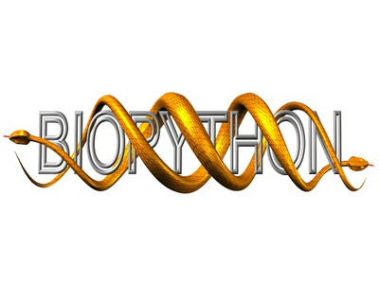
BioPython
Smaller, less modularized than BioPerl
http://biopython.org, https://github.com/biopython
NGS capabilities:
I/O for short read formats
For wrappers: see Galaxy

Slide 8
Ruby
Pro:
Clean syntax
Objects throughout
Gem packages
Rails great for web applications
Con:
Smaller (Japanese) user base
Not installed everywhere
Somewhat slow
Developed by Yukihiro "Matz" Matsumoto
Consistently object oriented
Python-like syntax
http://www.ruby-lang.org

Slide 9

BioRuby
Modularized toolkit with biogem package manager
http://bioruby.org/
https://github.com/bioruby
NGS capabilities:
https://github.com/helios/bioruby-ngs
I/O for common read and alignment formats
Wrappers for samtools, bwa, bowtie, tophat, cufflinks

Slide 10
R
Pro:
Excellent numerical capabilities
CRAN
Graphics and plotting
Con:
Less "sysadmin" functionality
Non-standard install
Unusual syntax & semantics
Developed by Ross Ihaka and Robert Gentleman
Multi-paradigm: functional programming and others
Somewhat C-like syntax
http://www.r-project.org

Slide 11

BioConductor
Very large (~3Gb) modularized project
Has specialized ShortRead library
Not under OBF
http://www.bioconductor.org/

Slide 12
Exercise: Programming with Objects
We will write a script that computes coverage within a genomic coordinate range.
Assume that we are interested in BAM file U0015717.bam, chromosome SL2.40ch00, between 1 and 100,000 bp.
Read the documentation for Bio::SamTool: “perldoc Bio::DB::SAM” and try to come up with a script that computes the coverage within our range.

