Slide 1
Downstream analysis: handling annotated genomes

Slide 2
Genome annotation
Identifying portions of the genome that do not code for proteins
Identifying elements on the genome, a process called gene prediction, and
Attaching biological information to these elements.
Structural annotation consists of the identification of genomic elements.
ORFs and their localisation
gene structure
coding regions
location of regulatory motifs
Functional annotation consists of attaching biological information to genomic elements.
biochemical function
biological function
involved regulation and interactions
expression

Slide 3
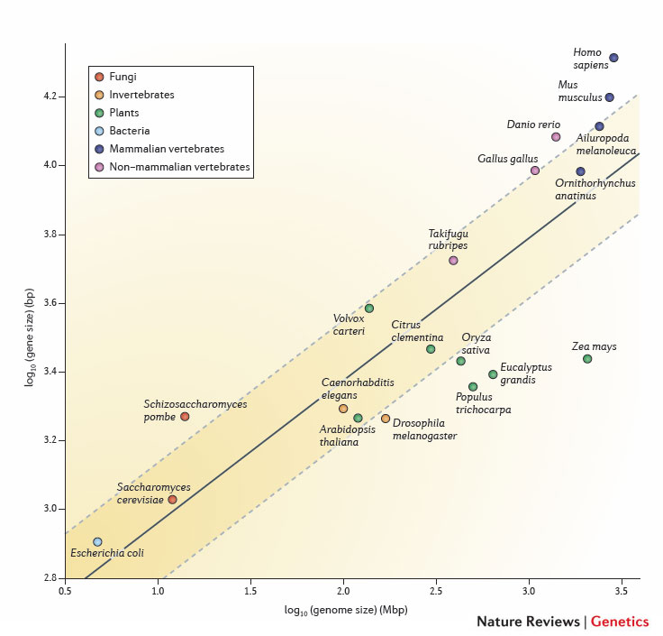
Genome size and gene size

Slide 4
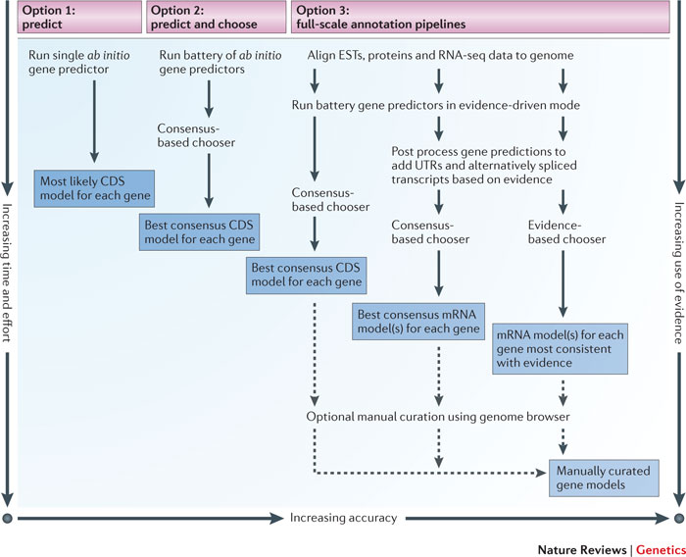
Approaches to genome annotation

Slide 5
Annotation files
Commonly used formats for annotated genomes:
GenBank
EMBL
GTF
GFF3

