Slide 1
Data sharing
Notes:
Introduce data sharing platforms. Short read archives. Sneaker net. Open data movement. Databases, FTP, rsync, WeShare, DropBox, Google Drive, github, galaxy data sets, biotorrents. Exercise FTP?

Slide 2
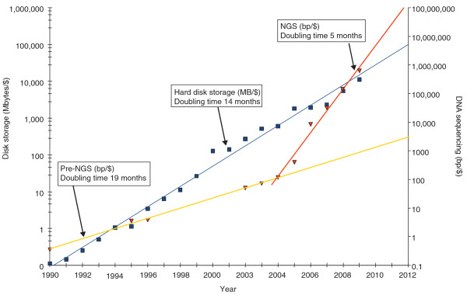
NGS data volumes
doi: 10.1186/gb-2010-11-5-207

Slide 3
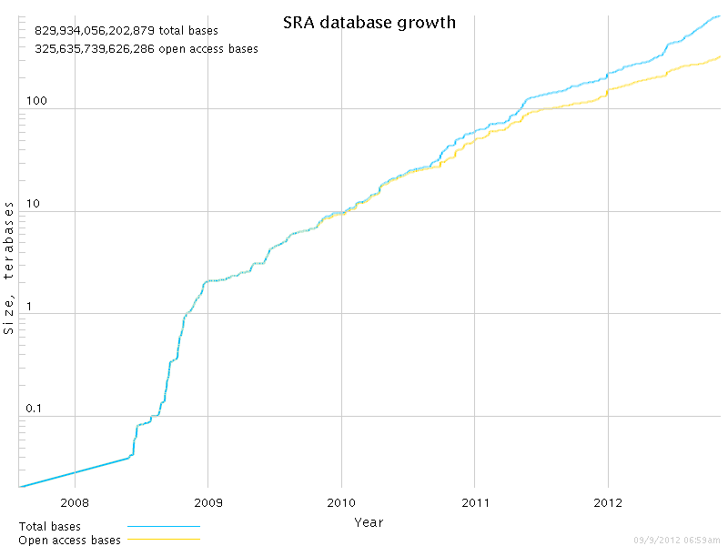
SRA database growth
http://www.ncbi.nlm.nih.gov/Traces/sra/

Slide 4

“Big Data”
NGS has led to massive data sets
Data formats are simple, binary, and/or compressed
Still, people drive around with USB hard disks

Slide 5
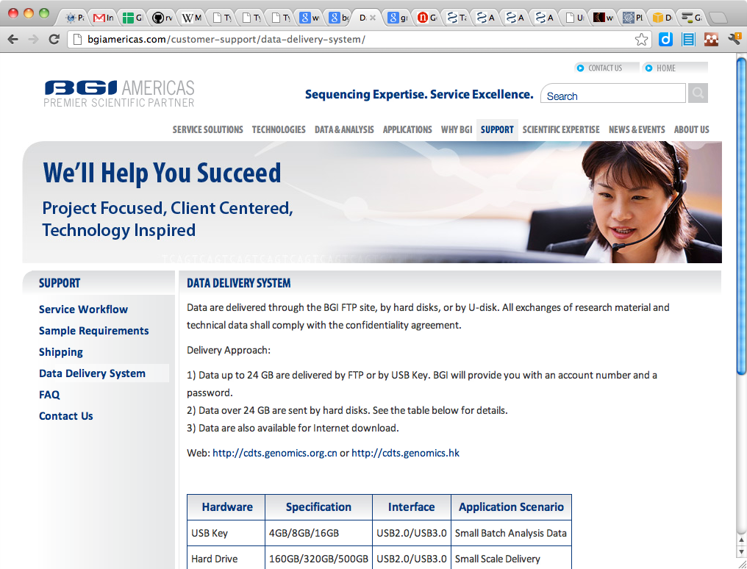
SneakerNet

Slide 6
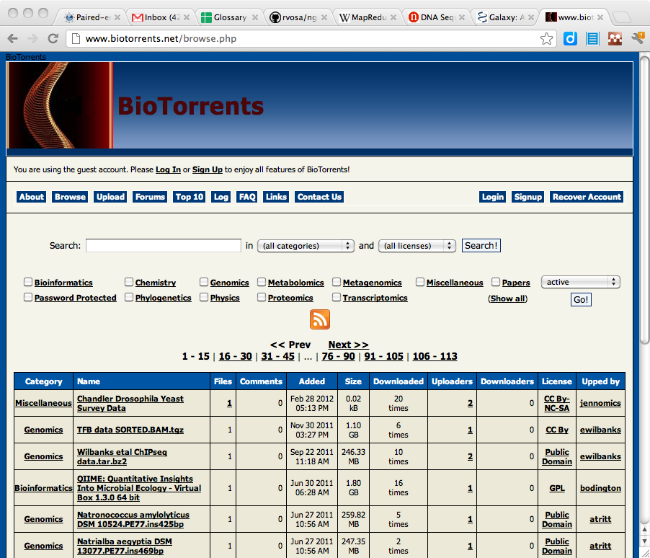
Internet data sharing
Relational databases
File servers
FTP
Rsync
WebDAV
HTTP
Version control
Peer-to-peer
Biotorrents

Slide 7
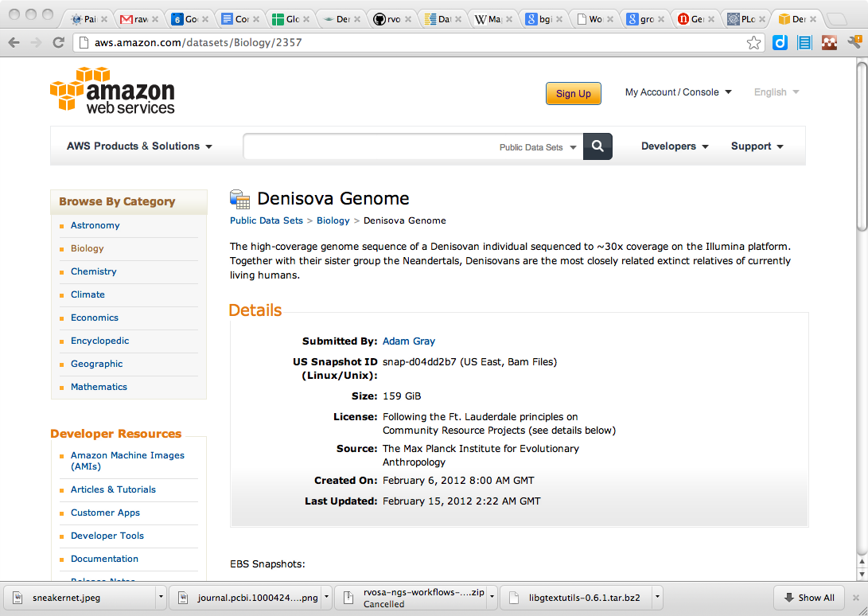
Proprietary systems
WeShare
Google Drive
DropBox
Amazon S3

Slide 8
Open data
"Science is based on building on, reusing and openly criticising the published body of scientific knowledge.
For science to effectively function, and for society to reap the full benefits from scientific endeavours, it is crucial that science data be made open."
-- PantonPrinciples.org

Slide 9
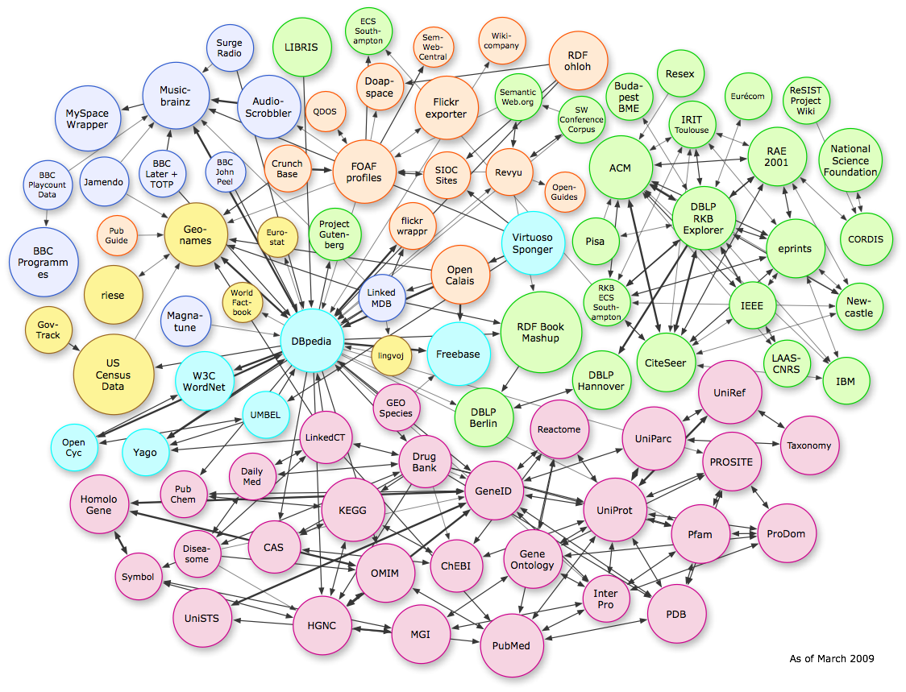
Semantic web

Slide 10
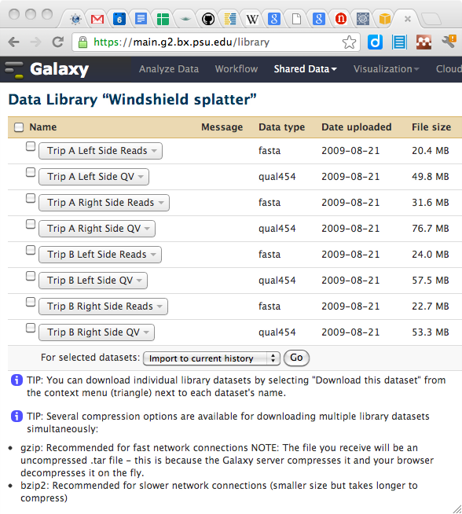
Galaxy data

Slide 11
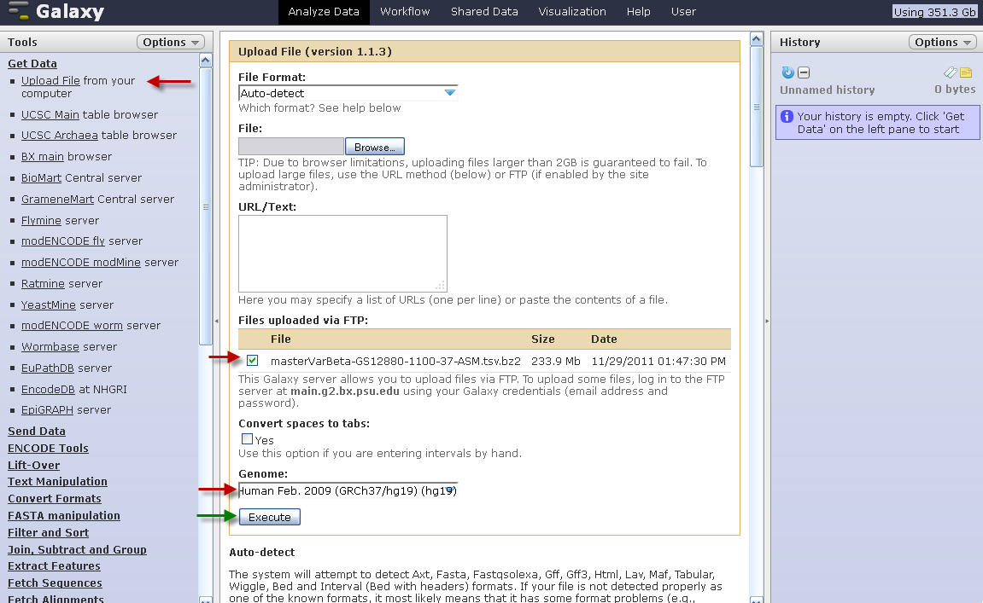
Upload data using FTP

Slide 12
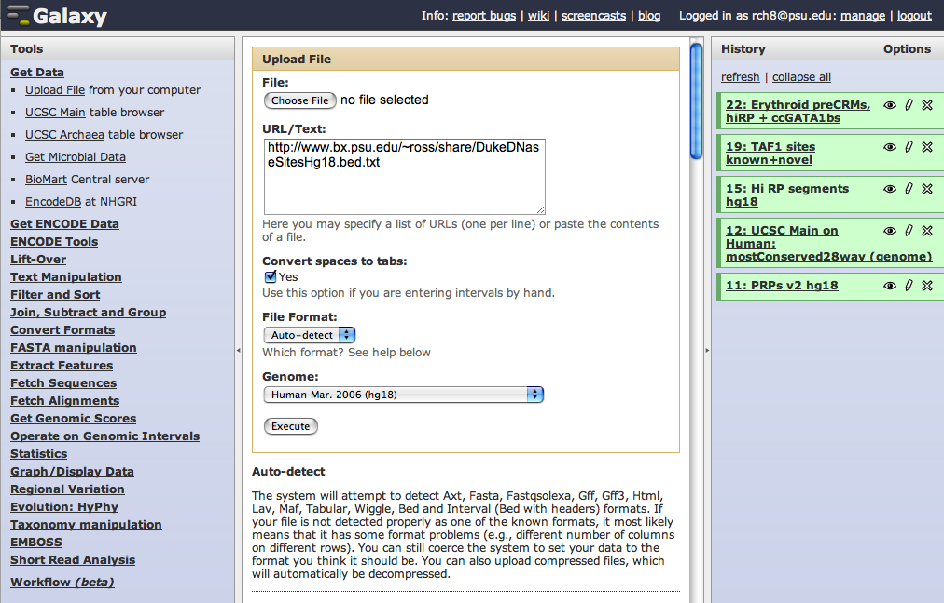
Fetch data from a URL

Slide 13
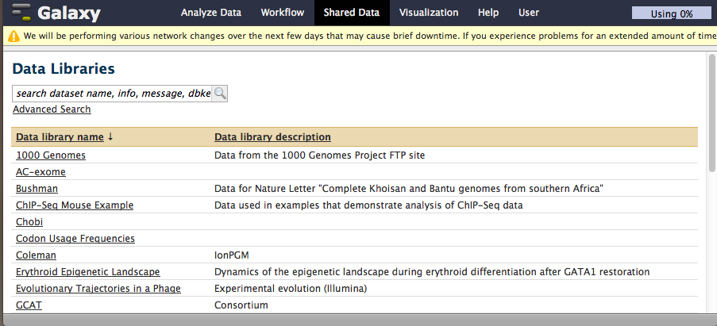
Import from data library

Slide 14
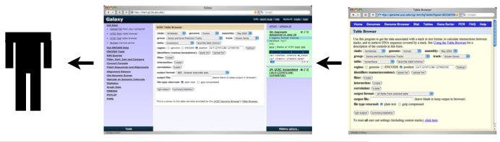
Fetch data from proxy service
User submits proxy request to Galaxy
Galaxy forwards request to remote service
Service returns data
Galaxy infers data type and presents results

Slide 15
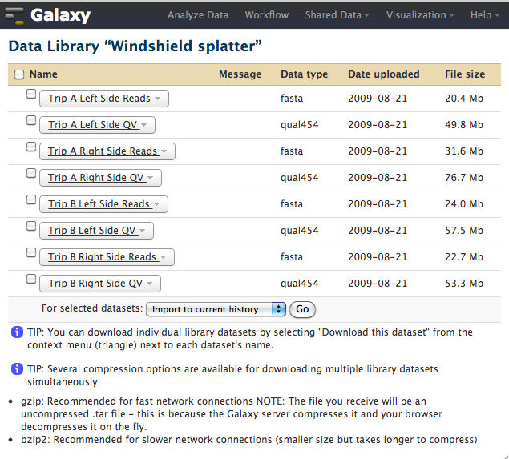
Data sharing/publishing
The Galaxy platform allows users to publish and share their data, for example as supplemental materials to a publication*
* example: http://genome.cshlp.org/content/19/11/2144

Slide 16
Exercise: upload to galaxy
Upload the Fastq files and reference genome in data/chipseq
Convert FASTQ to Sanger Select NGS: QC and manipulation and Fastq groomer
Alignment with BWA Select NGS: Mapping and BWA
Filter SAM We care mainly for reads that map uniquely (exactly once) to a reference genome. One of the problems with NGS mappers is that they all have different ways of reporting multiple hits. In the case of BWA if a read maps at multiple locations, a single location is randomly chosen and is reported. BWA reports this information through optional tags. The tag to use here is XT:A:U (XT:A:U - user defined tag called XT. A means the tag holds a character. The value associated with this tag is 'U'.), where U stands for unique (R for repeat). So first one selects all lines from the BWA output where XT:A:U is present. This is done with the Filter and Sort -> Select tool.
Convert SAM to BAM. Select NGS SAM Tool -> SAM to BAM
Adapted from http://manuals.bioinformatics.ucr.edu/home/gui-ngs-analysis
Notes:
Here do: upload data to your local galaxy instance, which means configuring universe_wsg.ini to:
make yourself admin
look in a data folder
import the contents of that folder in a data library

