Slide 1
Developing galaxy tools
Notes:
How galaxy invokes command line tools. The XML configuration file. Checkout galaxy, add a service, run locally.

Slide 2

Galaxy under the hood
Issues command
Parses HTTP request
Identifies which tool to use
Reads tool description
Queues tool
Parses result
Returns HTML representation of result

Slide 3
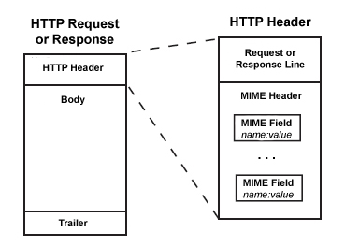
Web server
Simple Galaxy installs use a built-in, python-based HTTP server
More robust installs typically use the Apache httpd server

Slide 4
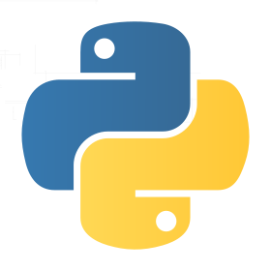
Code base
Most of the framework and the wrapper code is written in python
Some wrappers in other languages, e.g. perl

Slide 5

Interface language
Under the hood, Galaxy executes command-line programs and scripts
Their interfaces and tool tips are described in XML files:
main tool_conf.xml points to location of tool config files
tool config file defines inputs, outputs, command line arguments and tool tips

Slide 6
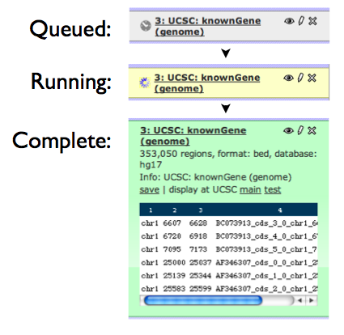
Queuing
Jobs are executed asynchronously
Progress is shown in the data browser
On big servers (e.g. “Main”), queuing is managed by the dedicated “Torque” system

Slide 7
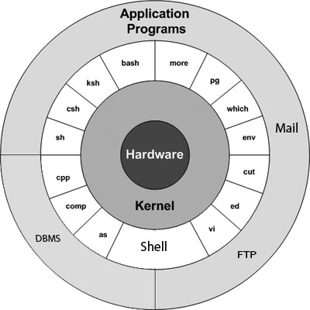
UNIX
Galaxy (simply)executes command-line programs within a UNIX-like environment
Galaxy doesn’t have to “know” how to run those programs, it finds out from their descriptions at runtime

Slide 8

Database
Analysis metadata is stored in a database, by default this is SQLite
More robust installs use PostgreSQL

Slide 9

Configuration
Galaxy has many moving parts that can be configured
Configuration is done using simple text-based INI files

Slide 10
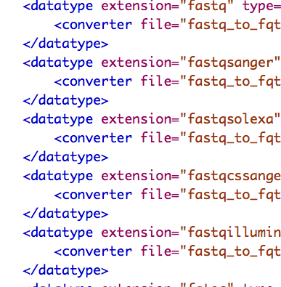
Data formats
Galaxy supports many different file formats
XML tool config file needs to specify input and output formats by standardized name
Recognized names/formats are in datatypes_conf.xml

Slide 11
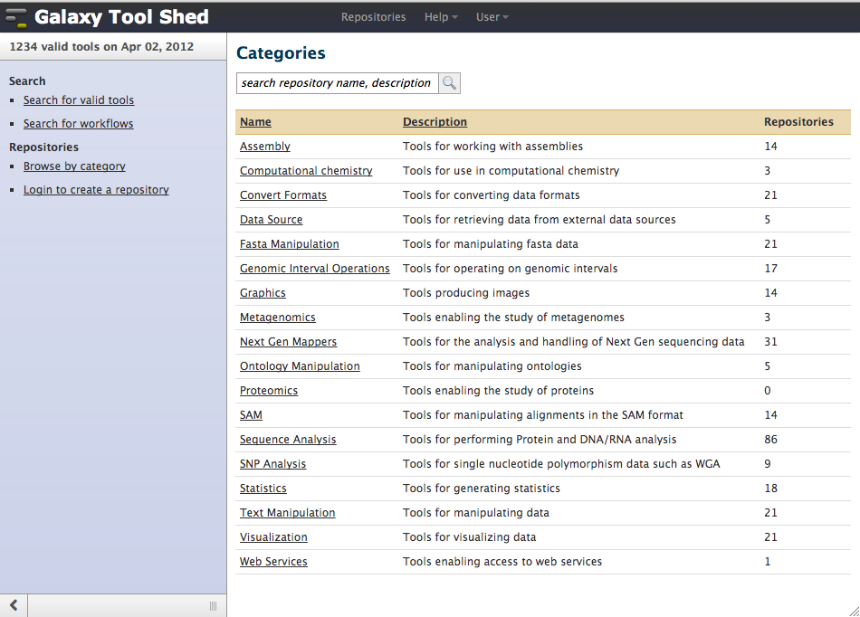
“Tool shed”
Easy sharing of new tools
Based on Mercurial
Turns Galaxy into a modular ecosystem

Slide 12
Example: phylotastic tools
Perl modules that operate on very large phylogenies http://search.cpan.org/dist/Bio-PhyloTastic/
Wrapped in a simple script whose interface is described in XML https://github.com/phylotastic/arch-galaxy
Screencast on deployment http://youtu.be/d-fDngweW-M

Slide 13
Exercise: deploy a simple tool
Create a wrapper xml file for fastqvalidate.pl
Fetch galaxy from bitbucket: hg clone https://bitbucket.org/galaxy/galaxy-dist
Launch it (sh run.sh), go to http://127.0.0.1:8080
If 8080 is occupied, edit universe_wsgi.ini (root of galaxy), uncomment #port and set it to something else, e.g. 8081
Edit tool_conf.xml to point to the wrapper xml for fastqvalidate.pl
Re-launch Galaxy
Test your wrapped tool with the FASTQ example files from github
Notes:
Here we install the HTS-barcode-checker

