Slide 1
Running existing workflows
Notes:
Run a canned workflow in galaxy. Example: prepare an example workflow on galaxy main (e.g. basic reads quality), make students register for main (https://main.g2.bx.psu.edu) and run the workflow. Also, myExperiment.

Slide 2
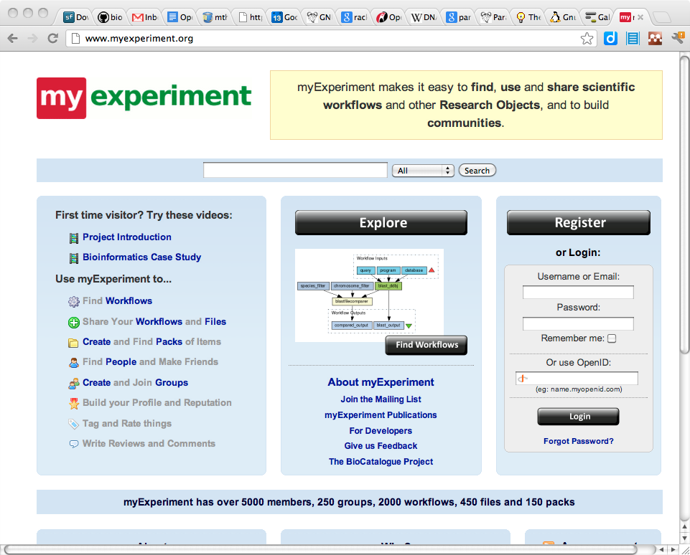
Workflow sharing
myExperiment.org is a platform for sharing files and workflows for:
  Taverna
  RapidMiner
  Kepler
  BioClipse
  etc.

Slide 3
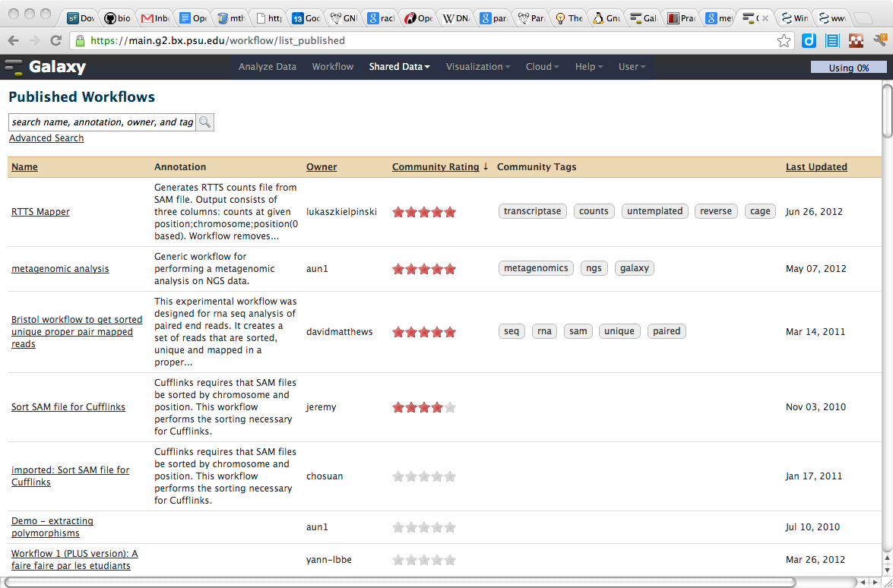
Galaxy workflow sharing
Galaxy, being web-based, hosts its own platform for workflow sharing
Any history you have built up can be turned into a workflow and shared
The URL for this workflow can be supplementary material to a publication

Slide 4
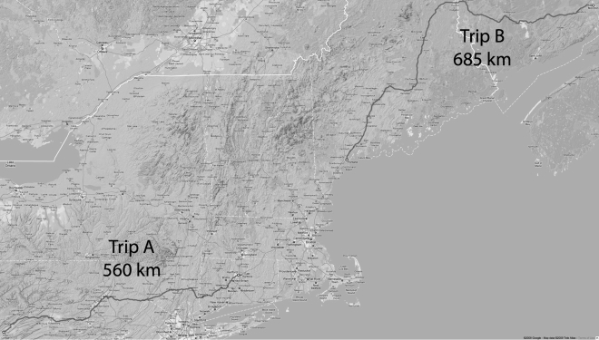
Example: metagenomics on windshield

Slide 5
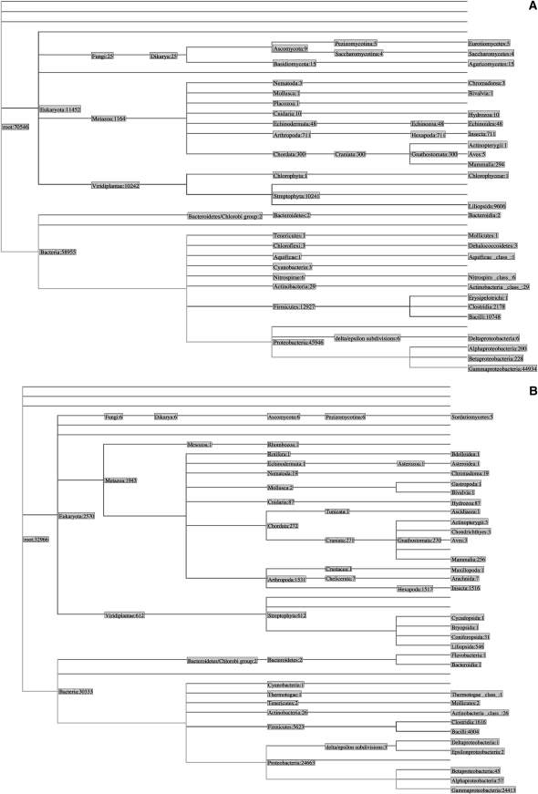
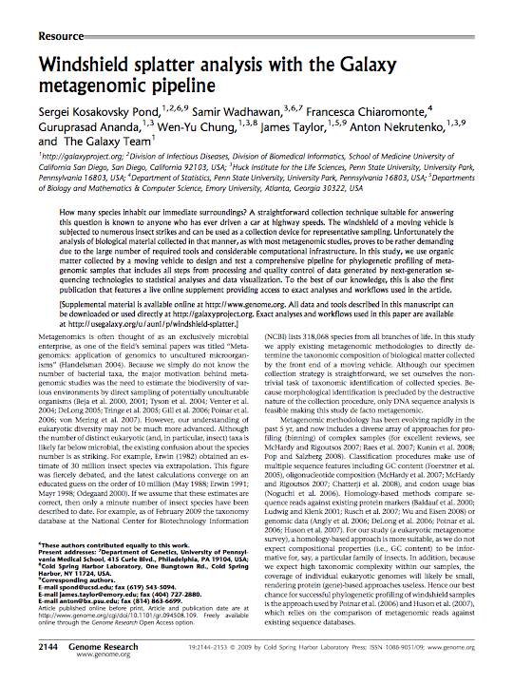
Example: metagenomics on windshield

Slide 6
Exercise: run an existing workflow
(Read doi:10.1101/gr.094508.109)
Go to https://usegalaxy.org/u/aun1/p/windshield-splatter
Import 'Galaxy history | metagenomic analysis'
Analyze the steps of the workflow:
  What was the minimal phred score we accept in step 3?
  Why would splitting on "low quality bases in homopolymers" result in fragmentation in 454 runs?
  Why was megablast run twice?
  What is a "join" (in step 11)?
  What do we filter on in step 12?
  Based on step 16, is windshield splatter actually mostly insects?

