Slide 1
Data sharing
Notes:
Introduce data sharing platforms. Short read archives. Sneaker net. Open data movement. Databases, FTP, rsync, WeShare, DropBox, Google Drive, github, galaxy data sets, biotorrents. Exercise FTP?
<number>

Slide 2
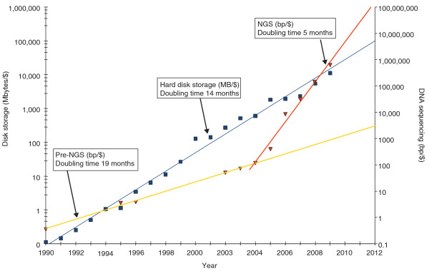
NGS data volumes
doi: 10.1186/gb-2010-11-5-207

Slide 3
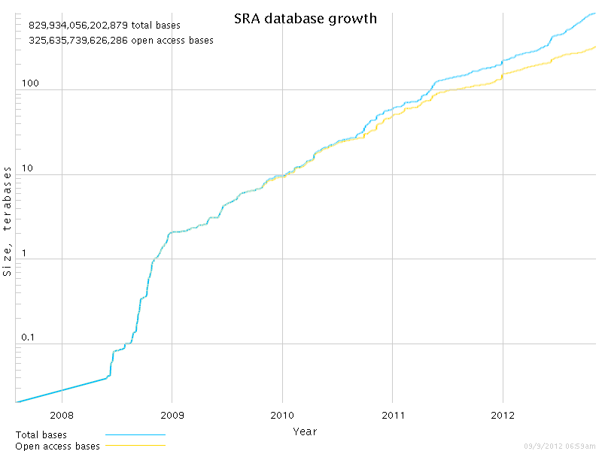
SRA database growth
http://www.ncbi.nlm.nih.gov/Traces/sra/

Slide 4

“Big Data”
NGS has led to massive data sets
Data formats are simple, binary, and/or compressed
Still, people drive around with USB hard disks

Slide 5
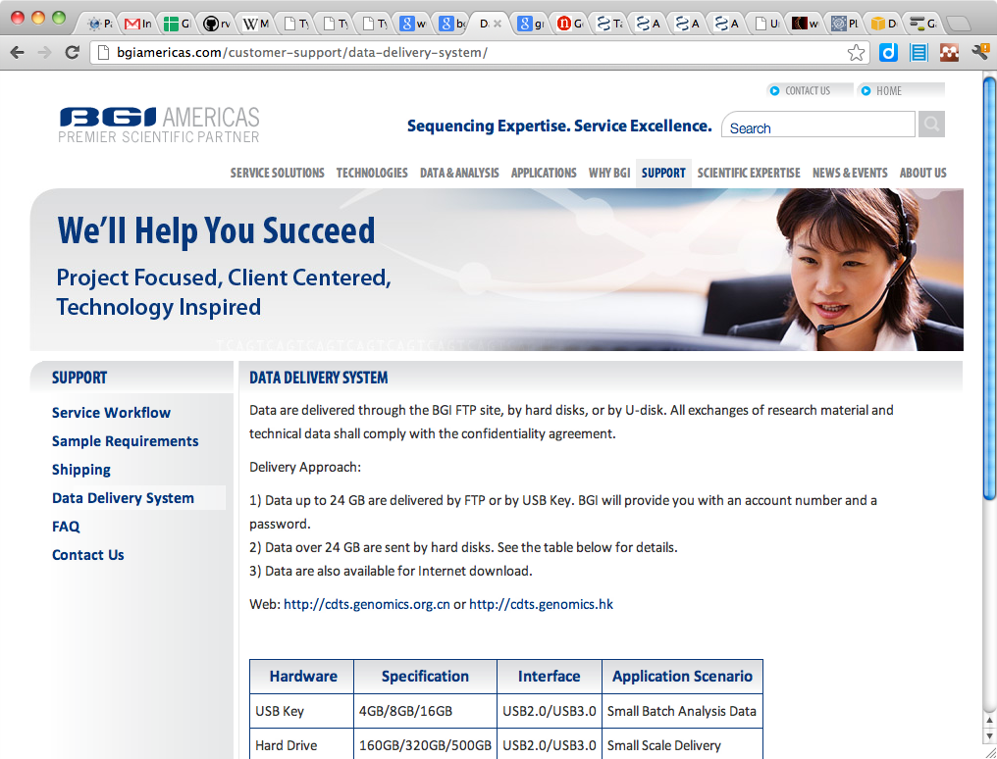
SneakerNet

Slide 6
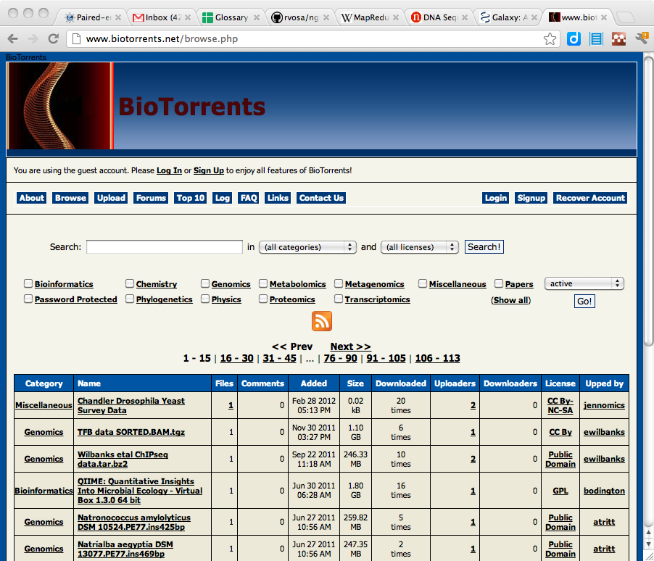
Internet data sharing
Relational databases
File servers
FTP
Rsync
WebDAV
HTTP
Version control
Peer-to-peer
Biotorrents

Slide 7
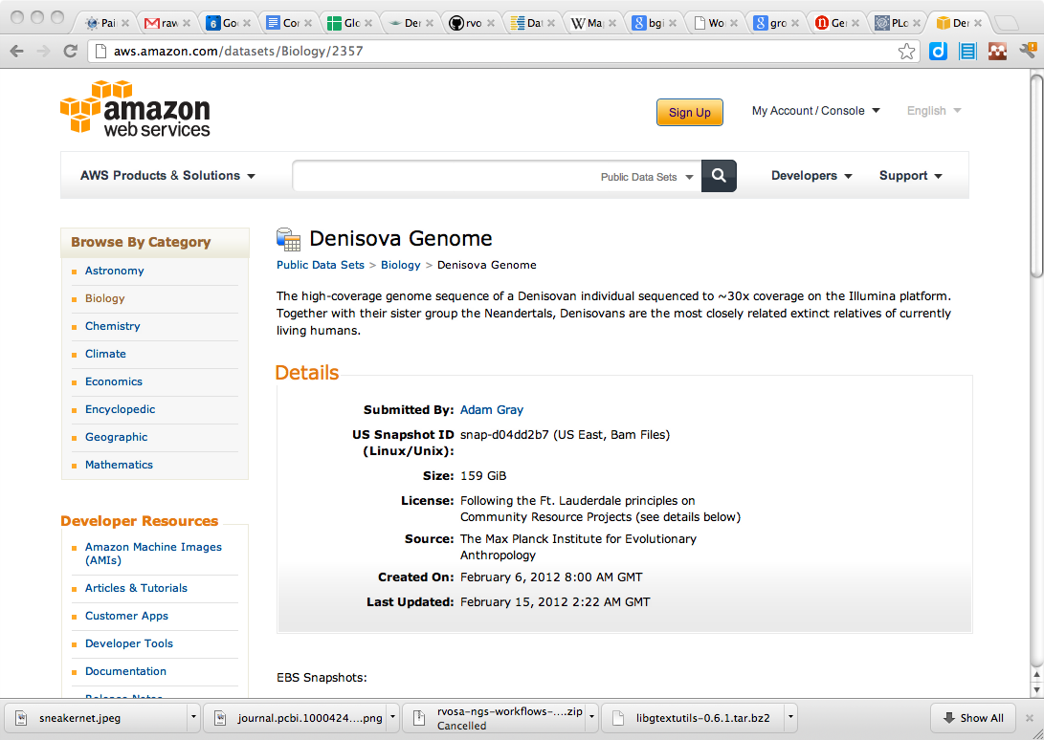
Proprietary systems
WeShare
Google Drive
DropBox
Amazon S3

Slide 8
Open data
"Science is based on building on, reusing and openly criticising the published body of scientific knowledge.
For science to effectively function, and for society to reap the full benefits from scientific endeavours, it is crucial that science data be made open."
-- PantonPrinciples.org

Slide 9
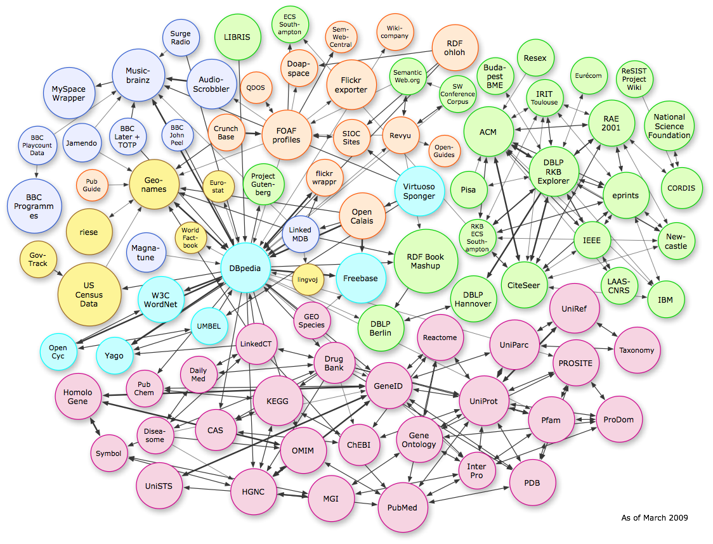
Semantic web

Slide 10
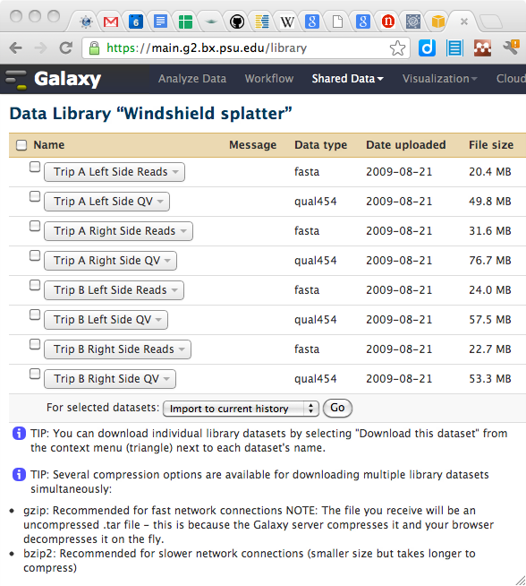
Galaxy data

Slide 11
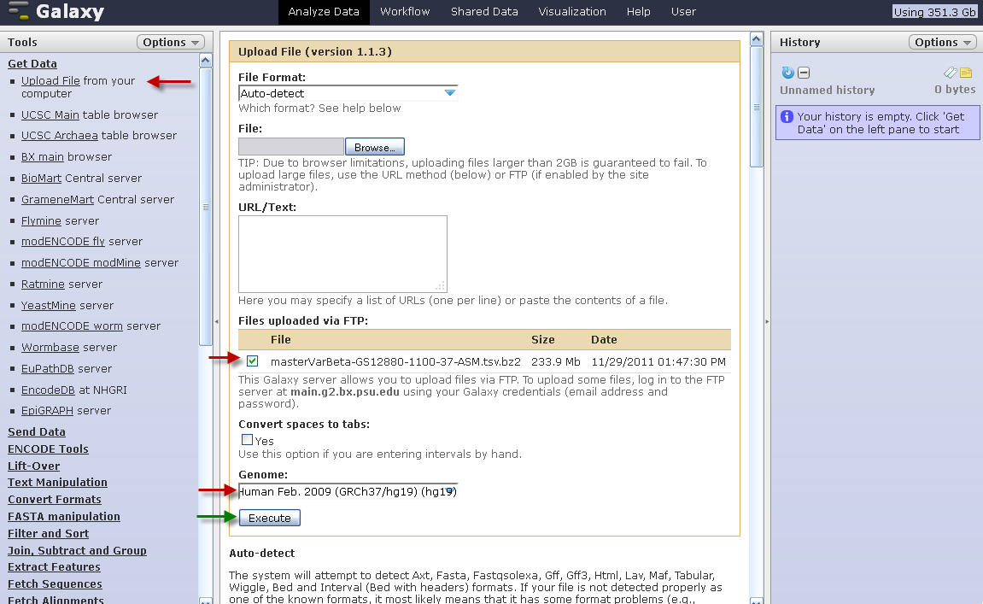
Upload data using FTP

Slide 12
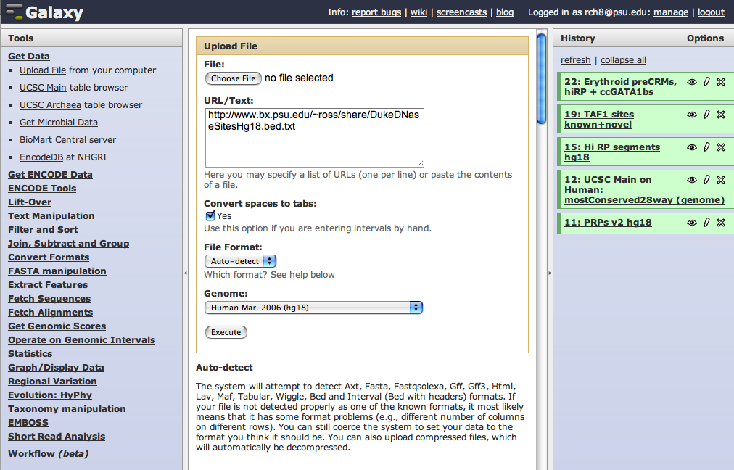
Fetch data from a URL

Slide 13
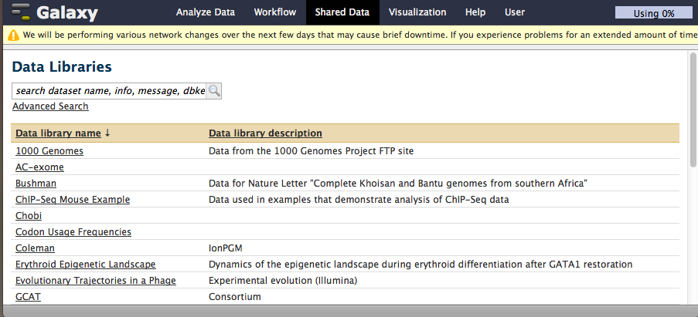
Import from data library

Slide 14
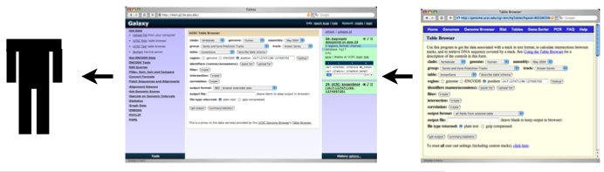
Fetch data from proxy service
User submits proxy request to Galaxy
Galaxy forwards request to remote service
Service returns data
Galaxy infers data type and presents results

Slide 15
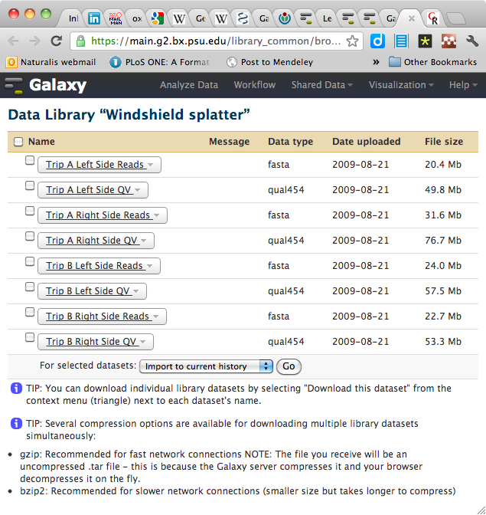
Data sharing/publishing
The Galaxy platform allows users to publish and share their data, for example as supplemental materials to a publication*
* example: http://genome.cshlp.org/content/19/11/2144

Slide 16
Exercise: managed data libraries
Edit universe_wsg.ini to un-comment and specify:
Admin rights for your account (admin_users)
Allow pasting paths to files (allow_library_path_paste)
Kill the current galaxy process if it is running:
ps ax | grep galaxy
kill the shell and python processes
Restart galaxy
Create a data library with some files in it:
Admin > Manage data libraries > Create new...
Add data sets > change upload option to filesystem paths and paste in:
/gsd/To_Participant/ARANGS13/ITAG2_3_genomic.fasta.gz
/gsd/To_Participant/ARANGS13/1-U0015717_GTGGCC_L005_R1_001.fastq.gz
/gsd/To_Participant/ARANGS13/1-U0015717_GTGGCC_L005_R2_001.fastq.gz
Notes:
Here do: upload data to your local galaxy instance, which means configuring universe_wsg.ini to:
make yourself admin
look in a data folder
import the contents of that folder in a data library
<number>

