Slide 1
Running existing workflows
Notes:
Run a canned workflow in galaxy. Example: prepare an example workflow on galaxy main (e.g. basic reads quality), make students register for main (https://main.g2.bx.psu.edu) and run the workflow. Also, myExperiment.
<number>

Slide 2
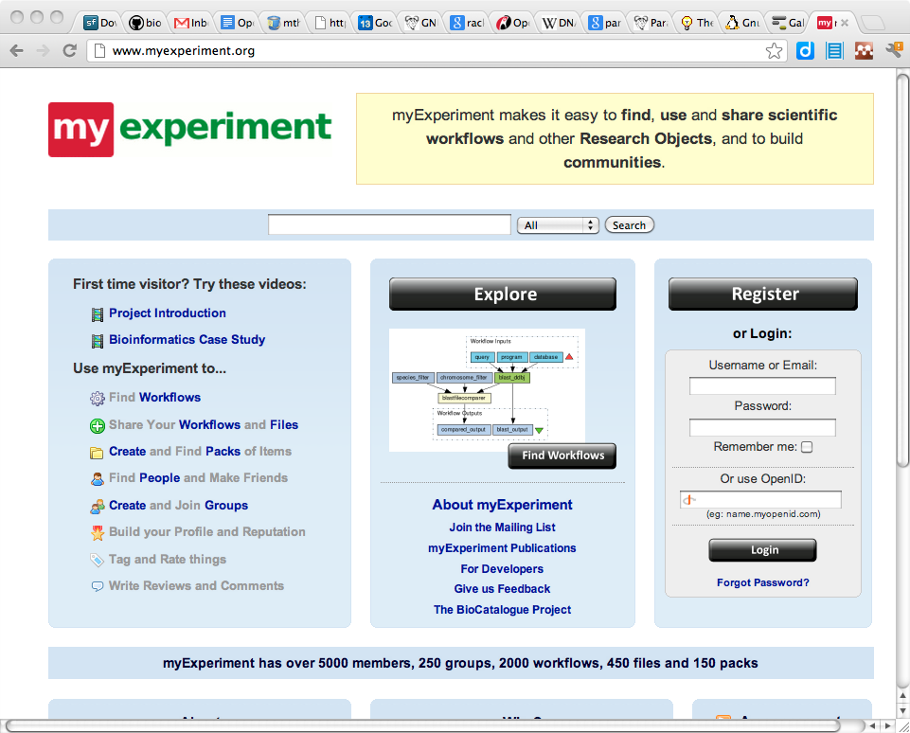
Workflow sharing
myExperiment.org is a platform for sharing files and workflows for:
Taverna
RapidMiner
Kepler
BioClipse
etc.

Slide 3
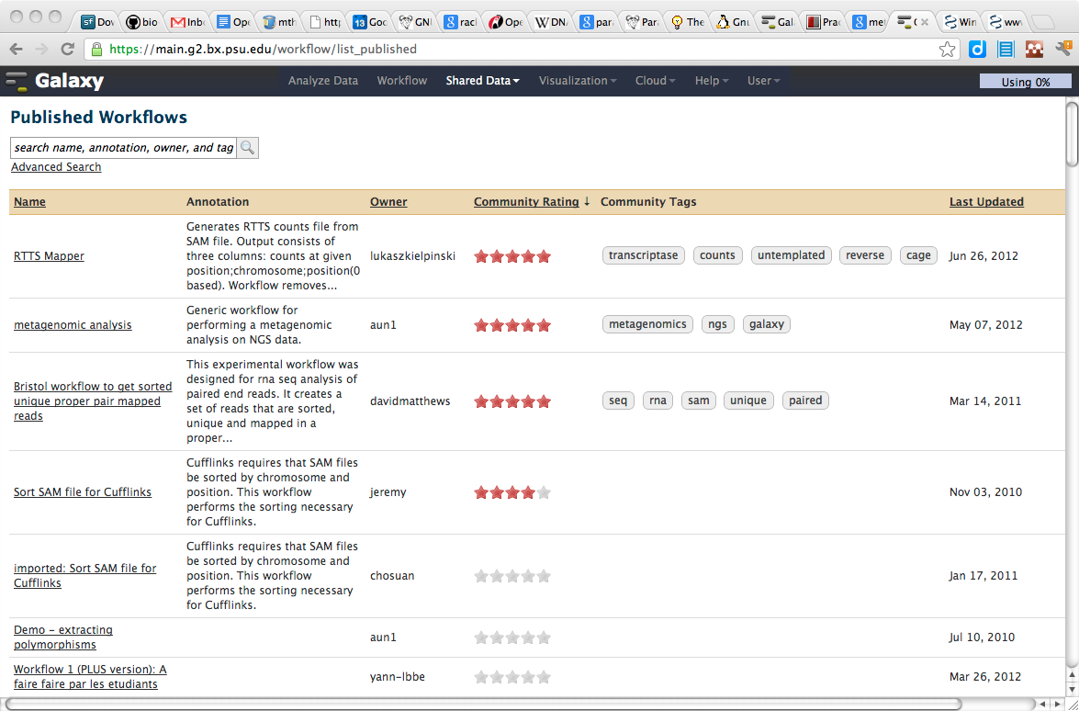
Galaxy workflow sharing
Galaxy, being web-based, hosts its own platform for workflow sharing
Any history you have built up can be turned into a workflow and shared
The URL for this workflow can be supplementary material to a publication

Slide 4
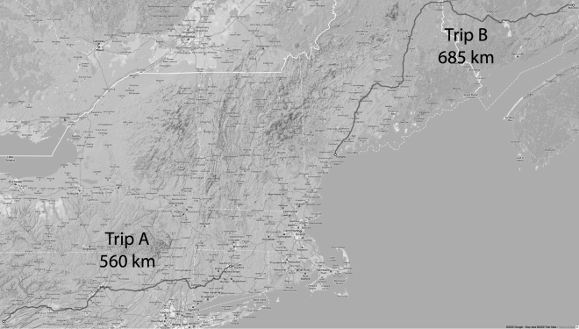
Example: metagenomics on windshield

Slide 5
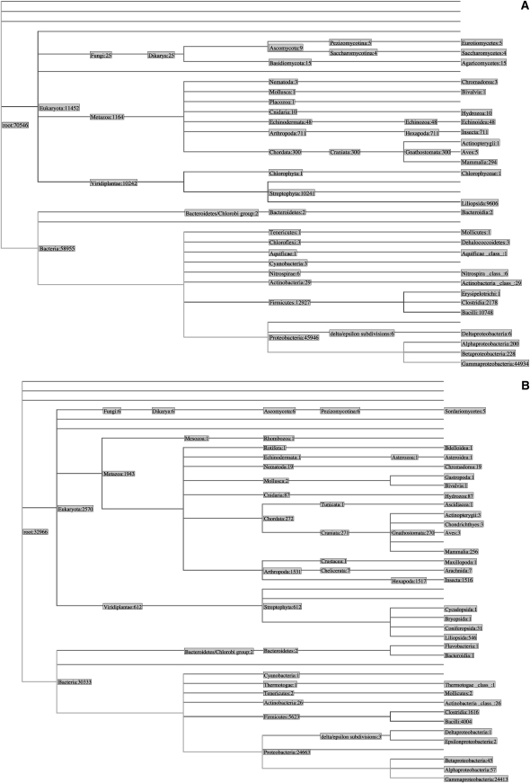
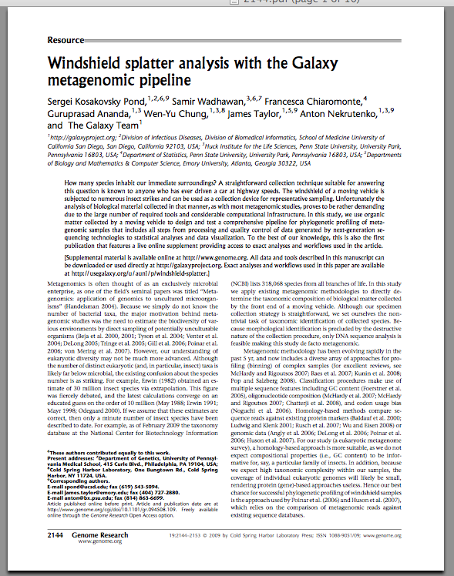
Example: metagenomics on windshield

Slide 6
Exercise: run an existing workflow
Log in on Galaxy "main"
Go to https://main.g2.bx.psu.edu/u/aun1/p/windshield-splatter
Import 'Galaxy history | metagenomic analysis'
Analyze the steps of the workflow:
What was the minimal phred score we accept in step 2?
Why would splitting on "low quality based in homopolymers" result in fragmentation in 454 runs?
Why was megablast run twice?
What is a "join" (in step 11)?
What do we filter on in step 12?
Based on step 16, is windshield splatter actually mostly insects?
Notes:
Then here we do:
1 bwa index, align, sampe
2 samtools index, filter, etc.
<number>

Slide 7
Edit universe_wsgi.ini to uncomment tool_config_file
(Restart galaxy)
Go into admin mode and select “Search and browse tool sheds” > Galaxy main tool shed
Search for BWA, select the verified bwa_wrappers tool and install it under menu option NGS Mapping
Import the data library you created in the previous session and import the data into your history
Go to NGS Mapping > Map with BWA for Illumina and do a paired-end mapping of the FASTQ files against the reference FASTA

