Slide 1
Project organization
Notes:
Explore layout of projects. This is a very short presentation, but that will allow for spill-over from the installation session before lunch.

Slide 2
How research actually works
Research is iterative: we make mistakes, acquire more data, learn new techniques
Different studies are done in parallel
Many months later (e.g. after reviews) you will have to re-visit old work
Research is done collaboratively, sometimes with people you don't know

Slide 3
A project-oriented view
Every study should be organized as a self-contained project
You should be able to share everything that relates to the project easily
You should be able to archive and retrieve the project easily

Slide 4
Project organization
store all of the files relevant to one project under a common root directory
logical top-level organization
Doc
data
src
bin
results
chronological Secondary organization
logical tertiary organization

Slide 5
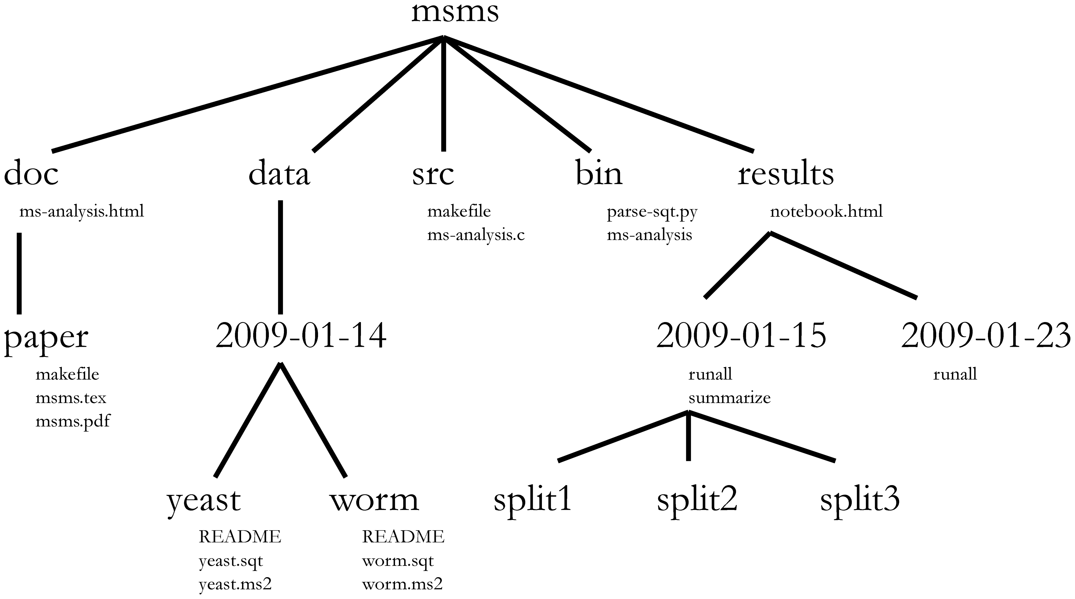
Directory structure
Choosing a consistent directory structure will help you (and your collaborators) find things later on.

Slide 6
Exercise
Read the article http://dx.doi.org/10.1371/journal.pcbi.1000424
In the same Teams, modify your scripts from session1 to take, as arguments, just the reference and raw file names instead of the full paths to the files. They should then create a timestamp subdirectory in the project ‘results’ directory (relative to $HOME, or ~/, depending on your preference), and place all results in that directory instead of in the current working directory

