Slide 1
The UNIX command line
Notes:
Introducing the UNIX command line. History of UNIX, MacOSX, Linux (Ubuntu 12). Exercises from ComPhy UNIX refresher.

Slide 2
History of UNIX
Developed (late ‘60s) at AT&T Bell labs
First written in assembly language, then C
Early adoption in academia
1983: AT&T monetize UNIX, GNU founded
UNIX wars: many variants in the ‘80s and ‘90s
1991: Linux development starts
1997: Apple acquires NEXTSTEP (BSD)

Slide 3



UNIX-like operating systems
Out of the ‘UNIX wars’ and the open source movement, many UNIX-like systems have evolved.
These systems can be installed on many different hardware platforms.
UNIX-like systems can often be ‘test-driven’ using different virtualization approaches.

Slide 4
UNIX file system conventions
UNIX-like file systems:
are hierarchical trees navigated with relative and absolute paths
follow some organizational conventions
consider everything a “file”
consider files simple byte arrays (and text)
Directory | Description
/bin | Single user binaries
/dev | Essential devices
/etc | Configuration files
/home | Users’ home dirs
/lib | Libraries
/sbin | System binaries
/tmp | Temporary files
/usr | Multi user utilities
/var | Variable files

Slide 5
File access
Access to files is granted at user and group level
Files can be read (r), written (w) and/or executed (x)
To read from or write to a file, a file handle is opened
File extensions don’t matter

Slide 6
Commonly-used CLI commands
(man $command for more information)
File operations
Text operations
Command | Function
ls | List files
cd | Change directory
pwd | Print working directory
rm | Delete files
cp | Copy files
mv | Rename/move files
mkdir | Make directory
rmdir | Delete directory
chmod | Change mode
chown | Change owner
md5sum/sha1sum | Print unique hashsum
Command | Function
more/less | Page through text
head/tail | View first/last lines of file
cut | Extract columns from table
grep | Search line by line
sed | Search and replace
sort | Sort lines
uniq | Filter duplicate lines
(z)cat | Print (zipped) file contents
wc | Word count
perl/R/… | Interpreters
Commands are binaries that are executed by typing their names on a terminal shell $

Slide 7
UNIX pipes
UNIX programs by default write to STDOUT and read from STDIN
The defaults can be re-directed with “> outfile” and “< infile”, respectively
The output from one program can be piped into the input from the next:
cat file | sort | uniq > sorted_no_dups

Slide 8
Environment variables
The shell environment is configured using variables, i.e. things with a name and a value.
These variables are often defined in config files.
Example:
export MYVAR=“hello world”
echo $MYVAR
Name | Function
PATH | Location of CLI commands
PERL5LIB | Location of perl libraries
PYTHONPATH | Location of python libraries
CLASSPATH | Location of java libraries
HOME | User home directory
USER | User name
PWD | Current working directory
TMPDIR | Temporary directory

Slide 9
UNIX programming
UNIX provides a standardized environment for developing applications (historically in C)
Many pieces of re-useable code (headers and libraries)
Standard powerful text editors (vi, emacs)
Standard toolchain for building binaries (e.g. autotools, make, gcc, ld, etc.)
Standard support for scripting languages (perl, python, ruby, etc.)

Slide 10
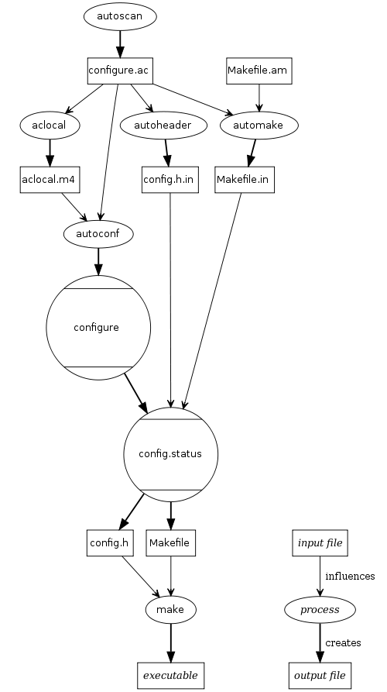
Compiling
Source code can be compiled into binary following standard (optional) steps:
tar -xzf prog.tar.gz
cd prog
(autoconf)
(./configure)
make
sudo make install

Slide 11
Exercise: UNIX commands
Open the terminal application on your machine.
Print out all of the environment variables currently set using the ‘env’ command.
Which Environment Variable holds your current SHELL interpreter?
Print out your PATH environment variable using ‘echo’. Try piping the output of env to grep.
Set a normal variable called MYTEST which holds some string. Is this in your environment?
Make MYTEST an environment variable.
Create an environment variable called MYTEST2 set to some number, using only one unix command.
Make it so that MYTEST2 is automatically set each time you login to your terminal application.
Find the largest file in your HOME directory (dont worry about sorting by size, just eyeball it).
Create a ’arangs' directory in your HOME directory from the commandline.
Rename that directory to ’arangs13' from the commandline.
Determine the full path to the perl interpreter executable using the ‘which’ command.
How are directories and files listed differently when using ls -l.
Use touch to create an empty file in / (the real root directory). What happens and why?
Repeat your attempt to create the empty file in /, but re-direct the warning to a separate file called error.txt.
Repeat, appending the error message to error.txt.
There is a very useful program in unix called 'find'. It is designed to start from a directory provided as an argument (default is current working directory), and apply certain filters that you specify using commandline switches to match only files in the directory and all its child directories which match them. Find out more about this incredibly useful command from the unix commandline using the ‘man’ command.
Use find to find all of the files ending in .txt in your Home Directory.
Notes:
Re-use ComPhy exercises

