Slide 1
Project organization
Notes:
Explore layout of projects. This is a very short presentation, but that will allow for spill-over from the installation session before lunch.

Slide 2
How research actually works
Research is iterative: we make mistakes, acquire more data, learn new techniques
Different studies are done in parallel
Many months later (e.g. after reviews) you will have to re-visit old work
Research is done collaboratively, sometimes with people you don't know

Slide 3
A project-oriented view
Every study should be organized as a self-contained project
You should be able to share everything that relates to the project easily
You should be able to archive and retrieve the project easily

Slide 4
Project organization
store all of the files relevant to one project under a common root directory
logical top-level organization
Doc
data
src
bin
results
chronological Secondary organization
logical tertiary organization

Slide 5
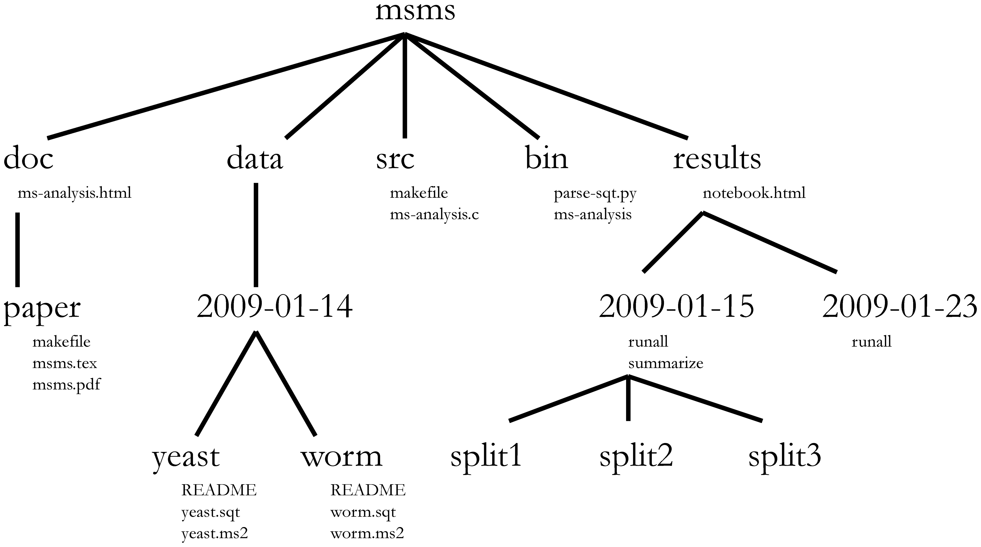
Directory structure
Choosing a consistent directory structure will help you (and your collaborators) find things later on.

Slide 6
Exercise
cp /gsd/To_Participant/ARANGS/1-U0015717_GTGGCC_L005_R[12]_001_$NUM.bfq . # $NUM will vary from team group to team group
In Teams, write a bash script (use /gsd/To_Participant/ARANGS13/arangs/src/template.sh and /gsd/To_Participant/ARANGS13/arangs/src/bwa-aln.sh for inspiration) that:
TeamA: takes reference and paired raw files (full paths required), tests to make sure reference and raw files exist, and print an error if they do not, then runs the alignment you manually ran on day1 session4 to generate a sam file named all_reads.sam
Usage: team_a_script.bash path_to_reference path_to_pair_one path_to_pair_two
Produces all_reads.sam
TeamB: takes the all_reads.sam file produced by team_a_script.bash, and produces two sorted bam files named aligned_reads.bam and unaligned_reads.bam
Usage: team_b_script.bash path_to_sam
Produces (sorted): aligned_reads.bam, unaligned_reads.bam
In the same Teams, modify your scripts from session1 to take, as arguments, just the reference and raw file names instead of the full paths to the files. They should then create a timestamp subdirectory in the project ‘results’ directory (relative to $HOME, or ~/, depending on your preference), and place all results in that directory instead of in the current working directory
Bash manual: http://www.tldp.org/LDP/abs/html/

