Slide 1
Running NGS analyses on the CLI
Notes:
Introducing command line tools for dealing with NGS data: SAM/BAM tools, sequence conversion using BioPerl, BioPython, reading with R BioConductor. How to run scripts on the command line. Exercise: http://bioinf.comav.upv.es/courses/sequence_analysis/sequence_file_formats.html http://samtools.sourceforge.net/

Slide 2
NGS analyses
Data pre-processing:
Characterize / trim low base scores
Clip adapters
Collapse duplicates
File conversion
Assembly:
de Novo
To reference sequence(s)
…more bioinformatics…

Slide 3
Data pre-processing
Many data cleaning steps can be programmed with common open source bioinformatics toolkits
Some off-the-shelf tools exist
FASTX-toolkit (also in galaxy)
FASTQC
PRINSEQ

Slide 4
Data conversion
Command line programs:
samtools
picard
APIs:
Bio::SamTools, Bio::SFF, Vcf.pm
Bio::SeqIO
Bio.SeqIO
bio-ngs

Slide 5
Assembly
De-novo assembly tools:
SOAP de-novo
Velvet
Reference mapping:
BWA
MAQ
Bowtie
BFAST
MIRA

Slide 6
The bioinformatics universe
Integrated suites (CLC, Geneious, GATK) versus small utilities versus APIs
Graphical user interface versus command line interface
Open source versus restrictive commercial licenses

Slide 7
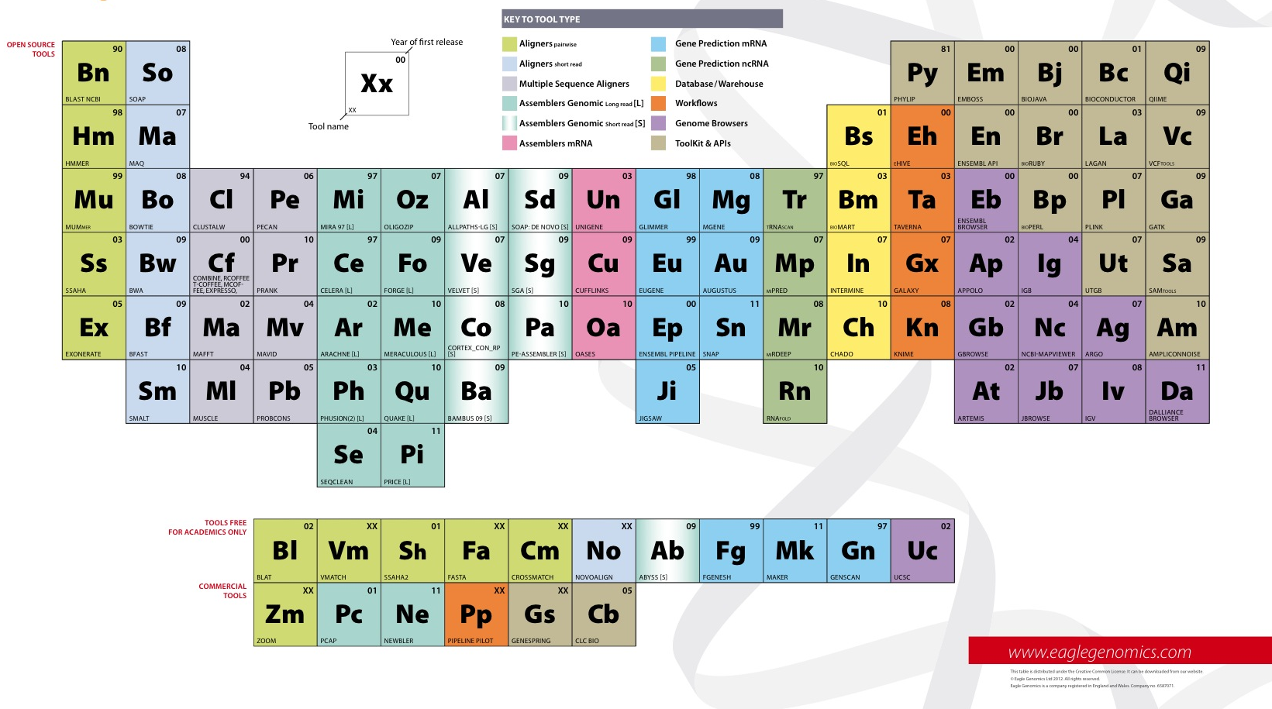
Periodic table of bioinformatics
Notes:
Introduces the

Slide 8
Exercise: compilation
Download BWA: http://bio-bwa.sourceforge.net/
On the command line:
Expand the archive
cd into it
run 'make’
run ./bwa to see that it prints its version and usage, compare to the bwa in PATH
Download Samtools: http://samtools.sourceforge.net/
On the command line:
Expand the archive
cd into it
run 'make’
Run ./samtools to see that it prints its version and usage, compare to samtools in PATH
Notes:
For this exercise, we compile samtools (?) and do some basic conversion on the command line.

