Slide 1
Virtualization and Configuration Management
Making your analysis computational environment scalable and reusable

Slide 2
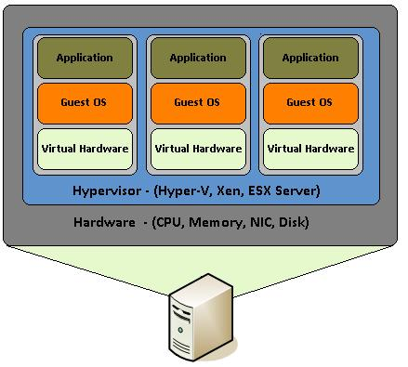
Virtualization

Slide 3


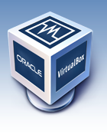
Components:
- machine images
- virtual machine manager
- hardware virtualization
VMWare
http://www.vmware.com/
VirtualBox
https://www.virtualbox.org/
Amazon EC2
http://aws.amazon.com/

Slide 4
Machine Images
Special Files
Based on pre-existing ISO file format allowing full archive of a disk into a file. ISO files can be mounted on a file system
OS *Nix distributions developed method of delivering installation on pre-packaged ISO images
ISO files used as the underlying ‘hard drive’ for the virtual machine

Slide 5
Virtual Machine Manager
Runs on ‘Host’ machine
Can launch as many ‘Guest’ virtual machines as its underlying resources (RAM, Storage) can support
Can launch multiple ‘Guests’ from a single ISO file, and/or from multiple, different ISO files
Can be configured to allow any/all guests tailored access to its resources

Slide 6
Hardware Virtualization
Virtual Machine Managers mount ISO file system, and boot the operating system installed on it, as if it were a machine with its own hard drive
Software running on guest machine can only access resources specifically granted to the guest by the host, and is totally unaware of all other host resources
Software designed for a specific architecture can run, unmodified, on the guest machine
Guest machine Operating system can be totally different from Host (e.g. Windows machine can host Linux guest, Linux machine can host Windows guest, subject to license restrictions)

Slide 7

http://www.vagrantup.com/
Virtualization Management Software
Compatible with Virtualbox and VMWare
Simplifies virtualization management for individuals, and small teams
Targeted towards application/pipeline development
Project Centric, projects defined by directories
Nicely interweaves into Project Version Control System

Slide 8
VagrantFile
Text File (Version Control Compatible)
Programmatically describes each guest to be launched for a given project
Hostname
Memory allocation
Vagrant ‘Box’ (vagrant compatible machine image)
Mounted host directories
Port forwards
ssh config
Configuration management provisioning

Slide 9
Vagrant Box
Specially packaged Machine Image with vagrant project directory and VagrantFile included
Can be shared with other vagrant users http://www.vagrantbox.es
Can be created from instantiated vagrant guests (e.g. after provisioning)

Slide 10
Vagrant CLI
$ vagrant box add $NAME $URL
$ vagrant box remove $NAME
$ vagrant init [$NAME] [$URL]
$ vagrant up
$ vagrant status
$ vagrant ssh
$ vagrant ssh-config
$ vagrant halt
$ vagrant destroy –force

Slide 11
Software Configuration Management
Developed to manage large enterprises with the following goals in mind:
Change Management
Automated Provisioning
Configuration Audits
Defect Tracking
Recently focused on management of Clusters and Clouds:
Quickly provision 100+ nodes with the exact same software environment
Automate updates
Standardize introduction of new applications

Slide 12



Choices, Choices
http://puppetlabs.com/puppet/puppet-open-source
http://www.opscode.com/chef/
http://www.ansibleworks.com/configuration-management/
Open Source
Target Open Source *Nix System Architectures
Simplify and Abstract Package Management
Optimized for Open Source Software Installation

Slide 13
The Basics
Configuration Specified in Code
Code can be separated into modules for DRY reusability (PuppetForge: https://forge.puppetlabs.com)
Code ideally stored in Version Control System
Application specific configuration files (httpd, iptables, etc.) can be stored with CM code in the same VCS, either as static files, or dynamic templates
Configuration can be run on target nodes in different ways:
Individual ‘Application’: Process runs independantly on each node. Suitable for one, or a few nodes
Master-Slave: ‘Slave’ processes on each node interact with a single ‘Master’ node to get CM code and files. Suitable for large enterprises with lots of nodes.

Slide 14
What does this all this have to do with me?
Reproducibility
Create Vagrant initialized Project Directory
Create Configuration Management to specify exact software requirements
Create Vagrantfile targeted to a standard *Nix Base Box available to anyone with an internet connection, provisioned with your configuration management
Store entire Project Directory on Distributed Version Control (GitHub)

Slide 15
Exercise
Create vagrant_test directory in your home directory
cd vagrant_test
List the boxes you have in vagrant
Add the box /gds/To_Participants/ARANGS/fedora* and name it ‘fedora’
Initialize vagrant_test as a ‘fedora’ box
Bring up vagrant_test
Ssh to the vagrant_test box
See what is installed by default
Exit back to host and halt the vagrant_test box (find out if it is halted)
Bring the vagrant_test box back up (find out if it is running)
Destroy the vagrant_test box (forcing it is often necessary)

