Slide 1
Configuring and running common galaxy tools
Notes:
Run a canned workflow in galaxy. Example: prepare an example workflow on galaxy main (e.g. basic reads quality), make students register for main (https://main.g2.bx.psu.edu) and run the workflow. Also, myExperiment.
<number>

Slide 2
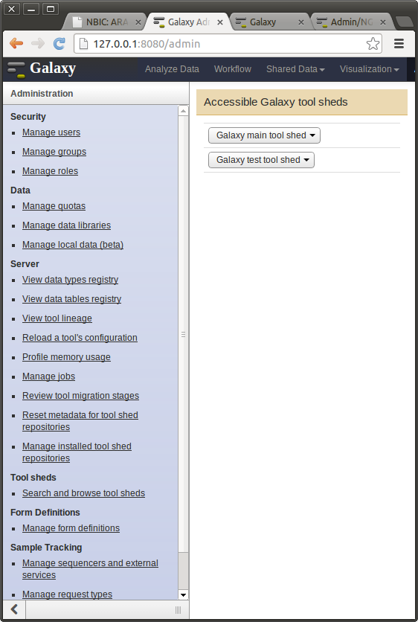
The Galaxy tool shed
Galaxy has very few tools by default (only simple text manipulation)
For heavy number crunching it “wraps” around command-line tools (such as BWA)
New wrappers can be downloaded and installed from the “tool shed”

Slide 3
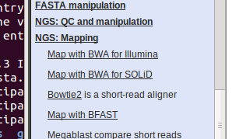
Exercise: install a tool
Uncomment tool_config_file in universe_wsgi.ini
Go into admin mode and access the main tool shed
Search for BWA and select the verified wrapper
Install it as a menu option under NGS: Mapping
Verify that it shows up as a new option in the left-hand menu

Slide 4
Galaxy tool data
Some Galaxy tools have their own “static” files inside the environment
For example, BWA can have static reference genome indexes against which you would map multiple sets of reads
These tool-specific data sets are configured in tab-delimited text files in /galaxy-dist/tool-data (e.g. bwa_index.loc)

Slide 5
Exercise tool data
Open /galaxy-dist/tool-data/bwa_index.loc in a text editor
As you can see in the commented examples, every static index is an entry with four columns. The first two need to be IDs, the third needs to be a human readable description, and the fourth the path to the stem file name to which BWA index added various extensions.
Edit the file to add a line with:
ITAG2.3
ITAG2.3
International Tomato Annotation Group, reference genome 2.3
/gsd/To_Participant/ARANGS13/indices/ITAG2_3_genomic.fasta.gz

Slide 6
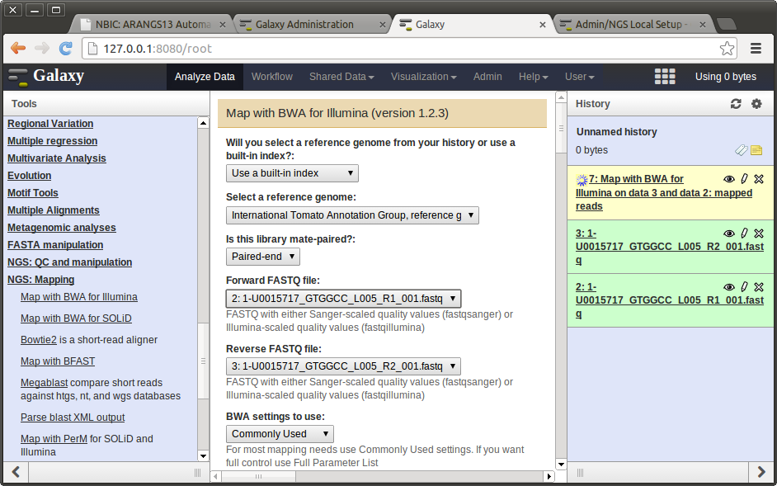
Example: BWA mapping

Slide 7
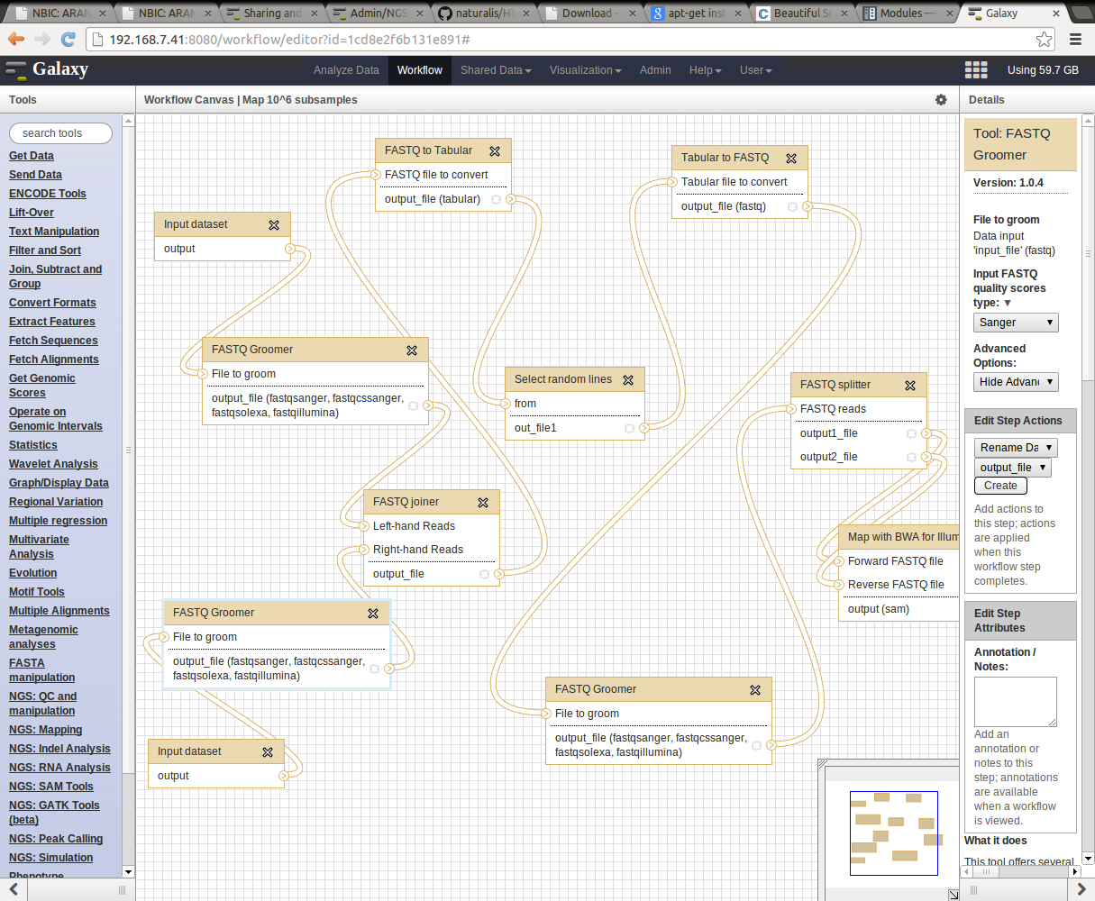
Workflow sharing
http://192.168.7.41:8080/u/rutger/w/map

